Slide 1
IPPB Ki Paathshala:
17th Jan 2026
Merchant Acquisition and Activation
(Business Loan Opportunities)

Slide 2
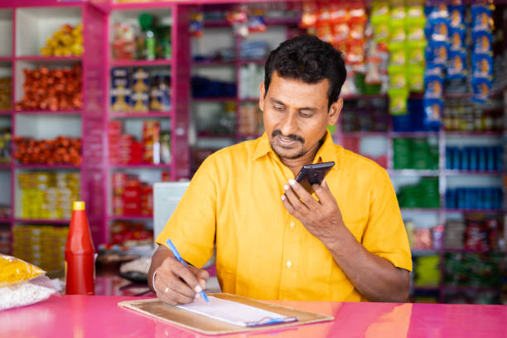
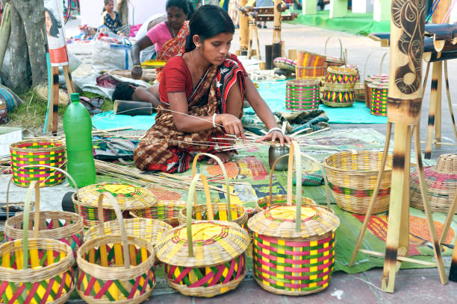
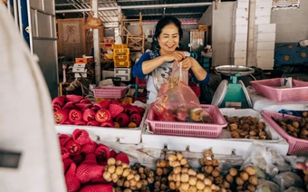
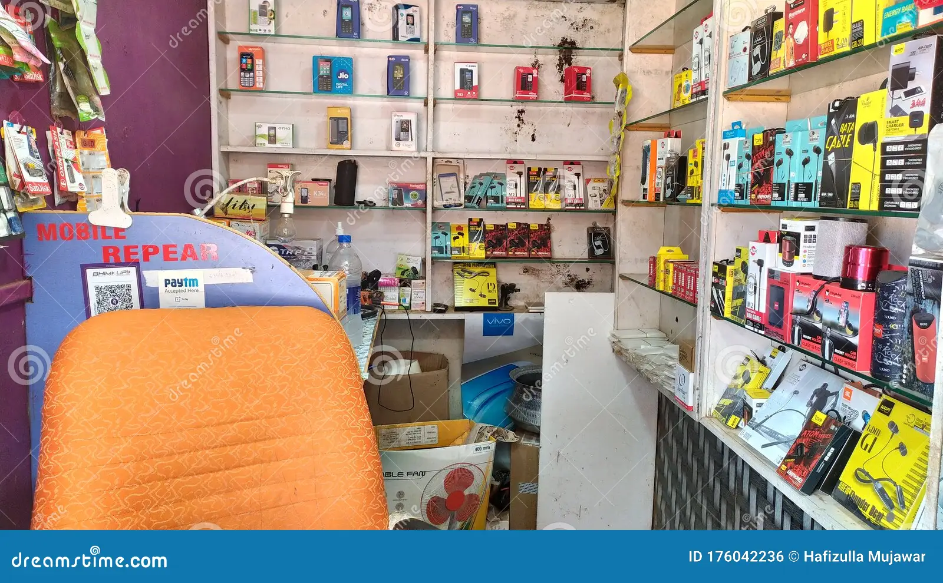
Target Segment: Small Merchants
Small Merchants i.e.
Small General/Provisional Stores
Kirana stores and Tea/Snacks vendors
Mobile repairing shops
Food stalls and Fruit/Vegetable shops
Moving vendors, E-rickshaw, Auto-Rickshaw or similar kind of merchants etc.

Slide 3
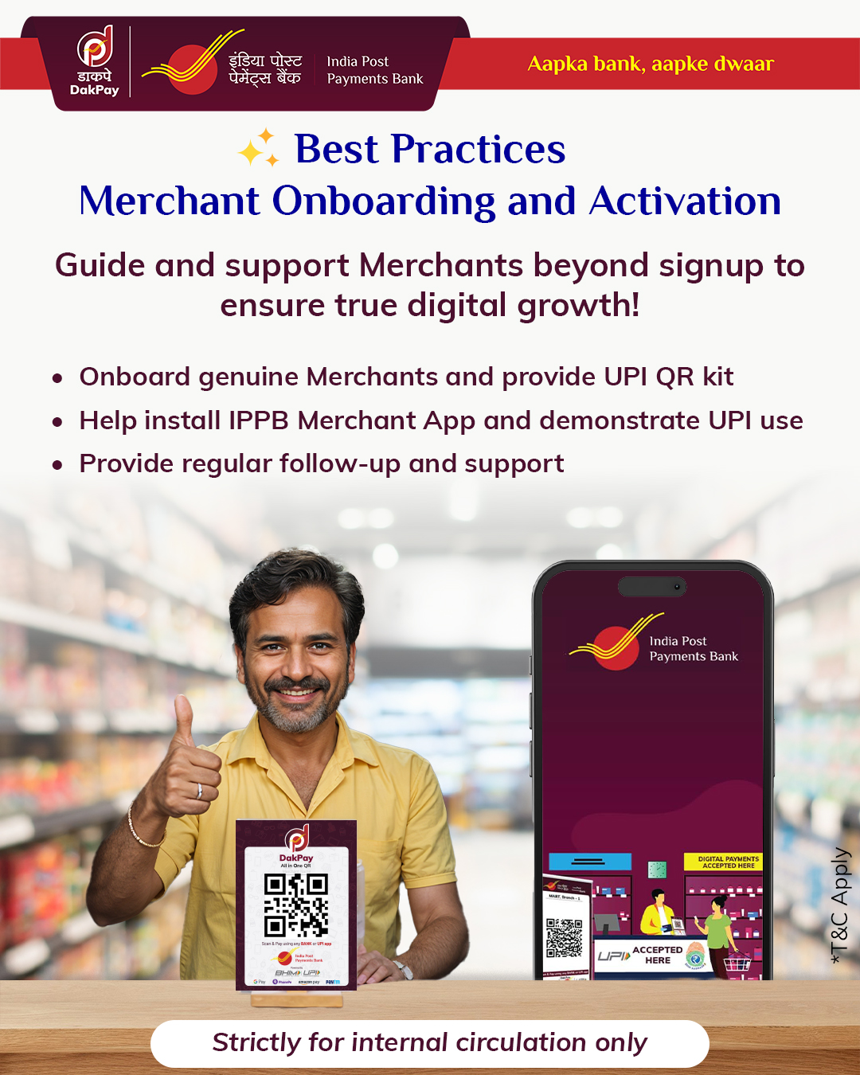

Slide 4
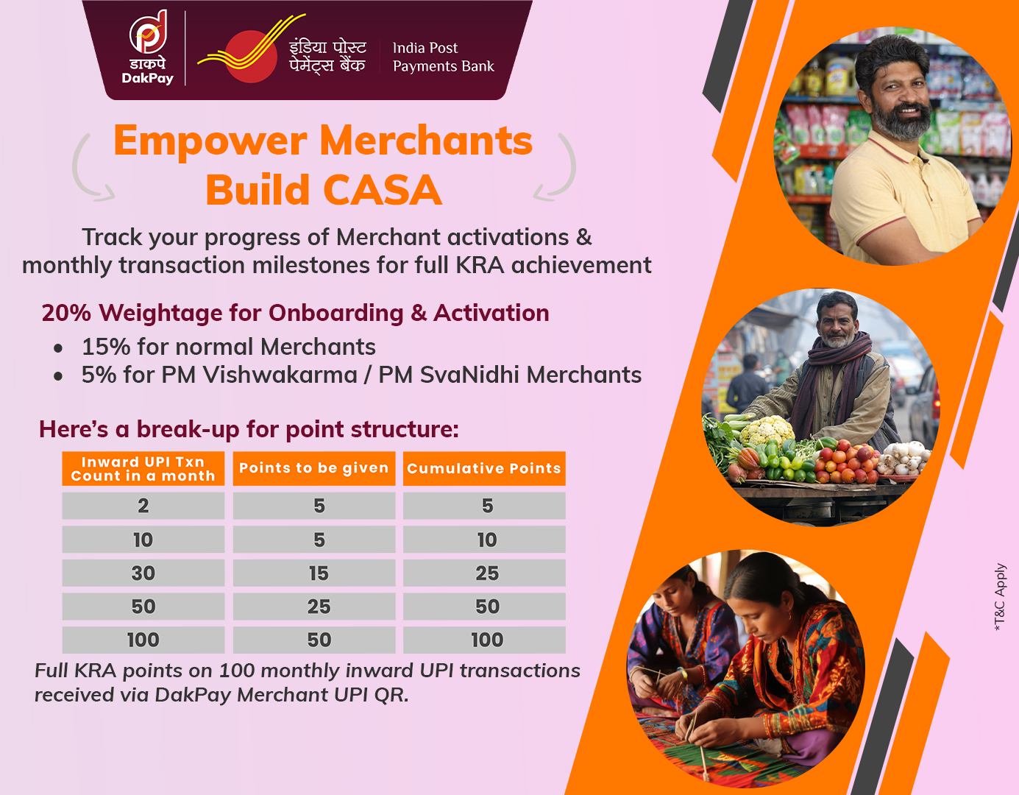

Slide 5
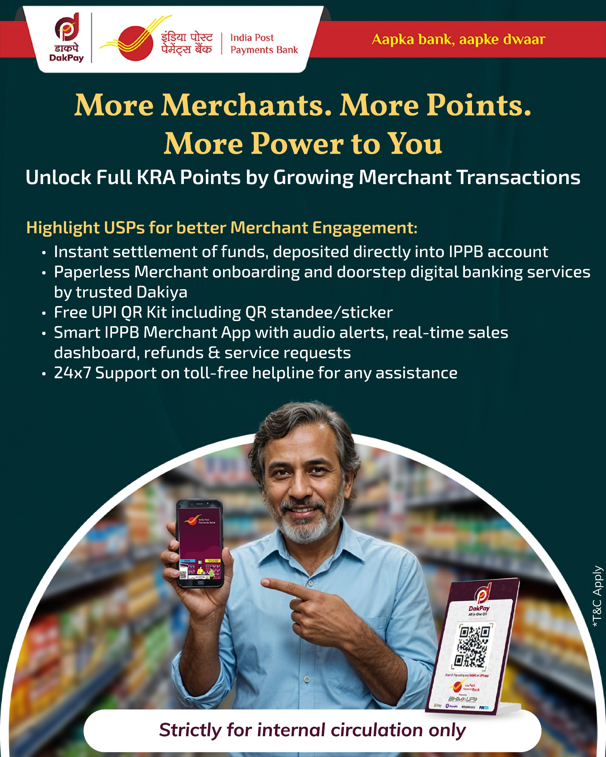

Slide 6
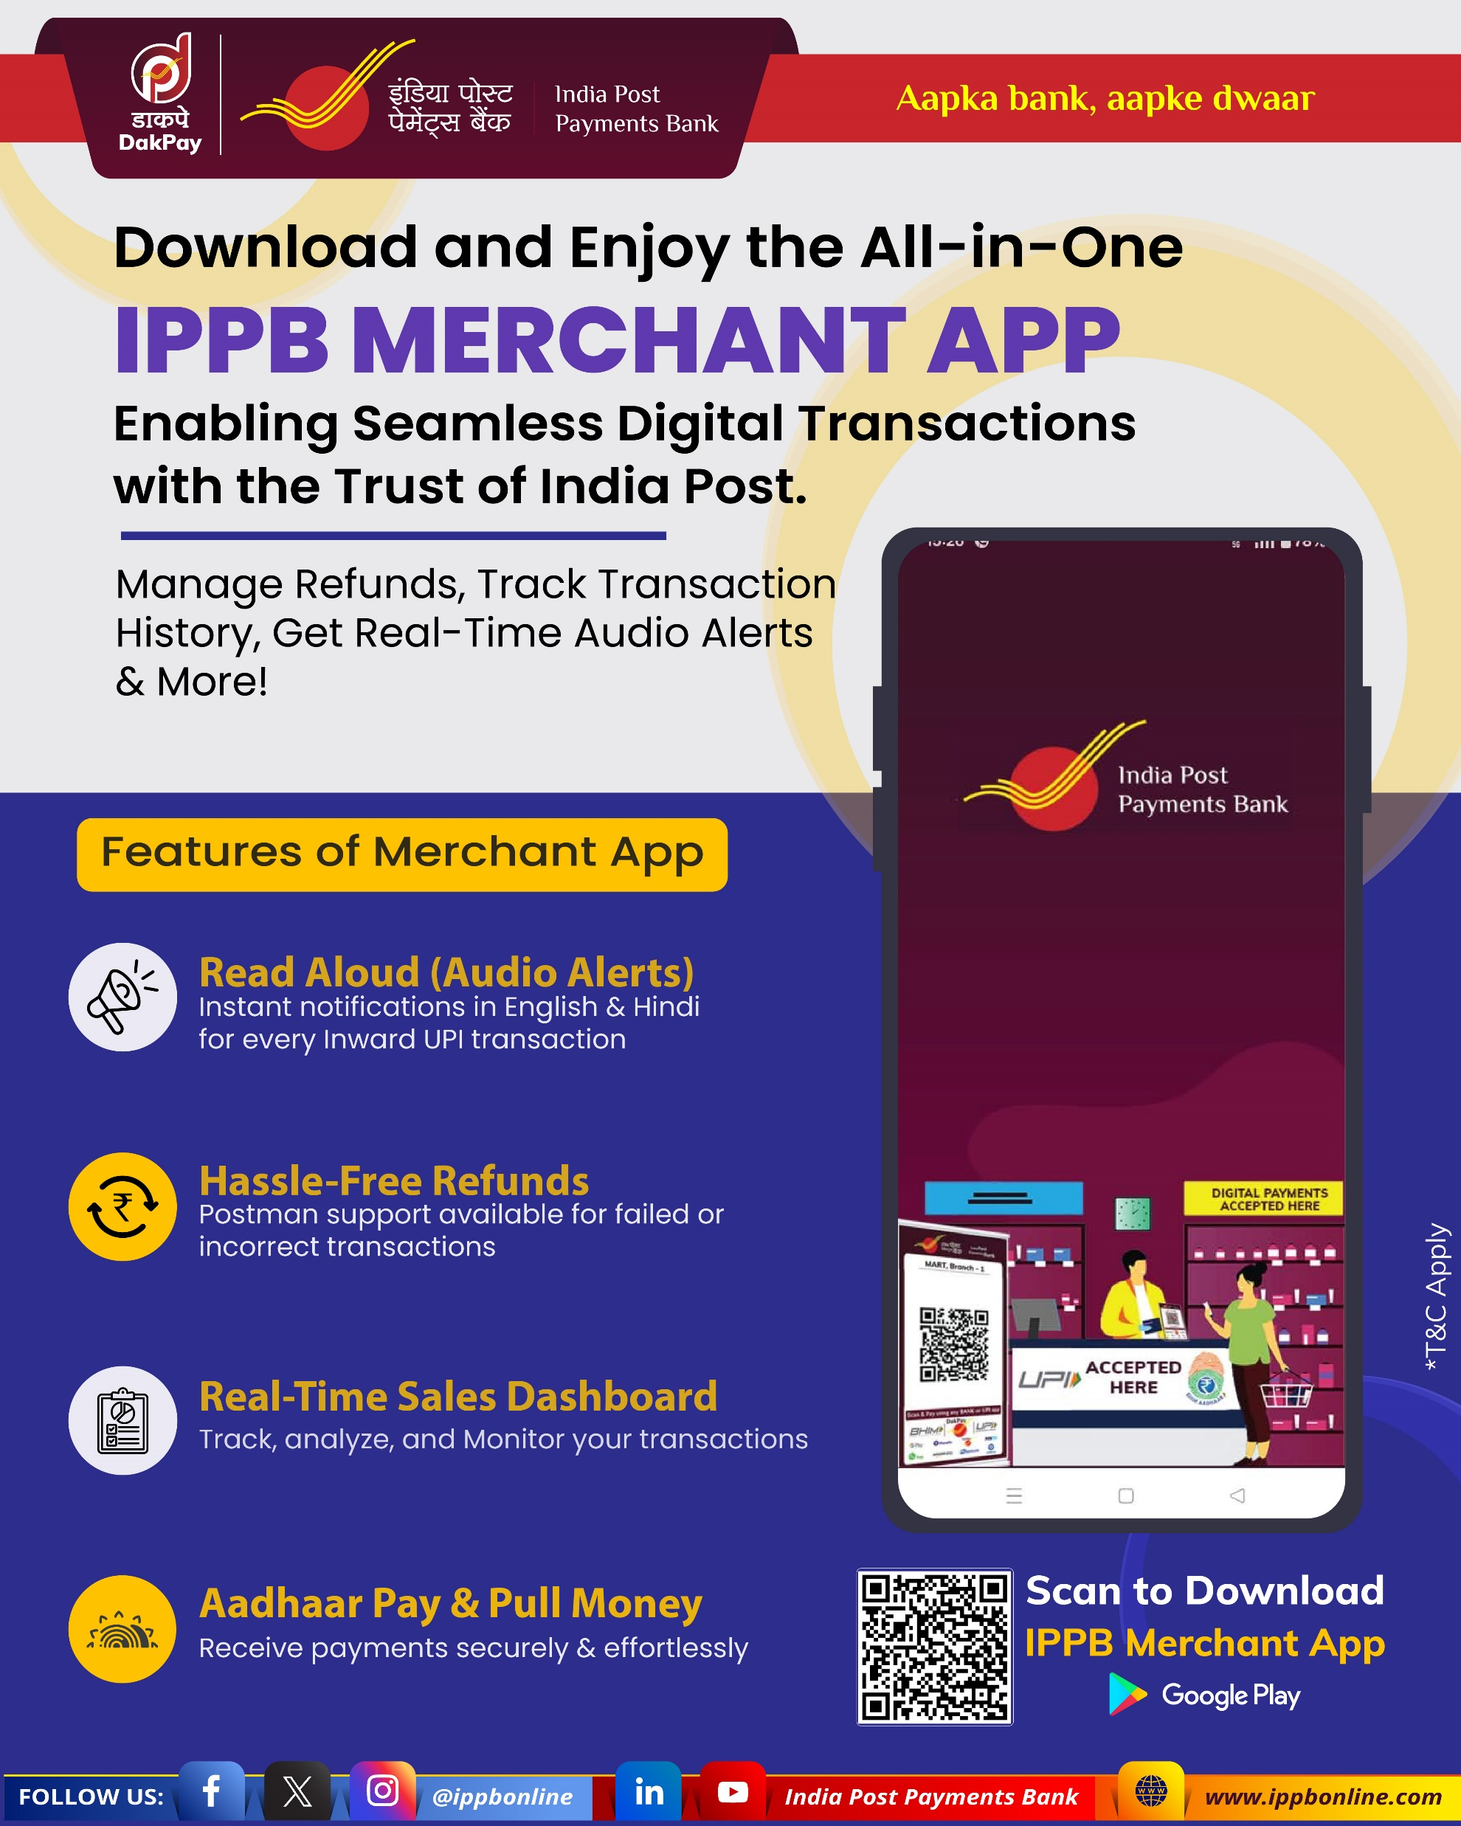

Slide 7
PM Vishwakarma Scheme
Objectives
Recognition of Artisans, Craftsmen, etc.
Skill Upgradation
Eligible Trades (Examples)
Carpenter/Boat Maker
Garland Maker, Washerman, Tailor, etc.
Salient Benefits
Skill Development through Trainings
Access to Collateral Free Credit
Access to Modern Equipments
Potter, Goldsmith, Mason, Blacksmith
Incentives for Digital Transactions

Slide 8
PM Svanidhi Scheme
Objectives
Recognition of Street Vendors
Financial Inclusion
Salient Benefits
Working Capital Term Loan (3 Tranches)
Access to Collateral Free Credit and UPI Linked Credit Card
Capacity Building
Incentives for Digital Transactions

Slide 9
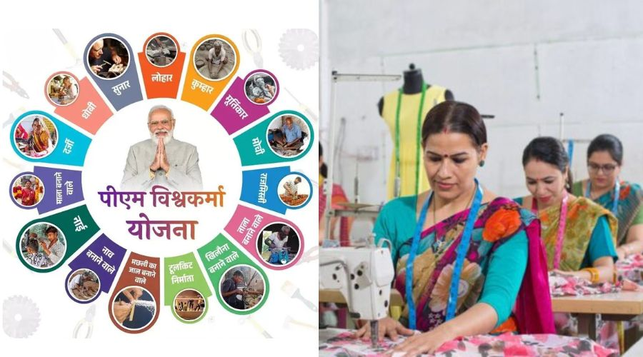


PMV & PM Svanidhi Beneficiaries as IPPB Merchants
Bank can onboard PM Vishwakarma & PM Svanidhi Beneficiaries as IPPB Merchants.
As per MOU with Ministry of MSME for PM Vishwakarma Merchant onboarding, Bank receives Rs. 150/- per successful beneficiary onboarding if 2 penny drop transactions are completed.
Bank can further get Rs. 150/- to keep the Merchants digitally active. (If merchant receives 50 inward UPI transactions on Merchant QR in next 3 months of onboarding.
End users/IBCs can also earn attractive incentive on PM Vishwakarma Merchant onboarding & activation.
#MoU with MoHUA for PM Svanidhi merchants is expired hence no incentive is applicable.

Slide 10

PMV & PM Svanidhi Beneficiaries as IPPB Merchants
Merchants can also be offered Business Loan by Muthoot FinCorp (Muthoot Blue).
The Merchants who are highly active on UPI can be contacted to offer business loan.
Incentive to End users / IBCs:- Rs. 600/- per 1 Lakh of loan amount disbursed is applicable.

Slide 11
Thank You

