Slide 1
POSTAL LIFE INSURANCE
&
RURAL POSTAL LIFE INSURANCE

Slide 2
POSTAL LIFE INSURANCE

Slide 3
Postal Life Insurance :
Insurance Scheme by the Central Government of India.
Low Premium – High Bonus
Eligibility:
Central Government
Defence Services
Para Military Forces
State Government
Local Bodies
Government-aided Educational Institutions
Reserve Bank of India
Public Sector Undertakings
Financial Institutions
Nationalized Banks
Autonomous Bodies
Extra Departmental Agents in Department of Posts

Slide 4
Postal Life Insurance :
Eligibility:
Employees engaged / appointed on contract basis by Central / State Governments.
Employees of Joint Ventures in which Central / State Governments / Public Sector Undertakings / Nationalised banks have minimum holding of 10%.
Members / Employees of Credit Cooperative societies and other Cooperative Societies registered with Government under the Cooperative Acts and partly funded from Central / State Governments / RBI / SBI / Nationalised Banks / NABARD.
Employees of Deemed Universities and Educational Institutes accredited by Recognised bodies such as NAAC, AICTE, MCI etc., and / or affiliated to Universities/Boards, etc.
Employees of all Scheduled Commercial Banks.
Other such institutions notified by the Government.

Slide 5
Postal Life Insurance :
Eligibility:
Employees of all Private Education Institutions / Schools / Colleges etc., affiliated to Recognized Boards (Recognized by Central / State Govt.).
Professionals such as:
- Doctors, Engineers, Management Consultants, Chartered Accountant (Regd. ICAI), Architects, Lawyers registered with Bar Council of India/State.
Employees of National Stock Exchange/Bombay Stock Exchange and employees of Companies registered on NSE & BSE.
All Graduates/Diploma holders from Universities/Institutions recognised by Central/State Governments [Rule-6, sub-rule(13)]

Slide 6
Postal Life Insurance :
Eligibility:
Professionals such as:
All types of Degree / Diploma / Post-Graduate Diploma holders in professional courses such as management, computer application, software development, agriculture, horticulture, journalism, mass communication, hospital administration, pharmacy, dental and veterinary, tourism administration, fine arts, fashion design, interior design, web design, gem, jewellery and diamond design, textile design, leather design, sport science and technology, pilot, visual communication, nutrition, physiotherapy, audiology, speech therapy, optometry, fisheries, home science, food production, JBT, DIET, B. Ed., M. Ed. Etc.
Such degree/diploma should be from a Central/State Government recognised institution.

Slide 7
Postal Life Insurance :
Eligibility:
Professionals such as:
Journalist and employees of print, electronic and digital media companies.
Regular employees working in Endowment Department of temples and religious places.
Nurses, para-medical staff, technicians and regular employees of private and government hospitals.
All types of ITI course recognised by Central / State Government.
AMIE / Degree / Diploma in civil, electrical, mechanical, architecture, agriculture and other branches of engineering recognised by Central / State Government.
Chartered Accountants, Company Secretary, Cost and Work Accountants of ICAI/ICSI/ICWA.

Slide 8
PLI/RPLI Sales Force :
Who can procure PLI/RPLI Business:
Any official of the Department (Departmental Agent including IP, ASP, AAO).
GDS can also procure PLI Business (GDS) a/w RPLI.
Direct Agents (DA).
Field Officer (FO).
For availing the facility the customer can visit any nearby Post Office or purchase PLI/RPLI policy from official website of Department of Posts.

Slide 9
PLI – Plans :
Whole Life Assurance (Suraksha)
Convertible Whole Life Assurance (Suvidha)
Endowment Assurance (Santosh)
Anticipated Endowment Assurance (Sumangal)
Joint Life Assurance (Yugal Suraksha)
Children’s Policy

Slide 10
Features :
Whole Life Assurance (WLA-Suraksha):
Payable on attaining the age of 80 years or after the death of the policy holder whichever occurs earlier.
Policy will be in force till the insurant attains the age of 80 years.
Premium payable upto 55/58/60 years.

Slide 11
Features :
Convertible Whole Life Assurance (CWA-Suvidha):
Policy can be converted into Endowment Assurance after 5 years and before 6 years.
If the same is not converted then it will be attract the benefits as of Whole Life Assurance Policy.
Premium payable upto 60 years.
Maturity can be claimed at the age of 50/55/58/60 years

Slide 12
Features :
Endowment Assurance (EA-Santosh):
Payable to the insurant after maturity of the policy.
In case of death, nominee/legal heir will be paid full amount of the sum assured with accrued bonus.
Maturity at the age of: 35/40/45/50/55/58/60 yrs.

Slide 13
Features :
Anticipated Endowment Assurance (AEA-Sumangal):
It is a money back type of policy.
There are two type of policies: 15 yrs & 20 yrs.
Benefits paid as under:
15 Years | 20 Years | Money Back
At the end of 6 yrs | At the end of 8 yrs | 20% of Sum Assured
At the end of 9 yrs | At the end of 12 yrs | 20% of Sum Assured
At the end of 12 yrs | At the end of 16 yrs | 20% of Sum Assured
At the end of 15yrs | At the end of 20 yrs | 40% of Sum Assured with Bonus

Slide 14
Features :
Joint Life Assurance (YS-Yugal Suraksha):
Life cover to both spouses to the extent of sum assured with accrued bonus.
The sum assured payable at the end of the endowment term or on the death of either of the two lives assured.
Spouse should be literate.
Minimum Policy Term of 5 Yrs and Maximum Policy Term of 20 Yrs.

Slide 15
Features :
Children’s Policy (CP):
Non-Medical policy.
Minimum Sum Assured: Rs. 20,000/-.
Maximum Sum Assured: Rs. 3,00,000/- for PLI, Rs. 1,00,000/- for RPLI or equal to the sum assured of the parent, whichever is less.
One Policy per child & Maximum 2 children aged between 5-20 years.
Allowed only on EA & WLA policies of main policy holder.
In case of death of insured of main policy before expiry of children’s policy no further premium to be paid.
The maturity of the policy should be before the maturity of parent’s policy.

Slide 16
PLI Age Conditions :
Policy Type | Minimum Age (Yrs) | Maximum Age (Yrs)
WLA | 19 | 55
CWA | 19 | 50
EA | 19 | 55
AEA | 19 | 40/45
YS | 21 | 45
CP
Child’s Age | 5 | 20
Parent’s Age |  | 45
Non-Medical | 19 | 40

Slide 17
PLI – Other conditions :
Policies should be minimum being Rs. 20,000/-, units of Rs. 10,000/-.
Maximum Sum Assured Rs. 50,00,000/-.
For Non-Medical: Maximum SA Rs. 5,00,000/-.
For Physically Handicapped: Maximum Sum Assured Rs. 50,00,000/- with normal or slightly higher premium (Only EA Policy for PH).
If single/aggregate of the proposal exceeds Rs. 20,00,000/-, it is to be accepted by DH.

Slide 18
Medical Report :
Medical report is necessary in following cases:
When age at entry exceeds 40 years.
When sum assured exceeds: Rs. 5,00,000/-.
AEA Policies.
Yugal Suraksha Policies.
The validity of the Medical Certificate is 60 days & if it is not accepted within that period, second medical examination is to be done.

Slide 19
Rebate for Premium Calculation :
Policies of Rs. 20,000/- and above Rs. 1/- rebate is given in monthly premium.
For Yugal Suraksha policies rebate of Rs. 1/- is allowed for first Rs. 40,000/- and Rs. 1/- for every additional Rs. 10,000/-.

Slide 20
RURAL POSTAL LIFE INSURANCE

Slide 21
RPLI – Plans :
Whole Life Assurance (Gram Suraksha)
Convertible Whole Life Assurance (Gram Suvidha)
Endowment Assurance (Gram Santosh)
Anticipated Endowment Assurance (Gram Sumangal)
Ten Year Rural PLI Policy (Gram Priya)
Children’s Policy

Slide 22
Features :
Ten Year Rural PLI Policy (Gram Priya):
It is a money back type of policy.
Term of Policy: 10 Years.
Benefits paid as under:
10 Years | Money Back
At the end of 4 yrs | 20% of Sum Assured
At the end of 7 yrs | 20% of Sum Assured
At the end of 10 yrs | 60% of Sum Assured with Bonus

Slide 23
RPLI Limits :
Minimum – Rs. 10,000/- & in multiples of Rs. 5,000/-.
Maximum - Rs.10,00,000/- (Medical).
Rs.1,00,000/-(Non-Medical & Standard Age Proof).
Rs.25,000/- (Non-Medical & non-standard Age Proof).

Slide 24
RPLI Age Conditions :
Policy Type | Minimum Age (Yrs) | Maximum Age (Yrs)
WLA | 19 | 55
CWA | 19 | 45
EA | 19 | 55
AEA | 19 | 40/45
GY | 19 | 45
CP
Child’s Age | 5 | 20
Parent’s Age |  | 45
Non-Medical | 19 | 35

Slide 25
RPLI Age Conditions :
Age Proof:
Standard – as notified by Government.
Non-Standard – 5% extra Premium Applicable.
- Policies worth or more than Rs. 25,000/- (sum assured) with non- standard proof of age shall not be beyond 45 years of age.
Aadhar Card.
Voter ID.
Elder’s declaration in the presence of Magistrate on Stamped Paper.
Medical Examiner’s approximate age certificate.
Declaration by insurant countersigned by Panchayat Member.

Slide 26
Rebate for Premium Calculation :
Rebate for premium calculation of RPLI Policy:
Monthly – Rs. 1 per 20,000/- Sum Assured
Quarterly - Rs. 3 per 20,000/- Sum Assured
Half Yearly - Rs. 6 Per 20,000/- Sum Assured
Yearly - Rs. 12 per 20,000/- Sum Assured

Slide 27
Bonus :
Policy Type | PLI Bonus* (per thousand SA) | RPLI Bonus* (per thousand SA)
WLA | 76 | 60
CWA | Proportionate Bonus
EA | 52 | 48
AEA | 48 | 45
CP | 52 | 48
YS | 52 | No plan in RPLI
GY | No plan in PLI | 45
*Bonus are subject to change.
*Bonus rates as on 01.04.2020.

Slide 28
Other Salient Feature of PLI/RPLI :
Premium paid is eligible for Income Tax Rebate under Section 80C of IT Act 1961.
Risk on life assured is covered from the date of acceptance of the proposal.

Slide 29
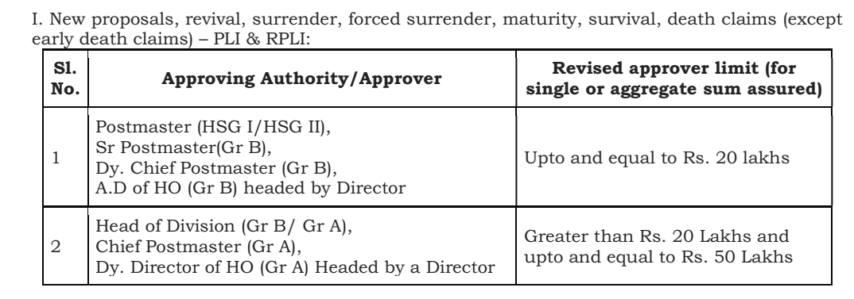
PLI/RPLI Approval Limits :

Slide 30
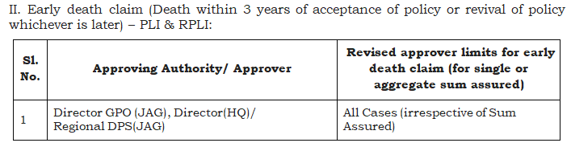
PLI/RPLI Approval Limits :

Slide 31
Types of After Sales Services :
We can categorise the PLI & RPLI - After Sales Services into 3 types as:
Financial Services
2. Claims
3. Non-Financial Services

Slide 32
Types of After Sales Services :
- : Financial Services : -
Premium Payment :
Re-instatement / Revival :
Disbursement / Payment :
Commutation :
Conversion :
Reduced Paid Up :
Loan :
Assignment /Re-assignment :
Surrender :
Free look / Policy Cancellation :

Slide 33
‘Premium’ & ‘Period of Grace’
Premium is due on the first day of the month.
If not paid on first day, it should be paid within the “Period of Grace”.
Grace Period refers to a specified time period after a premium payment is due for an insurance policy.
“Grace Period” shall extend up to the last day of the calendar month for which the premium is due (even for Quarterly, Half Yearly & Yearly policies).
Premium can be paid during Grace Period without any Penalty/Default.
If the due premium is paid within this grace period, the policy protection continues.

Slide 34
Rebate on Advance Premium Payment :
Rebate is admissible on advance payment of premiums as detailed under (Only for Monthly Premium policies):
All policies except YS:
Yugal Suraksha Policy:
Advance for 12 Months or more | 2% of Total Premium Amount
Advance for 6 Months to 11 months | 1% of Total Premium Amount
Advance for 3 Months to 5 months | 0.5% of Total Premium Amount (Only for RPLI Policies)
Advance for 12 Months or more | 50% of 1 Month’s Premium Amount
Advance for 6 Months to 11 months | 10% of 1 Month’s Premium Amount
Advance for 3 Months to 5 months | 2% of 1 Month’s Premium Amount

Slide 35
Policy becoming ‘Void’ :
What happens on expiry of Grace Period?
Upon ending of the Grace Period, the status of the policy changes to “Void”.
“Void” means a policy which is less than 3 years duration and any premium/s that have become due, not paid either on the 1st day of the month for which the premium is due or within the period of grace.
Premium can be paid in Void Policy, subject that the payment of Penalty/Default and insured person shall submit declaration of good health.

Slide 36
Calculation of Interest for defaulted months premium :
Formula for PLI/RPLI Premium Default Calculation:
For Monthly Premium Frequency:
n X (n+1) X rate of premium
200
Where n= no. of defaulted months
Other than Monthly Frequency:
No. of defaults X rate of premium
100

Slide 37
Re-instatement and Revival :
Up to 6 months –Void Lapse
(Re-instatement)
For polices < 3 years
After 6 months –Active Lapse
(Revival)

Slide 38
Re-instatement and Revival :
Up to 12 months –Inactive Lapse
(Re-instatement)
For polices => 3 years
After 12 months –Active Lapse
(Revival)

Slide 39
Re-instatement of Policy :
Scenario I : Policy which is in existence for a period less than 3 years :
If policy is less than 3 years old, premium can be accepted in Void Policy, within 6 months from which first premium was due with interest @12% & on submission of declaration of good health.
Scenario II : Policy which is in existence for a period more than 3 years :
If policy is more than 3 years old, premium can be accepted in Inactive Policy, within 12 months from which first premium was due with interest @12% & on submission of declaration of good health.

Slide 40
Lapsing of Policy :
Scenario I : Policy which is in existence for a period less than 3 years :
Shall be treated as Lapsed, if premia remain unpaid for more than 6 months.
Scenario II : Policy which is in existence for a period more than 3 years :
Shall be treated as Lapsed, if premia remain unpaid for more than 12 months.

Slide 41
Revival of Policy :
“Revival” of Policy means activating a policy which has became void or ceases to be active and that has not been re-instated.
Revival shall be allowed on any number of occasions during entire term of policy.
− A period of consecutive 5 years has not passed from the date of first unpaid premium of policy (i.e. consecutive 5 years premiums are not paid).
− The policy has not attended the date of maturity.

Slide 42
Revival of Policy – Contd. :
− The life assured is insurable at the time of revival (by submission of Medical Certificate from an authorized Medical Attendant in the prescribed proforma).
− Medical Certificate is valid for 60 days from the date of issue.
− If it is not accepted within that period, 2nd Medical Examination is to be done and the fee thereof shall be paid by the policy holder.

Slide 43
Revival of Policy – Contd. :
− Revival amount can be in paid installment. Minimum 2 installments & Maximum of 12 installments can be allowed.
− Insurant has to pay revival installment within the due date of payment i.e. the 1st day of the following month when first installment is paid.
− Example: In case first installment paid on any day of Mar-2021, Next Installment will be due on 1st-Apr-2021.
− If insurant doesn’t pay installment within due date, then payment made as first installment will move into suspense account and a fresh revival request will have to be initiated.

Slide 44
Premium Payment of Policy :
Premium of policy can be paid at all Post Offices by Cash / Cheque / Bank Slip (SB Withdrawal Slip)/Dop ATM
Premium can be paid using India Post Internet Banking, Mobile Banking , IPPB Mobile Banking and through NACH (Debit date 7th, 12th & 17th of the month).
Customer may pay the Premium / Repayment of Loan using Online Mode on PLI Customer Portal:
https://pli.indiapost.gov.in/CustomerPortal/Home.action
RICT Branch Post Offices will accept the premiums for RPLI & PLI also.
If payment is made by cheque, the same should be accepted on the day of presentation across all the Post Offices.
In case the cheque is dishonoured the same will be shown as Minus Entry against PLI/RPLI receipts on getting the information from the Bank.

Slide 45
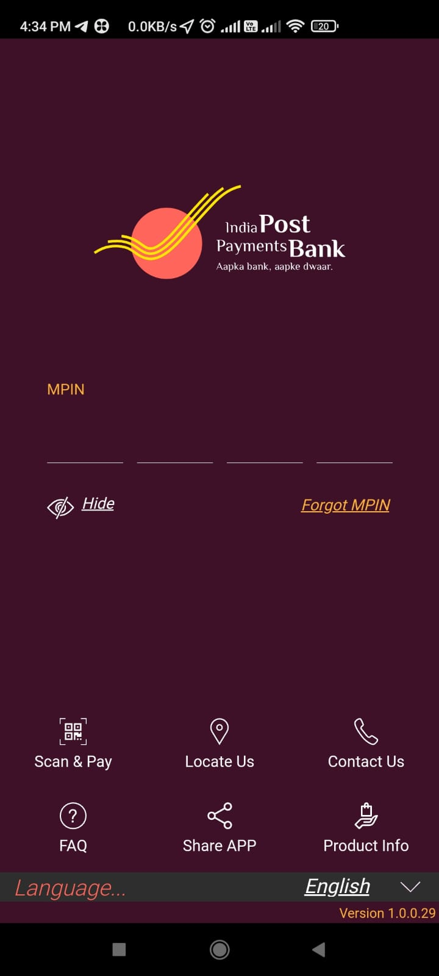
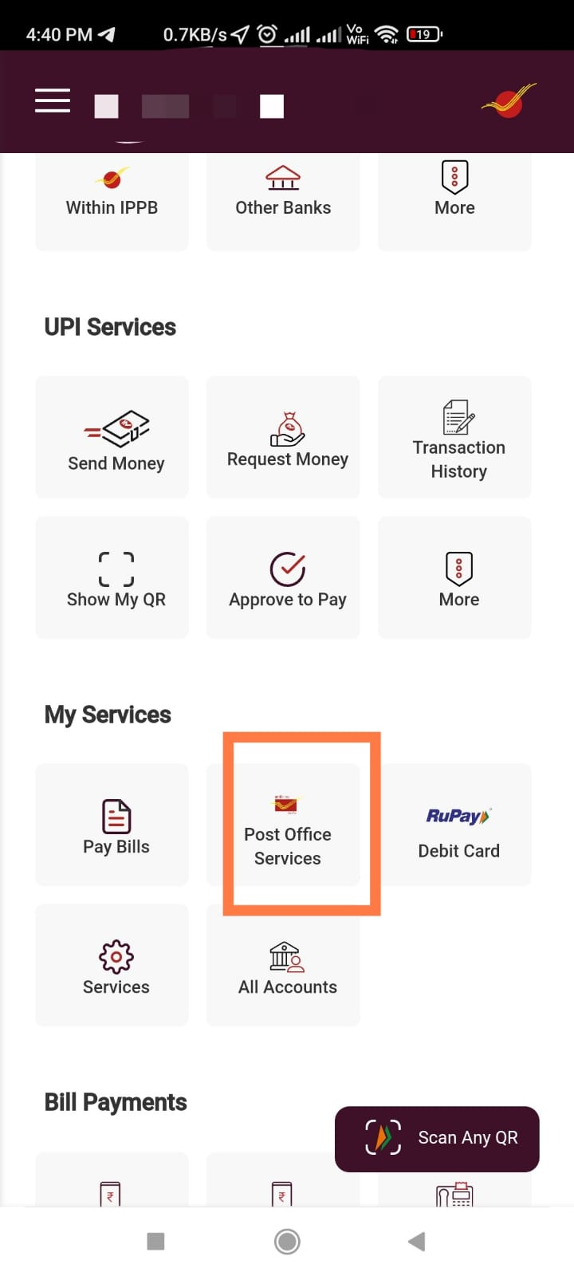
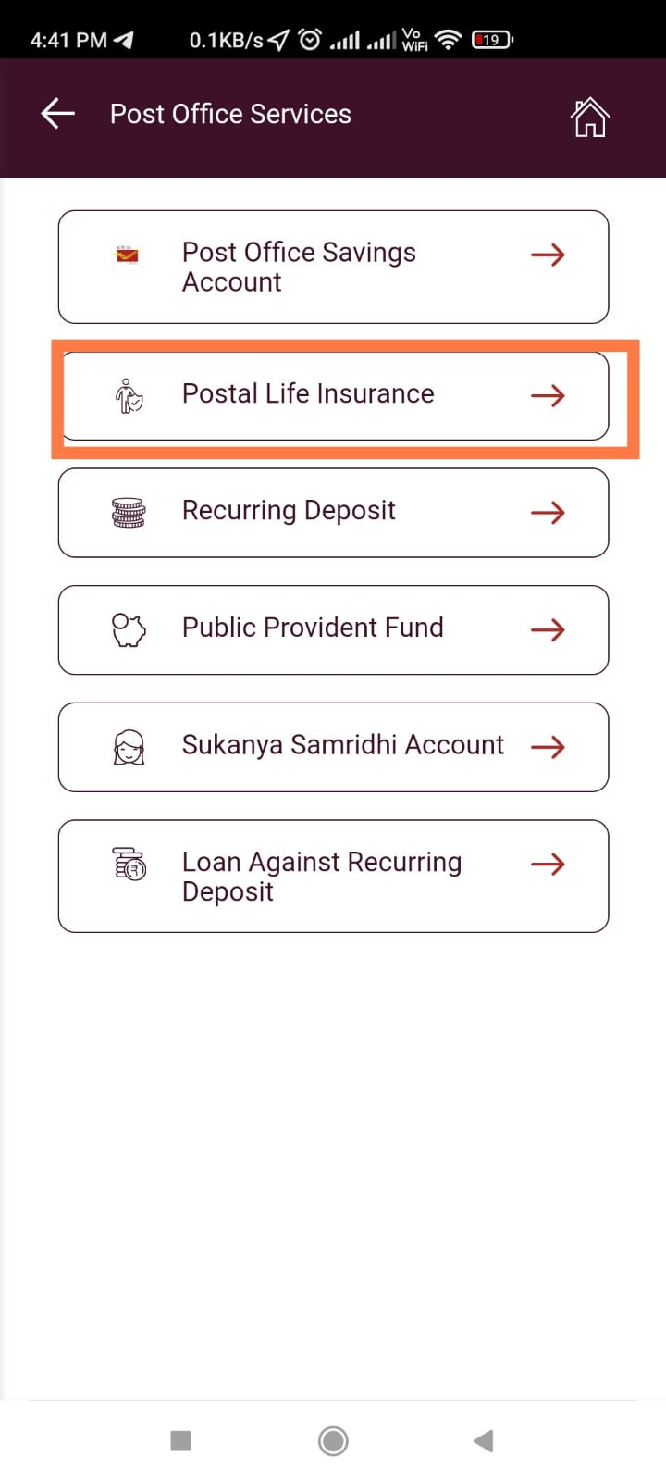
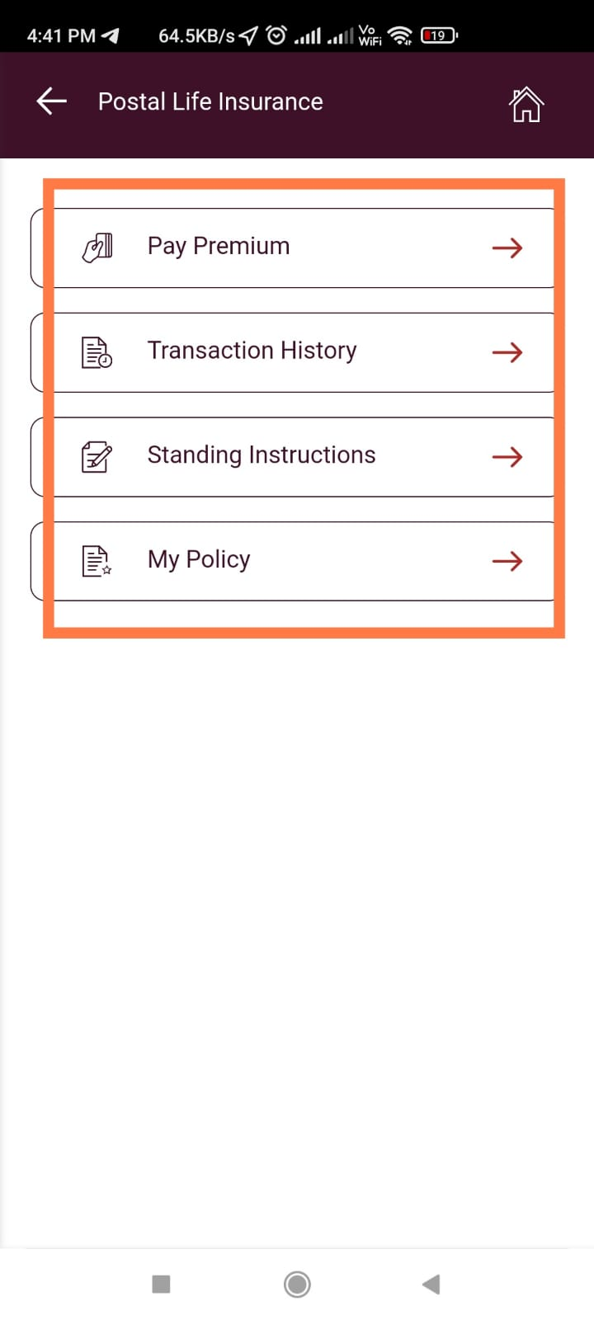
Premium Payment Through IPPB:

Slide 46
Disbursement / Payment of Policy :
All type of payments in respect of PLI & RPLI are called as Disbursement.
As per latest amendments in Rules Witness is not required for all types of PLI/RPLI Payments to customers.
Disbursement Details like By Cash/ By Cheque, should be updated in the McCamish Application by Payment office without fail.
Disbursement / Payment Sanction is valid for :
Type of Disbursement / Payment Sanction | Validity (From the date of Issue)
Maturity/Death/Surrender/Survival | 1 Year
Loan | 3 Months

Slide 47
Commutation of Policy :
“Commutation” means any alteration in a contract of insurance without any change in the date of maturity and includes :
− Alteration in the Sum Assured,
− Alteration in amount of premium,
− Alteration in the premium-term.
Commutation will be allowed only after payment of premia for an integral number of years.

Slide 48
Conversion of Policy :
“Conversion” means any alteration affecting the date of maturity of a contract of insurance.
At the time of Conversion, date of maturity can be ante-dated or post-dated.
Conversion also results into increase or decrease of the policy premium & premium-term.
Conversion is allowed either from one product to another or for same product type, for example;
i) WLA to EA, ii) CWA to EA,
iii) EA-60 to EA-50 or EA-50 to EA-60, etc.

Slide 49
Conversion of Policy – Contd. :
In any case where it is intended to extend the premium term or to defer the maturity date, on the production of a medical certificate of good health at the expense of the assured.
First Conversion will be without fee, second and subsequent conversion shall be subject to Fee of Rs. 20/- on each occasion.
Conversion will be allowed only after payment of premia for an integral number of years.

Slide 50
Conversion of Policy – Contd. :
Scenario I : WLA converted into EA :
Bonus attached prior to ordinary conversion will remain unchanged, further bonus rate of EA will be paid.
Scenario II : CWLA converted into EA :
Bonus rate of EA will be paid since the commencement of the policy.
Note: Joint Life Assurance, Children Policy, Anticipated Endowment Assurance and 10 Years Rural Postal Life Insurance(Gram Priya) can not be converted.

Slide 51
Reduced Paid up of Policy :
Reduced Paid up feature allows the policy holder to stop further premium payments resulting in reduction in Sum Assured without altering the term or class of the original policy.
Policies for which 36 or more months premiums have been paid and also completed 3 years or more duration are eligible for Reduced Paid Up service.
The Sum Assured gets reduced as per the premium paid till date and so as the policy remains in the reduced paid up state till maturity.

Slide 52
Reduced Paid up of Policy :
Reduced paid up policy can be Surrendered.
Proportionate Bonus will be paid on the paid up value if policy remains in force at least for 5 years.
Reduced paid up of policy can be done anytime after 3 years and before anytime of maturity date.
It is advisable to request the policy holder to utilize Reduced Paid up feature when he is not able to pay future premiums and his policy is discontinued.

Slide 53
Loan on Policy :
Loan is admissible on policies after :
Endowment Policies - After 3 years
- (EA & YS)
Whole Life Policies - After 4 years
- (WLA & CWA)
Anticipated Endowment Policies - No Loan
- (AEA-15, AEA-20 & GY)
Children Policies - No Loan
- (CP)

Slide 54
Loan on Policy – Contd. :
Policy should not have been assigned.
Maximum of 90% of Surrender Value can be sanctioned as Loan Amount.
Loan amount should be Minimum of Rs. 1000/- & in multiples of Rs. 100/-.
Loan Amount will be paid after executing the Loan Bond & Assignment in the name of President of India. Loan PRB is supplied to policy holder.
Policy Bond, Loan Bond & Assignment Document will be kept in Safe Custody with the Postmaster.

Slide 55
Loan on Policy – Contd. :
Interest will be charged @ 10% per annum compounding half yearly. A notice of Loan Capitalization will be sent to policy holder on half yearly basis.
When loan capitalization reaches 100% of surrender value, final intimation/notice will be sent to insurant to pay off outstanding loan amount and due interest.
Policy holder should repay the due amount within next 30 days from the date of final intimation, otherwise policy will be forcibly Surrendered and the balance, if any will be paid to holder.
2nd loan can be sanctioned after complete repayment of the previous loan.

Slide 56
Assignment of Policy :
Policies may be assigned by the policy holder, either:
for valuable consideration OR
by way of Gift
- either in favour of one person or jointly in favour of two or more persons.
The assignment may be made either by an endorsement on the reverse of the policy itself or by a separate deed attested by a witness.
Assigns is the only person competent to deal with Policy Assigned.
Assignment of policy shall automatically cancel the nomination (Except in case of Loan from Department).

Slide 57
Re-assignment of Policy :
Policies may be Re-assigned in the name of policy holder by the assigns.
- Re-assignment should be in writing attested by one or more witnesses.
Loan is admissible once the policy is re-assigned in the name of policy holder.
Nomination needs to be re-registered after the Re-assignment of policy.

Slide 58
Surrender of Policy – Contd. :
Surrender is allowed on policies after :
Endowment Policies - After 3 years
- (EA & YS)
Whole Life Policies - After 3 years
- (WLA & CWA)
Anticipated Endowment Policies - No Surrender
- (AEA-15, AEA-20 & GY)
Children Policies - No Surrender
- (CP)

Slide 59
Surrender of Policy :
“Surrender Value” of a policy means the amount that is payable to an insured, when he foregoes the contingent benefit of his policy and surrenders it for an immediate cash payment.
Surrender value offered to the client depends on the insurance product and how long the client has had it.
Provided that, at least 36 premiums have been paid and policy has completed minimum 36 months duration.
Sanction of Surrender Value shall only be issued on receipt of the consent of claimant for taking payment of admissible amount of surrender value.
The Sanctioning Authority may, in his discretion, allow withdrawal of SV application any time before payment.

Slide 60
Free look / Policy Cancellation :
“Free look Period” means a period of 15 days from the date of delivery of the policy at the address of the insurant during which the insurant may make a request for cancellation of his policy.
Policy may be cancelled and refund will be issued for the premium paid by policy holder.
Medical Examination Fee & proportionate Risk Premium for the period of cover and on account of stamp duty, if any may be deducted for refund.

Slide 61
Types of After Sales Services :
- : Policy Claims : -
Survival Claim :
Maturity Claim :
Death Claim :

Slide 62
Survival Claim of Policy :
“Survival Benefit” claim is admissible only in case of AEA Policies and Gram Priya Policy (i.e.10 Year RPLI Policy).
Payment of Survival Benefits, if insurant survives
AEA-15 Years | AEA-20 Years | GY-10 Year (RPLI Only)
20% after 06 years | 20% after 08 years | 20% after 04 years
20% after 09 years | 20% after 12 years
 |  | 20% after 07 years
20% after 12 years | 20% after 16 years
40% at maturity i.e. after 15 years with accrued bonus | 40% at maturity i.e. after 20 years with accrued bonus | 60% at maturity i.e. after 10 years with accrued bonus

Slide 63
Survival Claim of Policy – Contd. :
In case of death of the insured person at any time during the term of the policy, full sum assured shall be payable along with the accrued bonus without adjustment of the survival benefit(s) already paid.
In case of Survival benefit(s), which were due to be paid i.e. due survival benefit(s) which remain unpaid shall be paid along with the amount of death claim.
In case of discontinuation of policy no further periodical payment on account of survival benefit will be paid.

Slide 64
Maturity Claim of Policy :
Maturity Claim usually refers to the amount received when a policy matures (Policy term completes).
In case of WLA & CWA policy which remained unconverted, if the policy holder survives & attends 80 Years of age, the policy will be treated as matured & paid to the policy holder.
Sum Assured alongwith Accrued Bonus will be paid at the time of Maturity.
In case of discontinued policy, paid up value is paid alongwith proportionate bonus (if policy remains in force for 5 years).

Slide 65
Maturity Claim of Policy :
In those cases where death of the policy holder occurs after date of maturity but before settlement of claim or payment of claim :
Claim will be settled as Death Post-Maturity Claim (as the policy term is already completed).
Maturity sanction issued in the name of insurant will be cancelled and a fresh sanction will be issued in favour of beneficiary.
Any amount due of Accumulated Loan & unpaid premiums + default upto of last 12 months or any excess payment will be adjusted in Maturity Claim amount.

Slide 66
Death Claim of Policy :
Death Claim usually refers to grant the life insurance benefits due under the policy to the designated beneficiaries (Nominee, Assigns, Legal Heirs, Executors, administrators or other legal representatives) after the death of the insurant(s).
Full Sum Assured alongwith Accrued Bonus will be paid as Death Claim Amount. Advance premium payment for the unexpired months shall be refunded, if any.
There are some conditions that needs to be considered while processing the Death Claims. Details of the same are described in next slides.

Slide 67
Death Claim of Policy – YS & CP :
Death Claim in respect of YS Policy : -
In case of death of any one of the spouses, the payment of future premia shall cease.
Claim will be payable to the Survivor Insurant.
Death Claim of Parent Policy holder in respect of Child Policy : -
In case of death of parent policy holder, the payment of future premia will cease and policy will be treated as fully paid.
Insurance cover of the child will continue till the maturity or upto the death of the child, whichever occurs earlier.

Slide 68
Early Death Claim :
Early Death Claim : -
Death claim before completion of 3 years from the date of Acceptance or date of revival of the policy will be treated as Early Death Claim.
These cases will be investigated thoroughly to enquire :
− if the insurant while submitting the proposal had suppressed material information which otherwise would not have allowed the proponent to be eligible for PLI/RPLI,
− it should be examined whether insurant was suffering from any disease prior to taking of a policy,
− whether the cause of death had any relation to the disease,
− whether there was any deliberate attempt on the part of marketing staff to insure sub standard life,
− to cause loss to fund.

Slide 69
Early Death Claim :
Early Death Claim of Self-Employed / Private Sector Professionals: -
Documents such as Hospitalization Certificate, Death Certificate, Post-Mortem Reports, Police Reports, Medical Reports and Other related documents etc. will be required to carry out deep investigation to settle the claim.
In these cases, sales force must ensure that the health information of the proponent, in Proposal Form, should be filled carefully to avoid insurance of any bad life.

Slide 70
Lapsing of policy within thirty six months
and settlement of death claim :
Lapsing of policy within thirty six months and settlement of death claim : -
As we discussed earlier, if any policy become void and if death of insurant takes place at any time after becoming the policy void, all claims to any benefit in virtue thereof shall cease and all money that have been paid in consequence thereof shall be forfeited;
If death of the life assured occurs within thirty six months from the date of acceptance of the policy, a further “Period of Remission” shall be allowed in respect of void polices.
The details of Period of Remission are as in next slides.

Slide 71
Remission Period :
Remission Period : -
In the event of death of the life assured taking place during the period of remission allowed as above and before payment of arrears of premium/premia, the policy shall still be considered valid and the sum assured paid to the claimant after the deduction of unpaid premium/premia & default.
Death occurred (from date of acceptance of policy) | Remission Period allowed (in addition to Grace Period)
Within 6 Months | No remission period
After 6 Months & before 12 Months | 30 days
After 12 Months & before 24 Months | 60 days
After 24 Months & before 36 Months | 90 days

Slide 72
Non-Medical Policy’s Death Claim :
Non-Medical Policy’s Death Claim : -
In the event of a Non-Medical Policy’s death claim, the payment against such claim shall be restricted to the following amounts:
Death occurred (from date of acceptance of policy) | Claim Amount Restricted to
Before 1 Year | 35% of Sum Assured + Accrued Bonus
After 1 Year & before 2 Years | 60% of Sum Assured + Accrued Bonus
After 2 Years & before 3 Years | 90% of Sum Assured + Accrued Bonus
After 3 Years | Full Sum Assured + Accrued Bonus

Slide 73
Lapsing of policy beyond thirty six months
and settlement of death claim :
Lapsing of policy beyond thirty six months and settlement of death claim : -
Inactive Lapsed Policy :
As we discussed earlier, if any policy become Inactive Lapsed and if death of insurant takes place of the policy becoming Inactive Lapsed (i.e. within 12 months from last premium payment);
The policy shall still be considered valid and full Sum Assured alongwith Accrued Bonus will be paid to the claimant after the deduction of unpaid premium/premia & default.

Slide 74
Lapsing of policy beyond thirty six months
and settlement of death claim :
Lapsing of policy beyond thirty six months and settlement of death claim : -
Active Lapse Policy :
As we discussed earlier, if any policy become Active Lapsed and if death of insurant takes place of the policy becoming Active Lapsed (i.e. after 12 months from last premium payment);
The policy shall be settled for and Paid Up Value along with Proportionate Bonus (if policy remains in force for 5 years) & will be paid to the claimant.

Slide 75
Suicide Death Claim :
Suicide Death Claim : -
Where insured person commits suicide anytime before 1 year from date of acceptance of policy or date of revival whichever is later, the policy shall entitled for 80% of the premium paid till date of death or the surrender value, if applicable, as on date, whichever is higher provided the policy is in force.

Slide 76
Death Claim cases of murder of the insured
committed by the nominee(s) or any legal representative(s) :
Death Claim cases of murder of the insured committed by the nominee(s) or any legal representative(s) : -
If the policy holder is murdered by any of the legal representative/nominee(s), the policy money shall not be paid to the murderer, even if he/she is acquitted by the competent court of law by giving him/her the benefit of doubt.
If beneficiary person(s), who in the event of death of policy holder, is/are charged with the offence of murdering the policy holder, the claim of such person(s), including other eligible member or members of the family to receive the policy money, shall remain suspended till the conclusion of the criminal proceedings instituted against him/them.

Slide 77
Death Claim cases of murder of the insured
committed by the nominee(s) or any legal representative(s) :
Death Claim cases of murder of the insured committed by the nominee(s) or any legal representative(s) : -
If on the conclusion of the criminal proceedings, the person(s) concerned is/are convicted for the murder or abetting the murder of the policy holder or acquitted thereof by giving benefit of doubt, such person(s) shall be debarred from receiving the policy money which shall be payable to other eligible legal heir(s) of the policy holder.

Slide 78
Death Claims - Where no Nomination exists
or Nominee Pre-deceases insurant :
In death claim for an amount up to Rs 3,00,000/- (Rs. Three Lakh only), where no nomination exists or nominee pre-deceases insurant, the production of succession certificate may be waived by the Head of Circle, provided the case is recommended by the Postmaster General concerned on valid grounds.
After waiver, the case shall be settled by Postmaster/Manager of Central Processing Centre (GPO/Head Office)/ Head of Division/Director, as per the limits of the claim sanction prescribed by Director General of Posts from time to time, observing usual formalities.

Slide 79
Types of After Sales Services :
- : Non - Financial Services : -
Change in Nomination :
Duplicate Policy Bond :
Duplicate Premium Receipt Book :
Duplicate Loan Repayment Book :
Client Maintenance Services :
- Change in Billing Method :
- Change in Billing Frequency :
- Change in Name :
- Change in Address (Mobile/Aadhar) :

Slide 80
Change in Nomination :
Nomination can be registered for :
A person or maximum of three person(s),
Religious Trust.
Nomination may, at any time before the policy matures for payment, be cancelled or changed by the assured.
Assignment of policy shall automatically cancel the nomination (Except in case of Loan from Department itself).
In case of nominees die before the policy matures for payment, the amount shall be payable to the policy holder or his heirs or legal representative of the holder of a succession certificate as the case may be.

Slide 81
Change in Nomination :
In the event of death of a nominee or more than one nominees, the policy shall be payable to the survivor(s).
For nominating Minor Nominee, any person should be appointed with consent of the that person.
Nomination not allowed in the policies procured under Married Women Property Act (MWPA) 1874.
A nominee under a policy of the life insurance has a bare right to collect the money payable under the policy on the death of the insured and give a good discharge to the insurer. The nominee liable to make it over to the legal representative of the insured. Thus the nominee acts as a receiver only, subject to the provision of these Rules.

Slide 82
Duplicate Policy Bond :
In the event of loss or destruction of Policy Document from the custody of insurant, Duplicate Policy Bond may be issued. Procedure to be followed is as under :
Policy holder to submit the Affidavit/Bond of Indemnity duly filled.
Undertaking by the insurant concerned, that
“Policy has been lost irrecoverable and has not been mortgaged or assigned or submitted anywhere for any purpose”.
To pay Fee for issue of Duplicate Policy Bond of Rs. 100/- in McCamish System.
No need of Advertisement in Newspaper (irrespective of SA).
No need of Solvency Certificate.
Sum Assured upto Rs. 10 Lakh by Manager CPC to approve.
Sum Assured above Rs. 10 Lakh by Head of Division to approve.

Slide 83
Duplicate Premium Receipt Book /
Duplicate Loan Repayment Book :
In the event of loss of Premium Receipt Book / Loan Repayment Book, Duplicate PRB / Loan RB may be issued. Procedure to be followed is as under :
Policy holder to submit written application stating the circumstances under which the original PRB/Loan RB was lost.
To pay Fee for issue of Duplicate PRB of Rs. 20/- in McCamish System.
To pay Fee for issue of Duplicate Loan RB of Rs. 5/- in McCamish System.
Duplicate PRB/Loan RB will be issued by CPC & send it to the Post Office concerned for delivery to the Policy Holder.

Slide 84
Continuation PRB :
When the Book is filled up and has no further space for entries, it should be forwarded to the Postmaster/ Manager CPC.
Manager CPC after verifying the entries will arrange to issue a new Book in which it will be noted, under his signature, the month up to which premia have been paid.
The first page entries of old Premium Receipt Book to be copied; like Policy No., Name of Insurant, Class & Sum Assured, Rate of Premium, Date of Last Installment, Date of Maturity/Premium Ceasing Date, Premium Paid Up to, Non-credits etc.

Slide 85
Client Maintenance Services :
Change in Name : -
Policy holder may at any time during term of his policy change/correct his/her Name on Policy. He will apply with the supporting documents.
Change in Address : -
Policy holder may at any time during term of his policy change the Address of Policy, address change includes Addition/alteration/deletion of Communication Address, Permanent Address, Mobile No., eMail ID, Aadhar No., Passport No., etc.

Slide 86
Client Maintenance Services :
Change in Billing Method : -
Policy holder may at any time during term of his policy change the Billing Method (if the policy is in force) :
From Cash to Pay Recovery.
From Pay Recovery to Cash.
From Cash/Pay to ECS/NACH (Upcoming feature).
Change in Billing Frequency : -
Policy holder may at any time during term of his policy change the Billing Method (if the policy is in force) :
From Monthly to Quarterly/H.Yearly/Yearly & vice-versa.
While processing such request payment for the requested frequency cycle has to be observed accordingly.

Slide 87
Client Maintenance Services :
Precautions to be taken while updation of Mobile & eMail ID of Policy : -
As per PLI Directorate order dated 05.02.2019:
Request/Application on plain paper should be taken at Post Office/CPC.
Counter PA to update the details in the McCamish System.
Mobile & eMail ID can be updated by Counter PA / CPC PA (Operation Post Offices only and not by Administration Offices)

Slide 88
Citizen Charter for PLI & RPLI :
Sl. No. | Nature of work | Qualifying Description | Service Standards (Unit in Days)
1 | Issue of Acceptance Letter Issue of Policy Bond | Time taken from the receipt of completed documents | 15
2 | i) Maturity Claim settlement / Paid up value of Policy/ Survival Benefit Payment | Time taken from the receipt of completed documents | 15
3 | ii) Settlement of PLI/RPLI Death Claims | With/without nomination (Time taken from the receipt of completed documents) | 30
 |  | Involving investigation | 90
4 | Revival of Policy Conversion of Policy | Time taken from the receipt of completed documents. | 15
5 | i) Loan against Policies | Time taken for settlement on receipt of request. | 10
 | ii) Change of Address |  | 5
 | iii) Change of Nomination |  | 10
 | iv) Assignment of Policy |  | 10
 | v) Issue of Duplicate Policy Bond |  | 10
 | (* Service standards apply after receipt of complete documents)

Slide 89
Fees for Various Types of After Sales Services :
Sl. No. | Type of Service Request | Fees (in Rupees)
Fees for Policy Related Services
1 | Duplicate Policy Bond | Rs. 100/-
2 | Duplicate Premium Receipt Book | Rs. 20/-
3 | Duplicate Loan Repayment Book | Rs. 5/-
4 | 2nd & Subsequent Conversion of Policy | Rs. 20/-
5 | Cheque Dishonour Fee | Rs. 100/-
Fees for Agent Related Services
1 | Issue of Provisional License | Rs. 50/-
2 | Issue of Duplicate License/ Renewal of Permanent License | Rs. 50/-
3 | Issue of Permanent License | Rs. 100/-
4 | Examination Fee | Rs. 400/-
Friday, May 29, 2020

Slide 90
Extras :
It is advisable to the policy holder to pay the premium on time or in advance to avoid the chances of policy becoming void & so as rejection of death claim.
McCamish System generates different types of intimations and notices (at CPC level).
It is very important that these notices needs to be dispatched and delivered to policy holders to keep them informed with updated details of change of policy status intimation, loan capitalization intimation, survival benefit intimation, maturity intimation.

Slide 91
Extras :
Maturity & Survival claims can be submitted 60 days prior to the date of claim.
Maturity & Survival claims can be indexed to McCamish 30 days prior to the date of claim and sanction can be issued before the due date. This will help us to keep up with the norms of Citizen Charter and will avoid further complaints of delayed payments.
All type of Disbursements (Payments) generated through McCamish System are required to be updated in System without failing.
Failure to update the Disbursement automatically terminates the Service Request/Claim Request after validity.

Slide 92
Extras :
Terminal Bonus :
A Terminal Bonus will be paid @ Rs. 20/- per Sum Assured of Rs. 10,000/- subject to maximum of Rs. 1,000/- for Whole Life Assurance and Endowment Assurance policies with term of 20 years or more.
If the prescribed forms for the claims are not available the claim may be preferred by an application on plain paper.
List of Documents required for different types of After Sales Services are available on Customer Portal & in McCamish System (On Quote generated for Service Request).

Slide 93
Extras :
Penalty for delayed Payment of Claims :
Ex-gratia payment of interest at the rate of 8% per annum on the unsettled amount of claim shall be paid for the delay beyond this period stated as under :
For more than 30 days from the actual date of receipt of complete claim papers or 30 days from date of maturity whichever is later, in the case of maturity claim.
For more than 60 days, from the actual date of receipt of complete claim papers in the case of death claim under policies where no investigation is required.

Slide 94
INCENTIVE STRUCTURE
OF PLI / RPLI
Friday, May 29, 2020

Slide 95
Incentive Structure for Sales Force :
Procurement Incentive for PLI :
For Policies other than AEA Policies (i.e. WLA, CWLA, EA, Children Policy & Yugal Suraksha) :
Premium Paying Term | Incentive Structure
Up to and equal to 15 years | 4% of first year premium income
More than 15 years but less than or equal to 25 years | 10% of first year premium income
More than 25 Years | 20% of first year premium income

Slide 96
Incentive Structure for Sales Force :
Procurement Incentive for PLI :
For AEA Policies :
Premium Paying Term | Incentive Structure
Less than or equal to 15 years | 5% of first year premium income
With term beyond 15 years | 7% of first year premium income

Slide 97
Incentive Structure for Sales Force :
Renewal Incentive for PLI :
Renewal Incentive @ 1% of renewal premium will be payable to all sales force of PLI.

Slide 98
Incentive Structure for Sales Force :
Incentive for RPLI (All category of sales force):
For all types of RPLI policies incentive will be paid as under :
Procurement Incentive:
- 10% of first year premium income.
Ii) Renewal Incentive:
- 2.5% of renewal premium income in respect of policies procured on or after 01.10.2009.

Slide 99
Incentive on Online/Cash/Pay Policies :
Procurement Incentive will be payable on PLI/RPLI policies in case of Online/Cash/Pay policies.
Renewal Incentive will be payable on PLI/RPLI policies in case of Online/Cash policies.
No Renewal Incentive will be payable in case of pay policies.

Slide 100
Incentive Structure for Sales Force :
Incentive for Monitoring Staff:
DO will be paid @ 0.8% of total PLI & RPLI New Business Premium (NBP) procured by Direct Agents and FOs attached to that Development Officer.
Sub-Divisional Heads will be paid 0.6% & 0.8% of new business premiums procured by the GDS & DE in the Post offices under her/his jurisdiction respectively.
Mail Overseers will be paid 0.2% of new business premium procured by GDS
No renewal incentive on PLI/RPLI policies will be paid to Development Officer.

Slide 101
Incentive Structure for Sales Force :
Incentive for Monitoring Staff (Contd.):
ASP(HQ)/OS will be paid @ 0.8% of total PLI & RPLI New Business Premium (NBP) procured by DE in Administrative Offices under her/him
Divisional Heads will be paid 0.2% of new business premiums procured by all sales force of the Division (DA/DE/FO/GDS)
No renewal incentive on PLI/RPLI policies will be paid to the Development Officers, Sub-Divisional Heads, Mail Overseers, Dy. SP/ASP(HQ)/OS and Divisional Heads

Slide 102
Medical Fee Payable to Doctors
Amount of Sum Assured | Medical Fee Payable
Up to Rs. 10 Lakhs | Rs. 50/- per examination
Above Rs. 10 Lakhs & Up to Rs. 20 Lakhs | Rs. 70/- per examination
Above Rs. 20 Lakhs & Up to Rs. 50 Lakhs | Rs. 120/- per examination
Revival Cases * (Where SA is above 20 Lakhs and age of insurant is 55 years and above | Rs. 150/- for each opinion * (For obtaining Second Opinion on the Medical Report submitted by the insurant)

Slide 103
Thank You

