Slide 1
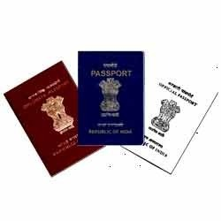
POPSK training of CSEs of DoP staffs scheduled on 21.02.2026 at PSK, Rasulgarh RPO, Bhubaneswar

Slide 2
Lack ness during process of applications
Lack nesses
Documentation and additional Documents
Filling Application
Capturing Photograph
Capturing NOC
Scanning Documents
Non acceptable Applications

Slide 3
1. Lacknesses in filling application
Given name and surname in inappropriate place.
Mentioning of Salutation and late in applicant’s or parent’s name.
Mentioning legal guardian name if either parents is the legal guardian.
Fully change of address in filling application as per address proof.
Significant changes in applicant’s particular without taking declaration/clarification/ documents.
Filling Official/Diplomatic Passport details rather than Ordinary passport details.
Variation of applicant’s details as per submitted document.
Variation of DOB and POB as per Birth Certificate.
Missing of Parents Passport details in Minor application.
Mentioning C/o in address column.
Name with initial if one document contains expandable form.
Variation of POB in application compare to the Old Passport.
Mother’s name is missing in application form.
Prefile details is not mention in applications, if any

Slide 4
2. Lack nesses in Documentation
Self attestation documents and clear copy of documents are missing.
Documents are missing in mandatory folder.
Taking Voter ID as DOB proof. E-voter id/old voter id without Pincode.
IC/NOC/PIL with stamp and signature of issuing authority is missing . Moreover, IC is not submitted in Letter Pad of the concerned Department.
Taking short e-aadhar/aadhar with present appearance is missing/ e-aadhar without verification mark.
Name change documents are not in proper format. No paper name and date in Paper avdt.
Address proof without Pincode.
Submitting Annexures remain unfilled.
Bank passbook without recent transaction and BM signature.
Citizenship certificate is missing in MVP, MV region applicants.
Accepting Provisional certificate as ECNR proof in place of Original Degree certificate.
Accepting minor applicants proof as address proof in place of Parents proofs.
Passport copy, Visa arrival, departure, immigration stamps are missing with Annexure-C.
Parents signature(as per Passport) is missing in minor applicants document while accepting Annexure-D.
Twins declaration is missing in twins case.

Slide 5
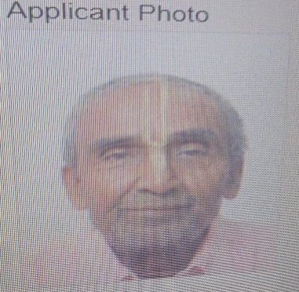
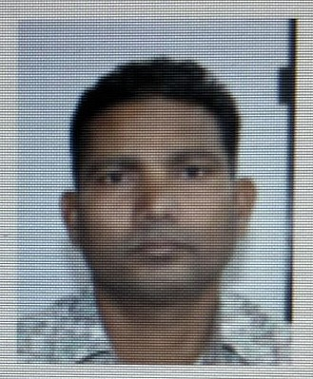
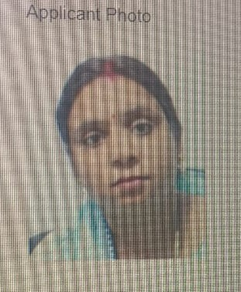
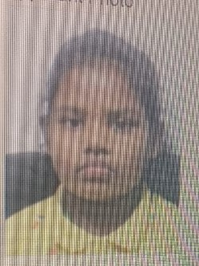
3. Lacknesses in photograph
Taking photograph with Spectacles, Tilak, Hijab, ear missing.
Taking photograph with background objects .i.e chair, backdrop bars.
Minor applicant’s photograph with color back ground.
Capturing bend head, one sided face or eye looks one sided.

Slide 6
4. Lacknesses in Capturing IC/NOC/PIL
Variation in selection of police verification desire in pre, post and no verification as per Annexure-A, G and H.
Scanning of Annexure-A, G and H in different folder as a result, NOC capture will reflected as pending.
Applications are forwarded without capture of NOC.
Signing authority details are missing in NOC.
Accepting invalid NOC.
Signing authority stamp and attestation is missing on the photograph in NOC.

Slide 7
5. Lacknesses in scanning of documents
Scanning of e-voter id card, short e-aadhar, e-aadhar digitally not verified, blur documents.
Scanning different documents in different folder.
Documents missing in mandatory folder.
Scanning of paper advt without paper name and date.
Scanning of Pan card without signature of applicant on original pan.
Scanning of documents without Attestation.
Scanning of Digilocker verified documents.

Slide 8
6. Non acceptable Applications in POPSKs
Application having ongoing court case.
Applications having out of jurisdiction.
Applications having Date of Birth or Place of Birth Change from Previous passport.
Application having renunciation of citizenship.
CARA cases .
In-country adoption cases.
Fully name change of applicant/Parents/Spouse.
Single Parent.
Transgender cases.
Fully change of address in filling application

Slide 9
Rectification for process the applications
Filling Application
Documentation
Capturing Photo
Capturing NOC
Scanning of documents

Slide 10
1.Rectification in filling applications
Not acceptable | Correct Filling
Name and surname in inappropriate column | Name and surname in appropriate column
Any salutation and late with name | Remove salutation and late from name with declaration
Application with legal guardian name and C/o in address | Remove legal guardian name and C/o from address with declaration
Significant changes in applicant’s particular without taking declaration/clarification/ documents | Minor changes in applicant’s particular with taking declaration/clarification/ documents
Filling Official/Diplomatic Passport details rather than Ordinary passport details | Remove Official/Diplomatic Passport details
Variation of applicant’s details as per submitted document | Check and take the documents as per the details filled in applications
Variation of DOB and POB as per Birth Certificate in fresh category | Fill proper DOB and POB as per BC in minor case in fresh category
Missing of Parents Passport details in Minor application | Add Parents Passport/file details with parents document
Name with initial if one document contains expandable form | If all documents contains initial then process in initial otherwise process with expandable form.
Mother’s name is missing in application form | Add mother’s name with declaration/clarification.
Variation of POB in application compare to the Old Passport | Take POB as per old Passport with declaration/clarification.
Prefile details is not mention in applications, if any | Add prefile details and confirm whether closed or still active.

Slide 11
2.Rectification in Documentation
Not acceptable | Correct Filling
Self attestation documents and clear copy of documents are missing | Take clear copy of documents with self attestation after verifying original only.
Documents are missing in mandatory folder. | Mandatory documents need to submit.
Taking Voter ID as DOB proof. E-voter id/old voter id and address proof without Pincode | Accept only original voter id and address proof with valid Pincode.
IC/NOC/PIL with stamp and signature of issuing authority is missing . Moreover, IC is not submitted in Letter Pad of the concerned Department. | Issuing authority stamp and signature is mandatory in IC/NOC/PIL with mentioning reference number and valid date. IC must be on Letter Pad from the concerned Dept.
Taking short e-aadhar/aadhar with present appearance is missing/ e-aadhar without verification mark | Only take original long aadhar, PVC aadhar card and verified e-aadhar with present appearance.
Name change documents are not in proper format. No paper name and date in Paper avdt | Take name change doc. in appropriate format and paper name and publication date must be on the news paper cutting.
Submitting Annexures remain unfilled. | Take annexures with filled all column
Bank passbook without recent transaction and BM signature | Take Bank Passbook with BM signature and recent transaction.
Citizenship certificate is missing in MVP, MV region applicants | Take Citizenship certificate in MVP, MV address
Accepting Provisional certificate as ECNR proof in place of Original Degree certificate | Take 10th, 12th or Degree certificate for ECNR proof only.
Accepting minor applicants proof as address proof in place of Parents proofs. | Take parents address proof in minor case only. Take applicants address proof in minor, if the minor attends 15 of age or above and taking 10 years of validity.
Passport copy, Visa arrival, departure, immigration stamps are missing with Annexure-C. | Take father’s Passport copy, Visa arrival, departure, immigration stamps with Annexure-C.

Slide 12
2.Rectification in Documentation
Not acceptable | Correct Filling
Parents signature(as per Passport) is missing in minor applicants document while accepting Annexure-D. | Match Parents signature(as per Passport) in minor applicants document while accepting Annexure-D.
Twins declaration is missing in twins case | Take twins declarations with their file/passport no., if any

Slide 13
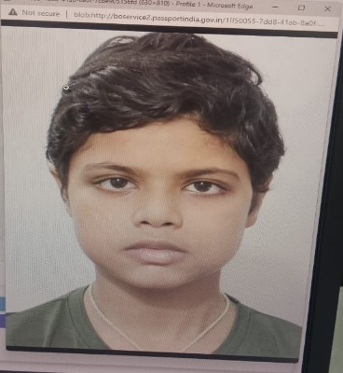
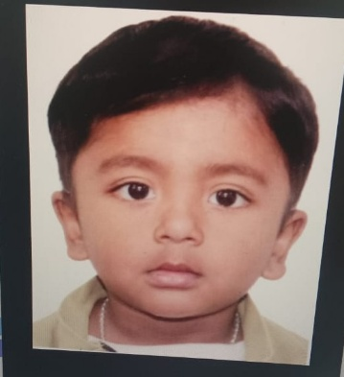
3.Admissible Photograph
Capture photograph without Spectacles, Cap and Tilak.
Photograph with Hijab acceptable, if only with visible both ears.
Capture photograph without any background objects.
Minor applicant’s photograph with white back-ground only.
Capture photograph with vertically straight. Don’t capture bend head, one sided face or eye looks one sided.
Example Image :

Slide 14
4.Rectification in capturing NOC
Capture Annexure-A/IC, if only select and scan in IC folder.
Capture Annexure-G/NOC, if only select and scan in NOC folder.
Capture Annexure-H/PIL, if only select and scan in PIL folder.
Forward application after capturing NOC of government servant.

Slide 15
5.Rectification in scanning documents
Scan only clear, legible documents with applicants attestation.
Scan full CBSC certificate.
Scan paper advt. with paper name and date.

Slide 16
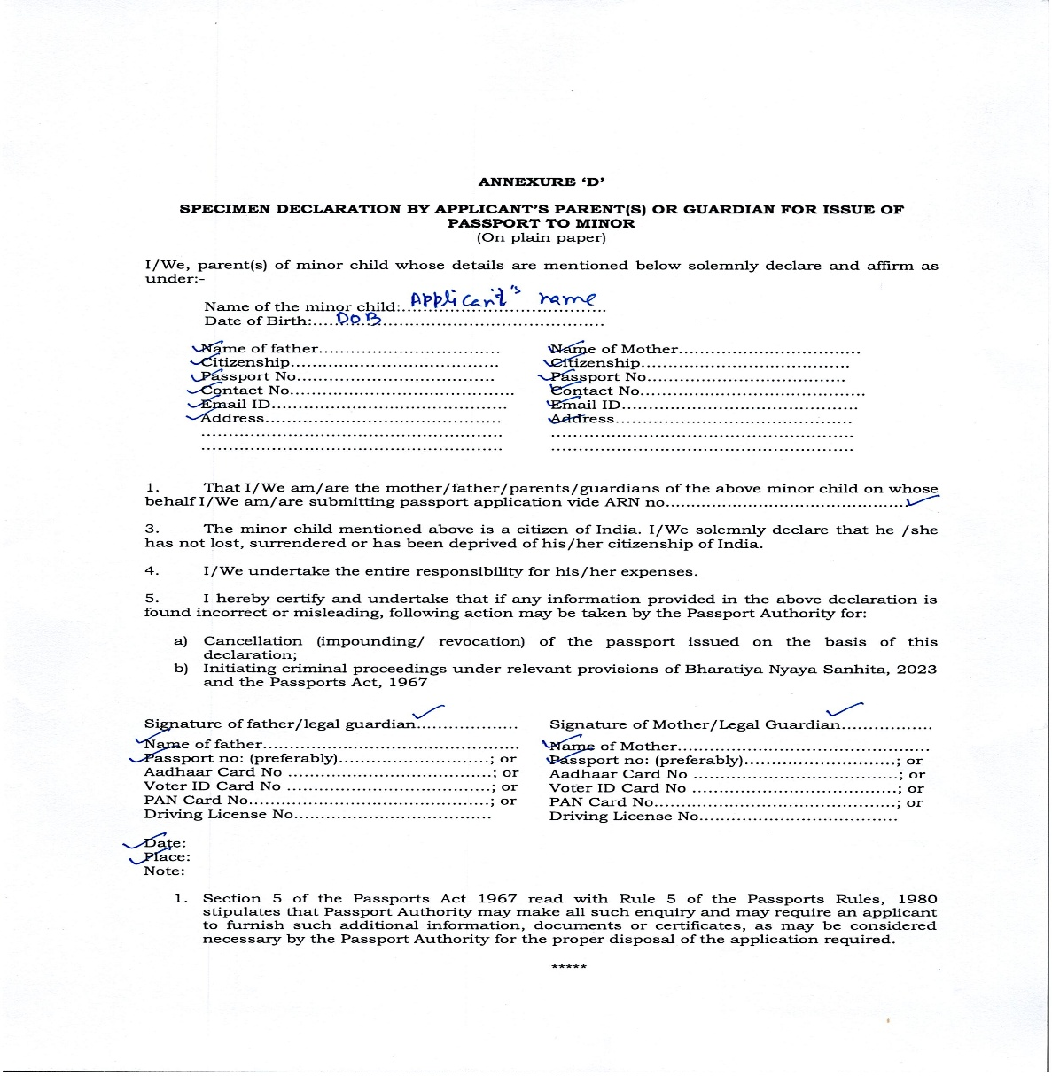
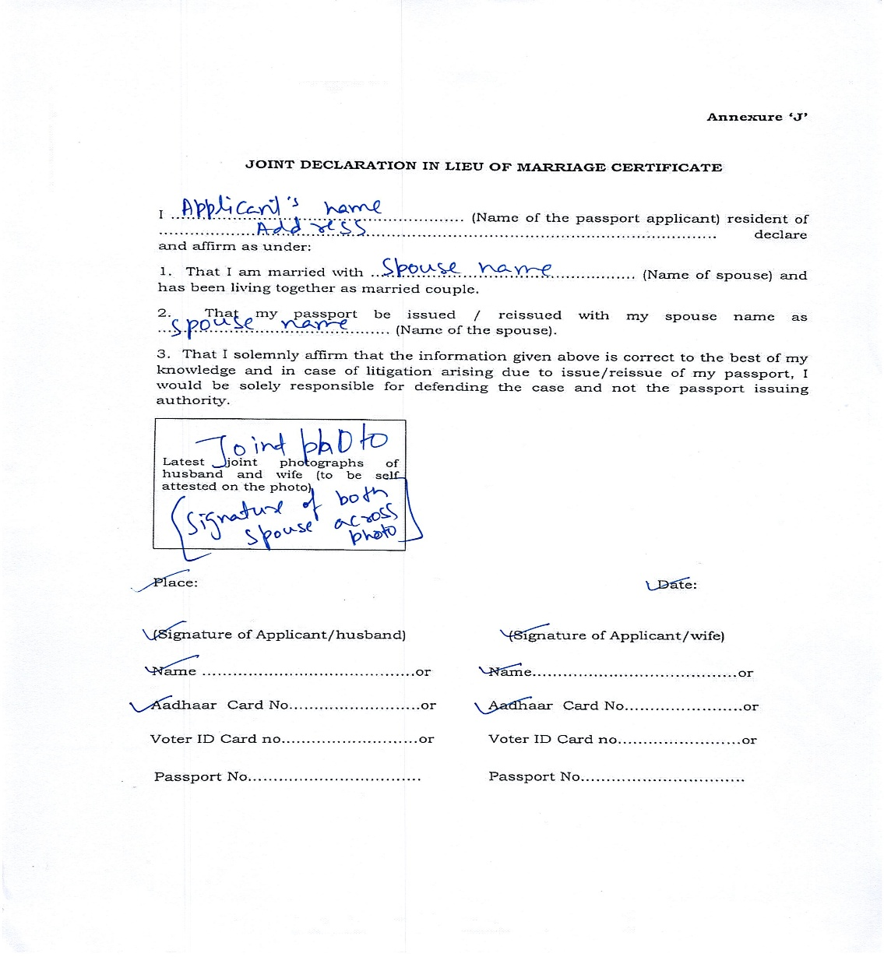
Annexure-D and F

Slide 17
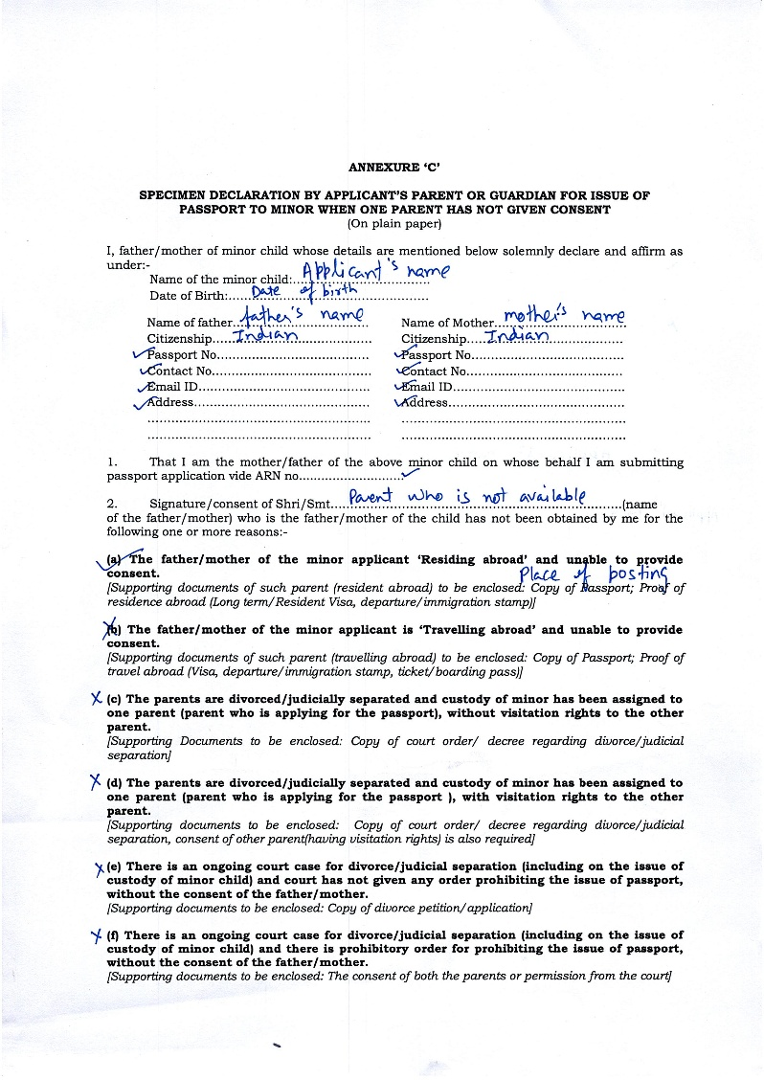
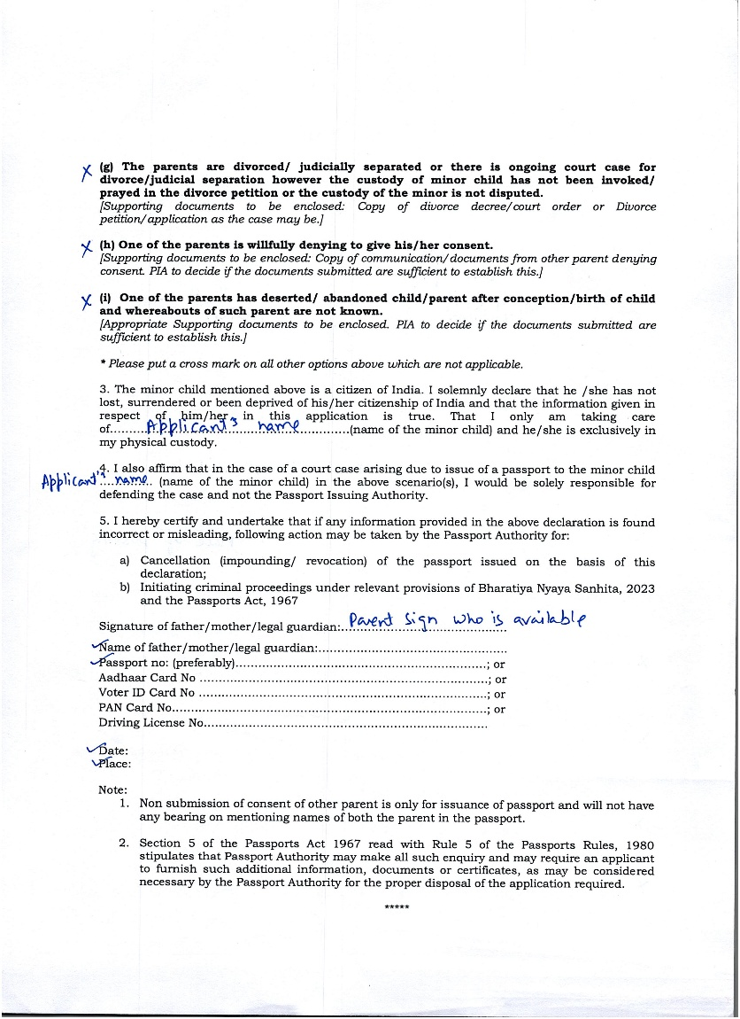
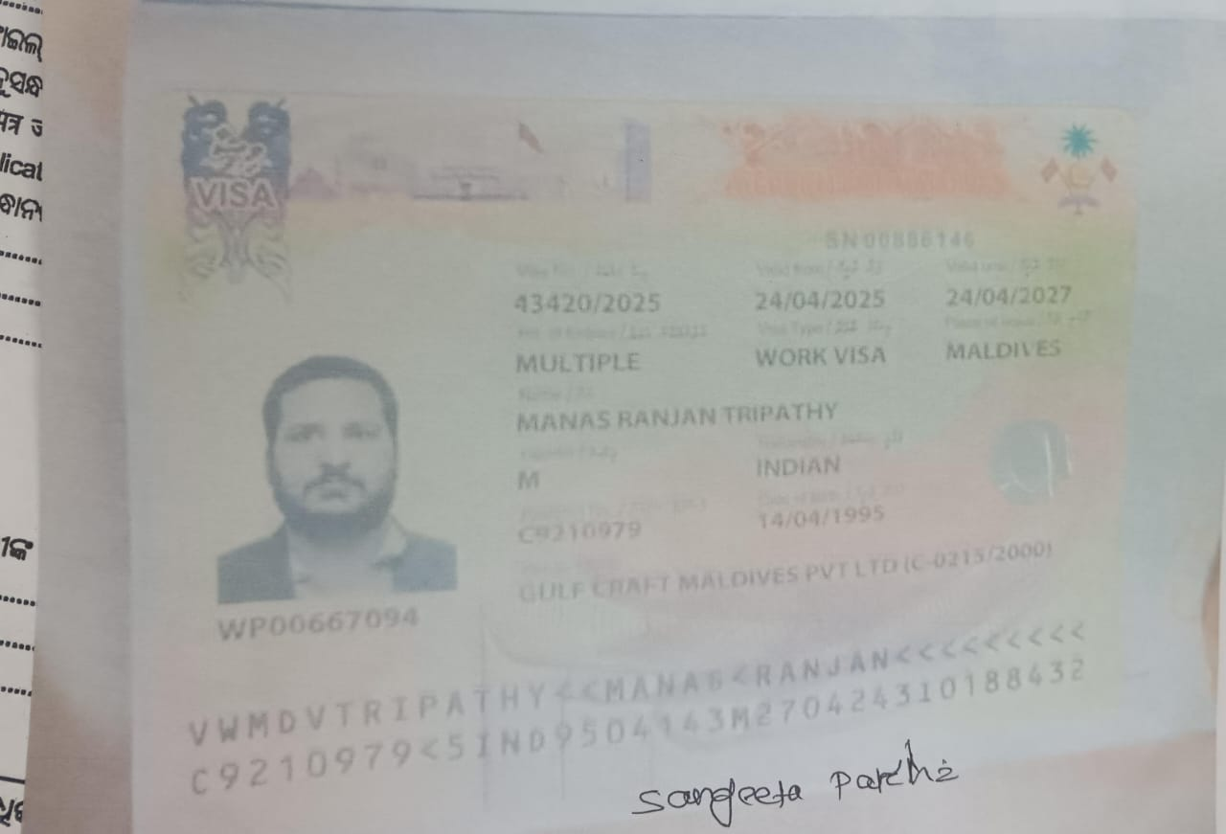
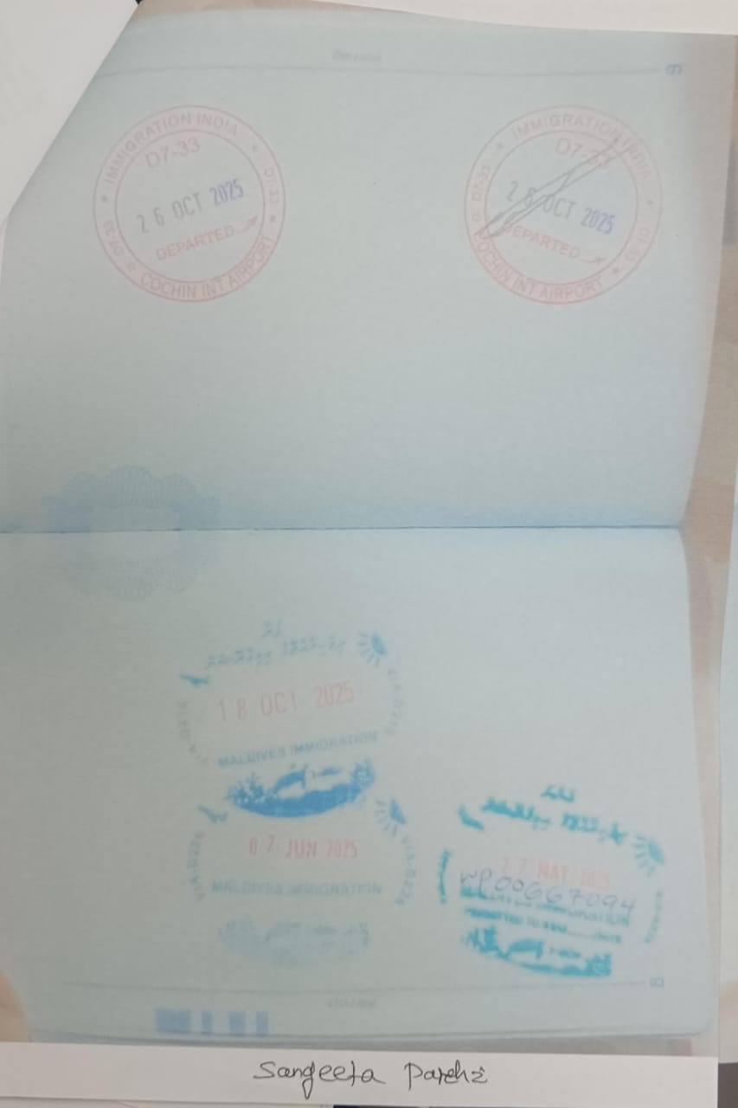
Annexure- C , Valid Visa and Immigration stamp

Slide 18
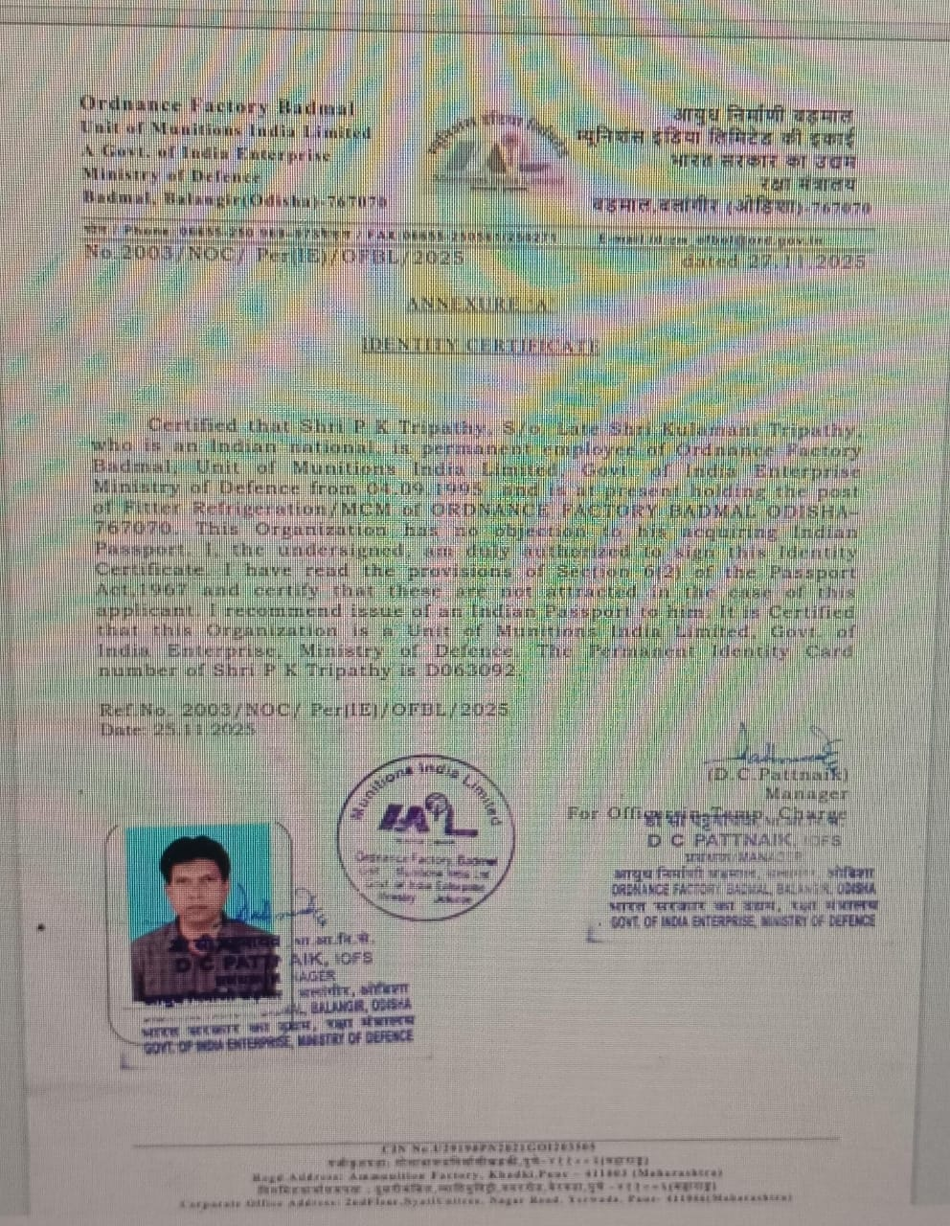
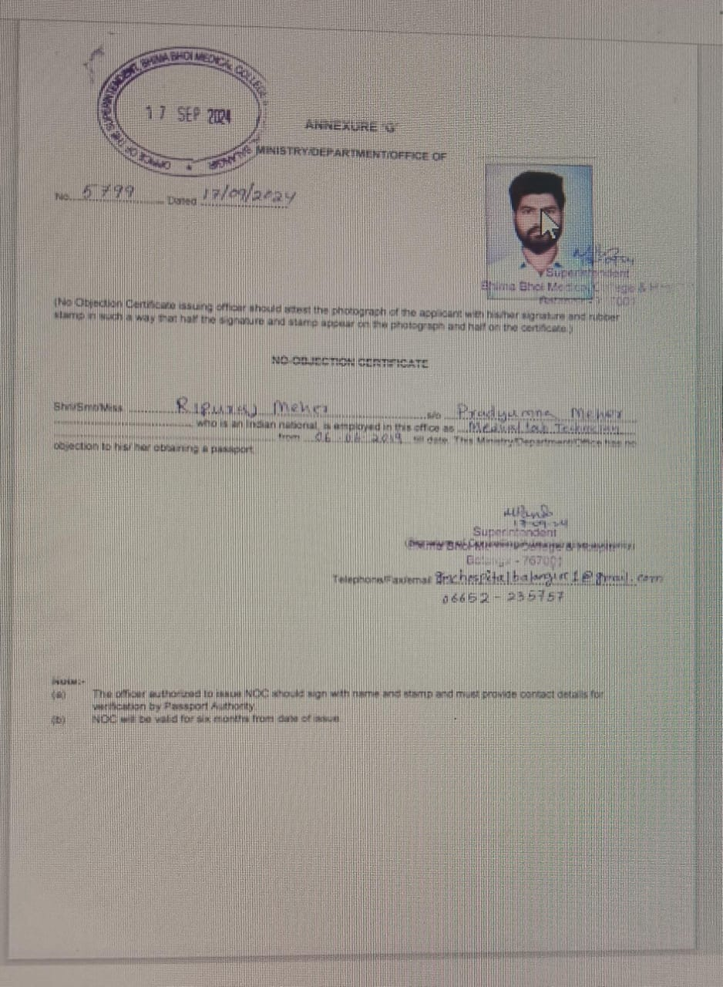
Annexure A(IC) & Ann-G(NOC)

Slide 19
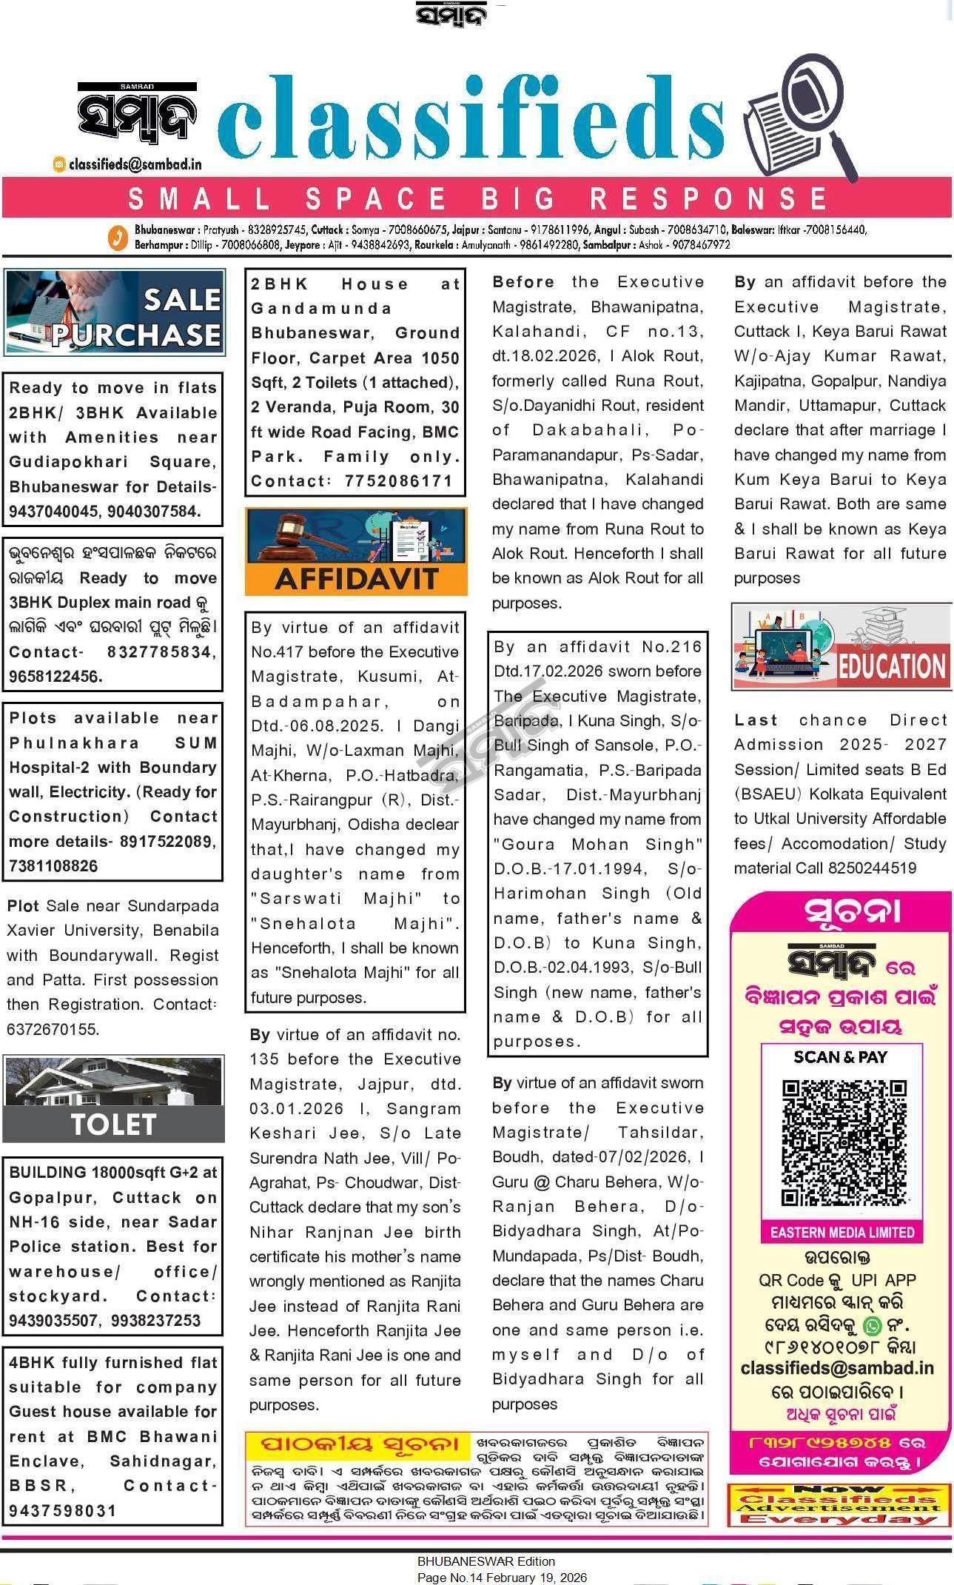
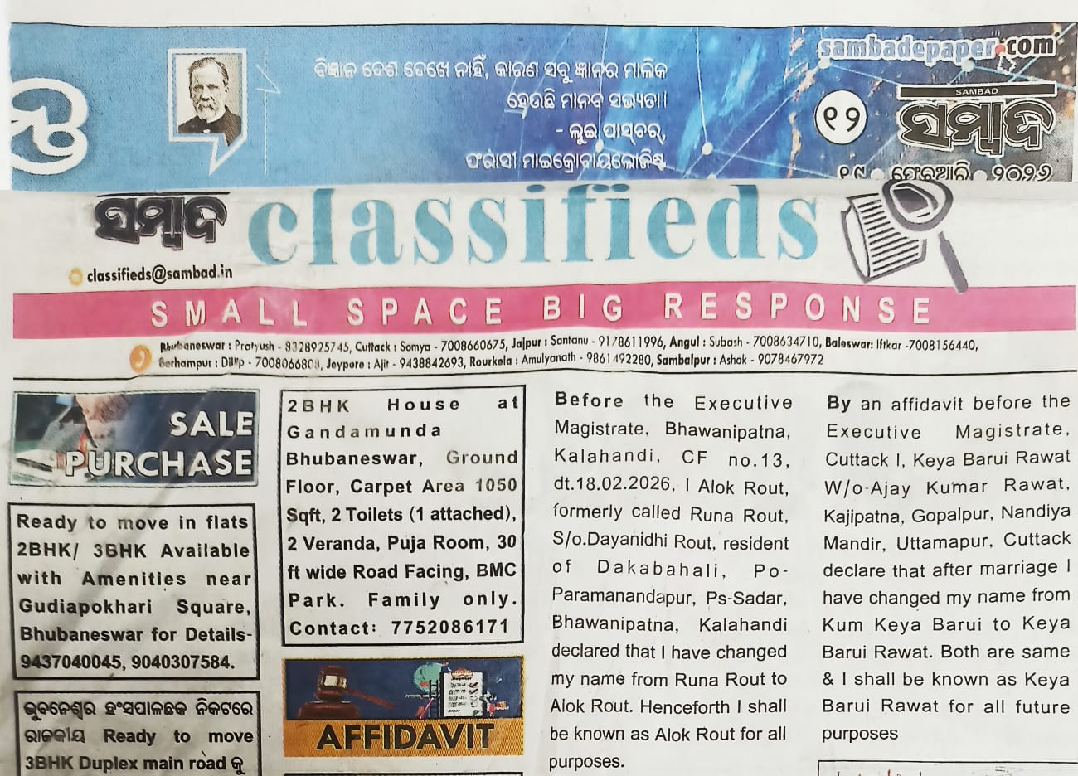
Paper Advt with correct and incorrect format with name date
✓
✓
✓

Slide 20
Follow these instructions and paste the sample annexures and paper cutting in POPSKs. Additional doubt may be clear from the concerned Nodal verification officer.

Slide 21
Thanking You.
Regional Passport Office, Bhubaneswar

