Slide 1
Introduction to Universal Client (UC)

Slide 2
Vision of Aadhaar
“Empower residents of India with a unique identity and a digital platform to authenticate anytime, anywhere”

Slide 3
Introduction
Universal Client (UC) : Designed by UIDAI to streamline and enhance the resident experience by unifying all Aadhaar related services under a single platform
Key objectives of UC :
    Simplify processes
    Improve transparency
    Minimize rejections
    Faster processing of enrolment/update requests
    Ensuring robust security of resident’s Personally Identifiable Information (PII)

Slide 4
Need of UC
Challenges with ECMP client | Description
No-real time Checks | Operators could proceed without instant validation, leading to error and fraudulent entries
Manual Errors | Typos in demographics (name/address) or poor biometric captures causing rejections

Slide 5
ECMP vs Universal Client
ECMP | UC
Works in offline mode, packets are created on client | Fully online application with packet creation at Backend
No validation of email and mobile number | Email and mobile number validated through OTP
No integration with Civil Registration System (CRS) | Integration with Civil Registration System (CRS) for auto-fetching demographic data based on BRN (Birth Registration Number)
No source verification of supporting documents | Online source-verification of supporting documents [Birth Certificate, Driving license, CBSE mark sheet, PAN, EPIC, passport…]
No separate flagging for resident foreigner enrolment | Resident foreigner enrolled for Aadhaar with limited validity
NRIs enrolled with Indian address only | NRI may enroll with Indian/foreign address as well

Slide 6
Useful features in UC for easing life of Operator
Feature | Description
Latest details of Aadhaar | Latest details of resident Aadhaar are displayed
Limits available | Limits available for Name/DoB/Gender change are displayed
Status of Aadhaar | Able to check the status of Aadhaar (Deactivated/suspended)
Documents preview | Able to preview the uploaded documents
Mobile/email validation | Mobile/email of resident/operator are validated through OTP
Validations at client side | Operator’s /resident’s biometric are validated at the frontend
Value added services | Value added services like Document Update, Find Aadhaar, PVC card etc. in a single interface
Notifications | Notification related to eligibility for MBU, eligibility for Document Update related to particular Aadhaar

Slide 7
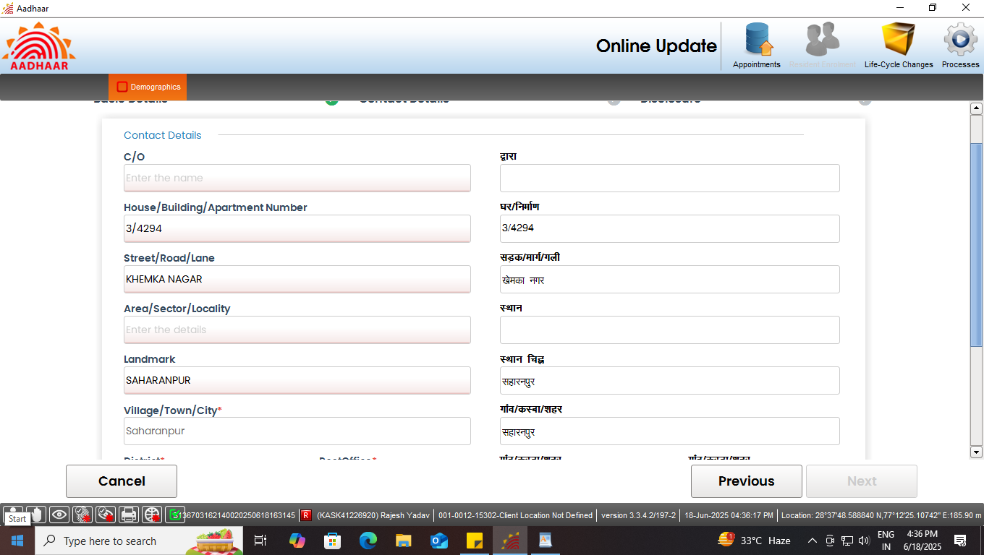
Latest details of Aadhaar

Slide 8
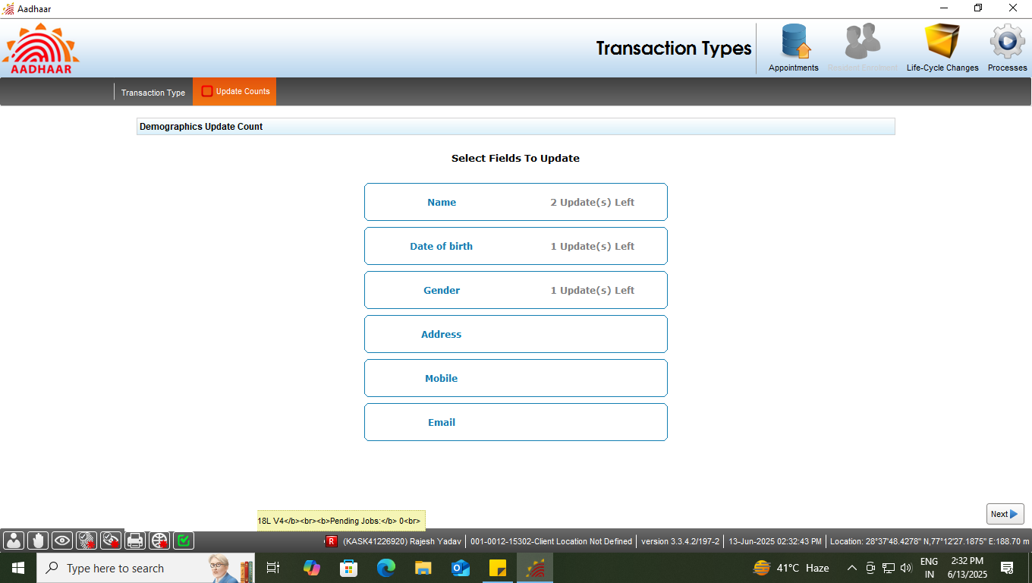
Limit Availability

Slide 9
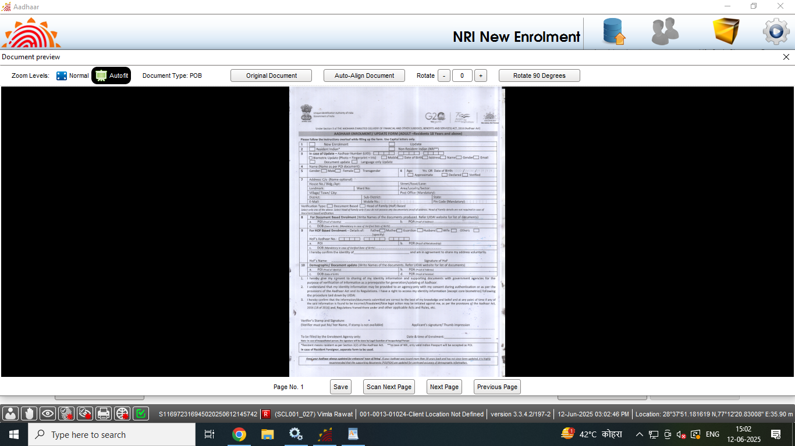
Documents preview

Slide 10
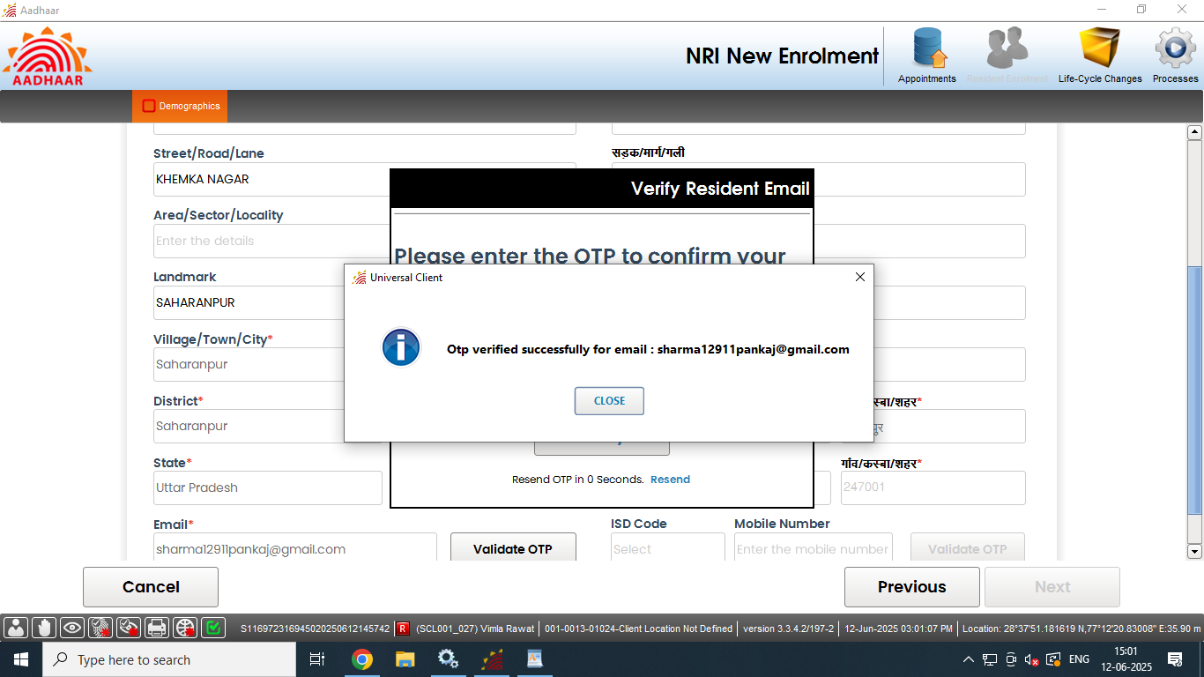
Mobile/e-mail validation

Slide 11
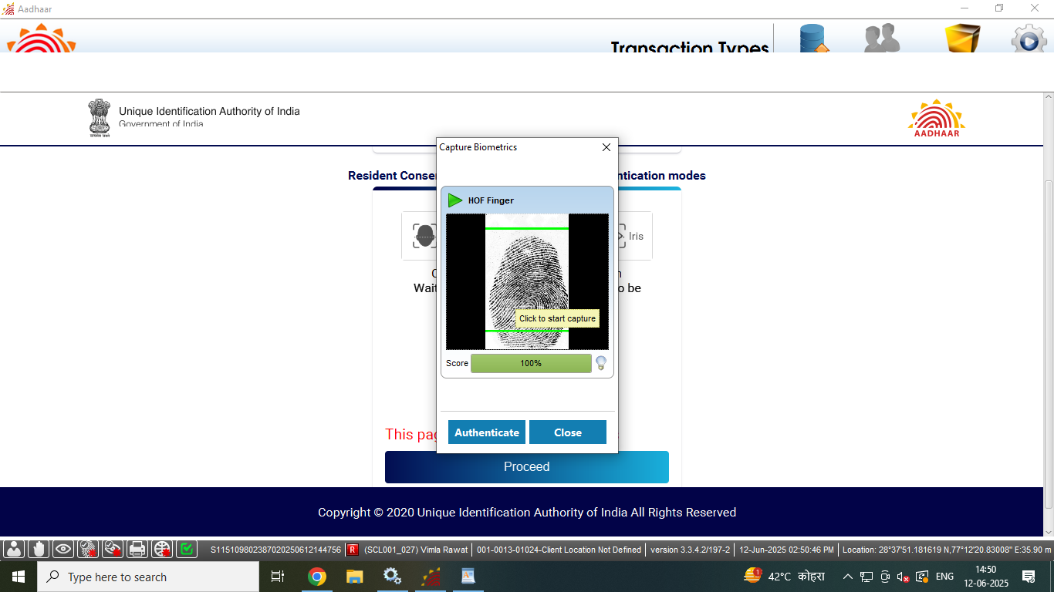
Validations at Client side

Slide 12
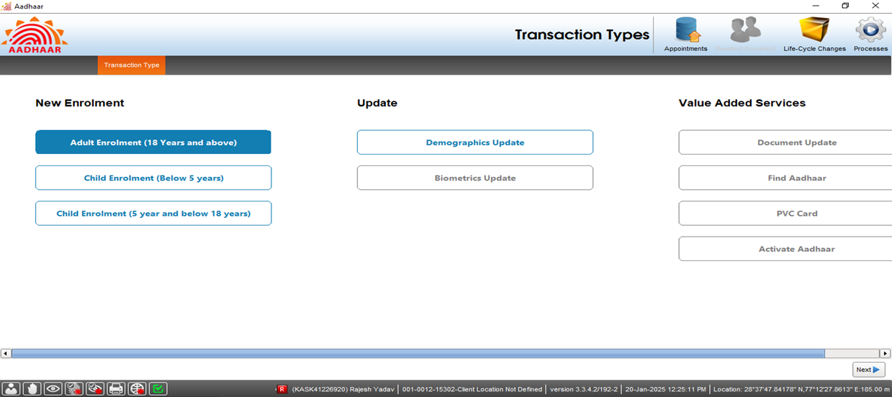
Value added services

Slide 13
Benefits to Operator
Benefit | Description
Less rejections | Due to real time validation of demographics/documents by flagging error upfront
Time saving | Pre-filled details of the resident Aadhaar are displayed, which can be edited, resulting in saving of time
Faster processing | The real time data fetching results in faster processing of enrolment and update process
Role based access & GPS geofencing | Prevents misuse and ensure that only authorized operator performs the enrolment and update activities

Slide 14
UC Interface

Slide 15
Enrolment scenarios in UC (age category wise)
Enrolment
Child
(below 5)
Child
(5 to below 18)
Adult
(18 & above)
Indian
Foreign
Document based
HoF
based
Indian
Foreign
Document based
HoF
Based
Indian
Foreign
Document based
Having
proof of birth
Not having proof of birth
With
BRN
Without
BRN
Having
proof of
birth
Not having proof of birth
Having
proof of
birth
Not having proof of birth
Document based
Document based
Document based
NRI
NRI
NRI
HoF
based
Document based
Document based
HoF
based
With BRN
Without BRN
HoF based
Note : For Indian and NRI born on and after 01.10.2023, ‘Birth Certificate’ is mandatory.

Slide 16
Thank You

