Slide 1
Adult Enrolment - Indian Resident (18 Years and above)

Slide 2
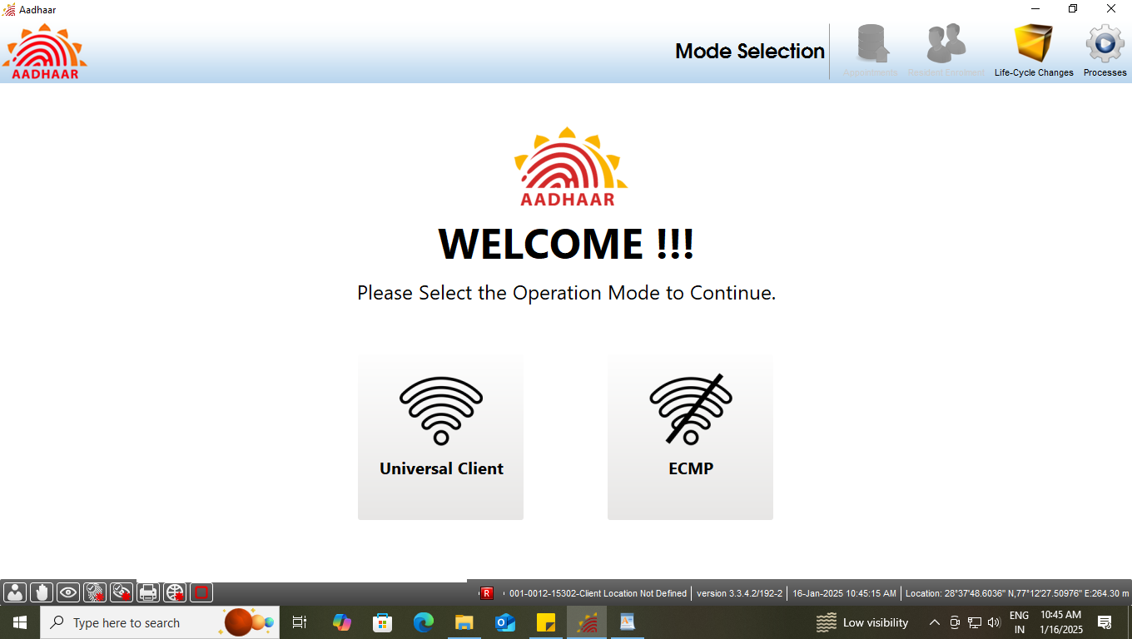
Step-1
Please ensure that the client is connected to internet, then Operator select the option ‘Universal Client’ in Mode Selection.

Slide 3
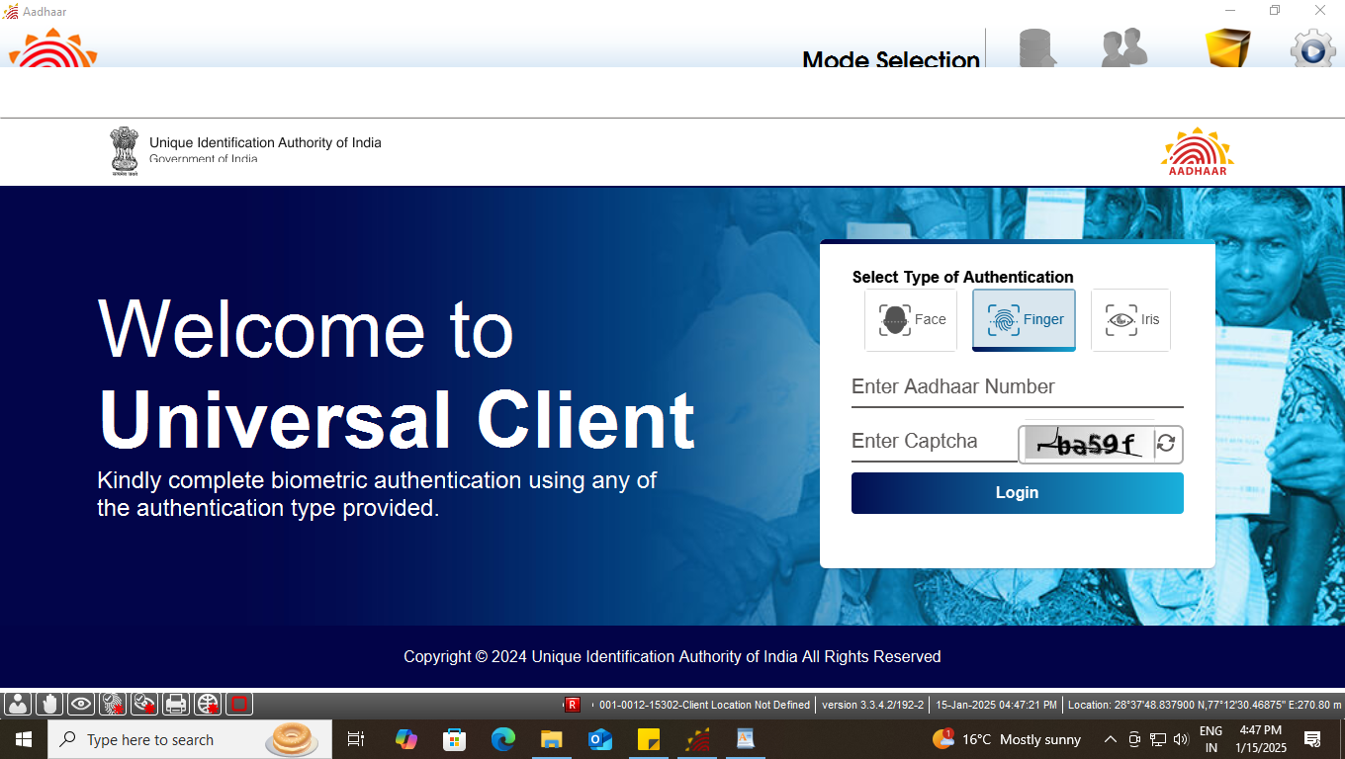
Step-2
Universal Client login page will appear, Enter the ‘Aadhaar Number’ and ‘CAPTCHA’ for login

Slide 4
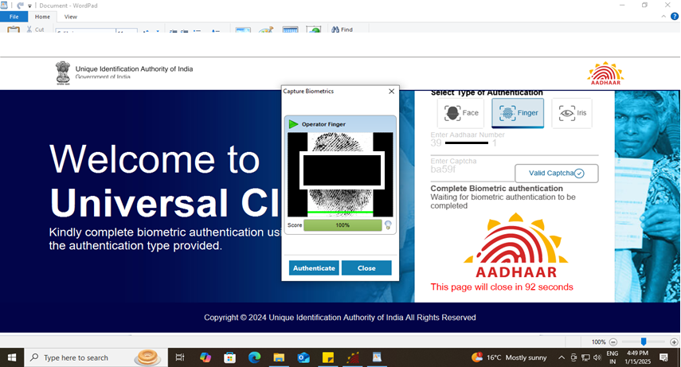
Step-3
Operator needs to give his/her ‘biometric’ for authentication using - fingerprint or Iris.

Slide 5
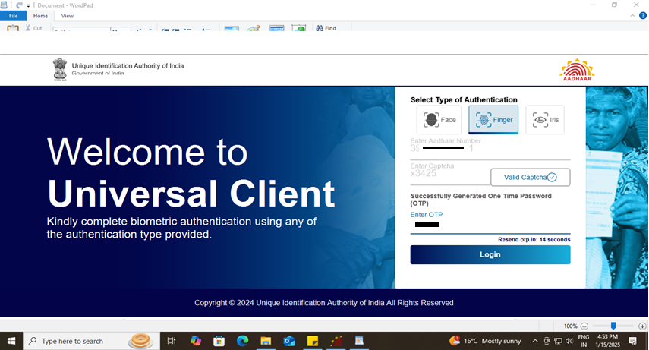
Step-4
After biometric authentication operator receives OTP, enter OTP to proceed.

Slide 6
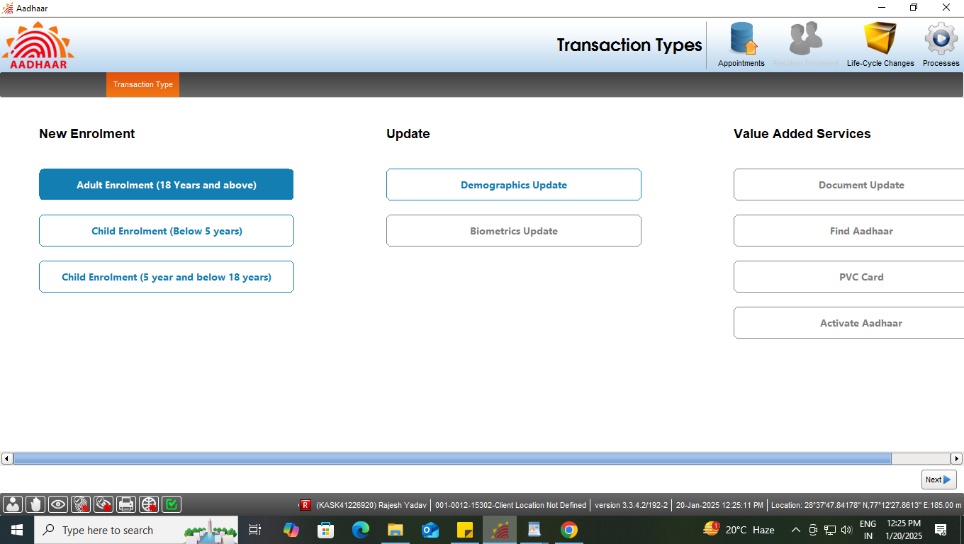
Step-5
Select the Adult enrolment (18 years and above) tab under new enrolment option, click next

Slide 7
Type of Enrolment
Enrolment Type
Document based enrolment
Case One: Resident having Proof of Birth
Case Two: Resident not having Proof of Birth
HoF Based Enrolment

Slide 8
Case One:
Resident having proof of birth

Slide 9
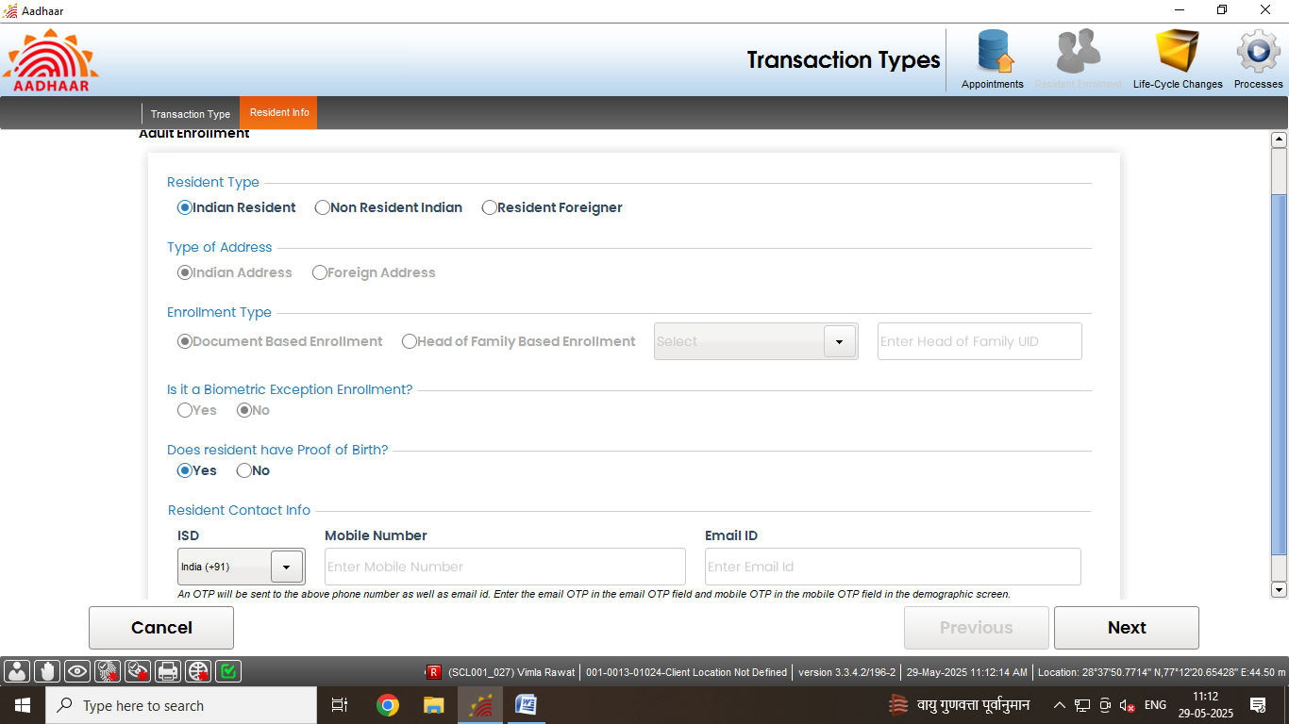
Document based enrolment
Step-6
Select “Indian Resident” radio button in resident type option, all other fields shall get selected according to the resident type.

Slide 10
Document based enrolment
Step-7
For Indian Resident enrolment, E-Mail id and Mobile no. are optional. However operator can fill the same if the resident has filled the E-Mail id and Mobile no. in enrolment form.
In case of Indian resident, mobile no. and email id are optional

Slide 11
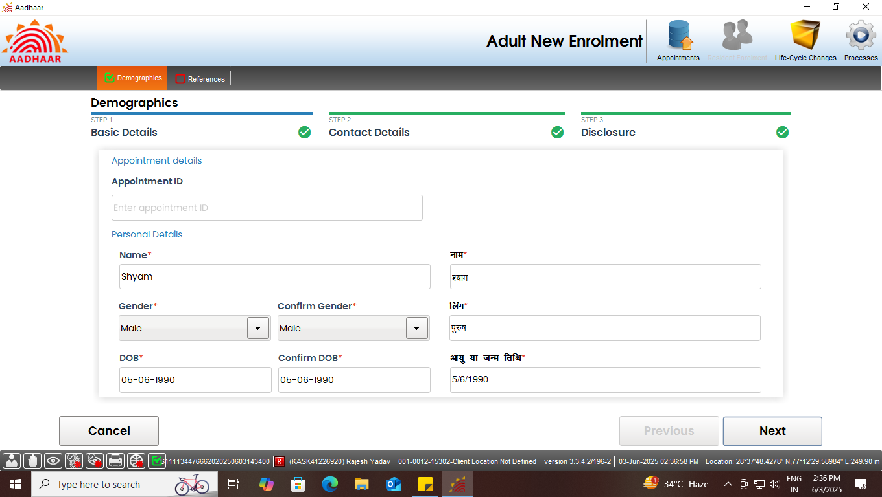
Document based enrolment
Step-8
Enter basic demographic details of the resident like Name, Gender, Age, etc. and confirm the same. Click Next

Slide 12
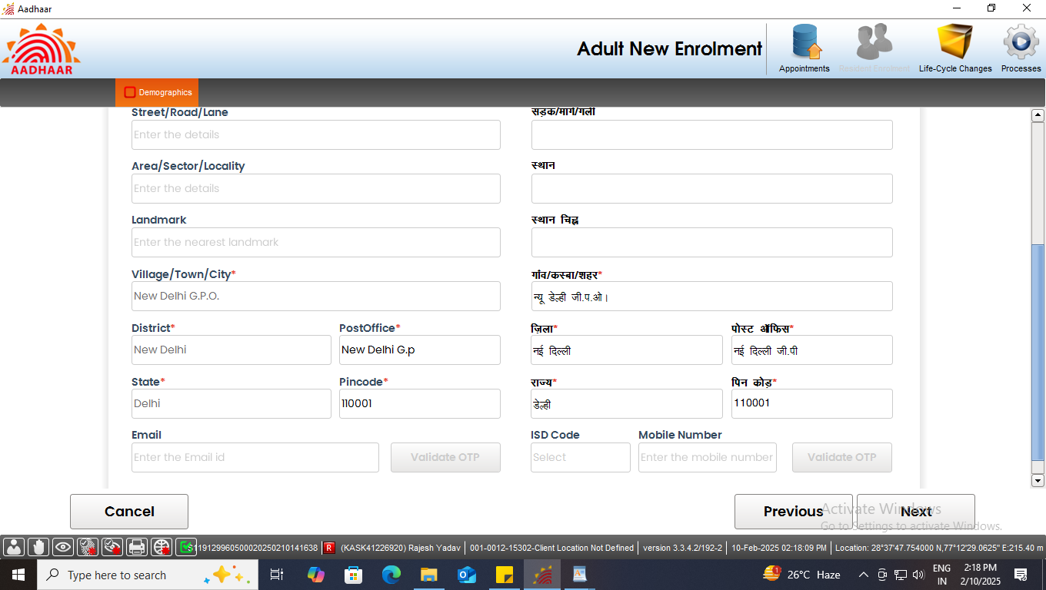
Document based enrolment
Step-9
Record address of the resident. Fields with (*) mark (pin code, state, district and post office) are mandatory. Click Next

Slide 13
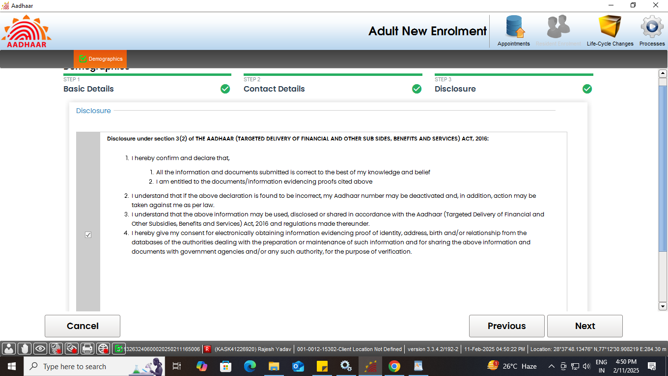
Document based enrolment
Step-10
Record consent of the applicant by selecting check box and click next

Slide 14
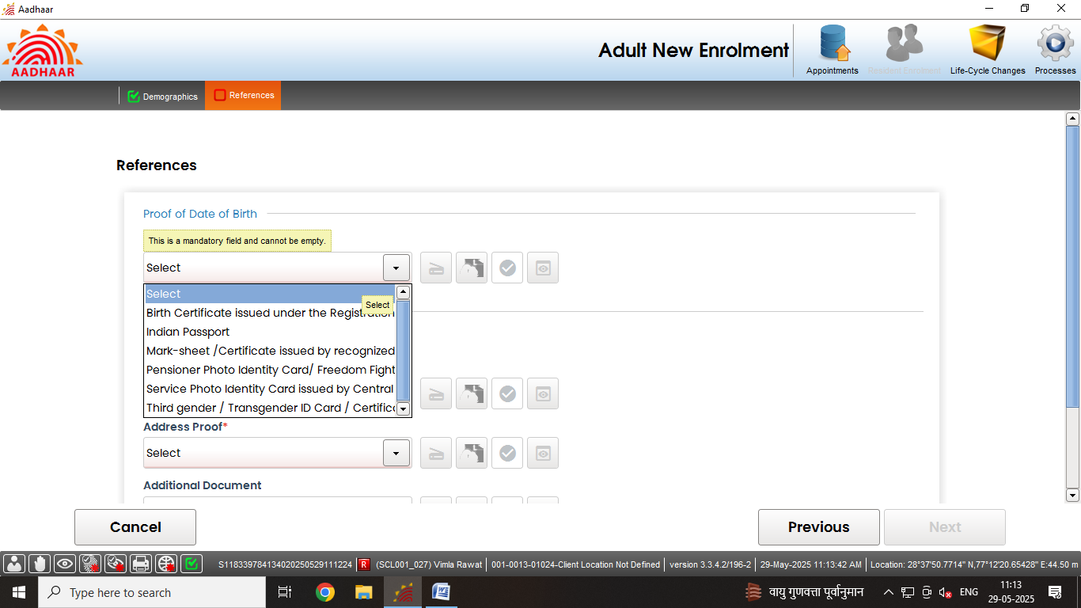
Document based enrolment
Step-11
List of supporting documents for Proof of Date of Birth of the Resident.

Slide 15
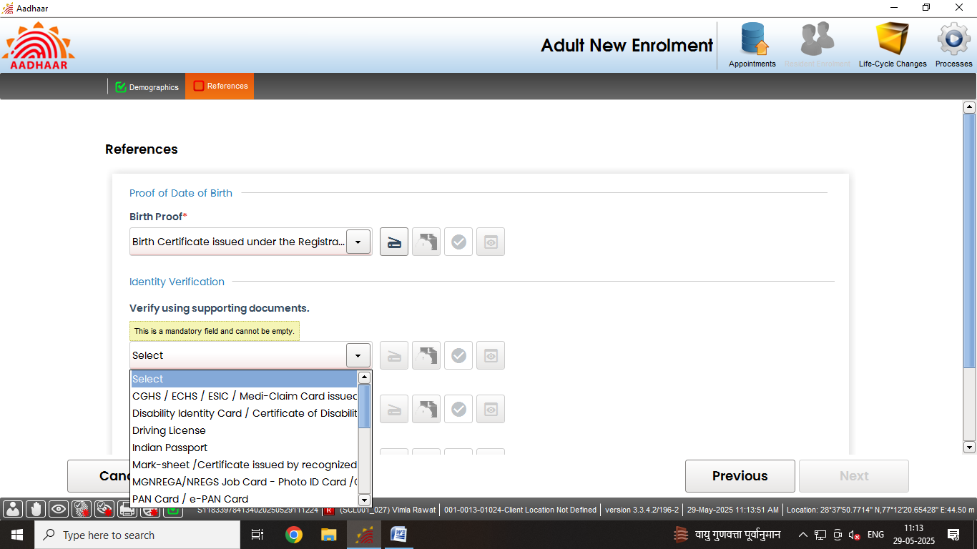
Document based enrolment
Step-12
List of supporting documents for Proof of Identity (POI) of the Resident.

Slide 16
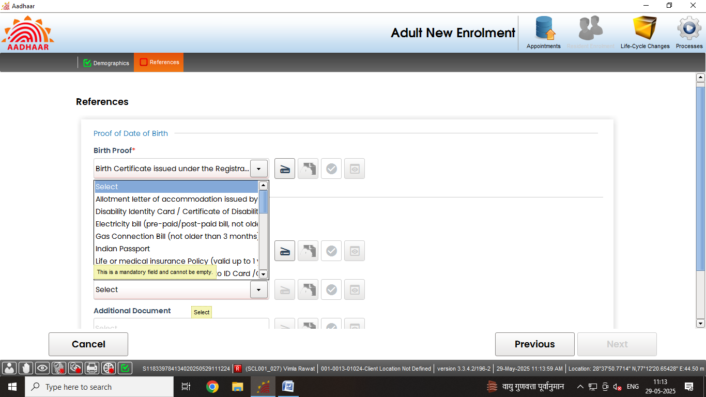
Document based enrolment
Step-13
List of supporting documents for Proof of Address (POA) of the Resident.

Slide 17
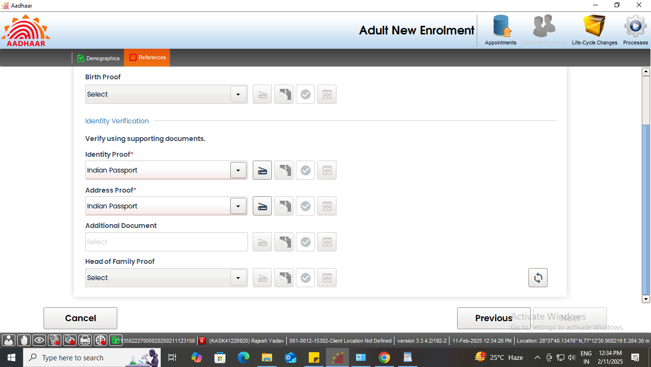
Document based enrolment
Step-14
Operator to click on the scan button to scan and upload the valid document
Click here to scan the documents

Slide 18
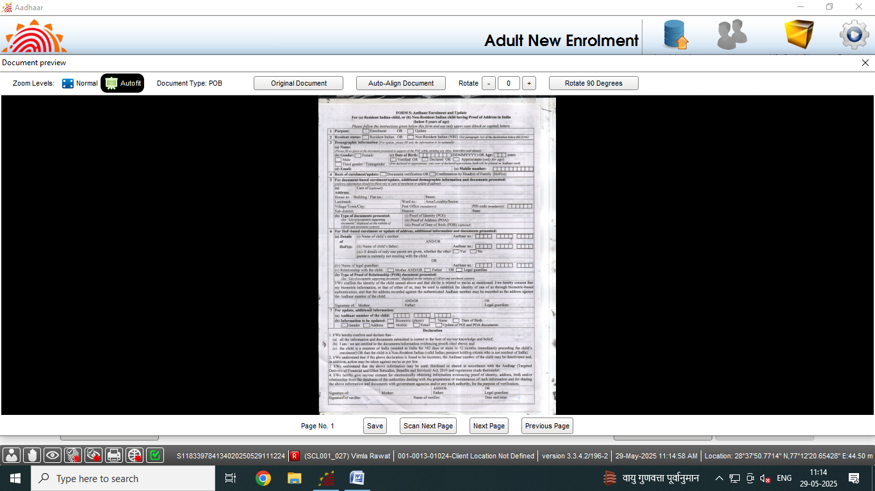
Document based enrolment
Step-15
Preview of the scanned document would appear, operator has to check the scanned document properly before upload.

Slide 19
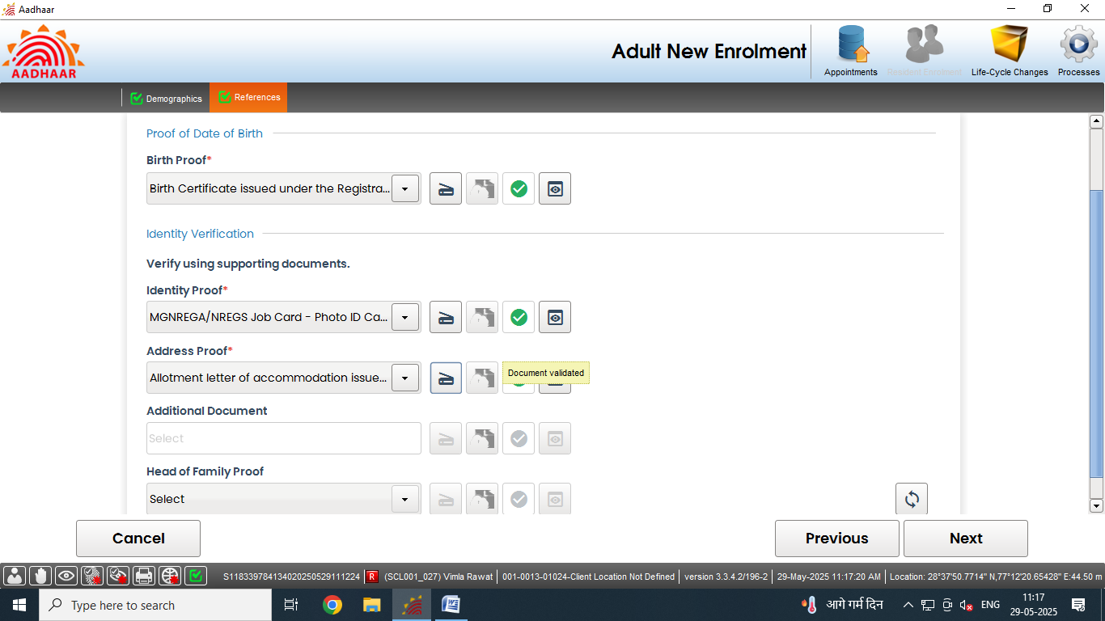
Document based enrolment
Step-16
Similarly upload all the valid documents. After the scanning is done successfully "Green Tick" symbol indicates that the upload to backend service is successful. Click next.
Documents scan successfully

Slide 20
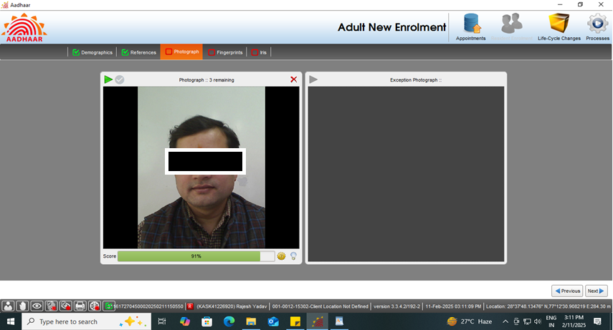
Document based enrolment
Step-17
Capture face of the applicant as per process and click next

Slide 21
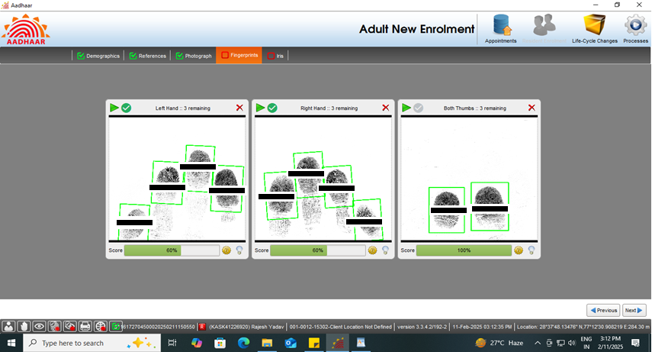
Document based enrolment
Step-18
Capture the fingerprints of the resident and click next

Slide 22
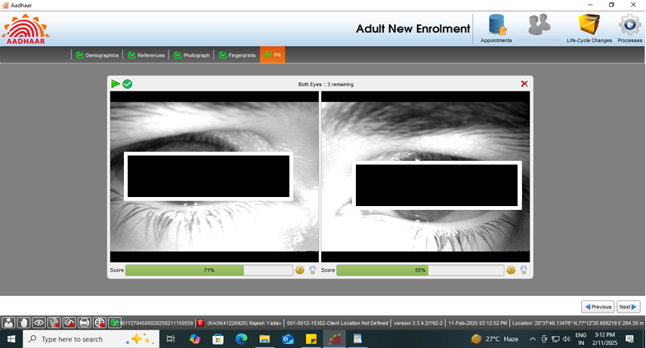
Document based enrolment
Step-19
Capture both iris of the resident and click next

Slide 23
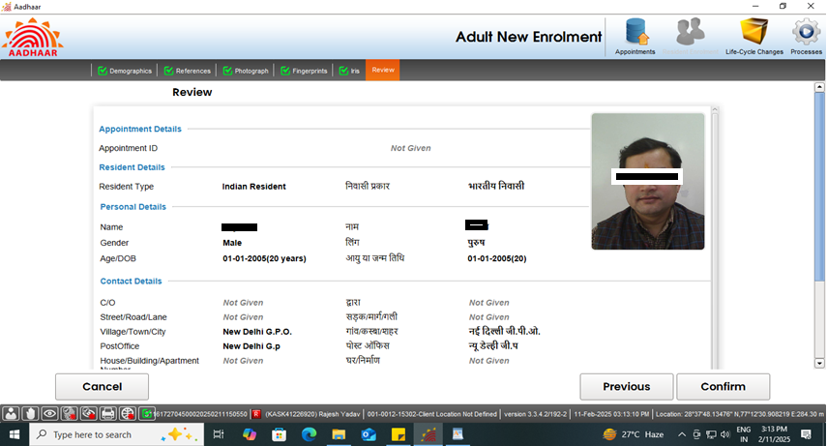
Document based enrolment
Step-20
Request the applicant to verify all the entered details, in the review page. After the operator’s confirmation, the details cannot be changed.

Slide 24
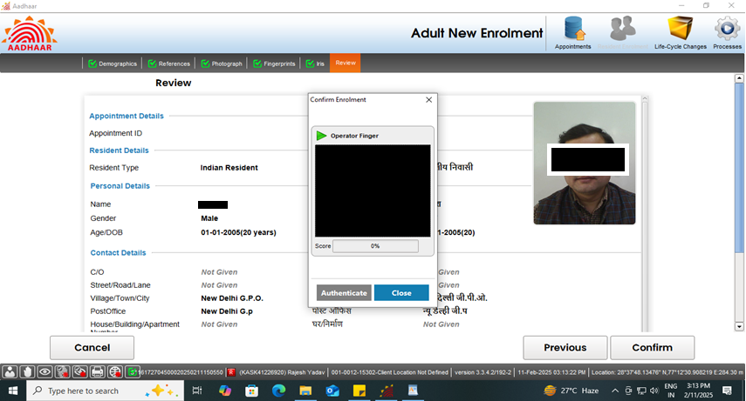
Document based enrolment
Step-21
The operator should confirm that the entered details are correct by providing his/her biometrics.

Slide 25
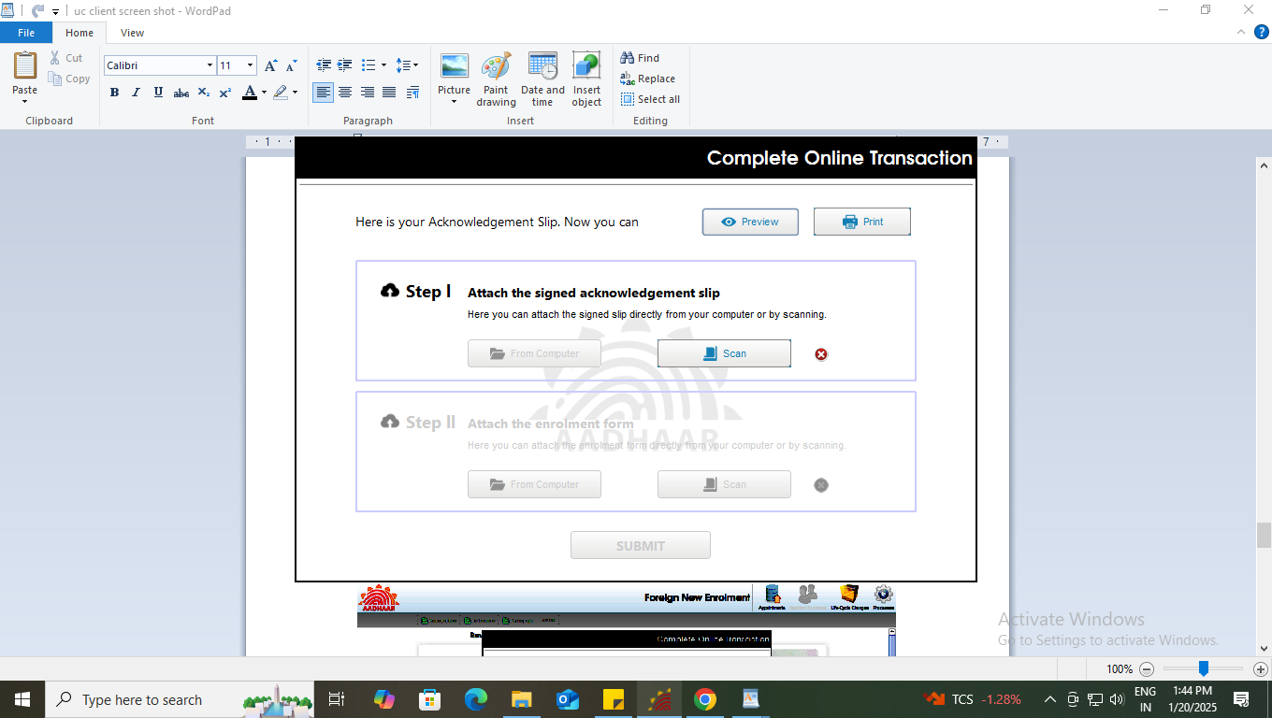
Document based enrolment
Step-22
After the confirmation, operator can preview the acknowledgement slip.

Slide 26
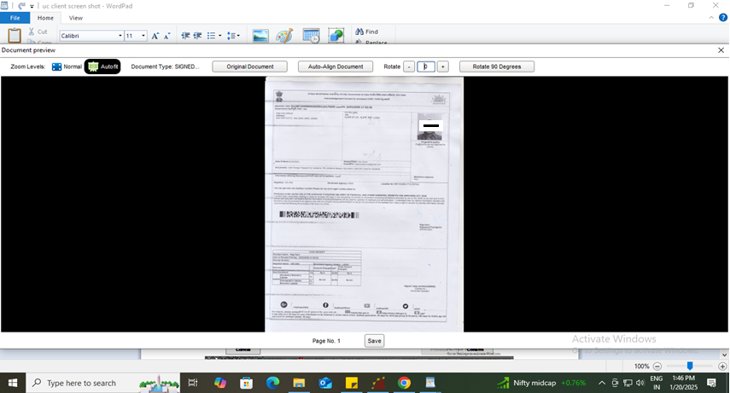
Document based enrolment
Step-23
See the Preview of acknowledgement slip and take the print-out for uploading the same.

Slide 27
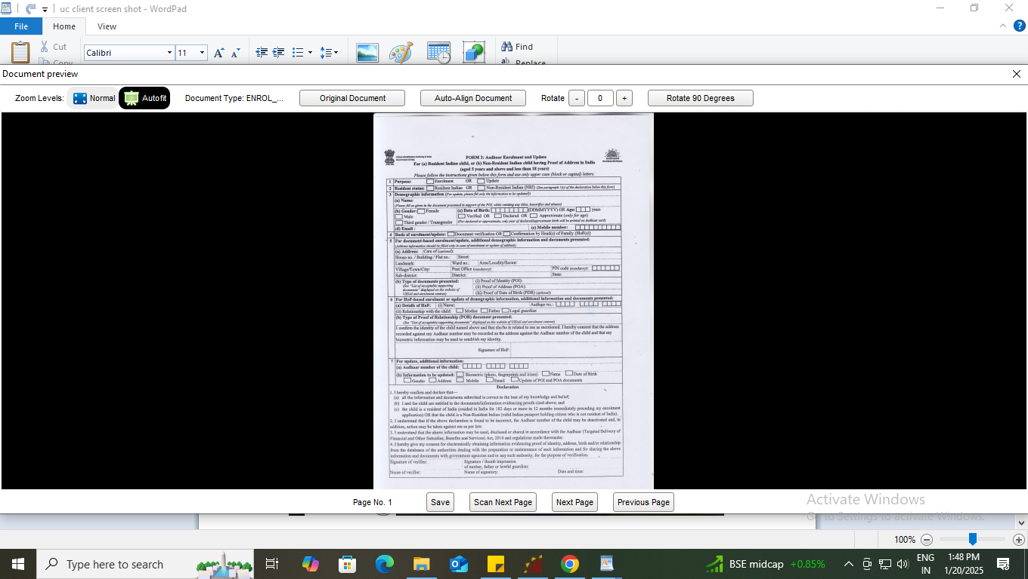
Document based enrolment
Step-24
Scan and upload the signed enrolment form filled by the resident

Slide 28
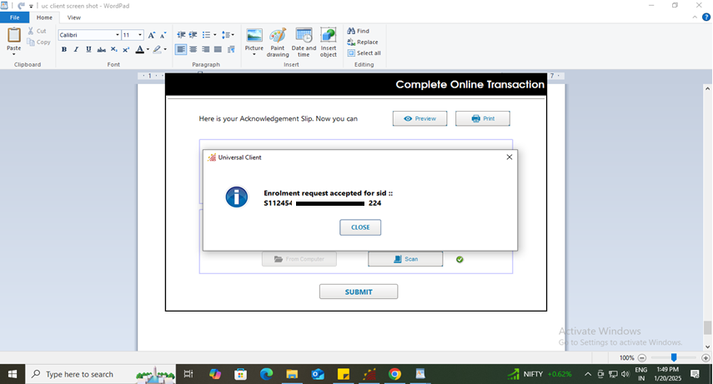
Document based enrolment
Step-25
After uploading the enrolment form and acknowledgement slip submit button will be enabled. After successful submission of enrolment request following message will be displayed showing completion of the transaction.

Slide 29
Case Two:
Resident not having proof of birth

Slide 30
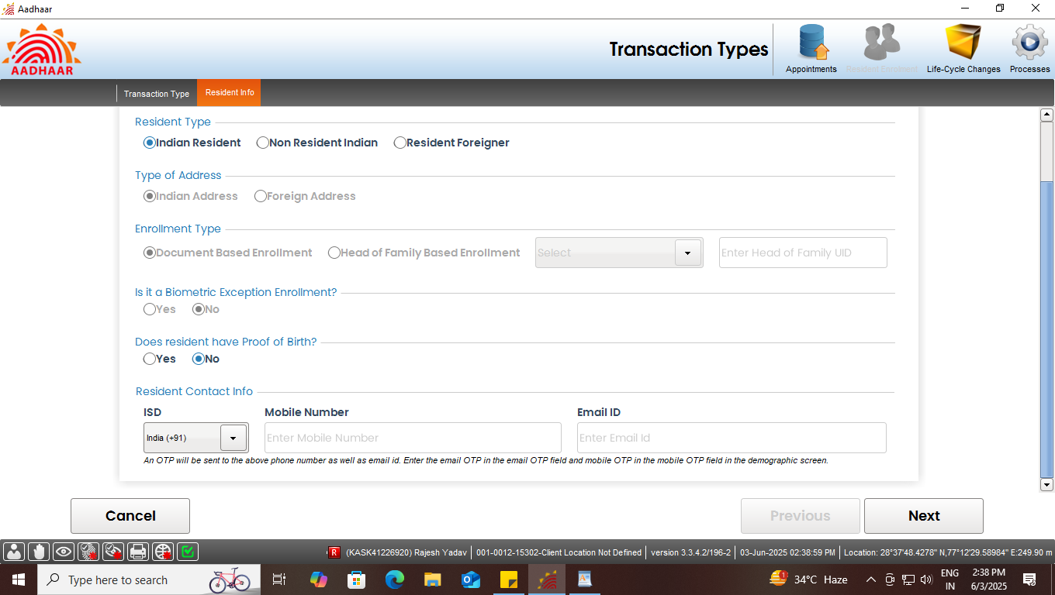
Document based enrolment
Step-1
Select “Indian Resident” radio button in resident type option, all other fields shall get selected according to the resident type. Then select ‘No’ in case resident not having proof of Birth.

Slide 31
Document based enrolment
Step-2
For Indian Resident enrolment, E-Mail id and Mobile no. are optional. However operator can fill the same if the resident has filled the E-Mail id and Mobile no. in enrolment form.
In case of Indian resident, mobile no. and email id are optional.

Slide 32
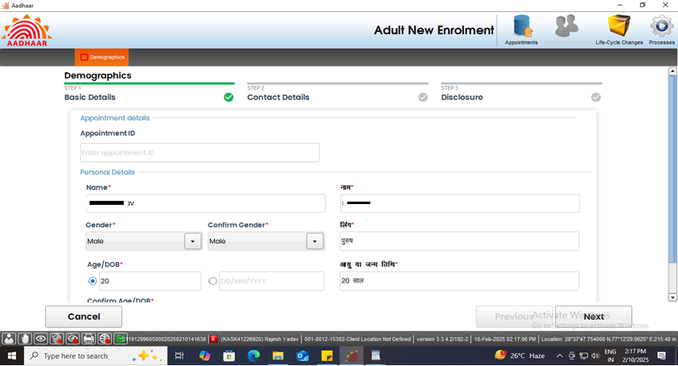
Document based enrolment
Step-3
Enter basic demographic details of the resident like Name, Gender, Age, etc. and confirm the same. Click Next

Slide 33
Document based enrolment
Step-4
Record address of the resident. Fields with (*) mark (pin code, state, district and post office) are mandatory. Click Next

Slide 34
Document based enrolment
Step-5
Record consent of the applicant by selecting check box and click next

Slide 35
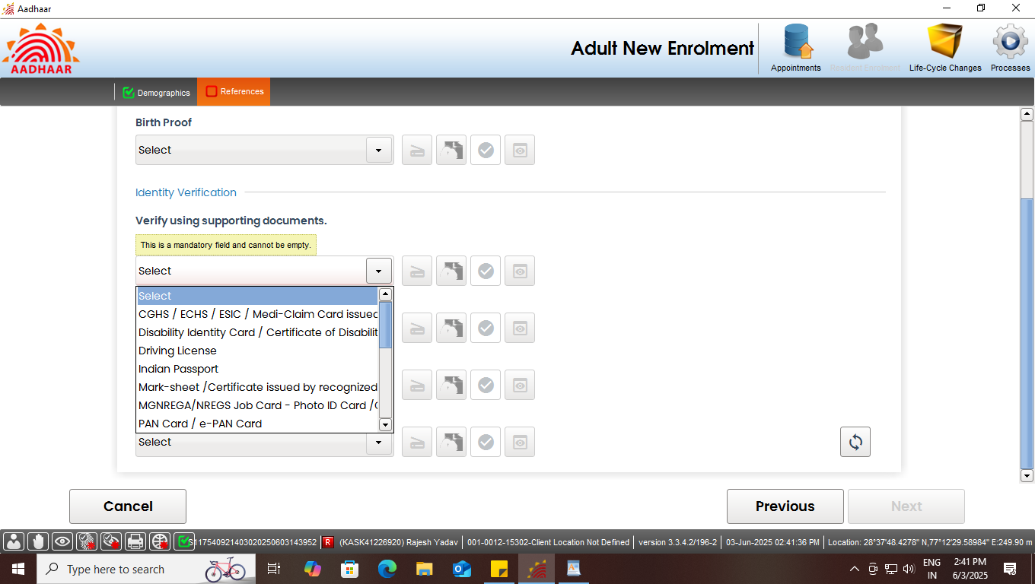
Document based enrolment
Step-6
In continuation, the supporting documents needs to be add by the operator as per the given list for Proof of Identification (POI).

Slide 36
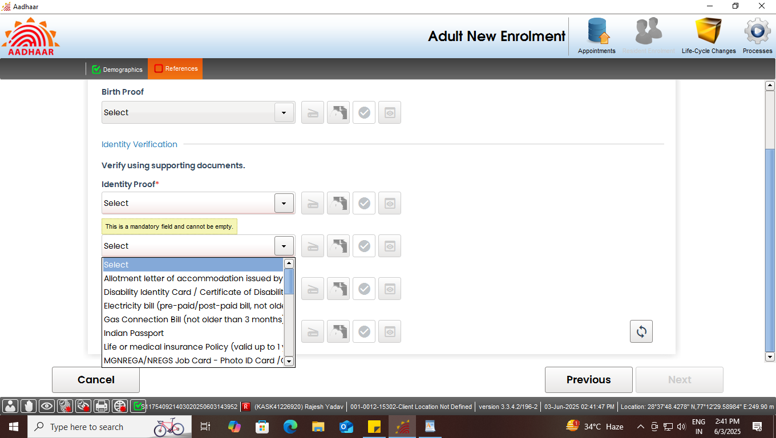
Document based enrolment
Step-7
List of supporting documents for Proof of Address (POA) of the Resident.

Slide 37
Document based enrolment
Step-8
Similarly upload all the valid documents.
Click here to scan the documents

Slide 38
Document based enrolment
Step-9
Preview of the scanned document would appear, operator has to check the scanned document properly before upload.

Slide 39
Document based enrolment
Step-10
Similarly upload all the valid documents. After the scanning is done successfully "Green Tick" symbol indicates that the upload to backend service is successful. Click next.
Documents scan successfully

Slide 40
Document based enrolment
Step-11
Capture face of the applicant as per process and click next

Slide 41
Document based enrolment
Step-12
Capture the fingerprints of the resident and click next

Slide 42
Document based enrolment
Step-13
Capture both iris of the resident and click next

Slide 43
Document based enrolment
Step-14
Request the applicant to verify all the entered details, in the review page. After the operator’s confirmation, the details cannot be changed.

Slide 44
Document based enrolment
Step-15
The operator should confirm that the entered details are correct by providing his/her biometrics.

Slide 45
Document based enrolment
Step-16
After the confirmation, operator can preview the acknowledgement slip.

Slide 46
Document based enrolment
Step-17
See the Preview of acknowledgement slip and take the print-out for uploading the same.

Slide 47
Document based enrolment
Step-18
Scan and upload the signed enrolment form filled by the resident.

Slide 48
Document based enrolment
Step-19
After uploading the enrolment form and acknowledgement slip submit button will be enabled. After successful submission of enrolment request following message will be displayed showing completion of the transaction.

Slide 49
Thank You

