Slide 1
Child Enrolment- Indian Resident (Below 5 Years)

Slide 2
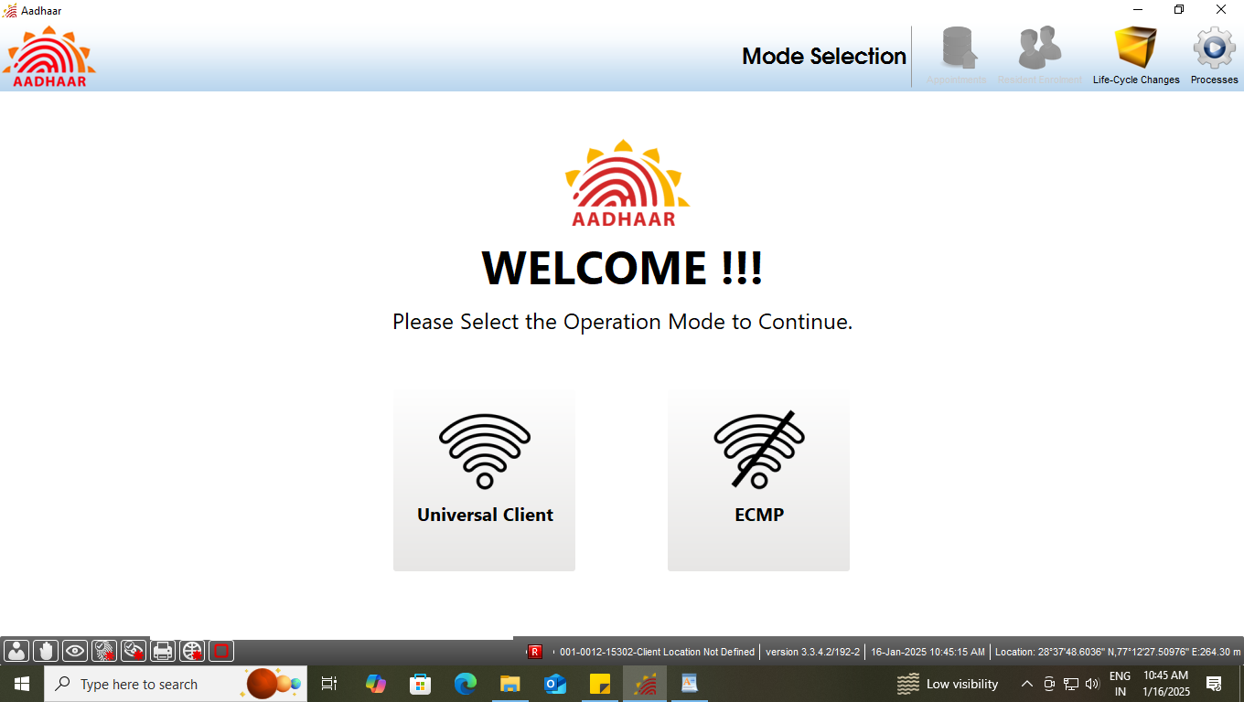
Step-1
Please ensure that the client is connected to internet, then Operator select the option ‘Universal Client’ in Mode Selection

Slide 3
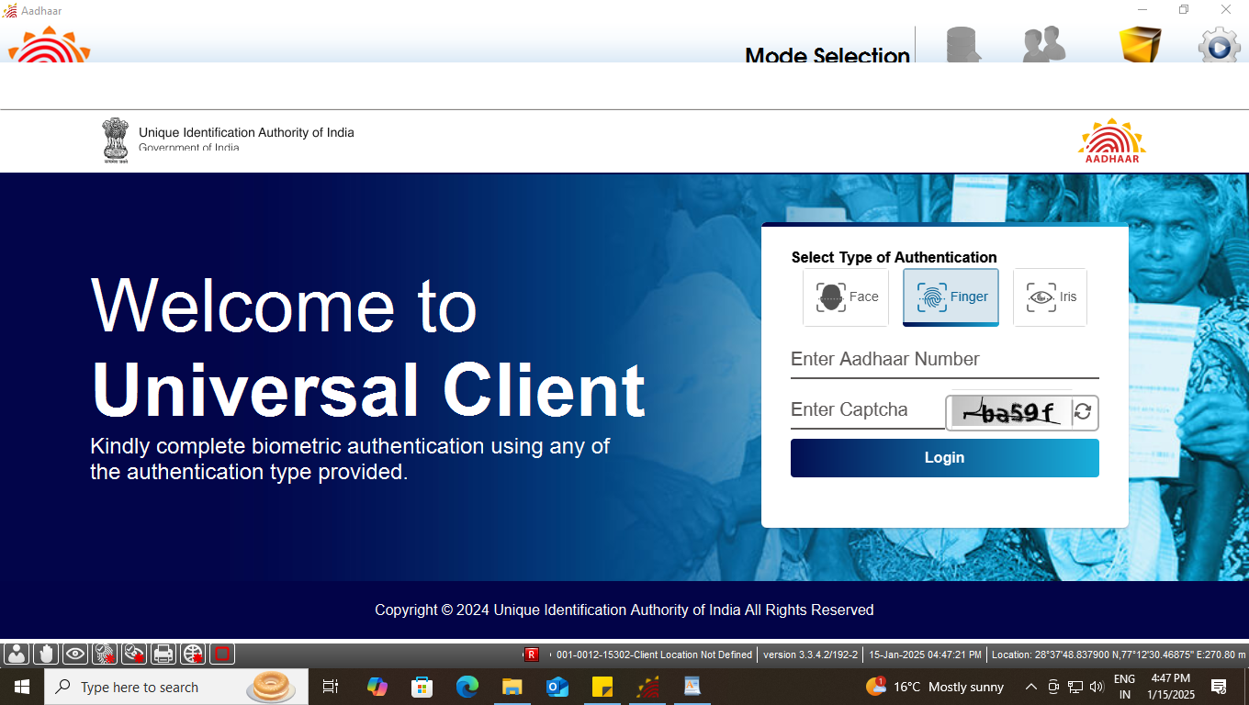
Step-2
Universal Client login page will appear, Operator needs to enter his/her ‘Aadhaar Number’ and ‘CAPTCHA’ for login

Slide 4
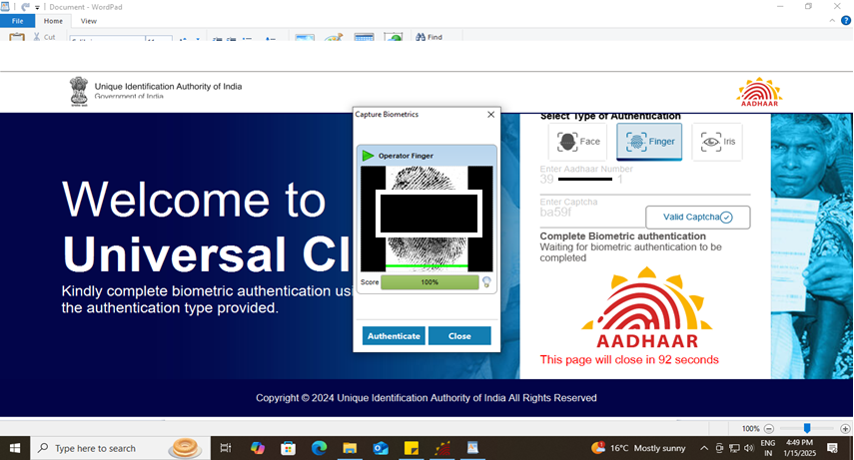
Step-3
Operator needs to give his/her ‘biometric’ for authentication.

Slide 5
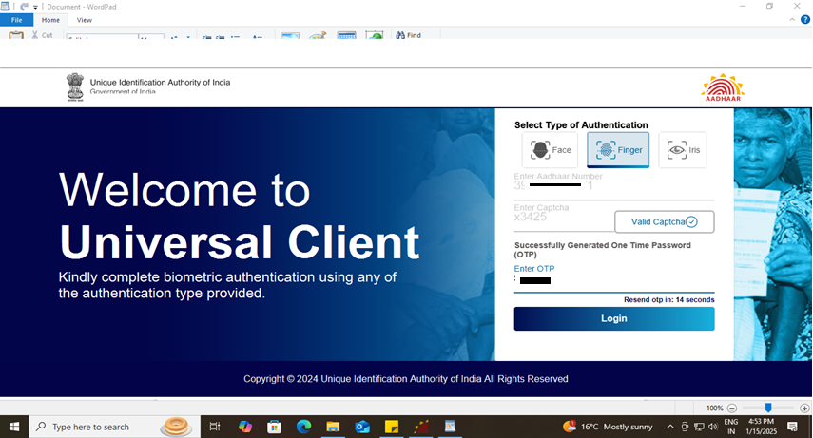
Step-4
After biometric authentication operator received an ‘OTP’, Further, Operator will enter the received OTP to proceed.

Slide 6
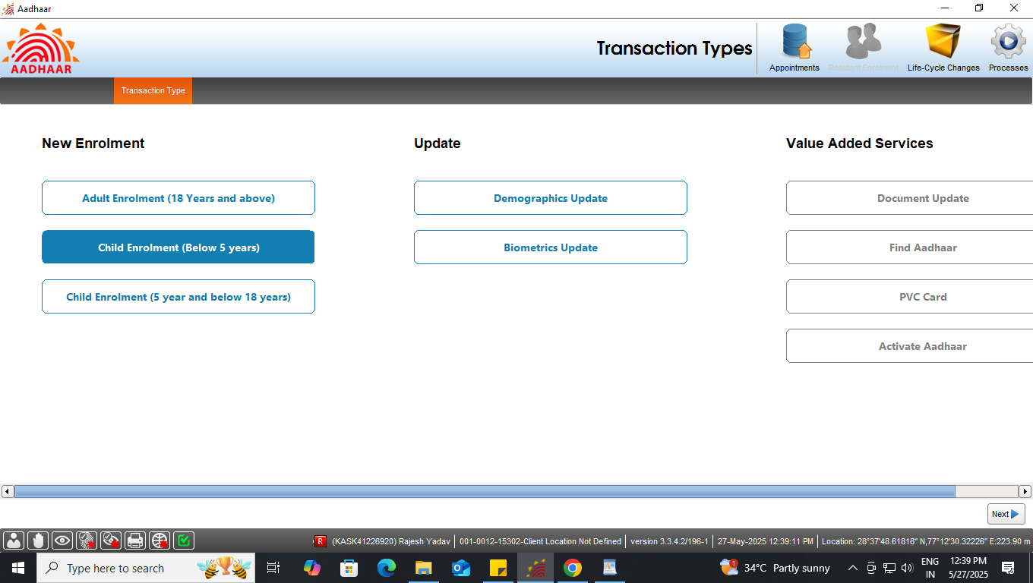
Step-5
Select ‘Child enrolment (Below 5 Years)’ under new enrolment option, click next

Slide 7
Types of Enrolment
Enrolment Type
Document Based Enrolment
Resident having Proof of Birth
Resident not have Proof of Birth
Head of Family (HoF) Based Enrolment
Enrolment without BRN
Enrolment with BRN

Slide 8
Document based enrolment
Case One:
Resident having Proof of Birth

Slide 9
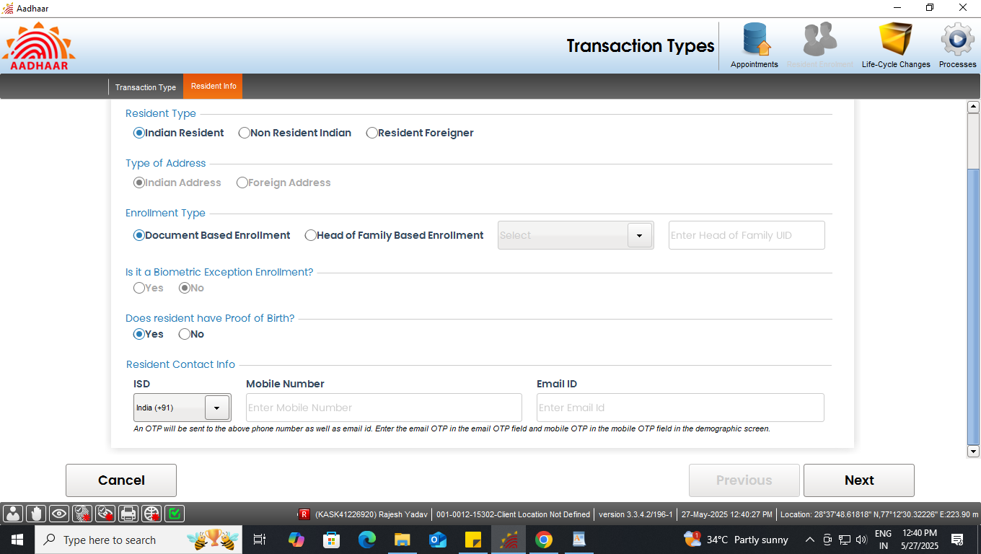
Document based enrolment
Document based enrolment
Step-1
Select “Indian Resident” radio button in resident type option. Further, In enrolment type select “Document Based enrolment”. If resident having proof of Birth then select ‘Yes’.
Select ‘Yes’ if having proof of birth

Slide 10
Document based enrolment
Document based enrolment
Step-2
For Indian Resident enrolment, E-Mail id and Mobile no. are optional. However operator can fill the same if the resident has filled the E-Mail id and Mobile no. in enrolment form.
For Indian Resident enrolment, Email Id and Phone no. are optional

Slide 11
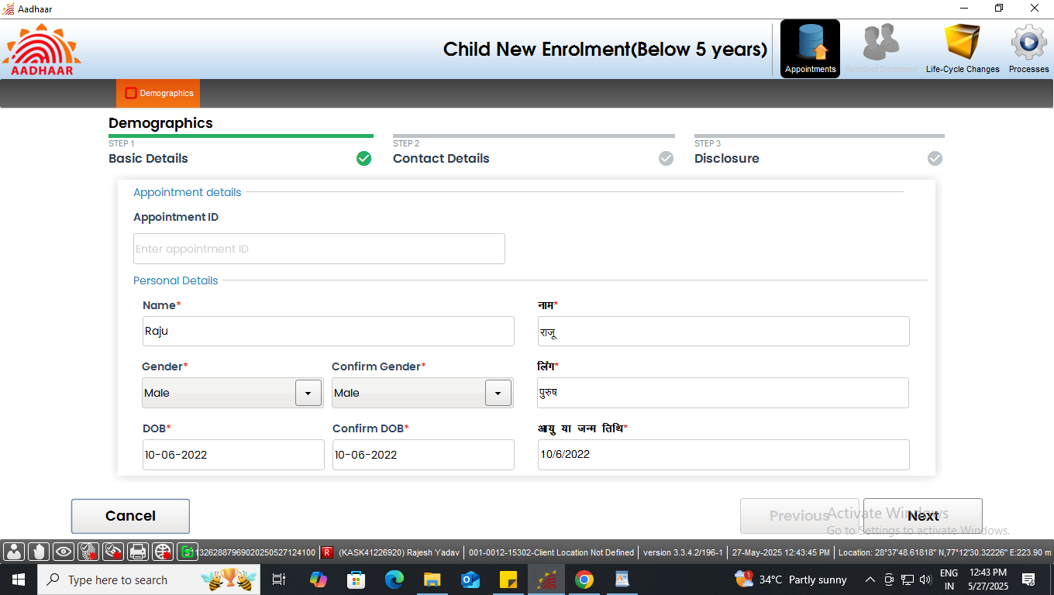
Document based enrolment
Document based enrolment
Step-3
Enter basic demographic details of the resident like Name, Gender, Date of Birth (DOB) and confirm the same. Click Next

Slide 12
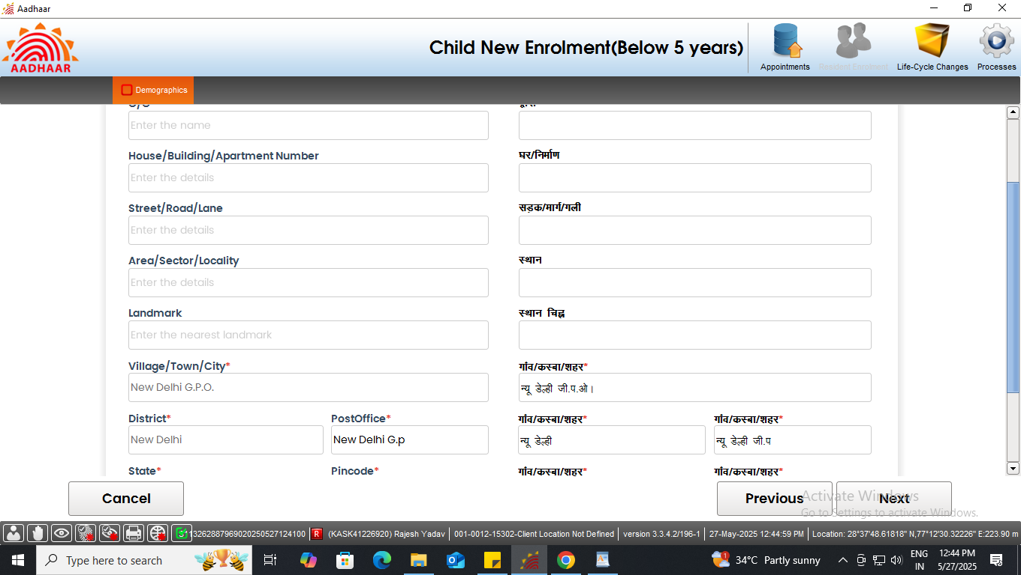
Document based enrolment
Document based enrolment
Step-4
In contact details, enter the relevant details of the resident like Pin code, Village/Town/City, District, Post Office etc. Click Next

Slide 13
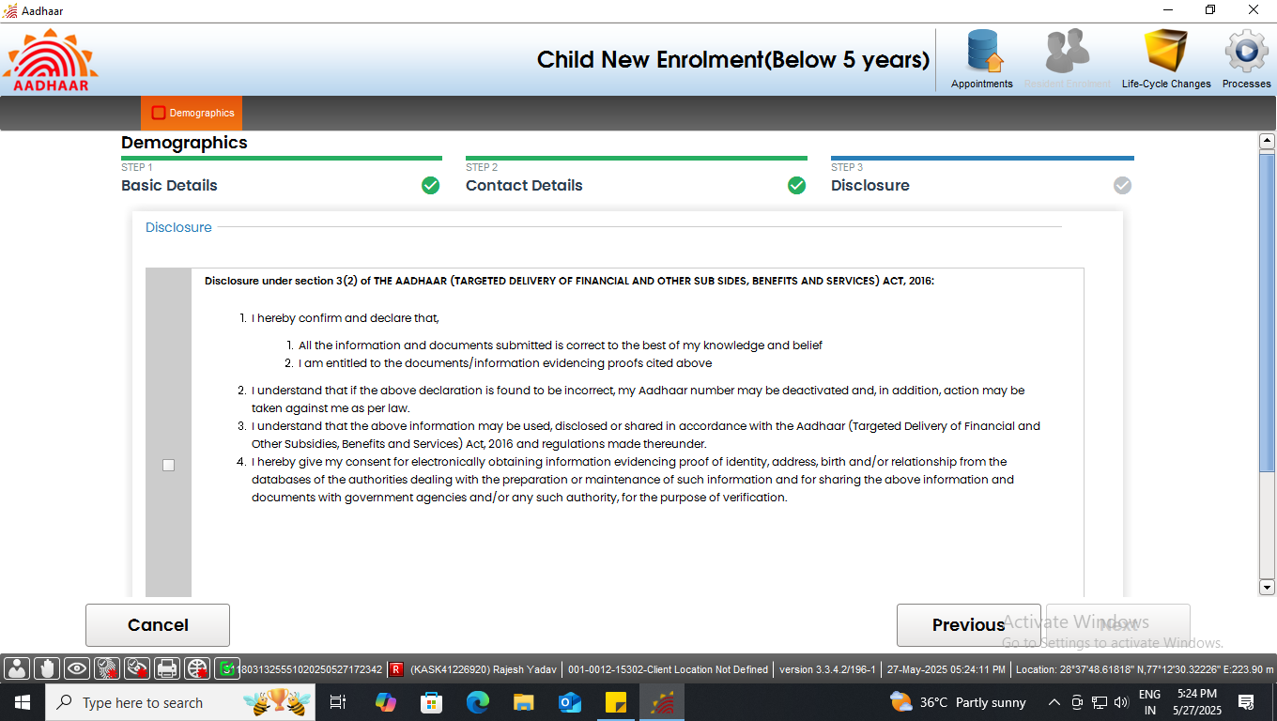
Document based enrolment
Document based enrolment
Step-5
Request resident to read the disclosure and give their consent by selecting check box, Click Next

Slide 14
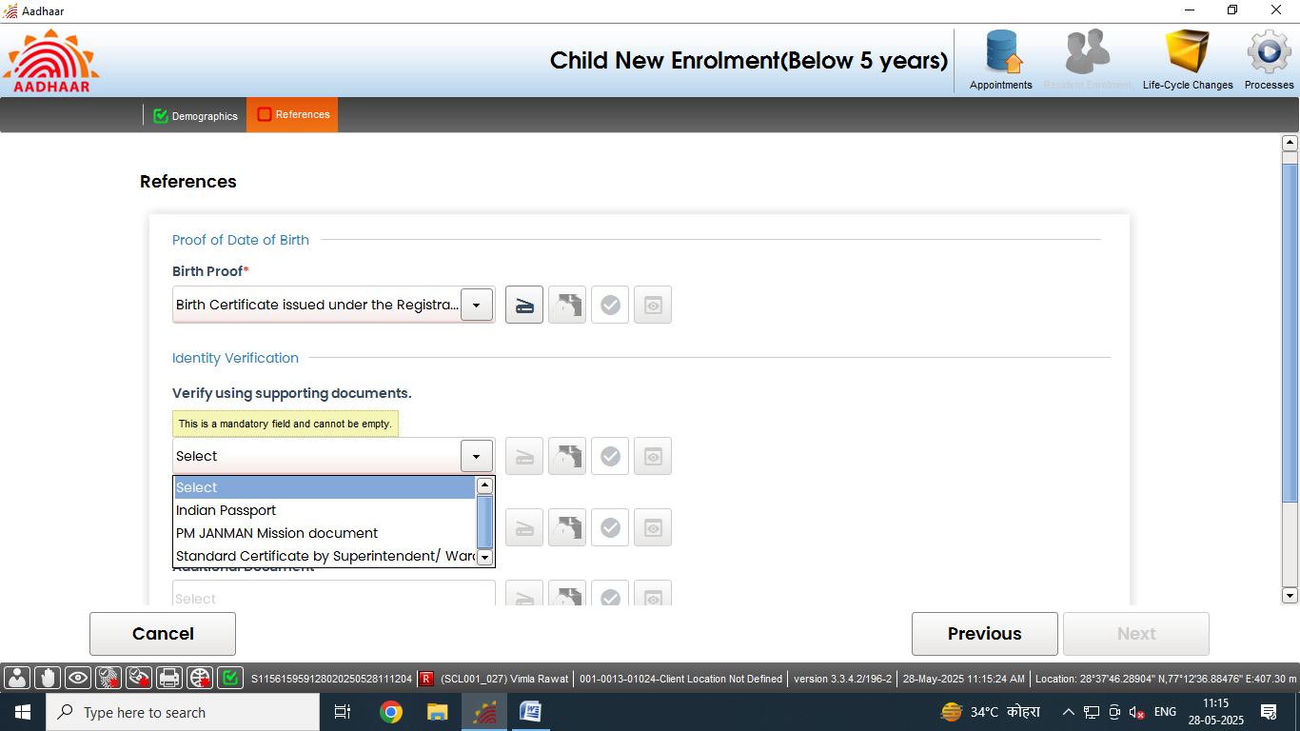
Document based enrolment
Document based enrolment
Step-6
1. Scan and upload Proof of Date of Birth.
2. Further, Select Proof of Identification (POI) of the Resident as per the ‘List of supporting documents for Enrolment and Update’.

Slide 15
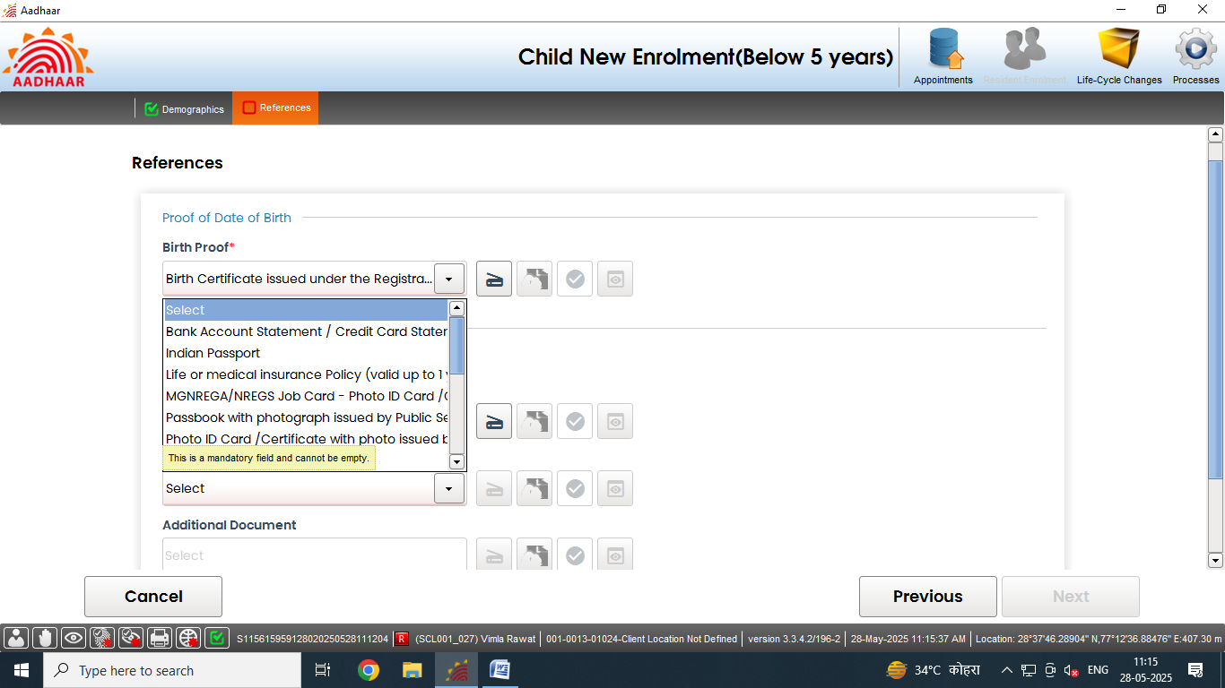
Document based enrolment
Document based enrolment
Step-7
Select Proof of Address (POA) of the Resident as per the ‘List of supporting documents for Enrolment and Update’.

Slide 16
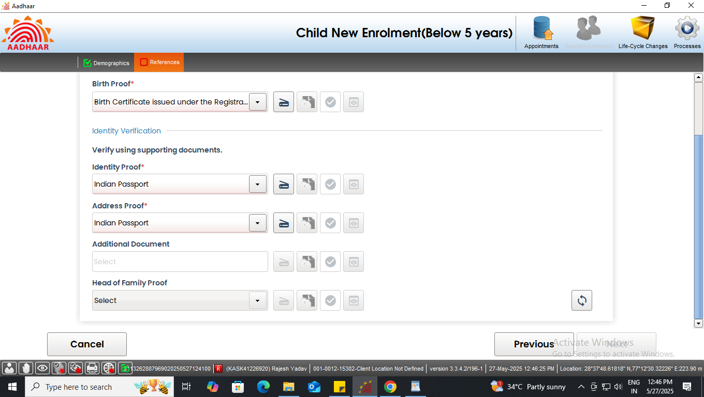
Document based enrolment
Document based enrolment
Step-8
Operator now click on the scan button to scan the valid documents.
Click here to scan the documents

Slide 17
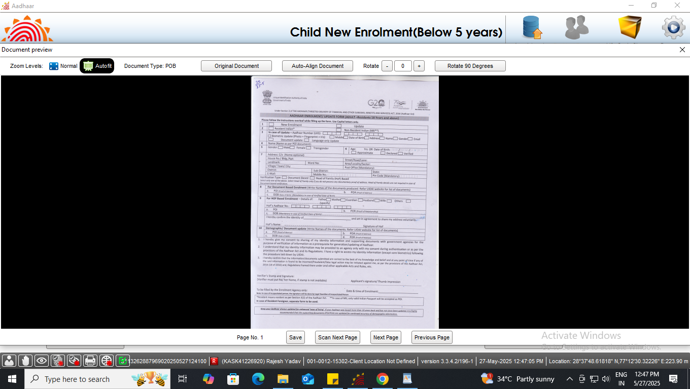
Document based enrolment
Document based enrolment
Step-9
Preview of the scanned document would appear, operator shall check the document preview. Click on save

Slide 18
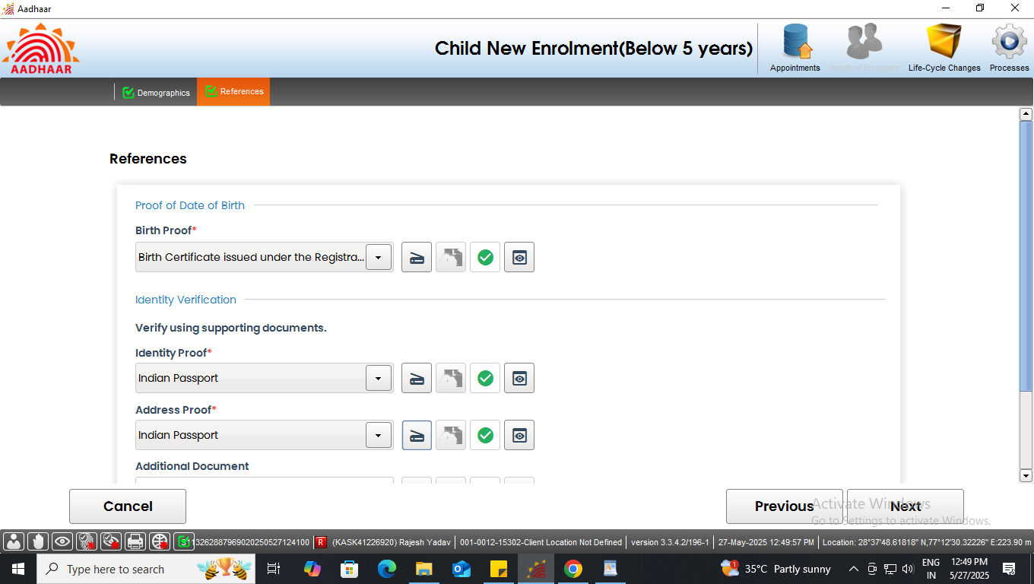
Document based enrolment
Document based enrolment
Step-10
Similarly upload all the valid documents. After the scanning is done successfully a ‘Green tick’ will appear for validation of the document. Click next
Documents uploaded successfully

Slide 19
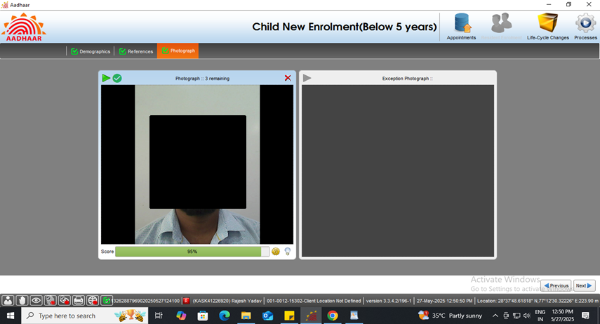
Document based enrolment
Document based enrolment
Step-11
Capture the face of the resident, click next

Slide 20
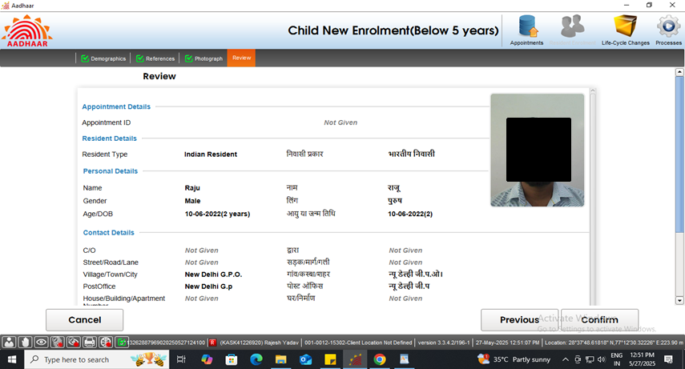
Document based enrolment
Document based enrolment
Step-12
The residents will verify all the entered details in the review page. After the operator’s confirmation, the details cannot be changed.

Slide 21
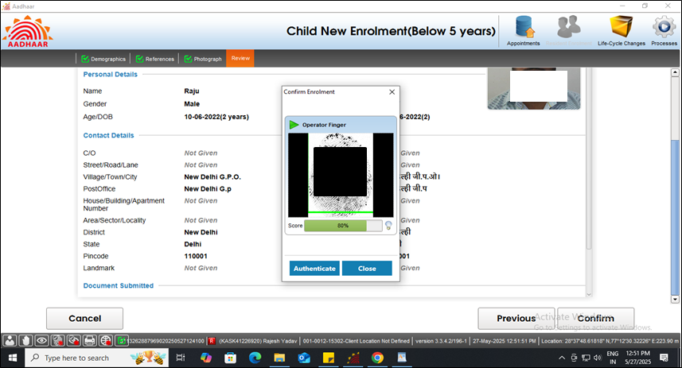
Document based enrolment
Document based enrolment
Step-13
The operator will confirm that the entered details are correct by providing his/her biometrics.

Slide 22
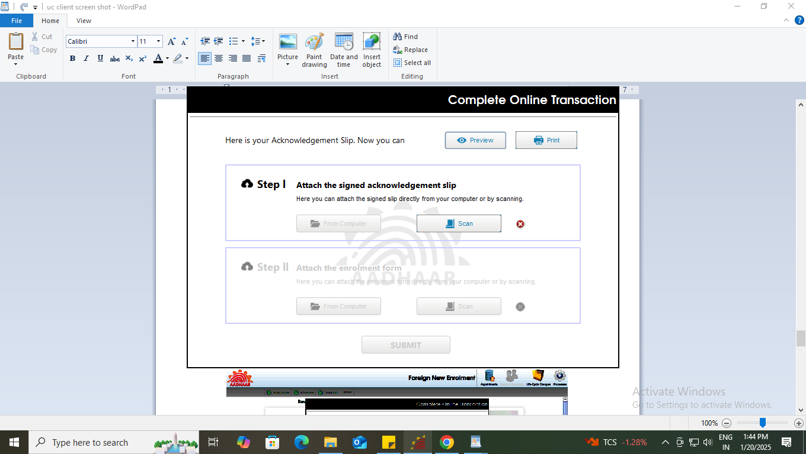
Document based enrolment
Document based enrolment
Step-14
After the confirmation, operator can preview the acknowledgement slip.

Slide 23
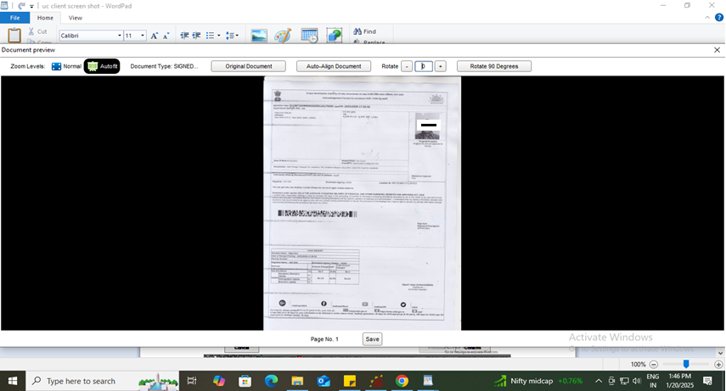
Document based enrolment
Document based enrolment
Step-15
See the Preview of acknowledgement slip and take the print-out for uploading the same

Slide 24
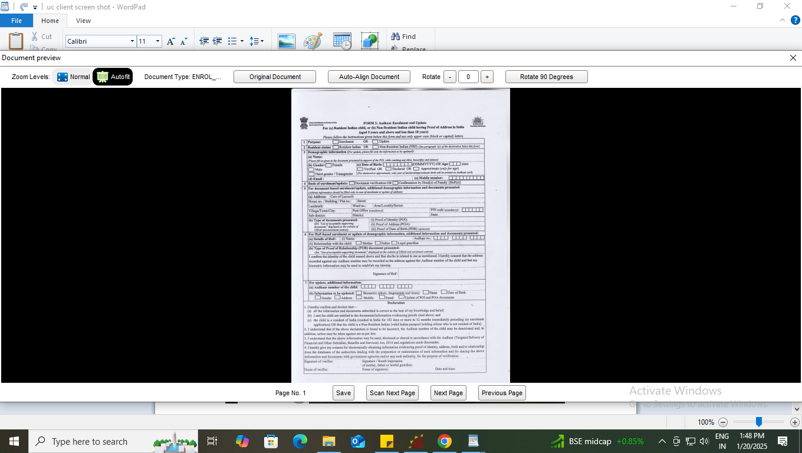
Document based enrolment
Document based enrolment
Step-16
Scan and upload the signed enrolment form filled by the resident

Slide 25
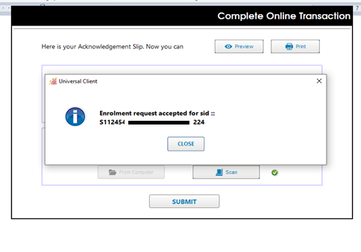
Document based enrolment
Document based enrolment
Step-17
After uploading the enrolment form, ‘Submit’ button will be enabled, after successful submission of enrolment request following message will be displayed.

Slide 26
Document based enrolment
Document based enrolment
Case Two:
Resident not having Proof of Birth

Slide 27
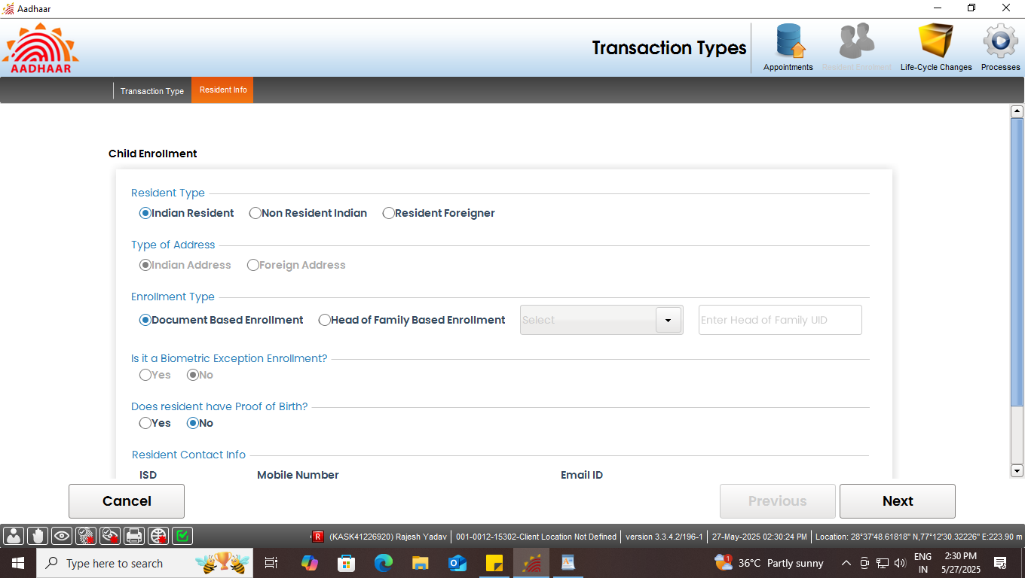
Document based enrolment
Document based enrolment
Step-1
In case resident doesn’t have proof of Birth, then select ‘No’ and Click next.
Select ‘No’ if resident doesn’t have proof of birth

Slide 28
Document based enrolment
Document based enrolment
Step-2
Enter basic demographic details of the resident like Name, Gender, Date of Birth and confirm the same. Click Next

Slide 29
Document based enrolment
Document based enrolment
Step-3
In contact details, enter the relevant details of the resident like Pin code, Village/Town/City, District, Post Office etc. Click Next

Slide 30
Document based enrolment
Document based enrolment
Step-4
Request resident to read the disclosure and give their consent by selecting check box, Click Next

Slide 31
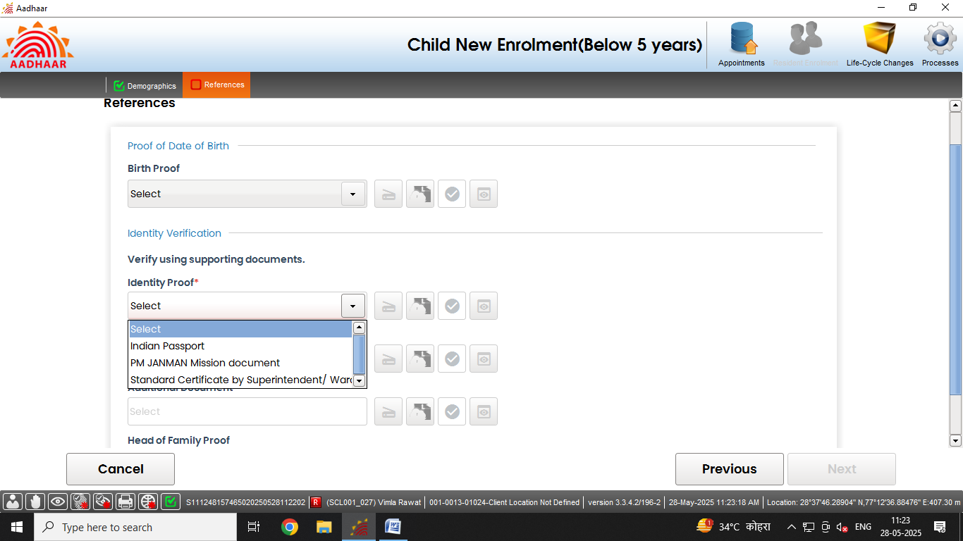
Document based enrolment
Document based enrolment
Step-5
Select Proof of Identity (POI) of the Resident as per the ‘List of supporting documents for Enrolment and Update’ and click on the scan button to scan the valid documents.

Slide 32
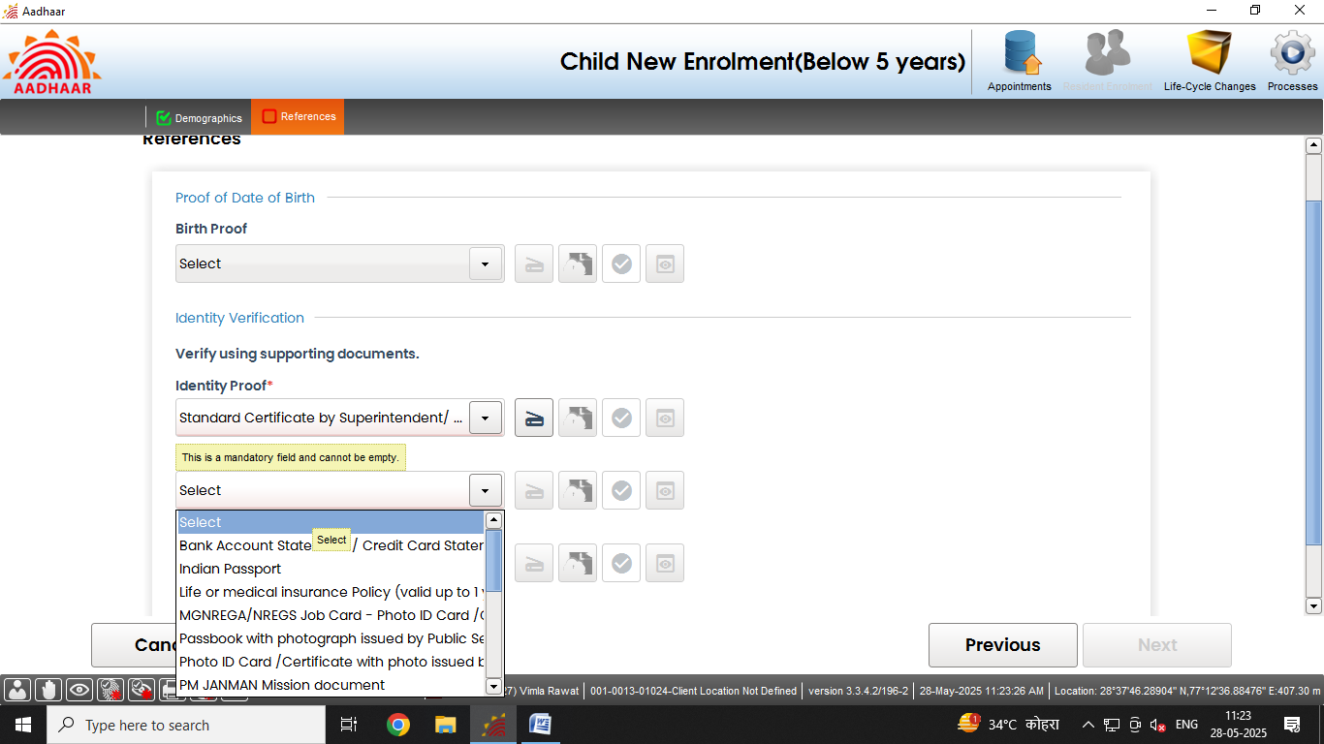
Document based enrolment
Document based enrolment
Step-6
Select Proof of Address (POA) of the Resident as per the ‘List of supporting documents for Enrolment and Update’.
and click on the scan button to scan the valid documents.

Slide 33
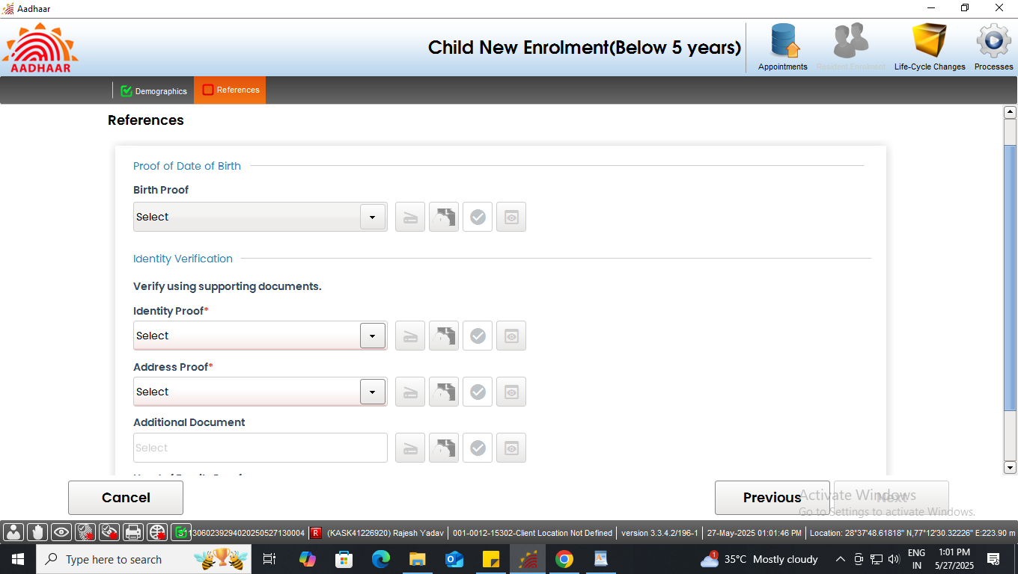
Document based enrolment
Document based enrolment
Step-7
Operator shall upload required document and click on the scan button to scan the valid documents.
Click here to scan the documents

Slide 34
Document based enrolment
Document based enrolment
Step-8
Preview of the scanned document would appear, operator shall check the document preview. Click on save

Slide 35
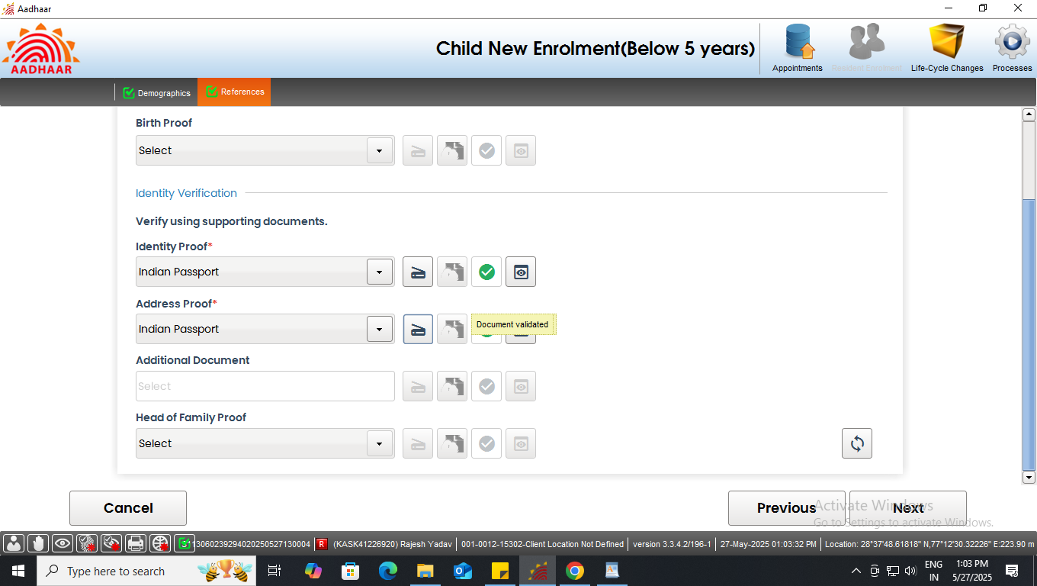
Document based enrolment
Document based enrolment
Step-9
Similarly upload all the valid documents. After the scanning is done successfully a ‘green tick’ will appear for validation of the document. Click next
Documents uploaded successfully

Slide 36
Document based enrolment
Document based enrolment
Step-10
Capture the face of the resident, click next

Slide 37
Document based enrolment
Document based enrolment
Step-11
The residents will verify all the entered details, in the review page. After the operator’s confirmation, the details cannot be changed.

Slide 38
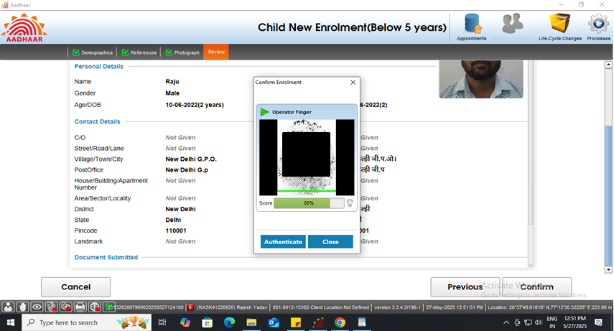
Document based enrolment
Document based enrolment
Step-12
The operator will confirm that the entered details are correct by providing his/her biometrics.

Slide 39
Document based enrolment
Document based enrolment
Step-13
After the confirmation, operator can preview the acknowledgement slip.

Slide 40
Document based enrolment
Document based enrolment
Step-14
See the Preview of acknowledgement slip and take the print-out for uploading the same

Slide 41
Document based enrolment
Document based enrolment
Step-15
Scan and upload the signed enrolment form filled by the resident

Slide 42
Document based enrolment
Document based enrolment
Step-16
After uploading the enrolment form ‘submit’ button will be enabled, after successful submission of enrolment request following message will be displayed.

Slide 43
Head of Family (HoF) based enrolment

Slide 44
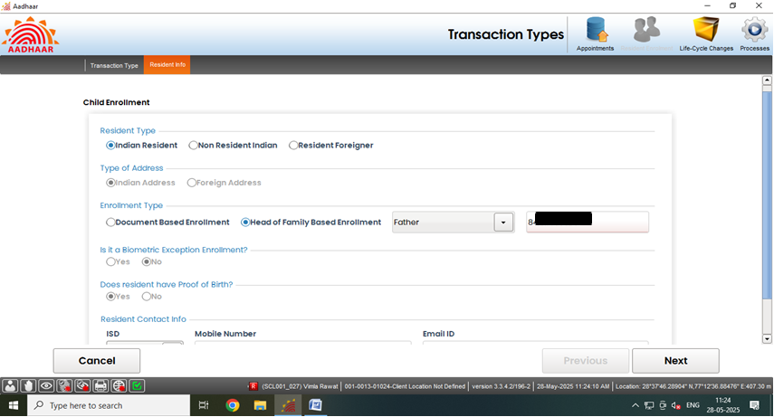
HoF based Enrolment (without BRN)
HoF based enrolment (without BRN)
Step 1
Select enrolment type “Head of Family Based Enrolment”, then select HoF (i.e. Father, Mother and Legal Guardian) from drop-down list and fill their Aadhaar details. Then click Next

Slide 45
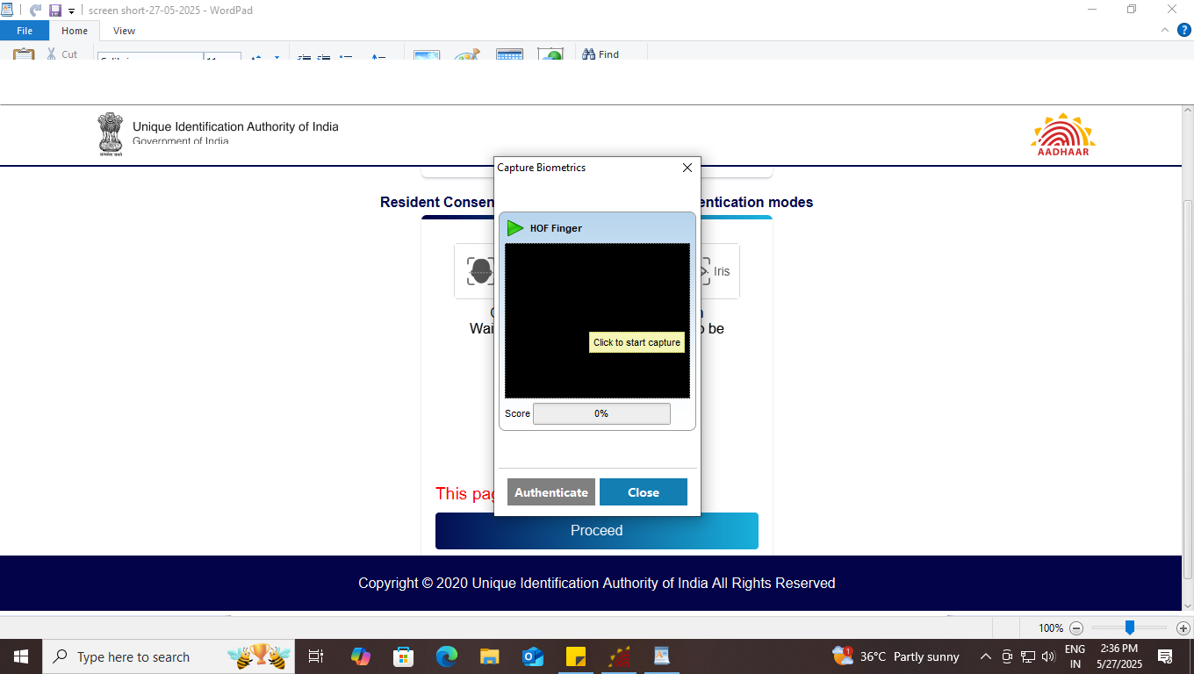
HoF based Enrolment (without BRN)
HoF based enrolment (without BRN)
Step 2
Authentication window will Pop-Up, Operator now take the resident consent via any Biometric Authentication mode (i.e. Face/Finger/Iris).

Slide 46
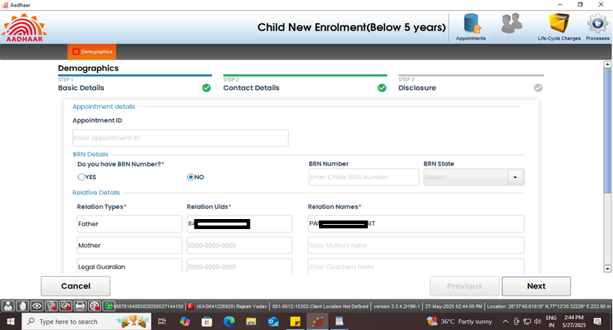
HoF based Enrolment (without BRN)
HoF based enrolment (without BRN)
Step 3
After filling out the HoF Aadhaar details, the data will be auto populated in relative details. In case BRN number is not available. Select ‘No’.

Slide 47
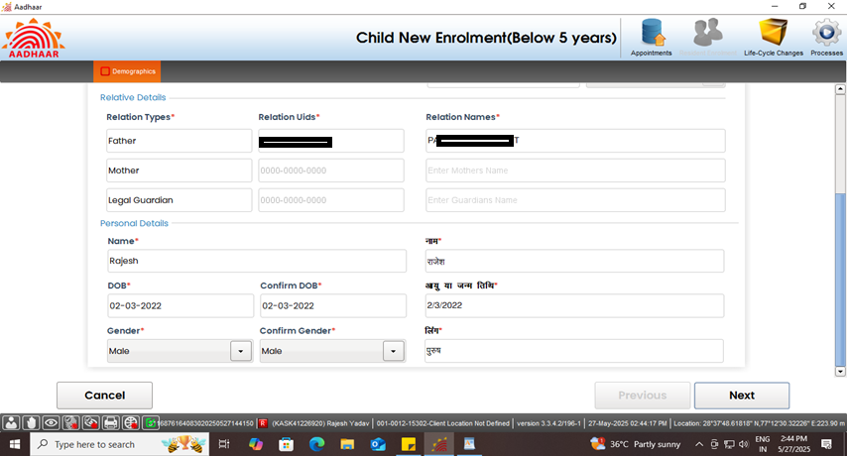
HoF based Enrolment (without BRN)
HoF based enrolment (without BRN)
Step 4
Operator needs to fill the personal details like Name, DOB and Gender and confirm the same and click next.

Slide 48

HoF based Enrolment (without BRN)
HoF based enrolment (without BRN)
Step 5
In contact details, details like Pin code, Village/Town/City, District, Post Office auto pulled from HoF Aadhaar. Click Next

Slide 49
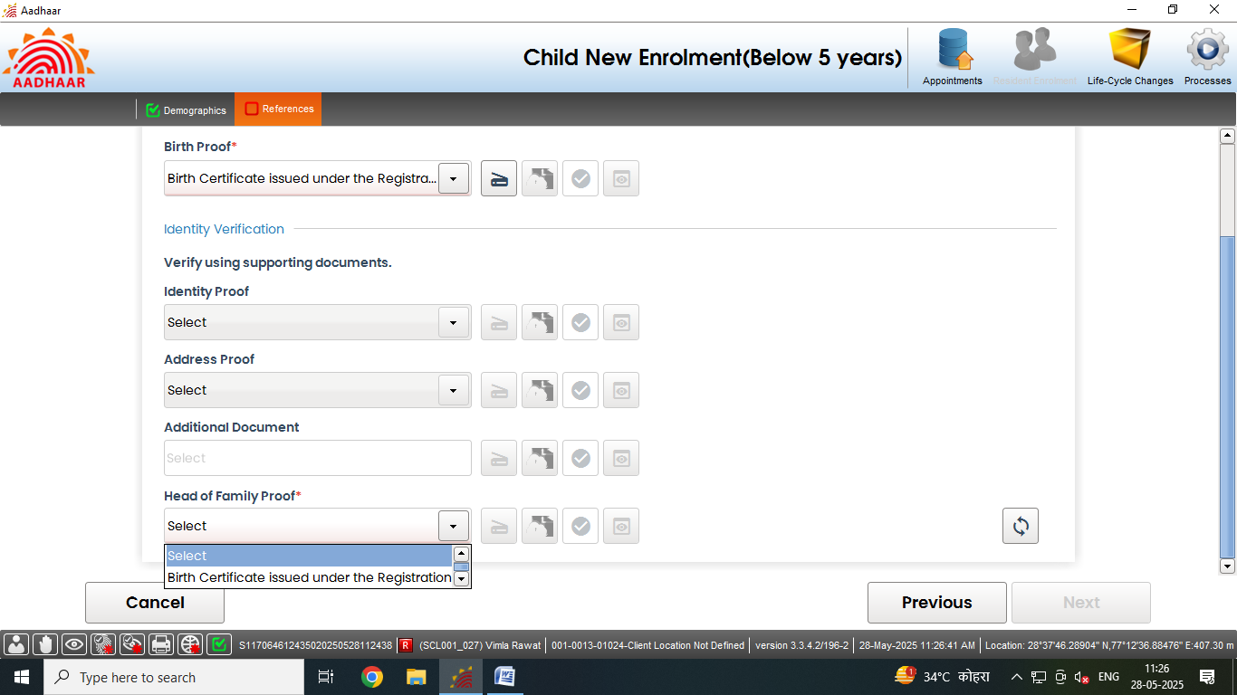
HoF based Enrolment (without BRN)
HoF based enrolment (without BRN)
Step 6
Operator will upload required document ad click on the scan button to scan the valid documents.
Click here to scan the required document

Slide 50
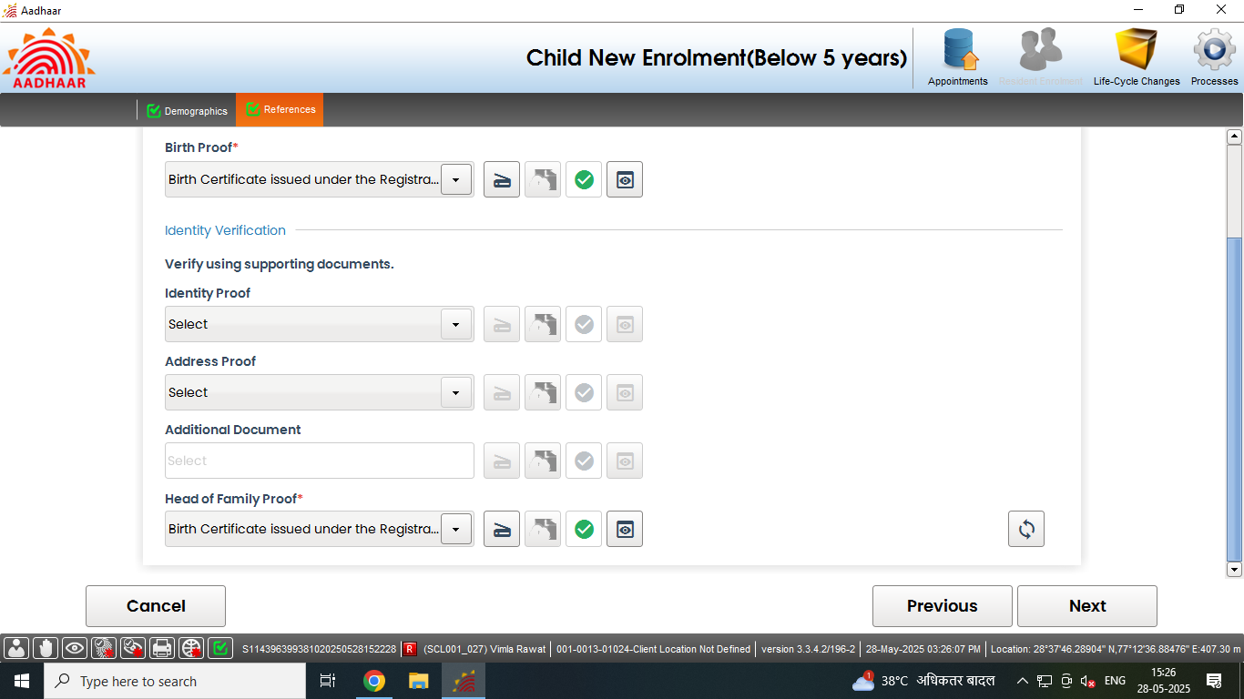
HoF based Enrolment (without BRN)
HoF based enrolment (without BRN)
Step 7
Accordingly upload all the valid documents. After the scanning is done successfully a ‘green tick’ will appear for validation of the document. Click next
Document uploaded successfully

Slide 51
HoF based Enrolment (without BRN)
Document based enrolment
Step-8
Capture the face of the resident, click next

Slide 52
HoF based Enrolment (without BRN)
Document based enrolment
Step-9
The residents will verify all the entered details, in the review page. After the operator’s confirmation, the details cannot be changed.

Slide 53
HoF based Enrolment (without BRN)
Document based enrolment
Step-10
The operator will confirm that the entered details are correct by providing his/her biometrics.

Slide 54
HoF based Enrolment (without BRN)
Document based enrolment
Step-11
After the confirmation, operator can preview the acknowledgement slip.

Slide 55
HoF based Enrolment (without BRN)
Document based enrolment
Step-12
See the Preview of acknowledgement slip and take the print-out for uploading the same

Slide 56
HoF based Enrolment (without BRN)
Document based enrolment
Step-13
Scan and upload the signed enrolment form filled by the resident

Slide 57
HoF based Enrolment (without BRN)
Document based enrolment
Step-14
After uploading the enrolment form, ‘Submit’ button will be enabled, after successful submission of enrolment request following message will be displayed.

Slide 58
Thank You

