Slide 1
Child Enrolment - Indian Resident (5 years and below 18 years)

Slide 2
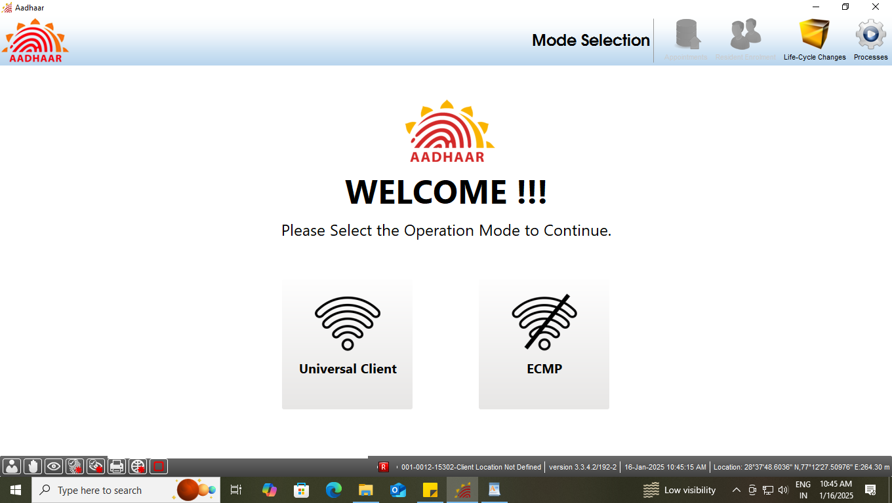
Step-1
Please ensure that the client is connected to internet, then Operator select the option ‘Universal Client’ in Mode Selection.

Slide 3
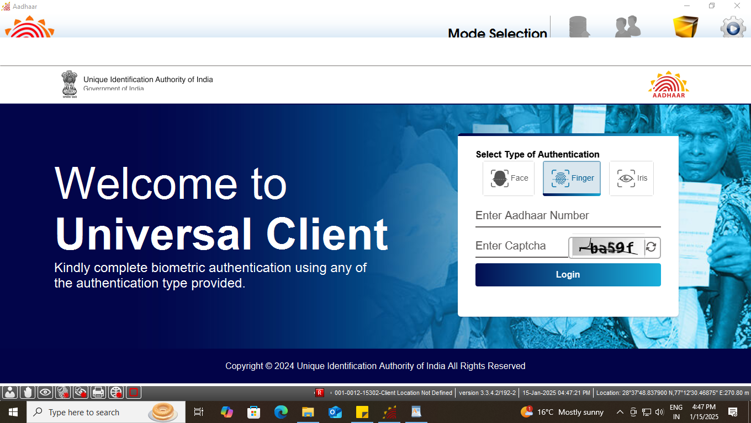
Step-2
Universal Client login page will appear, Enter the ‘Aadhaar Number’ and ‘CAPTCHA’ for login

Slide 4
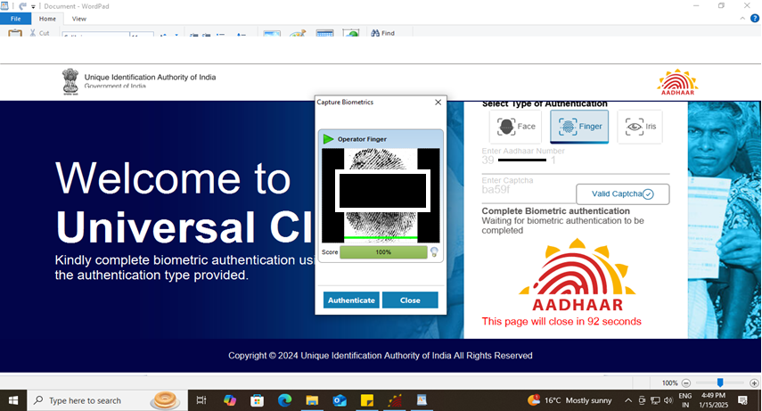
Step-3
Operator needs to give his/her ‘biometric’ for authentication using - fingerprint or Iris.

Slide 5
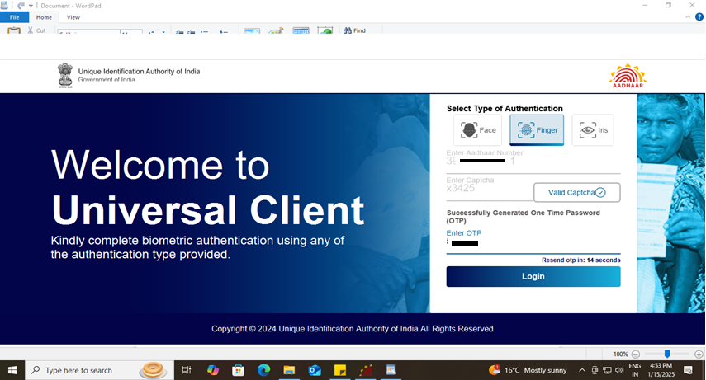
Step-4
After biometric authentication operator received an OTP, Further, Operator will enter the received OTP to proceed.

Slide 6
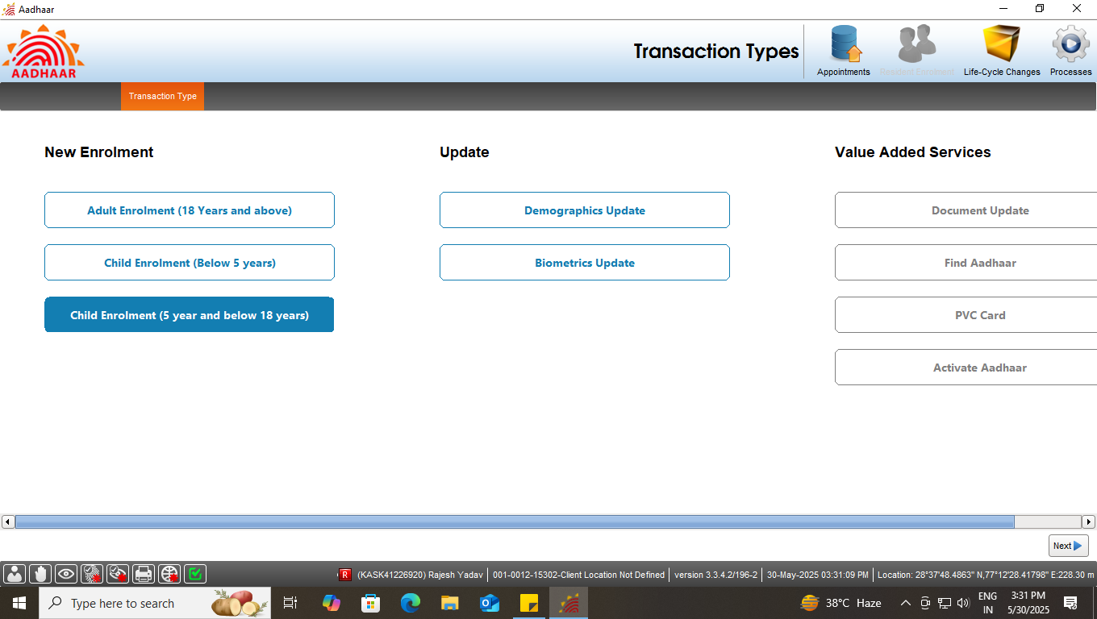
Step-5
Select the ‘Child Enrolment (5 year and below 18 years)’ tab under new enrolment option, then click next

Slide 7
Type of Enrolment
Enrolment Type
Document based enrolment
Resident having Proof of Birth
Resident not having Proof of Birth
Head of Family (HoF) based enrolment

Slide 8
Document based enrolment
Case One
Resident having Proof of Birth

Slide 9
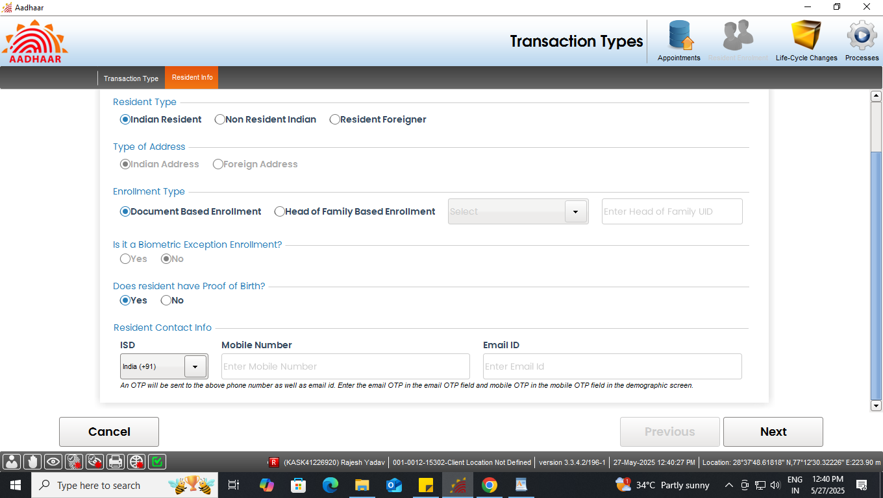
Document based enrolment
Step-1
Select “Indian Resident” radio button in resident type option. Further, In enrolment type select “Document Based enrolment” and Select ‘Yes’ in case resident having proof of Birth.
Select ‘Yes’ if having proof of birth

Slide 10
Document based enrolment
Document based enrolment
Step-2
For Indian Resident enrolment, E-Mail id and Mobile no. are optional. However operator can fill the same if the resident has filled the E-Mail id and Mobile no. in enrolment form.
For Indian Resident enrolment Mobile no. and Email Id details are optional

Slide 11
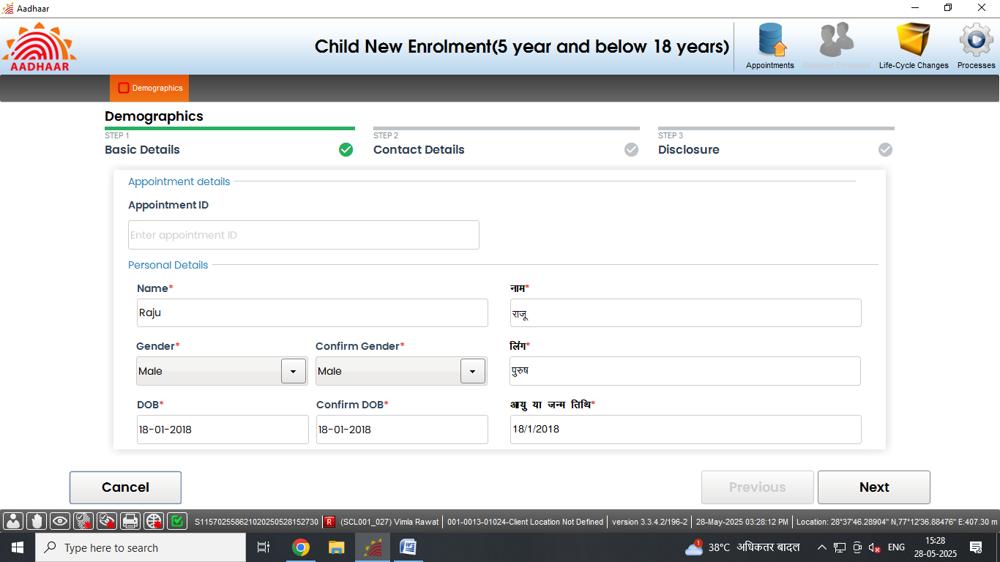
Document based enrolment
Document based enrolment
Step-3
Enter basic details of the resident as per filled submitted form:

Slide 12
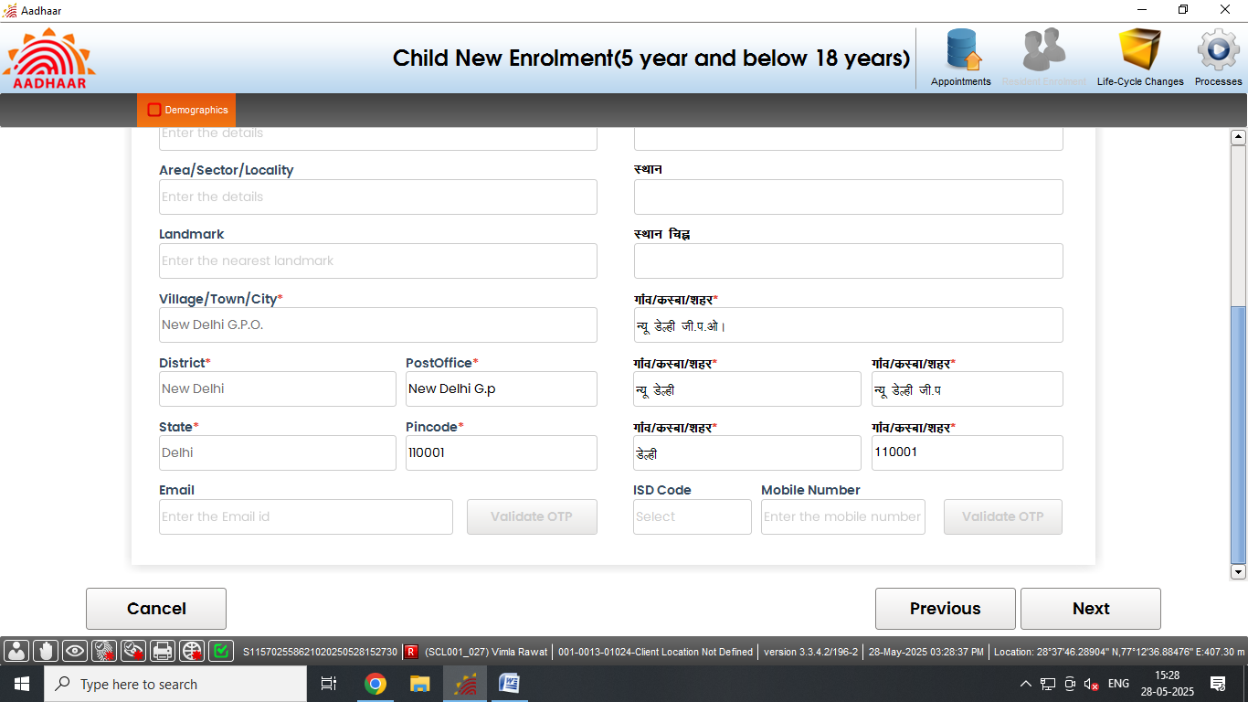
Document based enrolment
Document based enrolment
Step-4
Record address of the resident . Fields with (*) mark (pin code, state, district and post office) are mandatory. Click Next

Slide 13
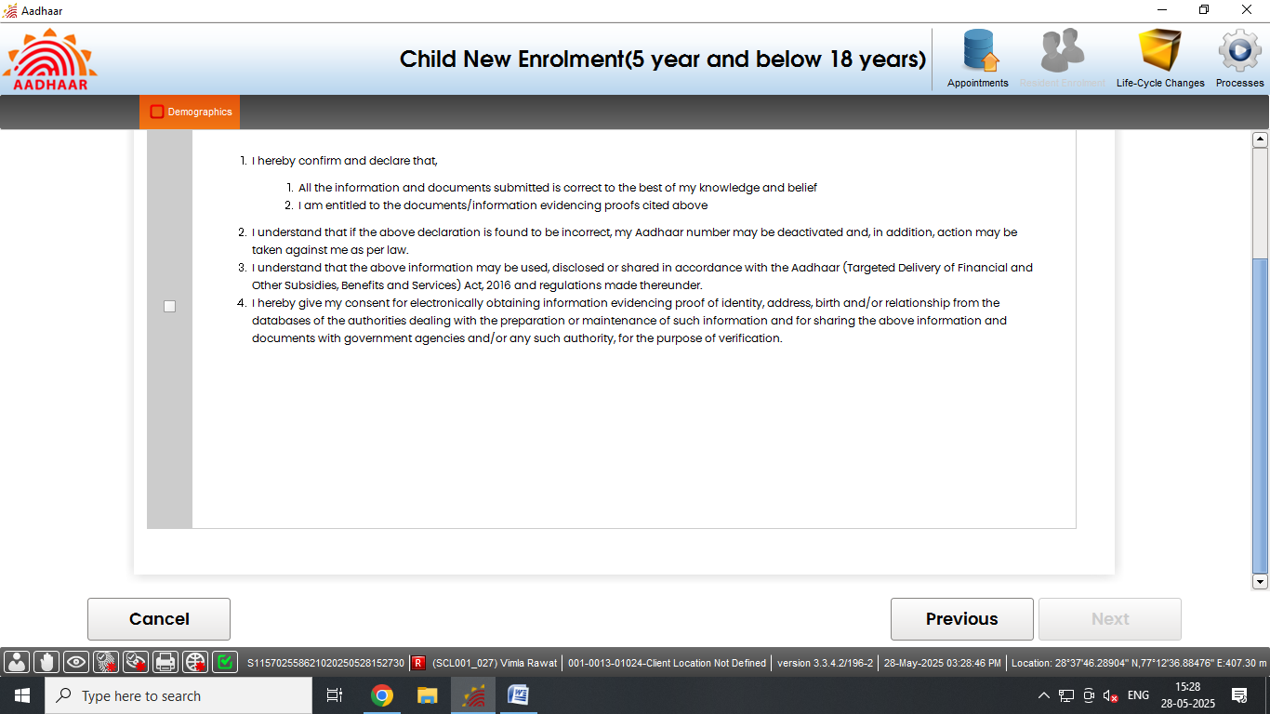
Document based enrolment
Document based enrolment
Step-5
Request resident to read the disclosure and give their consent by selecting check box, Click Next

Slide 14
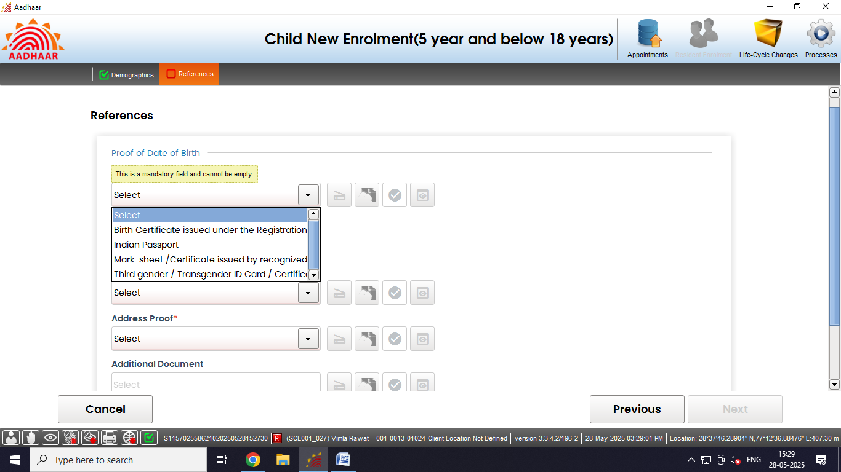
Document based enrolment
Document based enrolment
Step-6
Select and upload Proof of Date of Birth as per the ‘List of supporting documents for Enrolment and Update’.

Slide 15
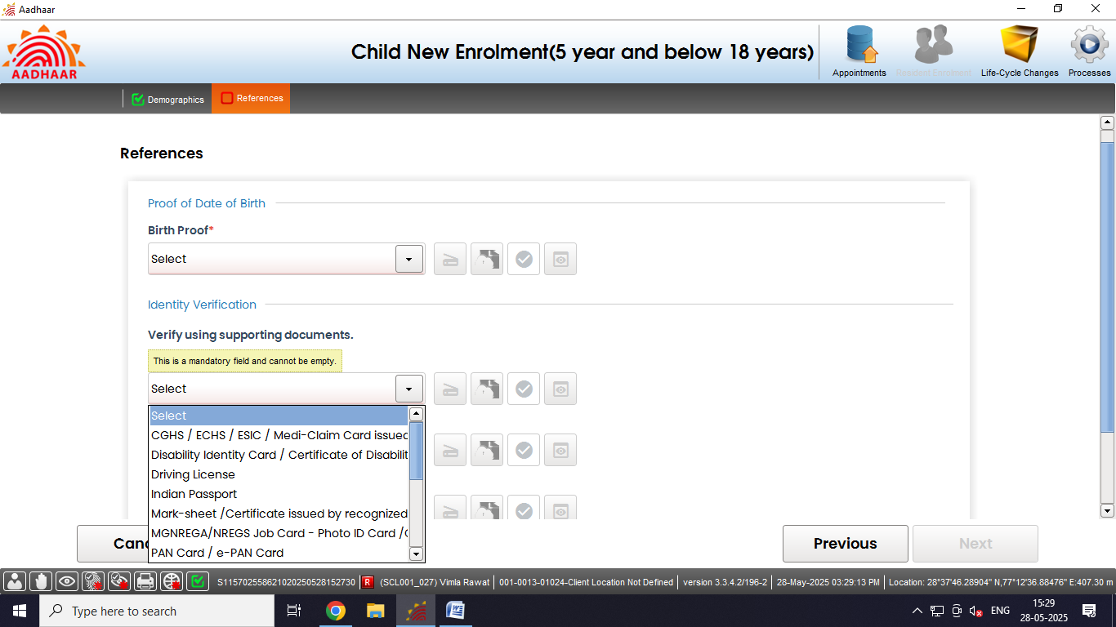
Document based enrolment
Document based enrolment
Step-7
Select Proof of Identification (POI) of the Resident as per the ‘List of supporting documents for Enrolment and Update’.

Slide 16
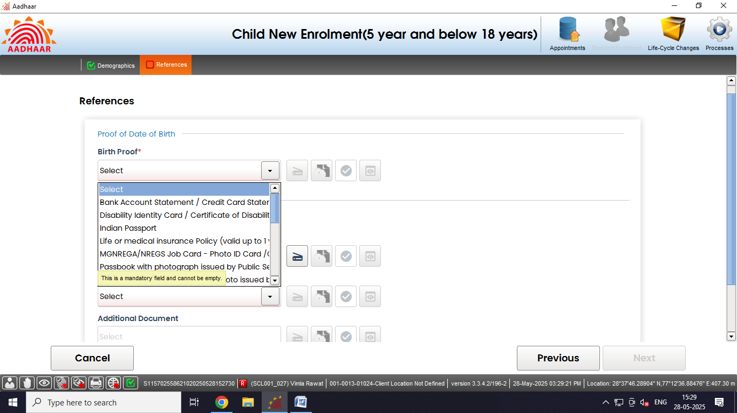
Document based enrolment
Document based enrolment
Step-7 (continued…)
Select Proof of Address (POA) of the Resident as per the ‘List of supporting documents for Enrolment and Update’.
Click here to scan the document

Slide 17
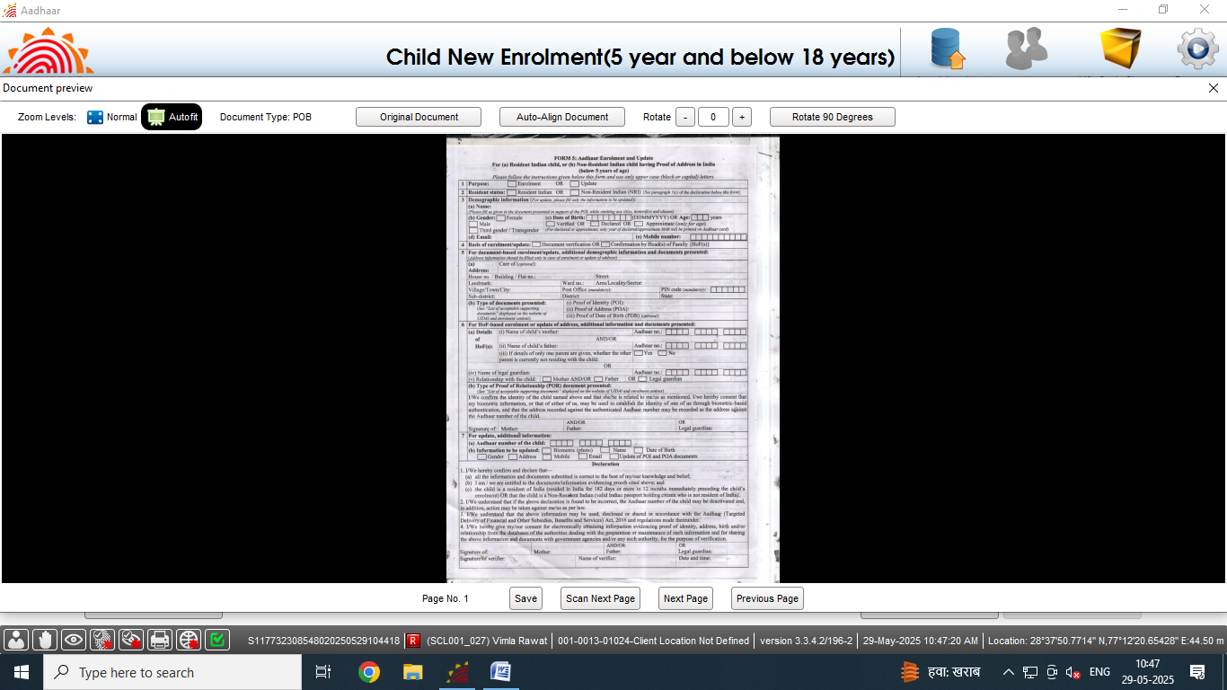
Document based enrolment
Document based enrolment
Step-8
‘Preview’ of the scanned document would appear, operator should check the document preview. Click on save

Slide 18
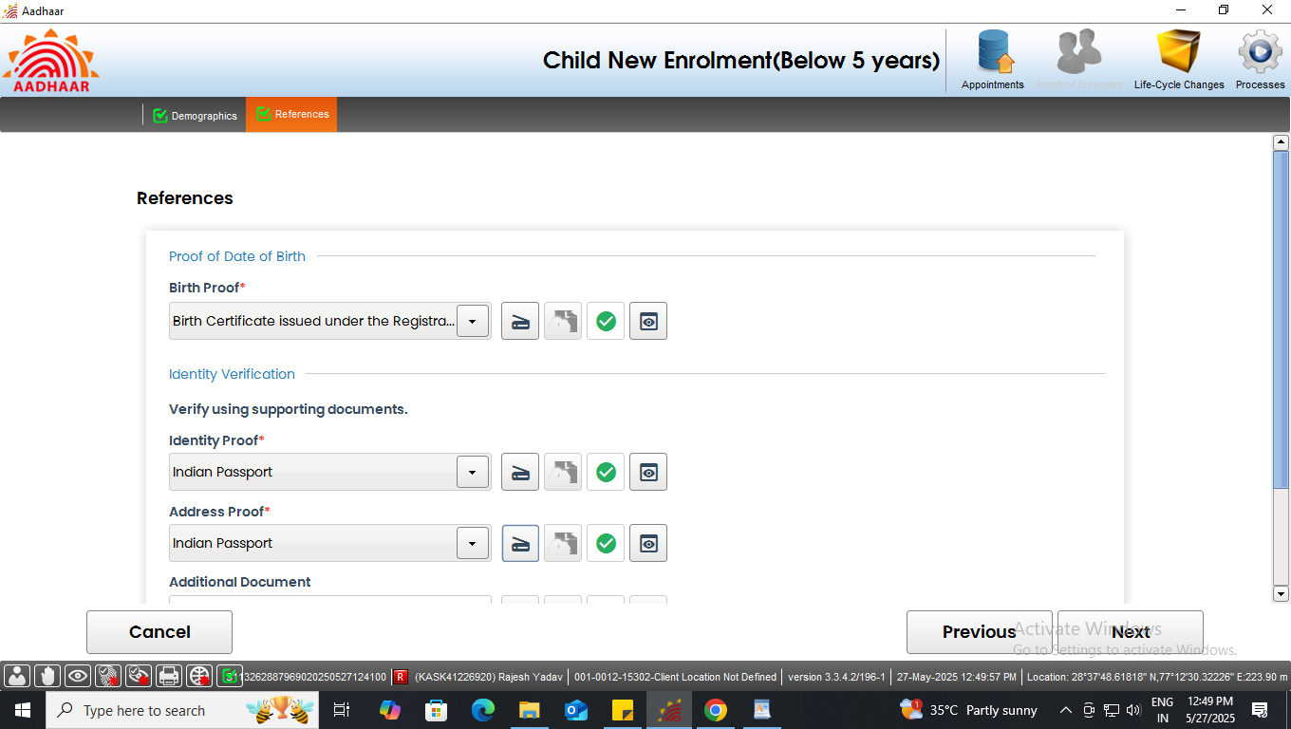
Document based enrolment
Document based enrolment
Step-9
Accordingly upload all the valid documents. After the scanning is done successfully "Green Tick" symbol indicates that the upload to backend service is successful. Click next.
Documents scan successfully

Slide 19
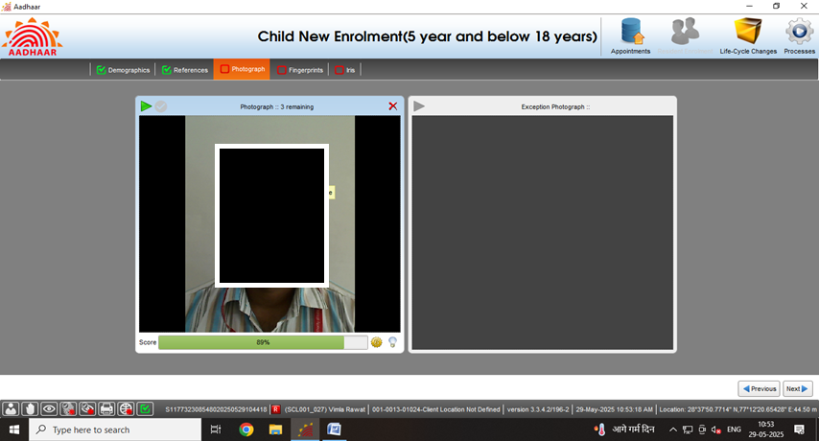
Document based enrolment
Document based enrolment
Step-10
Capture face of the applicant as per process and click next

Slide 20
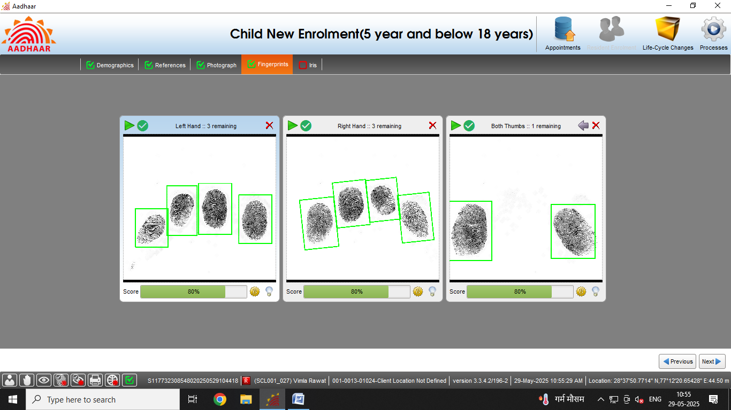
Document based enrolment
Document based enrolment
Step-11
Capture the fingerprints of the resident and click next

Slide 21
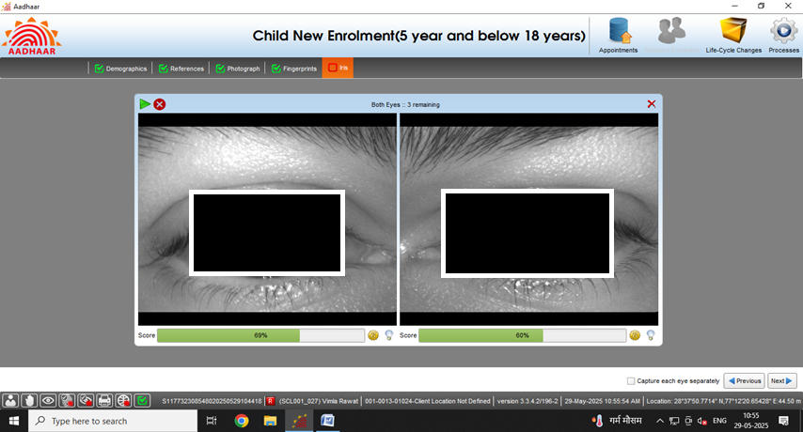
Document based enrolment
Document based enrolment
Step-12
Capture both iris of the resident and click next

Slide 22
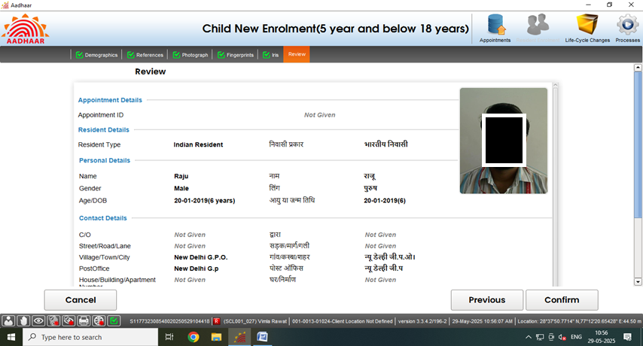
Document based enrolment
Document based enrolment
Step-13
Request the applicant to verify all the entered details, in the review page. After the operator’s confirmation, the details cannot be changed.

Slide 23
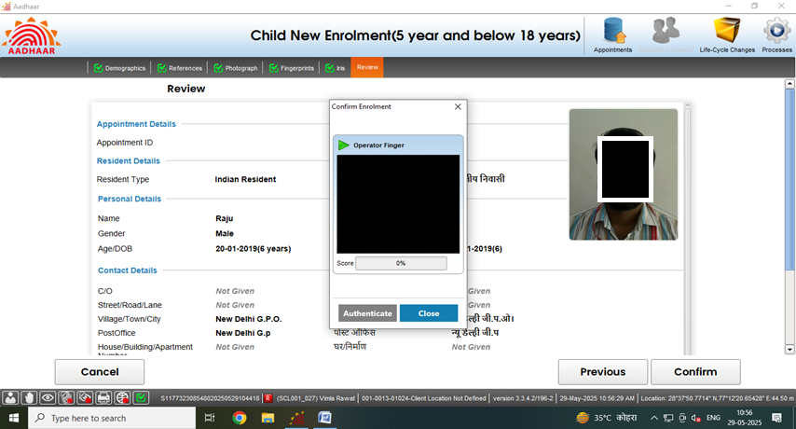
Document based enrolment
Document based enrolment
Step-14
The operator will confirm that the entered details are correct by providing his/her biometrics.

Slide 24
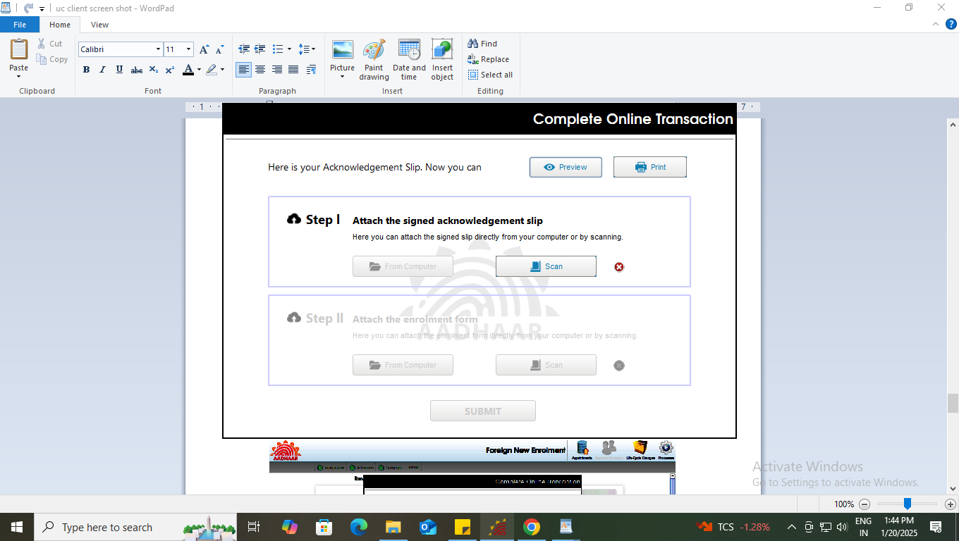
Document based enrolment
Document based enrolment
Step-15
After the confirmation, operator can preview the acknowledgement slip.

Slide 25
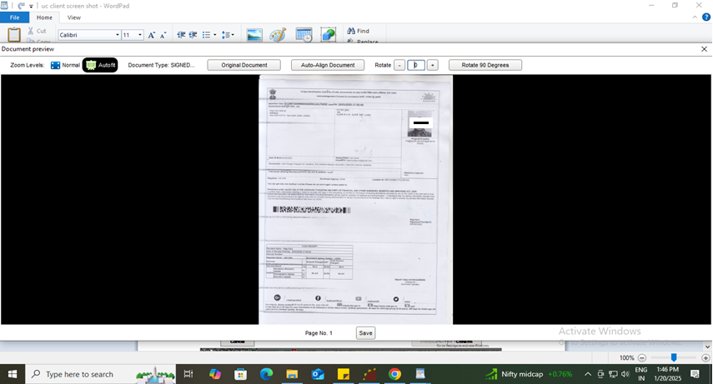
Document based enrolment
Document based enrolment
Step-16
See the Preview of acknowledgement slip and take the print-out for uploading the same.

Slide 26
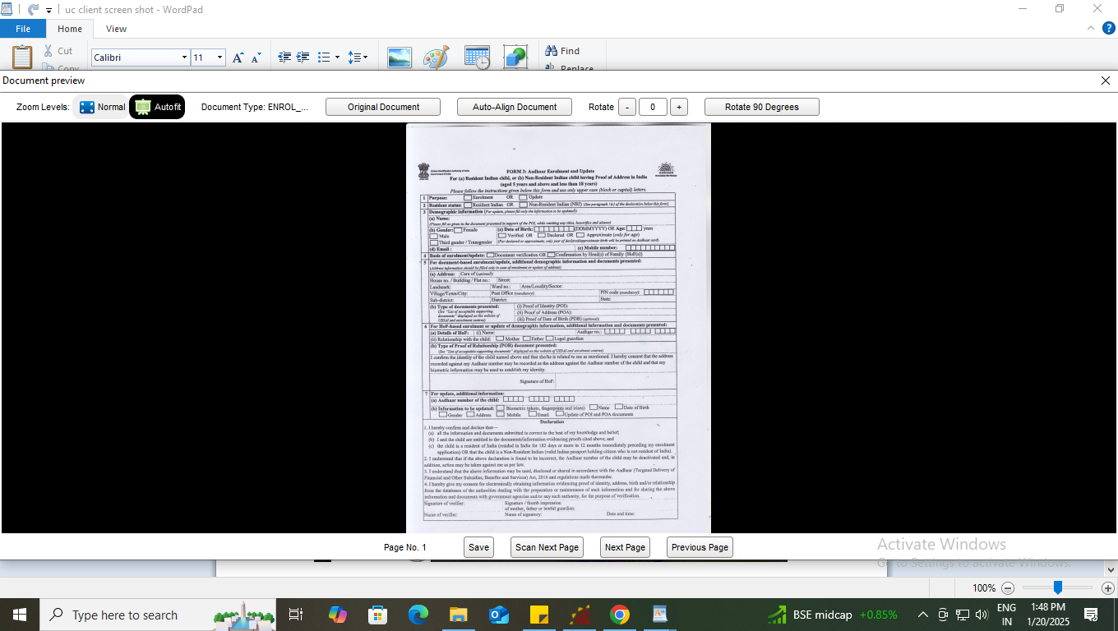
Document based enrolment
Document based enrolment
Step-17
Scan and upload the signed enrolment form and acknowledgement slip.

Slide 27
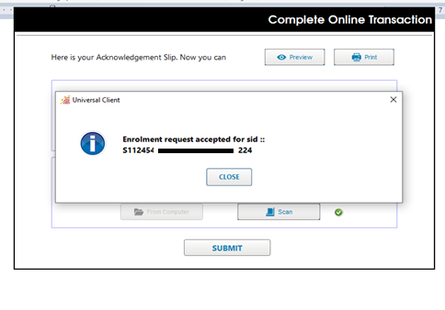
Document based enrolment
Document based enrolment
Step-18
After uploading the enrolment form and acknowledgement slip ‘submit’ button will be enabled. After successful submission of enrolment request following message will be displayed showing completion of the transaction.

Slide 28
Document based enrolment
Document based enrolment
Case 2:
Resident not having Proof of Birth

Slide 29
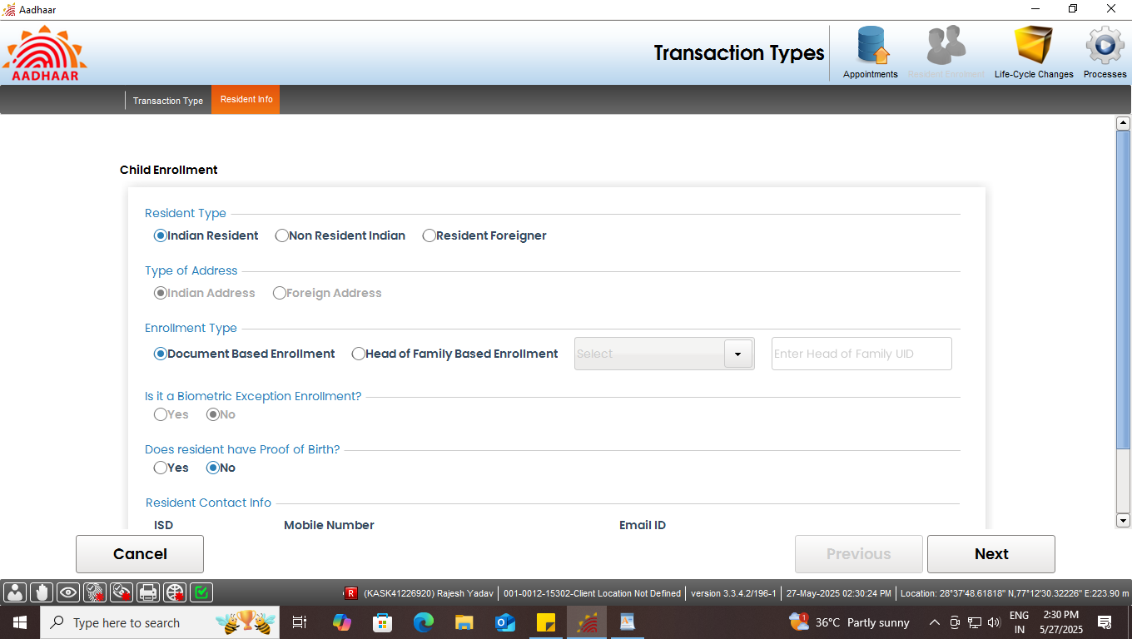
Document based enrolment
Document based enrolment
Step-1
Select “Indian Resident” radio button in resident type option. Further, In enrolment type select “Document Based enrolment” and Select ‘No’ in case resident not having proof of Birth.
Select ‘No’ if resident not having proof of birth

Slide 30
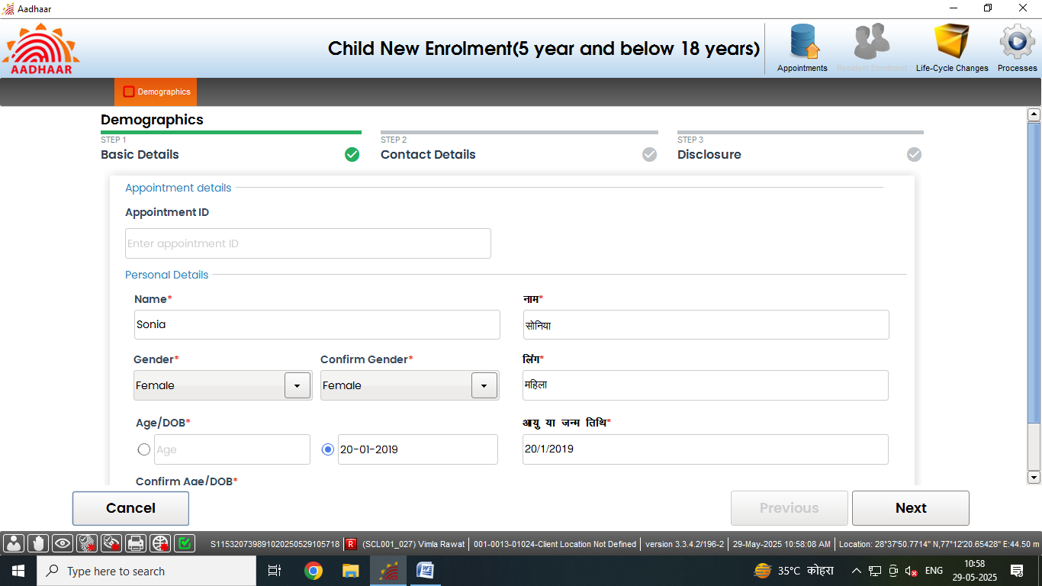
Document based enrolment
Document based enrolment
Step-2
Enter basic details of the resident as per enrolment form submitted by resident:

Slide 31
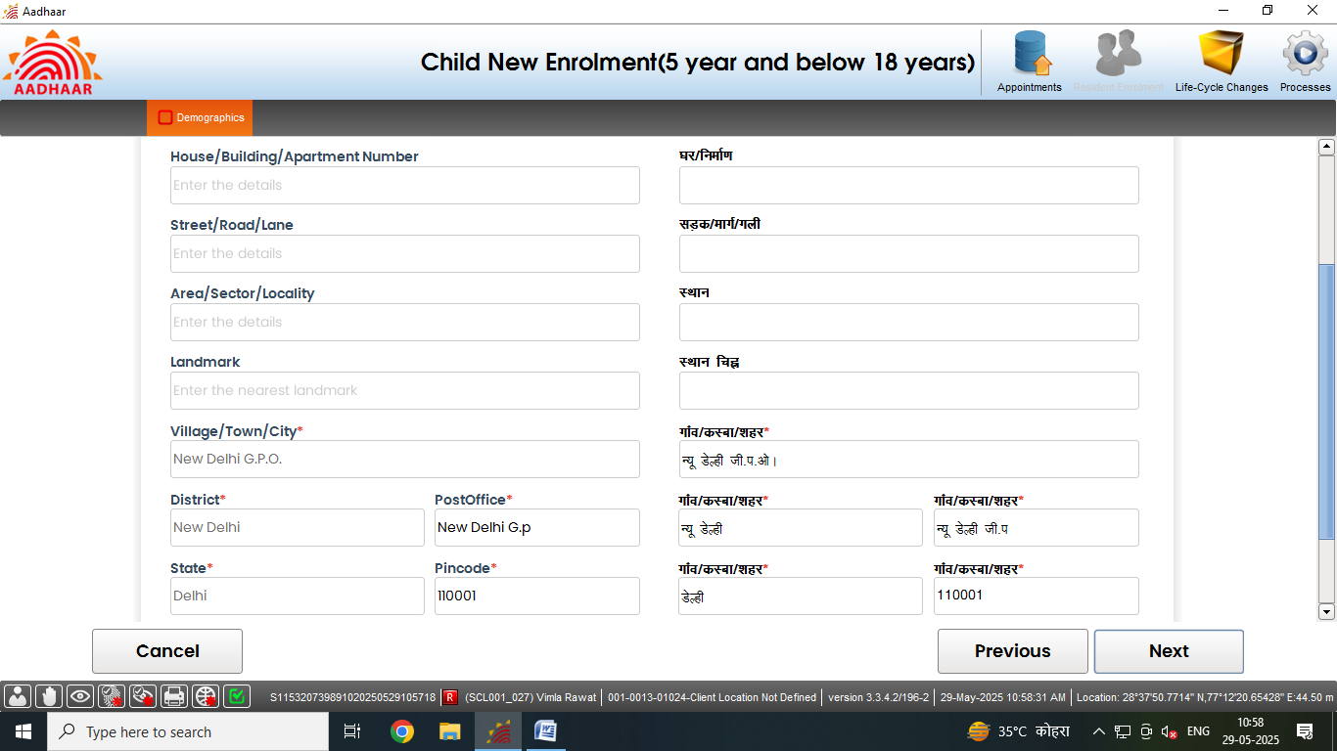
Document based enrolment
Document based enrolment
Step-3
Record address of the resident. Fields with (*) mark (pin code, state, district and post office) are mandatory. Click Next

Slide 32
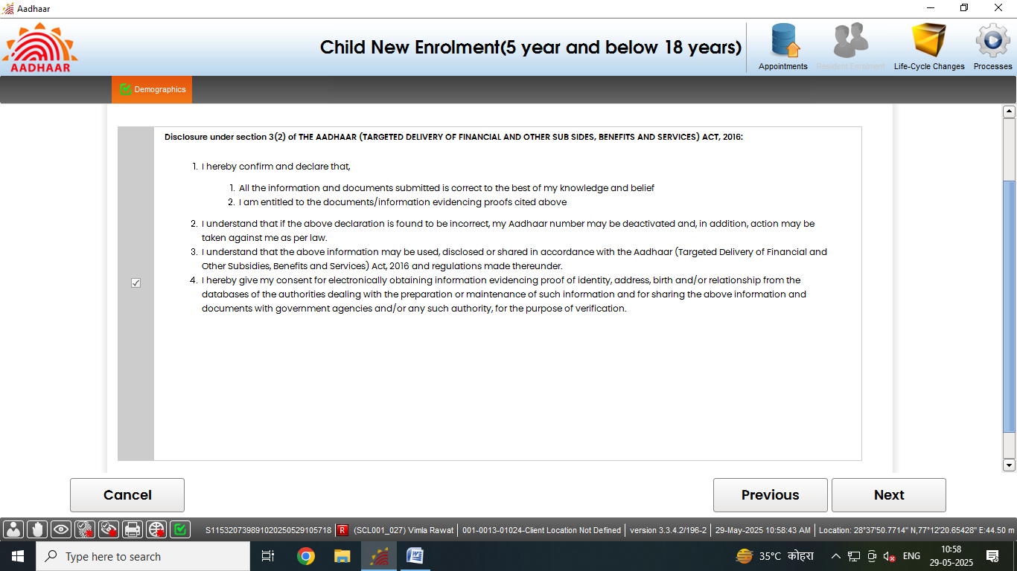
Document based enrolment
Document based enrolment
Step-4
Request resident to read the disclosure and give their consent by selecting check box, Click Next

Slide 33
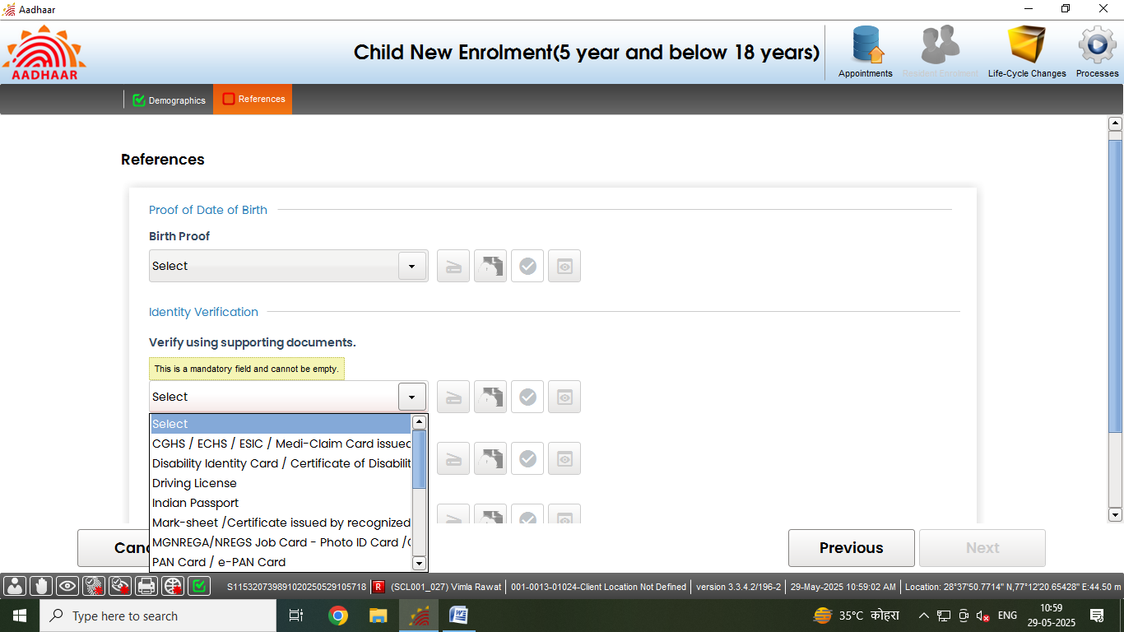
Document based enrolment
Document based enrolment
Step-5
Select Proof of Identity (POI) of the Resident as per the ‘List of supporting documents for Enrolment and Update’ and click on the scan button to scan the valid documents.
Click here to scan the documents

Slide 34
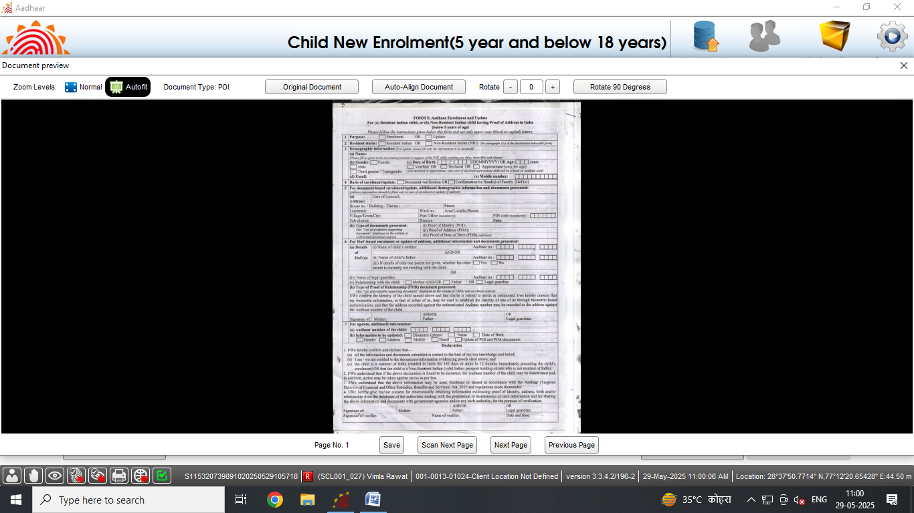
Document based enrolment
Document based enrolment
Step-6
Preview of the scanned document would appear, operator will check the document preview. Click on save

Slide 35
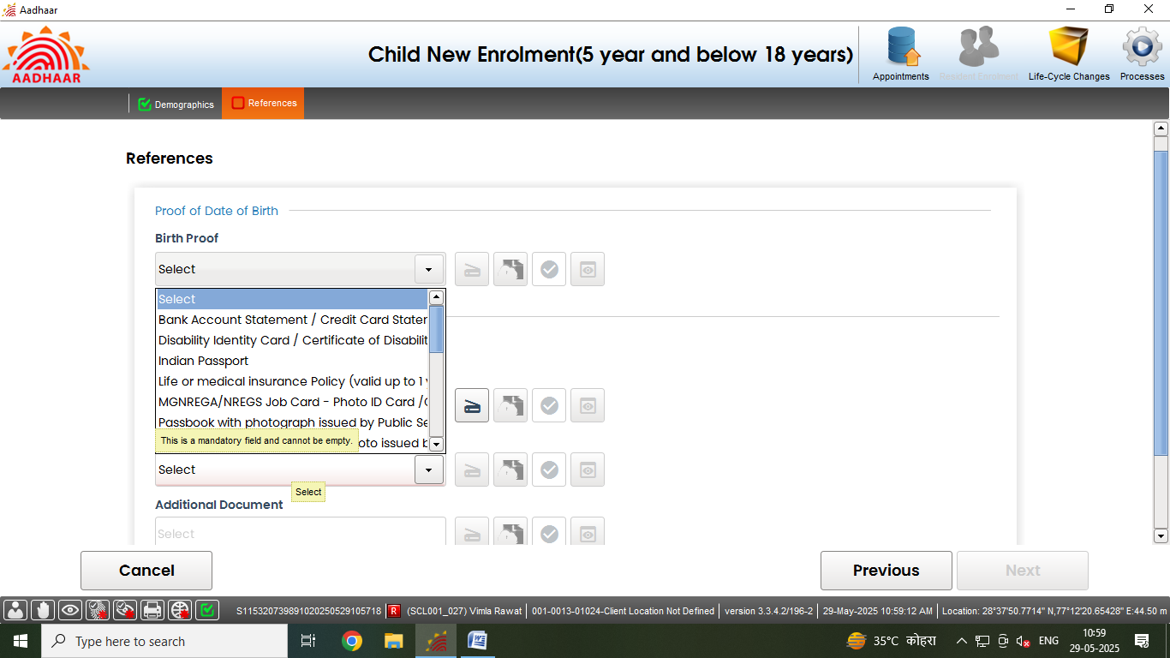
Document based enrolment
Document based enrolment
Step-6 (cont.)
Select Proof of Address (POA) of the Resident as per the ‘List of supporting documents for Enrolment and Update’.
and click on the scan button to scan the valid documents.
Click here to scan the documents

Slide 36
Document based enrolment
Document based enrolment
Step-6 (cont.)
Preview of the scanned document would appear, operator will check the document preview. Click on save

Slide 37
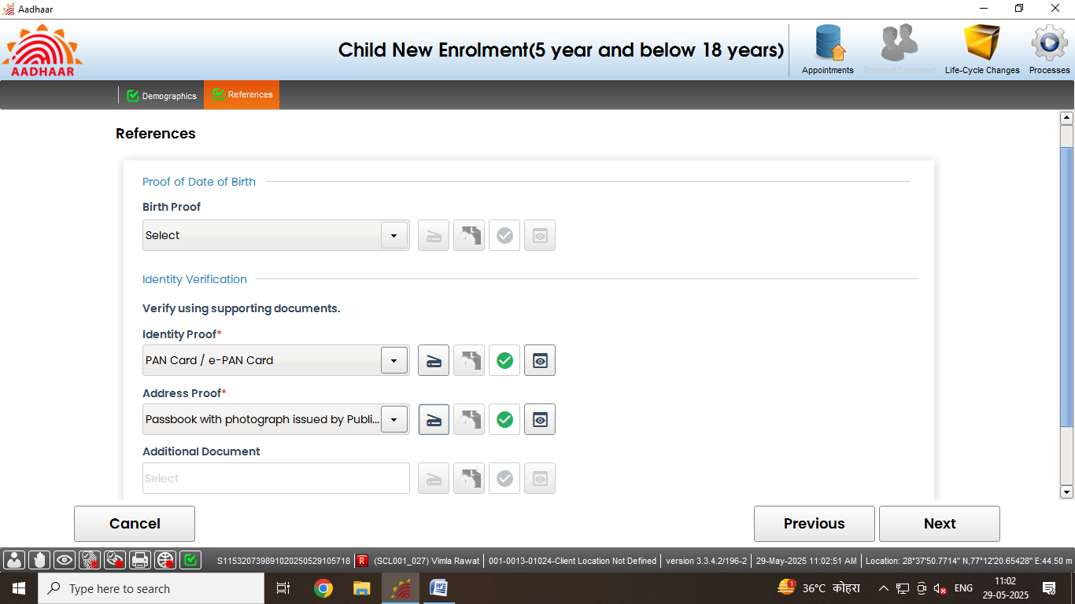
Document based enrolment
Document based enrolment
Step-7
Accordingly upload all the valid documents. After the scanning is done successfully ‘Green Tick’ symbol indicates that the upload to backend service is successful. Click next.
Documents scanned successfully

Slide 38
Document based enrolment
Document based enrolment
Step-8
Capture the face of the resident, click next

Slide 39
Document based enrolment
Document based enrolment
Step-9
Capture the fingerprints of the resident, click next

Slide 40
Document based enrolment
Document based enrolment
Step-10
Capture both the iris of the resident, click next

Slide 41
Document based enrolment
Document based enrolment
Step-11
The residents should verify all the entered details, in the review page. After the operator’s confirmation, the details cannot be changed.

Slide 42
Document based enrolment
Document based enrolment
Step-12
The operator should confirm that the entered details are correct by providing his/her biometrics.

Slide 43
Document based enrolment
Document based enrolment
Step-13
After the confirmation, operator can preview the acknowledgement slip.

Slide 44
Document based enrolment
Document based enrolment
Step-14
See the Preview of acknowledgement slip and take the print-out for uploading the same

Slide 45
Document based enrolment
Document based enrolment
Step-15
Scan and upload the signed enrolment form filled by the resident

Slide 46
Document based enrolment
Document based enrolment
Step-16
After uploading the enrolment form, ‘Submit’ button will be enabled, after successful submission of enrolment request following message will be displayed.

Slide 47
Head of Family (HoF) based enrolment

Slide 48
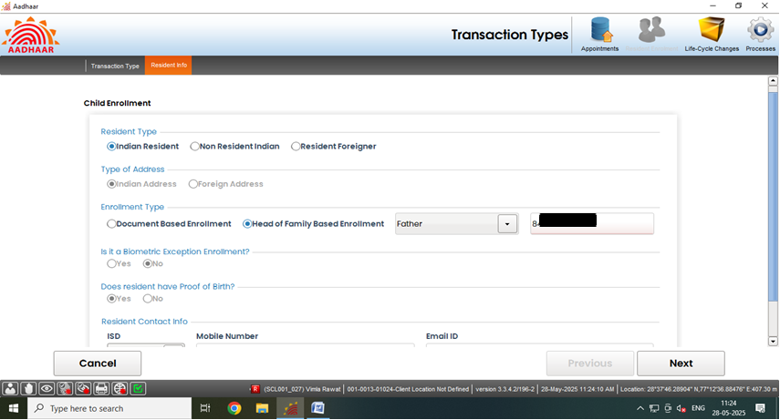
HoF based enrolment
Step 1
Select enrolment type “Head of Family Based enrolment”, Then select HoF member (i.e. Father, Mother and Legal Guardian) from drop-down list and fill their Aadhaar details as provided in enrolment form. then click Next

Slide 49
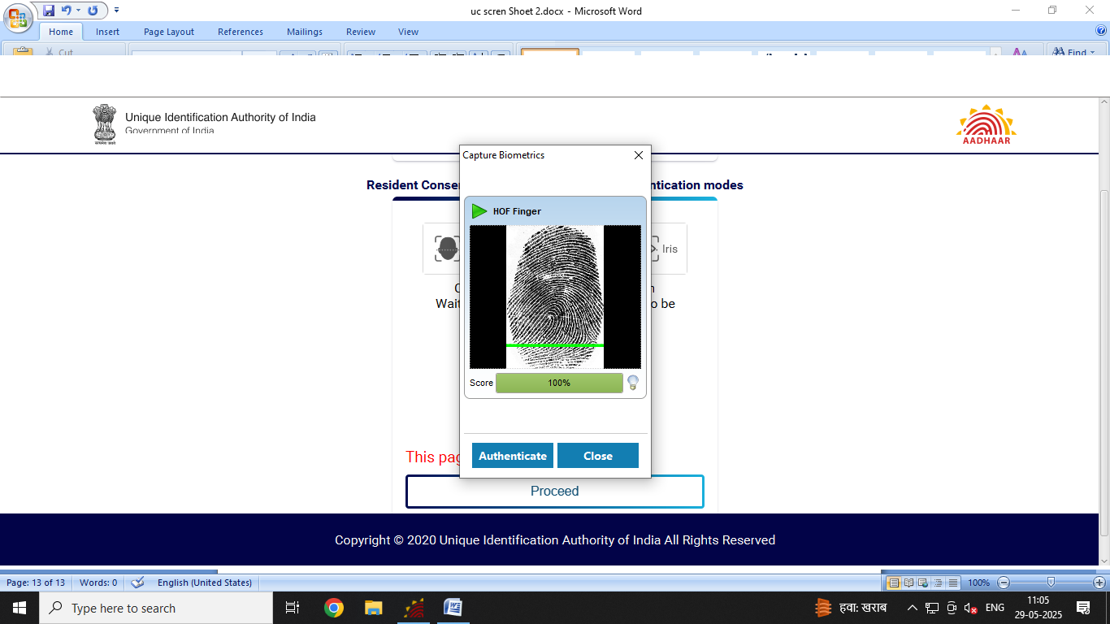
HoF based enrolment
HoF based enrolment
Step 2
Operator now take the HoF consent via any Biometric Authentication mode (i.e. Face/Finger/Iris) by clicking on ‘Proceed’, button and authenticate the same.

Slide 50
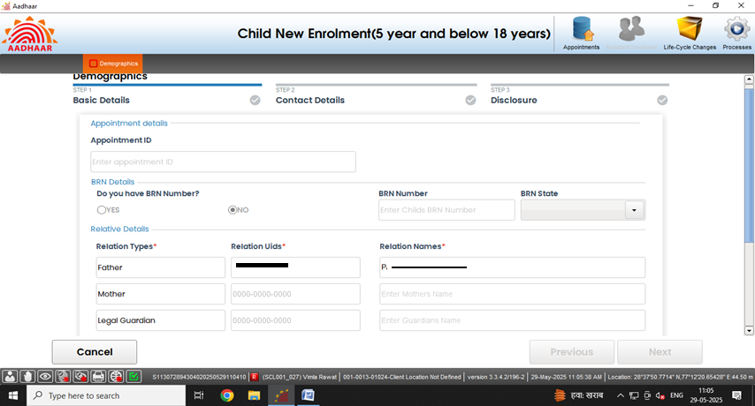
HoF based enrolment
HoF based enrolment
Step 3
HoF details will be auto populated in relative details.

Slide 51
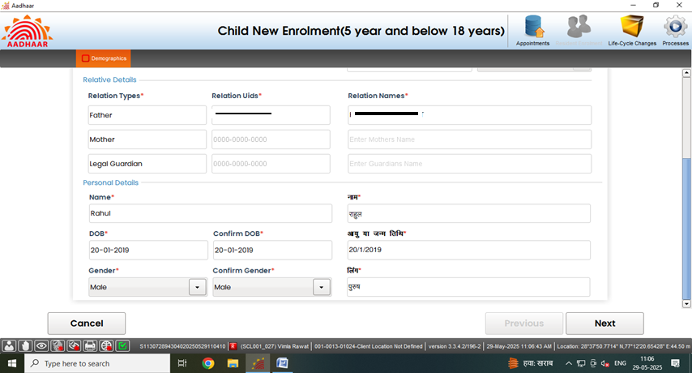
HoF based enrolment
HoF based enrolment
Step 4
Enter basic details (Name, Date of Birth and Gender) of the resident as per filled submitted form:

Slide 52
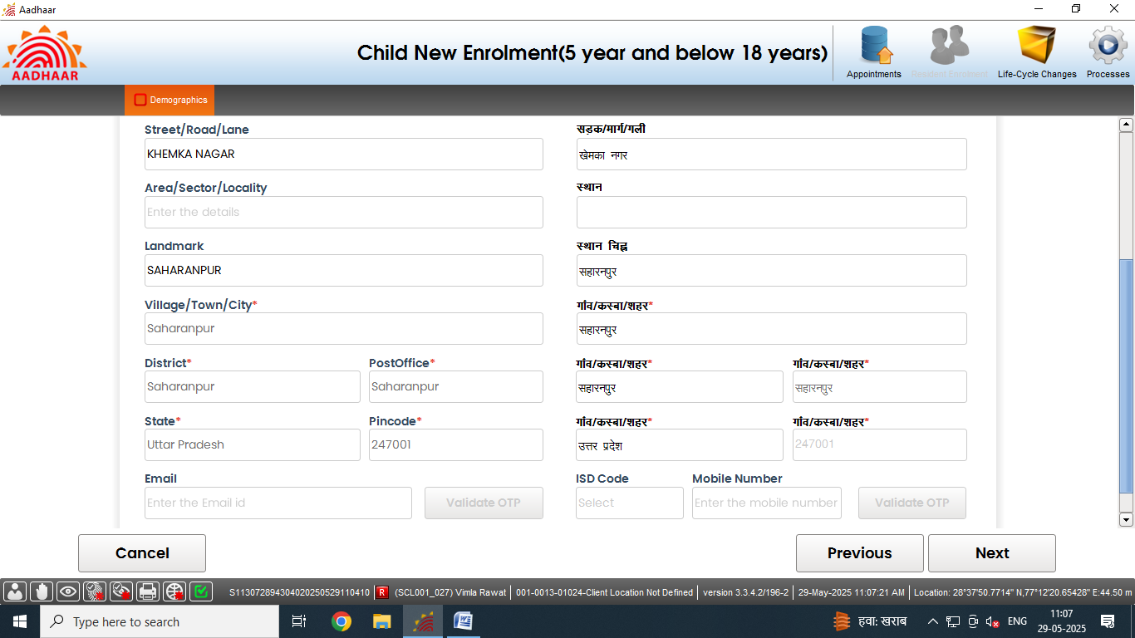
HoF based enrolment
HoF based enrolment
Step 5
In contact details, Pin code, Village/Town/City, District, Post Office auto fetched from HoF Aadhaar. Click Next

Slide 53
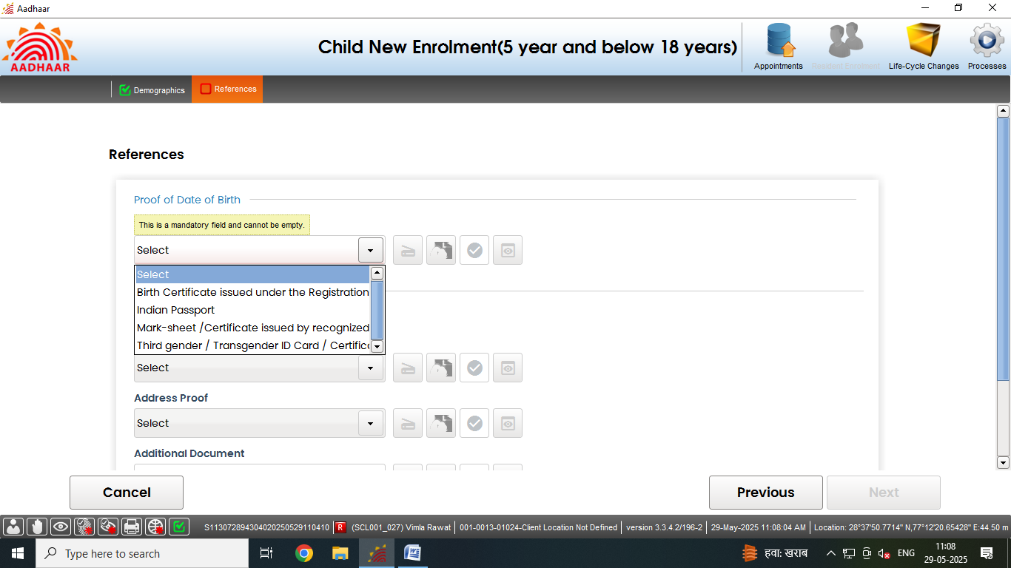
HoF based enrolment
HoF based enrolment
Step 6
Operator will upload required document ad click on the scan button to scan the valid documents.
Click here to scan the required document

Slide 54
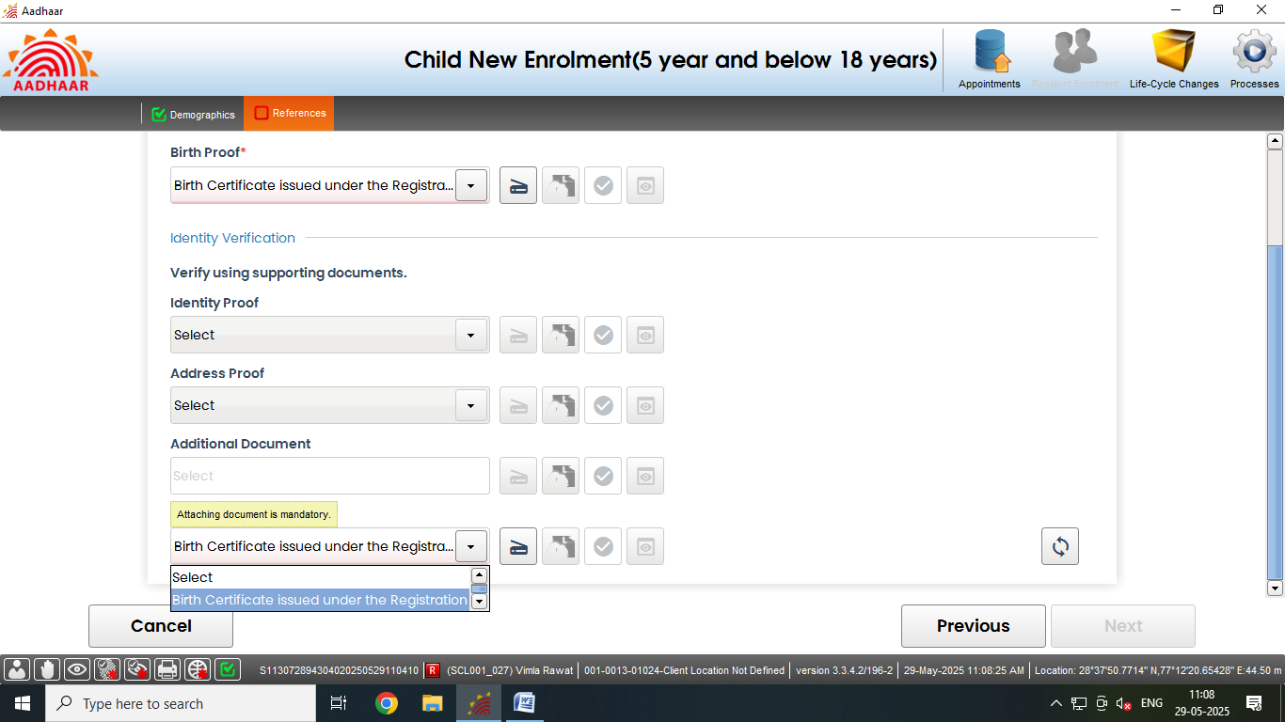
HoF based enrolment
HoF based enrolment
Step 7
Operator shall upload required document ad click on the scan button to scan the valid documents.
Click here to scan the required document

Slide 55
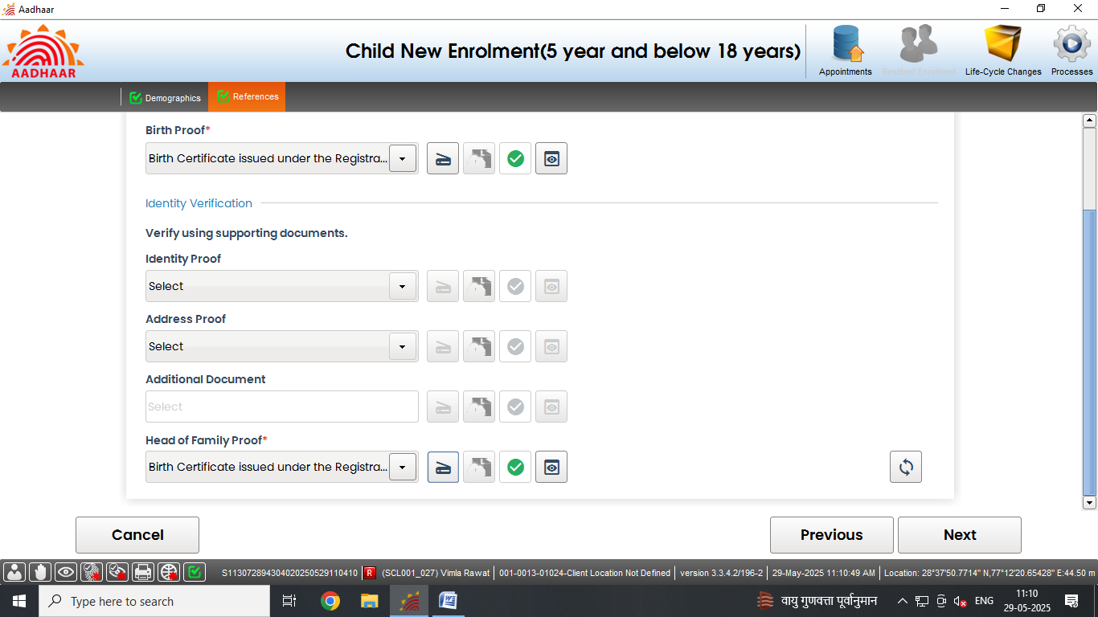
HoF based enrolment
HoF based enrolment
Step 8
Accordingly upload all the valid documents. After the scanning is done successfully "Green Tick" symbol indicates that the upload to backend service is successful. Click next.
Document scanned successfully

Slide 56
HoF based enrolment
HoF based enrolment
Step-9
Capture the face of the resident, click next

Slide 57
HoF based enrolment
HoF based enrolment
Step-10
Capture the fingerprints of the resident, click next

Slide 58
HoF based enrolment
HoF based enrolment
Step-11
Capture both the iris of the resident, click next

Slide 59
HoF based enrolment
HoF based enrolment
Step-12
The residents will verify all the entered details, in the review page. After the operator’s confirmation, the details cannot be changed.

Slide 60
HoF based enrolment
HoF based enrolment
Step-13
The operator will confirm that the entered details are correct by providing his/her biometrics.

Slide 61
HoF based enrolment
HoF based enrolment
Step-14
After the confirmation, operator can preview the acknowledgement slip.

Slide 62
HoF based enrolment
HoF based enrolment
Step-15
See the Preview of acknowledgement slip and take the print-out for uploading the same

Slide 63
HoF based enrolment
HoF based enrolment
Step-16
Scan and upload the signed enrolment form filled by the resident

Slide 64
HoF based enrolment
HoF based enrolment
Step-17
After uploading the enrolment form, ‘Submit’ button will be enabled, after successful submission of enrolment request following message will be displayed.

Slide 65
Thank You

