Slide 1
Adult Enrolment -Resident Foreigner
(18 Years and above)

Slide 2
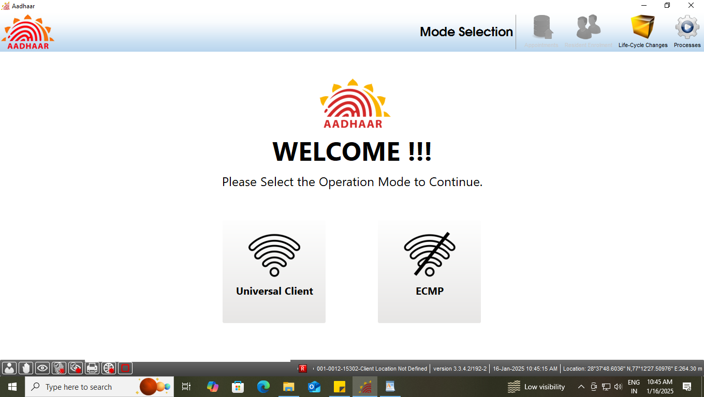
Step-1
Please ensure the client is connected on internet, then Operator select the option ‘Universal Client’ in Mode Selection.

Slide 3
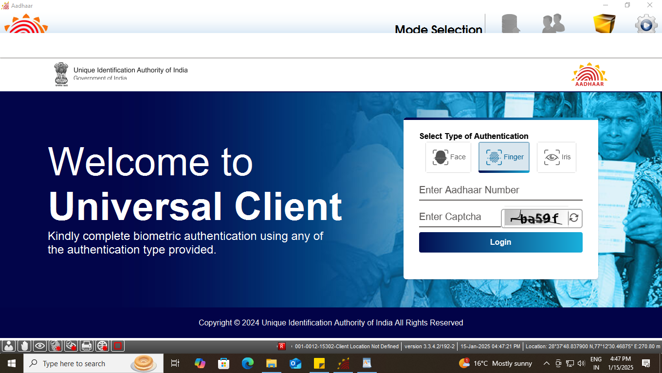
Step-2
Universal Client login page will appear, Enter the ‘Aadhaar Number’ of Operator and ‘CAPTCHA’ for Login.

Slide 4
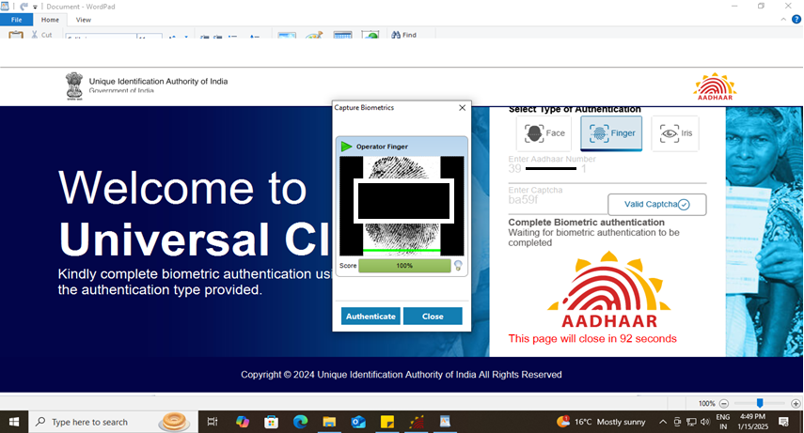
Step-3
Operator needs to give his/her biometric for authentication using - fingerprint or Iris. Fingerprint authentication is possible using slaps scanner or Single fingerprint RD device. Iris authentication is possible using dual iris scanner or single iris RD device

Slide 5
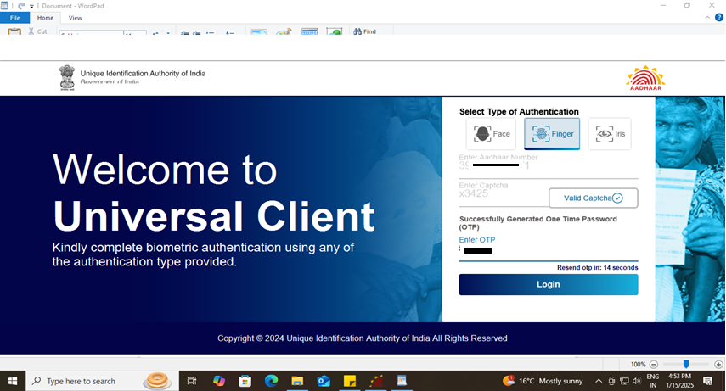
Step-4
After biometric authentication operator receives OTP, enter OTP to proceed.

Slide 6
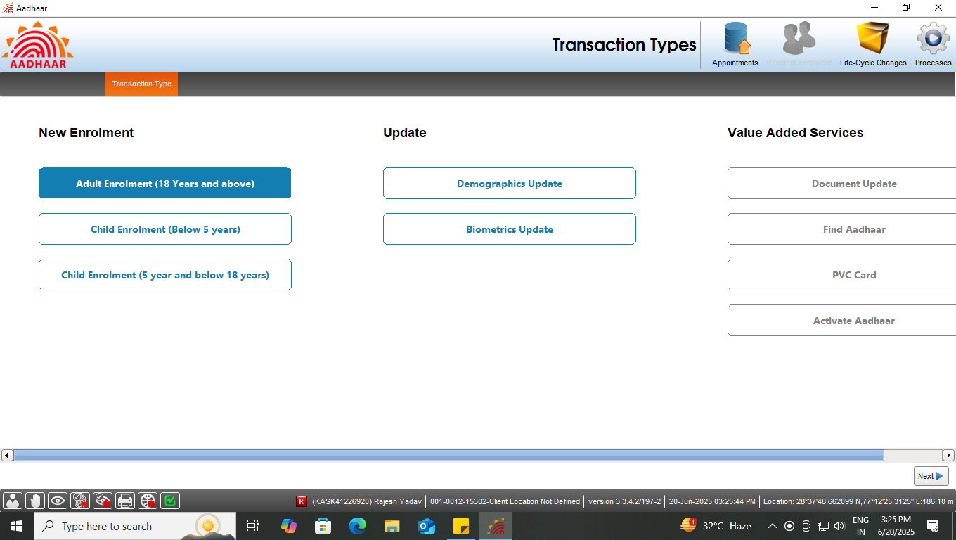
Step-5
Select the ‘Adult enrolment (18 years and above)’ under new enrolment option, click next

Slide 7
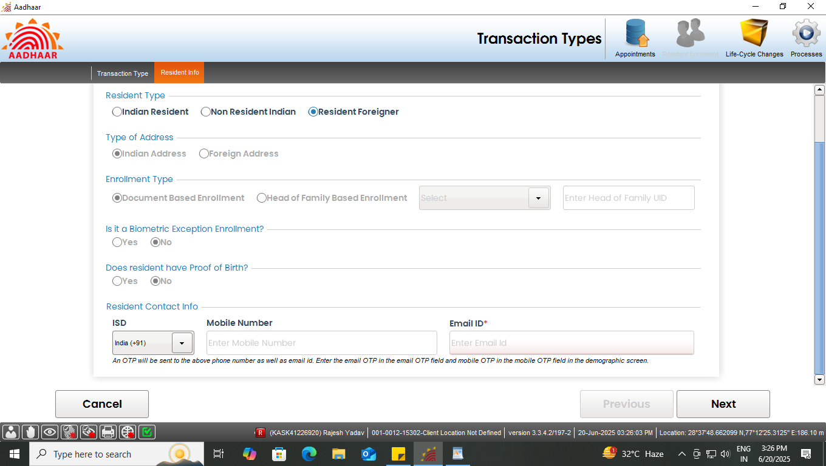
Step-6
Select “Resident Foreigner” radio button in resident type option, all other fields shall get selected according to the resident type.

Slide 8
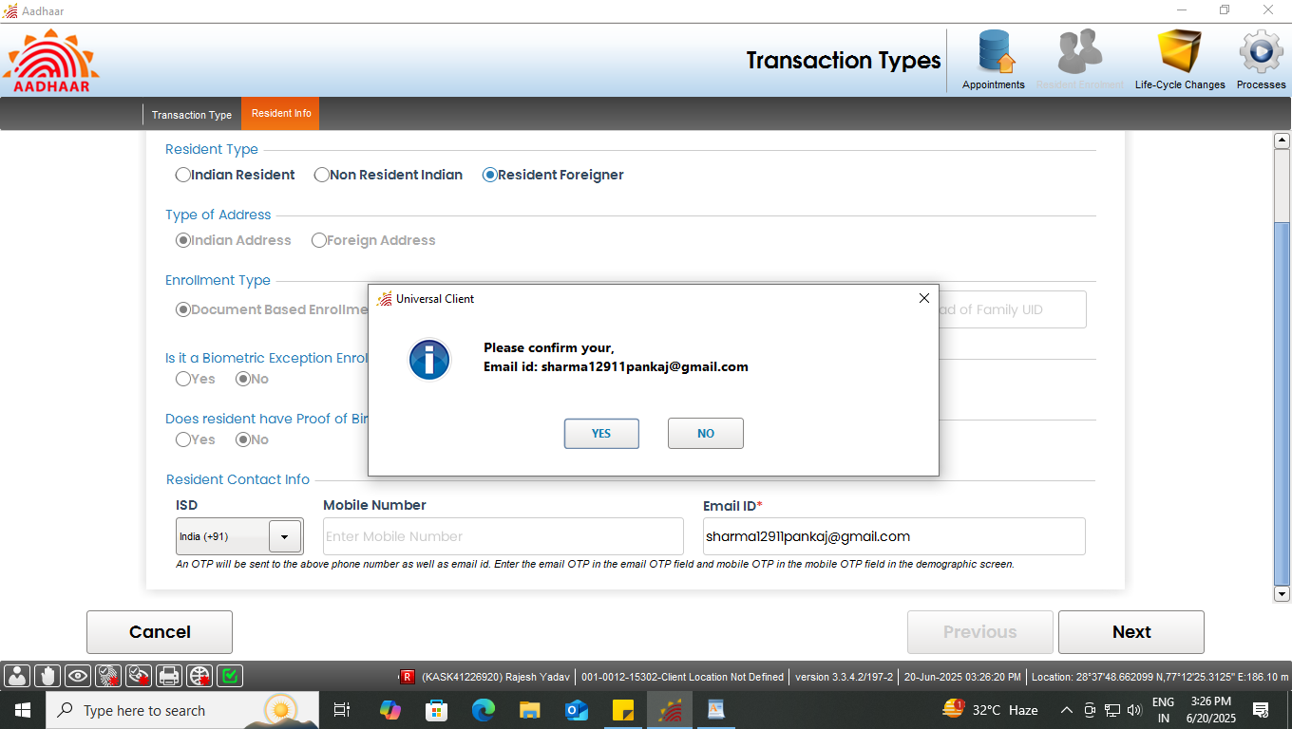
Step-7
Enter valid email address (mandatory) and mobile number (optional). After filling the details operator need to confirm the same with resident.
Email address is mandatory and mobile no is optional for “Foreign Resident” enrollment

Slide 9
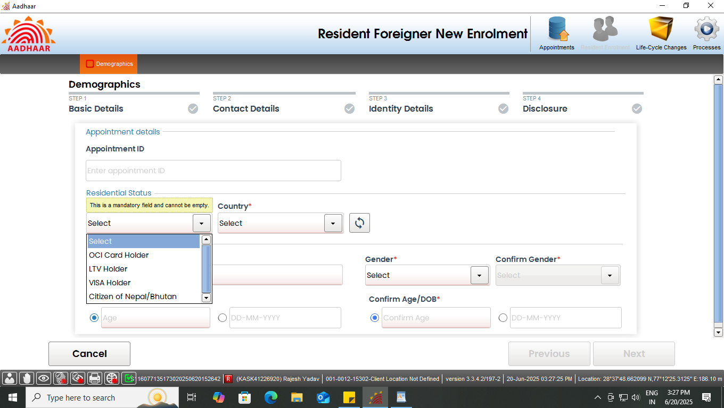
Step-9
Enter basic details of the resident foreigner as per filled submitted form:
A) Select type of Foreigner: Select one option from the 4 types available in drop-down menu: i) Common Visa, ii) OCI holder, iii) LTV holder and iv) Citizen of Nepal/Bhutan
B) Select foreigners' country of origin from the drop-down list
C) Enter name, gender and age/DoB as per document and click next

Slide 10
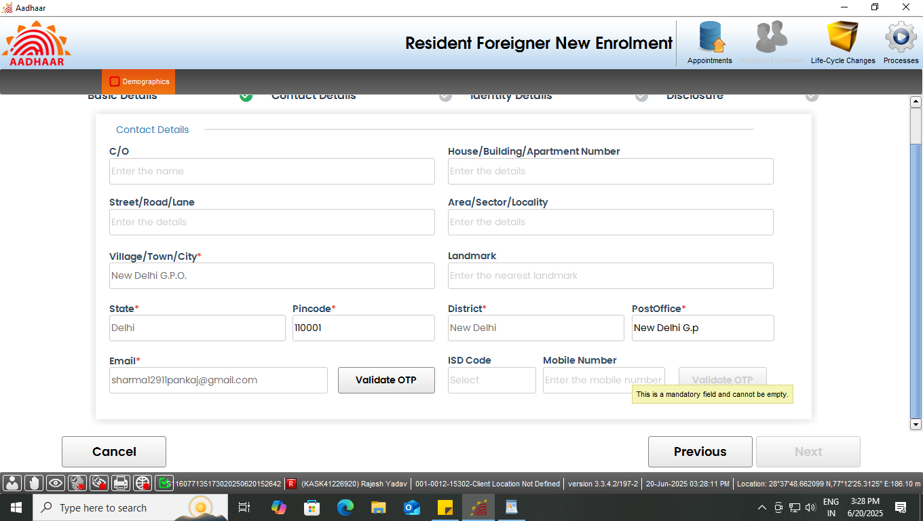
Step-10
Record address of the resident foreigner. Fields with (*) mark (pin code, state, district and post office) are mandatory. Email address and mobile will be auto populated as per the details filled earlier, click next.

Slide 11
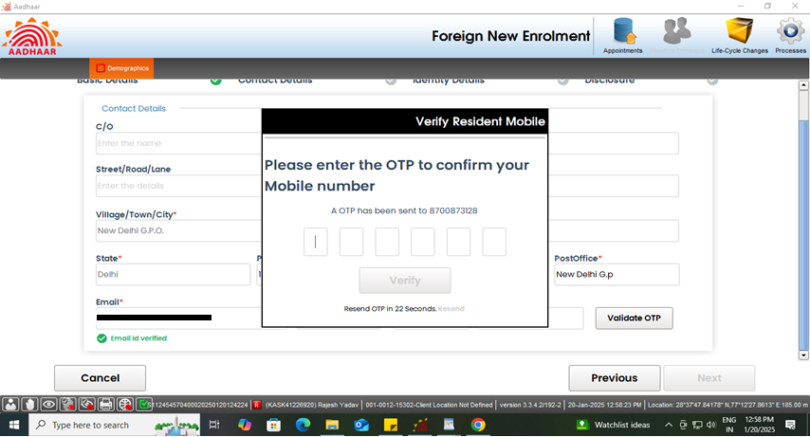
Step-11
Validate the email address and mobile number through OTP received on provided email and mobile number and click next.

Slide 12
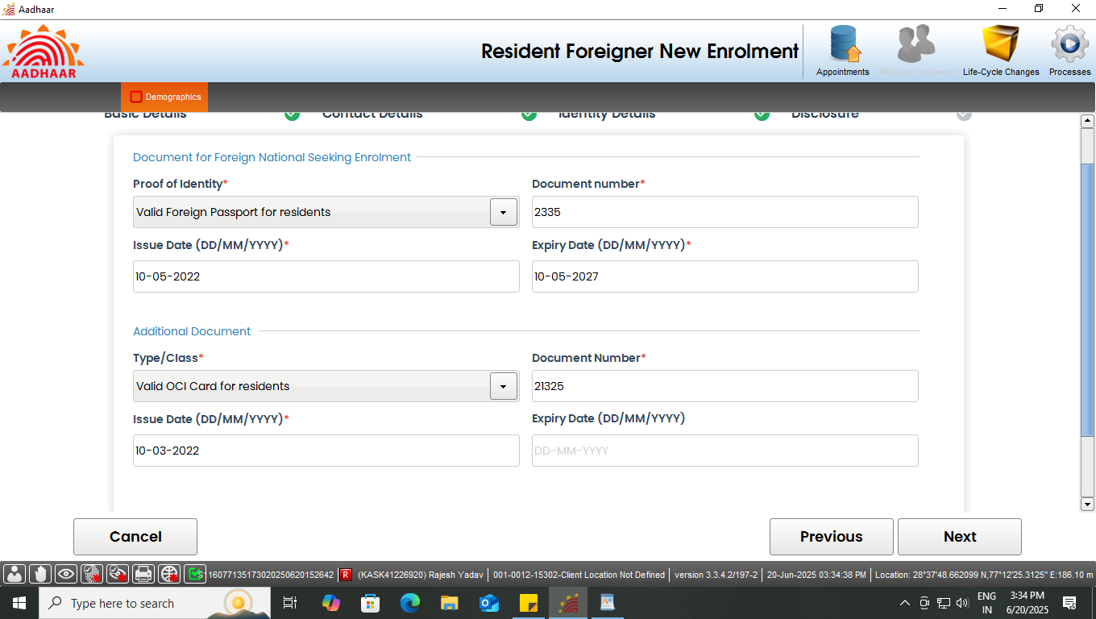
Step-12
Enter all the details of foreigner in identity details tab.
Select proof of identity (POI) and record document number, issue date and expiry date. In case of Nepal/Bhutan and OCI, there is No expiry date if document submitted is "Citizenship Certificate", "Voter-ID" or "OCI card"
Additional Document (e.g VISA, OCI card, LTV etc) will be auto populated for selection in drop-down menu, according to the selection of foreigner type in the Basic Details tab. Select the appropriate document and record details as mentioned in (a).
In case Passport selected for Nepal/Bhutan no need of additional document. Click next

Slide 13
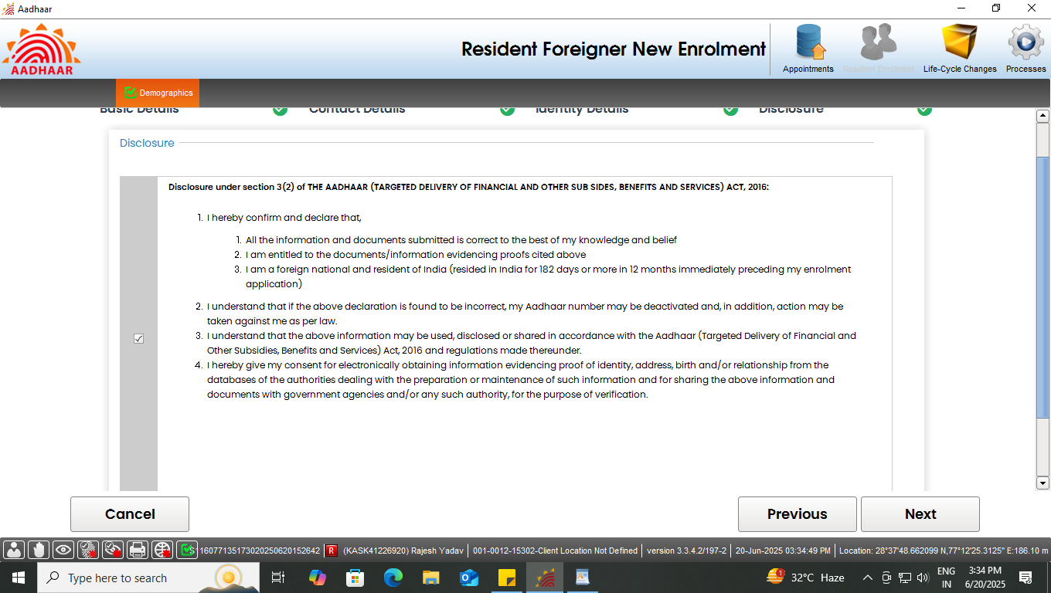
Step-13
Record consent of the applicant by selecting check box and click next

Slide 14
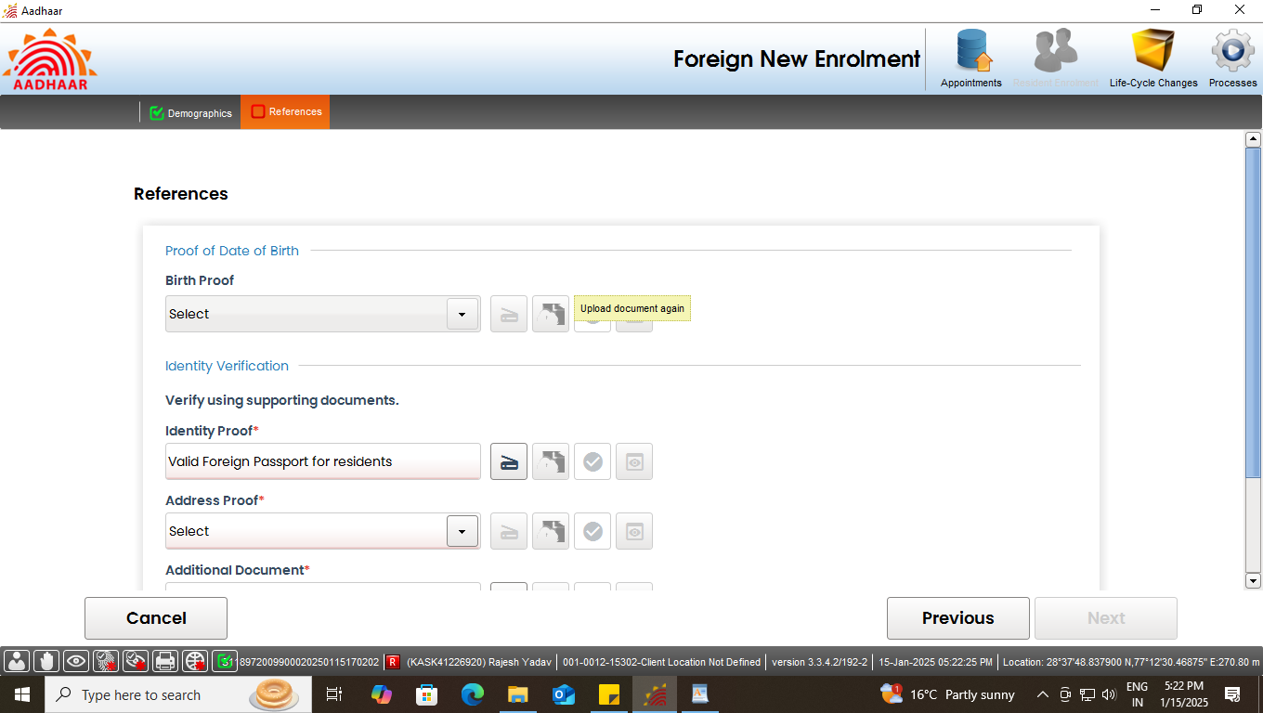
Step-14
Operator to click on the scan button to scan and upload the valid document displayed as per ‘List of acceptable document for Enrolment and Update’.
Click Here to Scan Documents

Slide 15
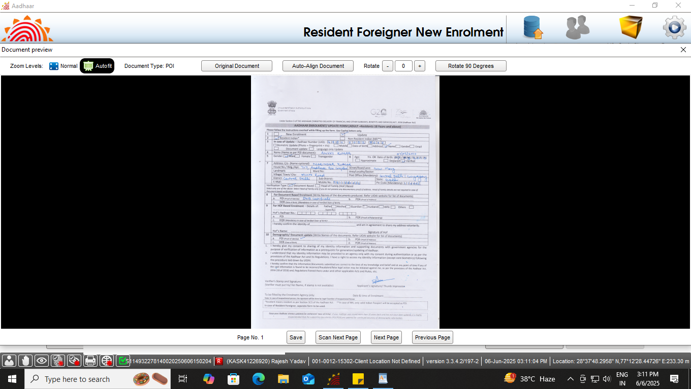
Step-15
Preview of the scanned document would appear, operator shall check the document preview

Slide 16
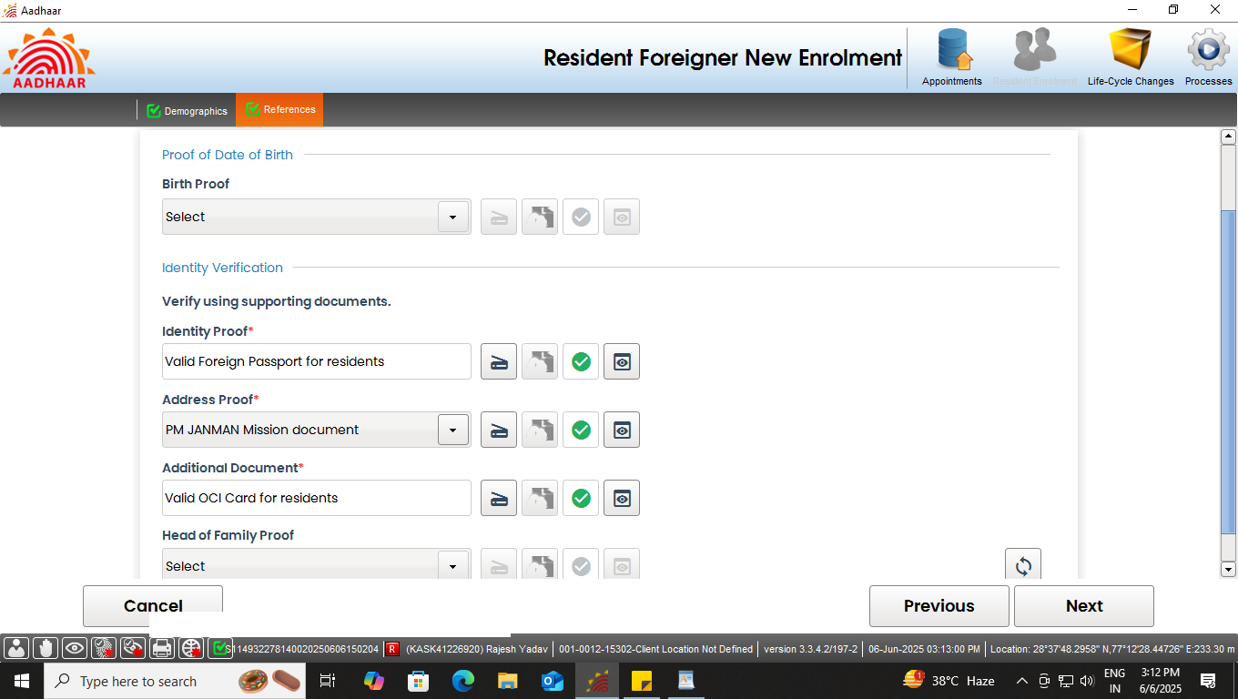
Step-16
Similarly upload all the valid documents. After the scanning is done successfully "Green Tick" symbol indicates that the upload to backend service is successful. Click next.
Document scanned successfully

Slide 17
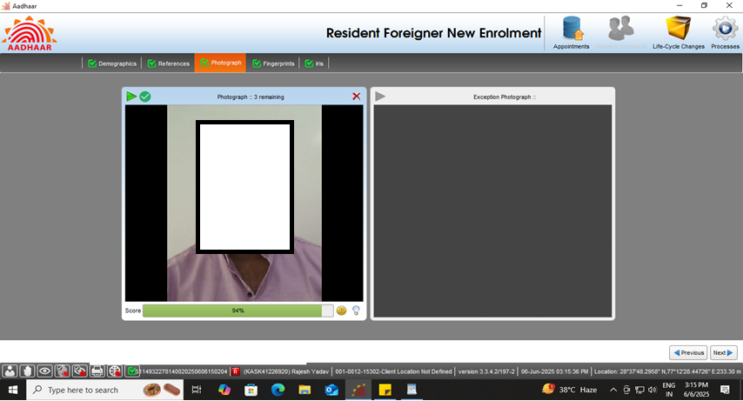
Step-17
Capture face of the applicant as per process and click next

Slide 18
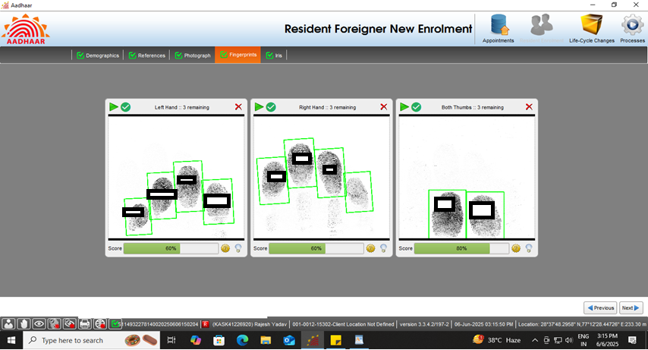
Step-18
Capture the fingerprints of the resident and click next.

Slide 19
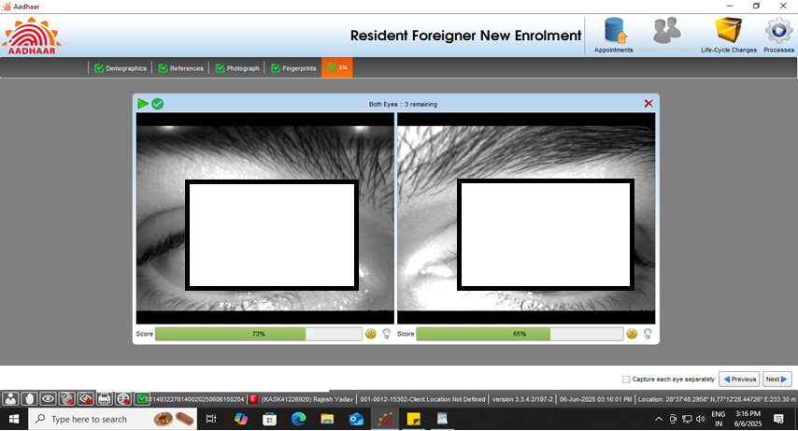
Step-19
Capture both iris of the resident and click next

Slide 20
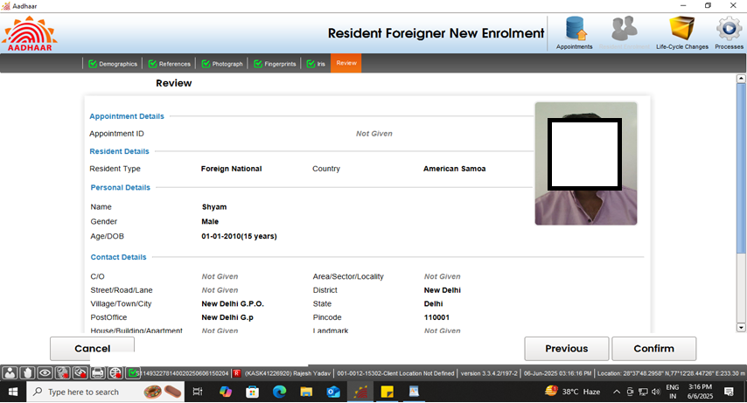
Step-20
Request the applicant to verify all the entered details, in the review page. After the operator’s confirmation, the details cannot be changed.

Slide 21
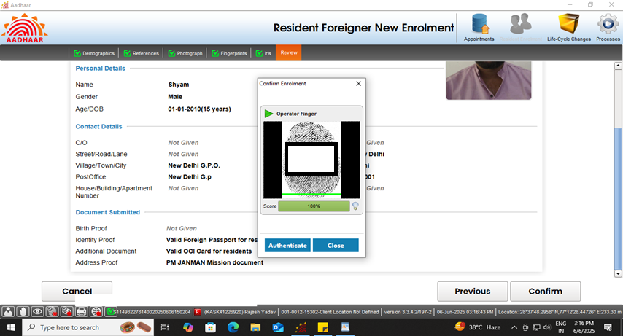
Step-21
The operator should confirm that the entered details are correct by providing his/her biometrics.

Slide 22
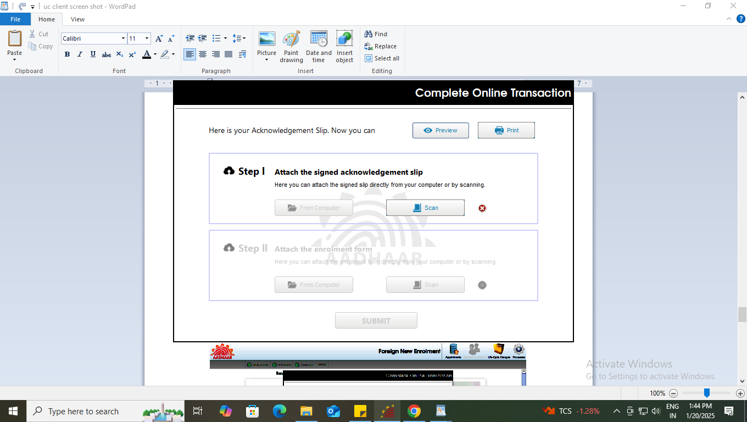
Step-22
After the confirmation, operator can preview the acknowledgement slip.

Slide 23
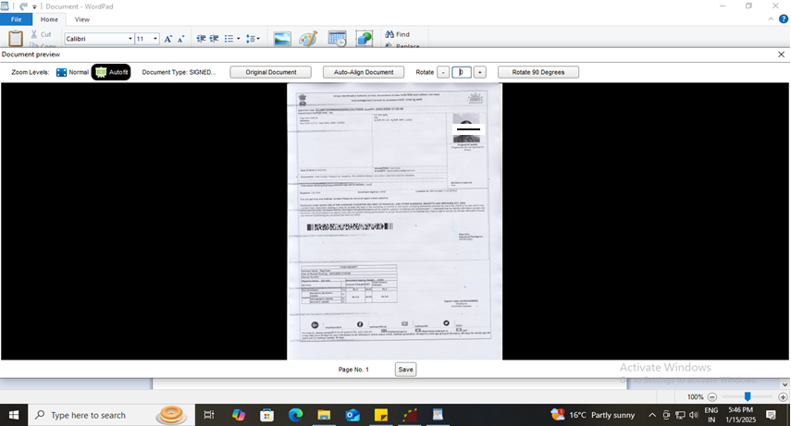
Step-23
See the Preview of acknowledgement slip and take print-out for uploading the same

Slide 24
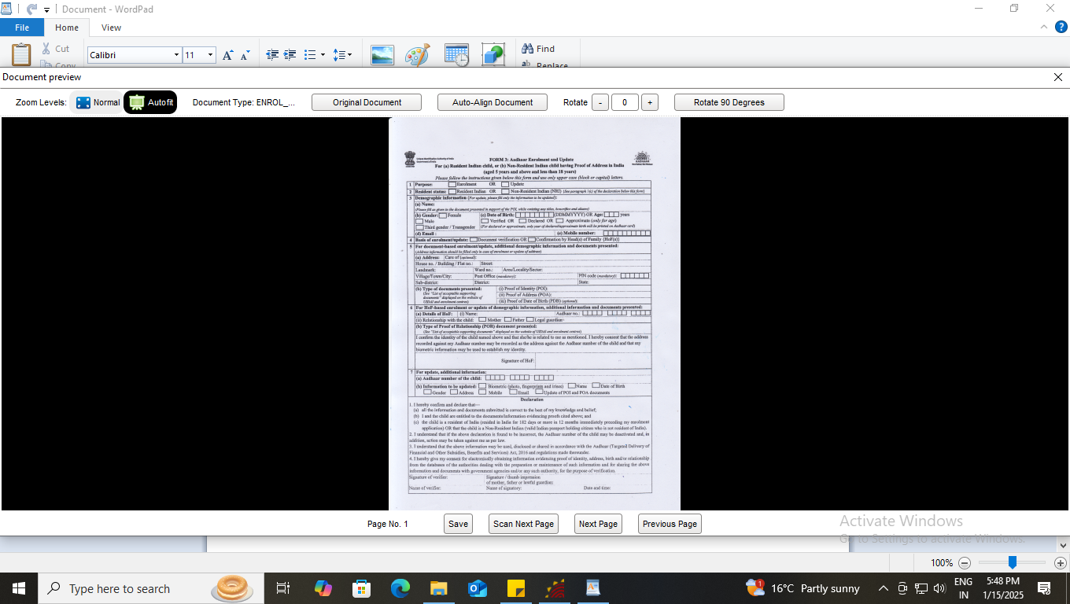
Step-24
Scan and upload the signed enrolment form and acknowledgement slip, Resident Foreigner / NRI the "Enrolment Form" is a "2 Page" document. Scanning of both pages are required.

Slide 25
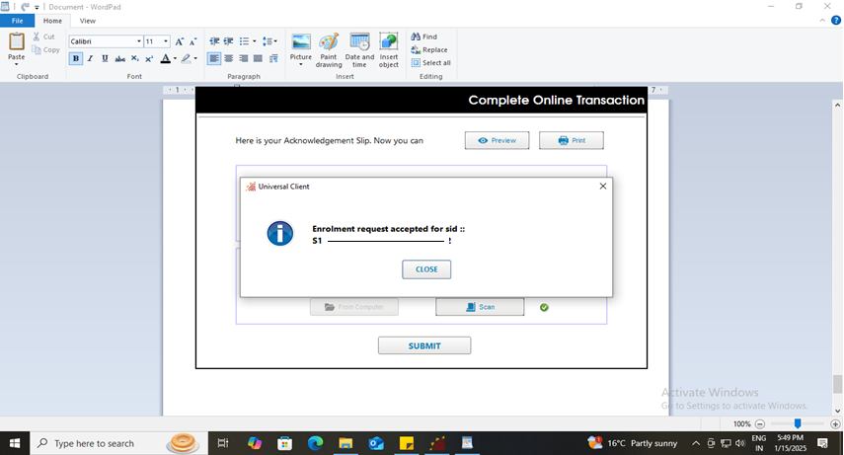
Step-25
After uploading the enrolment form and acknowledgement slip submit button will be enabled. After successful submission of enrolment request following message will be displayed showing completion of the transaction.

Slide 26
Thank You

