Slide 1
Adult Enrolment - Non Resident Indian (18 Years and above)

Slide 2
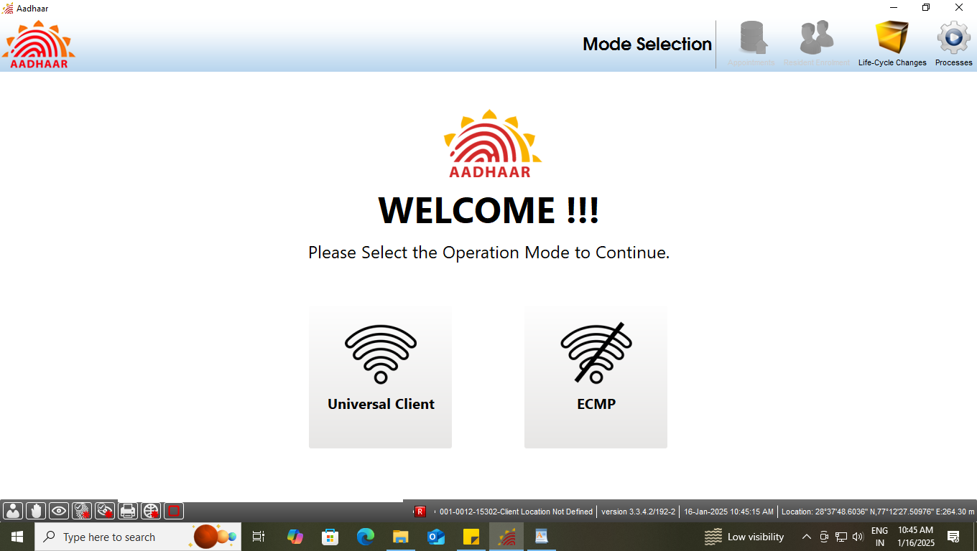
Step-1
Please ensure the client is connected on internet, then Operator select the option ‘Universal Client’ in Mode Selection.

Slide 3
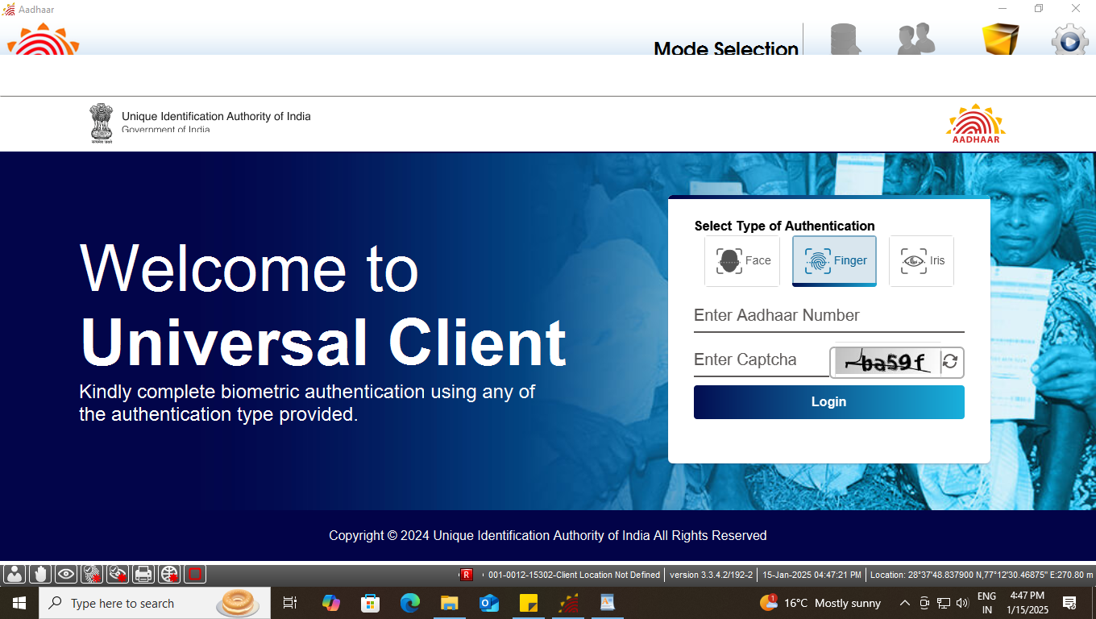
Step-2
Universal Client login page will appear, Enter the ‘Aadhaar Number’ of Operator and ‘CAPTCHA’ for Login.

Slide 4
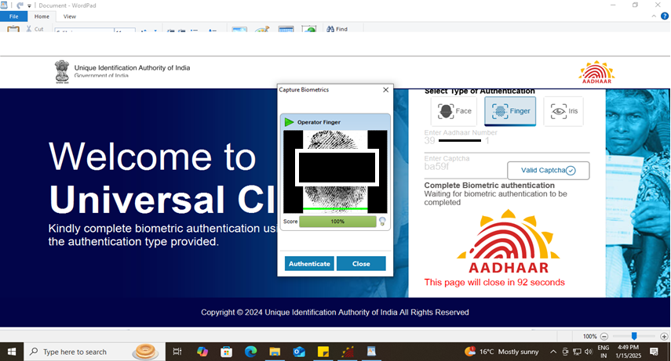
Step-3
Operator needs to give his/her biometric for authentication using – ‘fingerprint’ or ‘Iris’. Fingerprint authentication is possible using slaps scanner or Single fingerprint RD device. Iris authentication is possible using dual iris scanner or single iris RD device

Slide 5
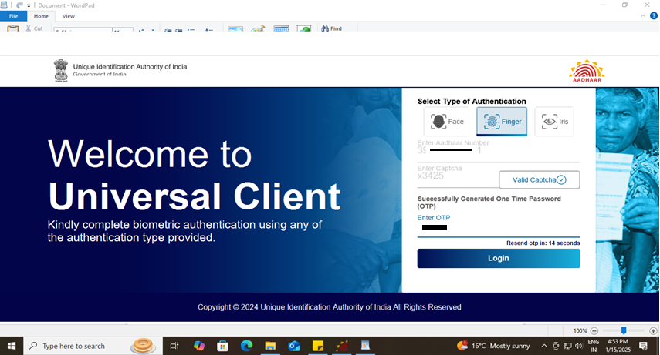
Step-4
After biometric authentication operator receives OTP, enter ‘OTP’ to proceed.

Slide 6
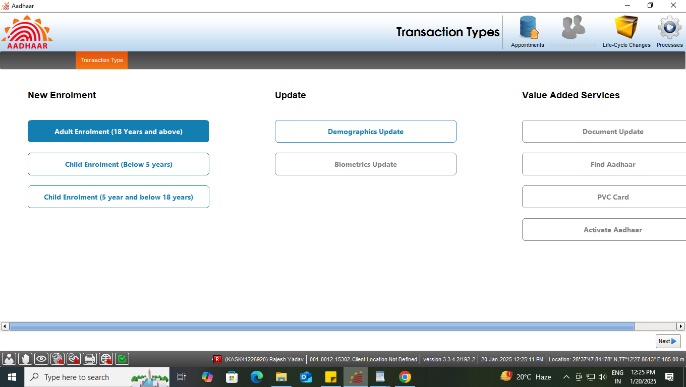
Step-5
Select the ‘Adult enrolment (18 years and above)’ under new enrolment option, click next

Slide 7
Type of Enrolment
Type of Address
Indian Address
Foreign Address

Slide 8
Case One
Resident having Indian Address

Slide 9
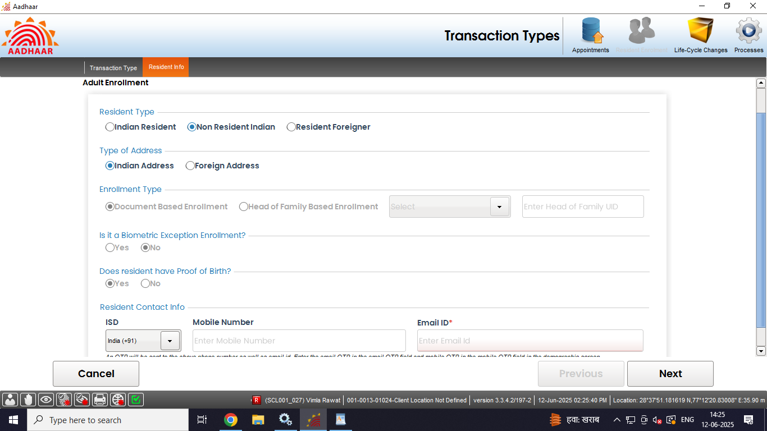
Step-6
Select “Non Resident Indian” radio button in resident type option, Then select ‘Indian Address’ if available, all other fields shall get selected according to the resident type.

Slide 10
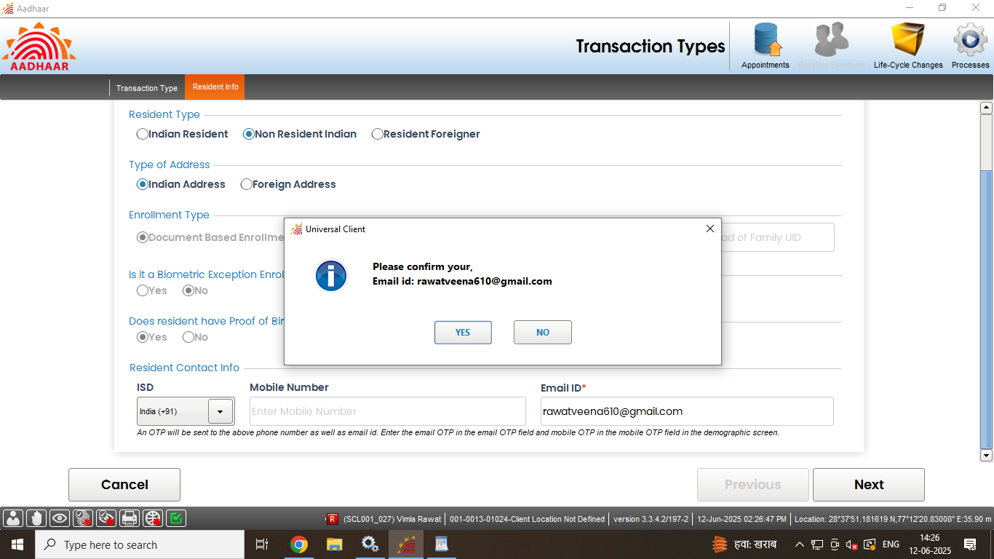
Step-7
Enter valid ‘email address (mandatory)’ and mobile number (optional).

Slide 11
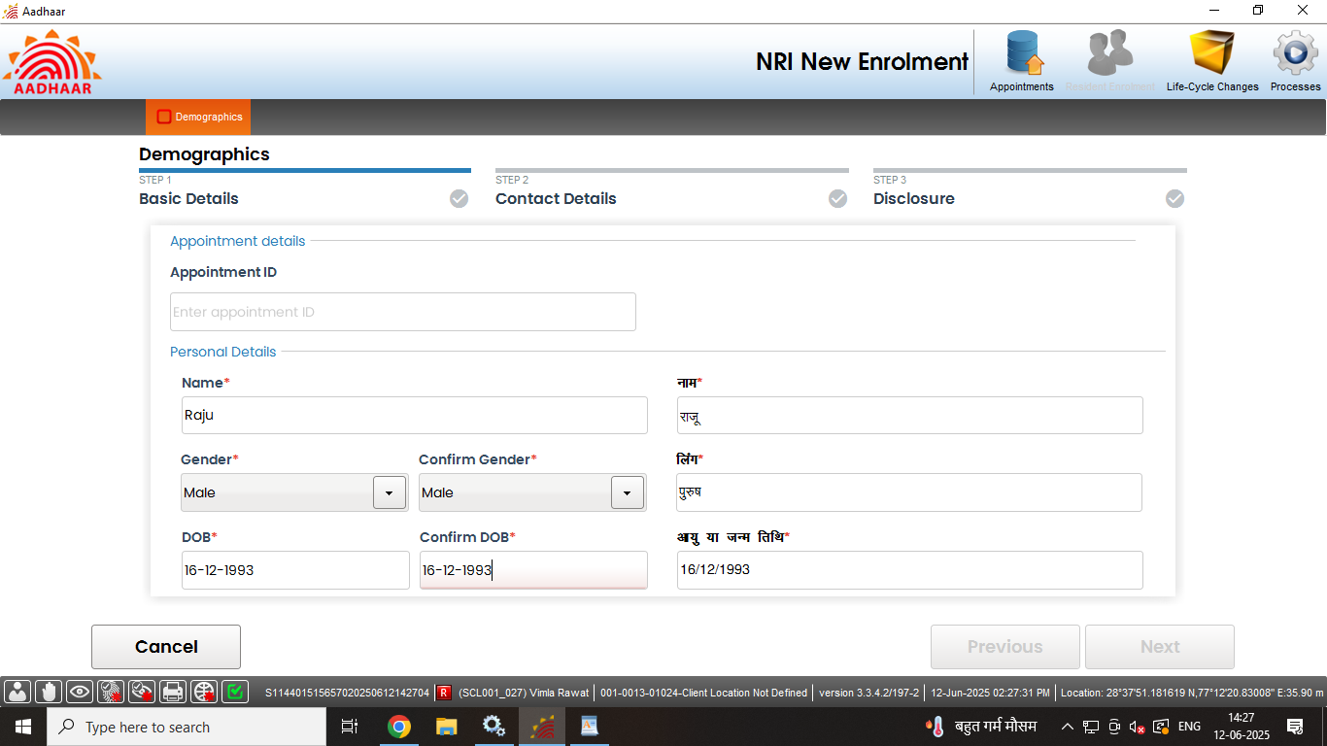
Step-8
Enter basic details of the resident as per filled submitted form:

Slide 12
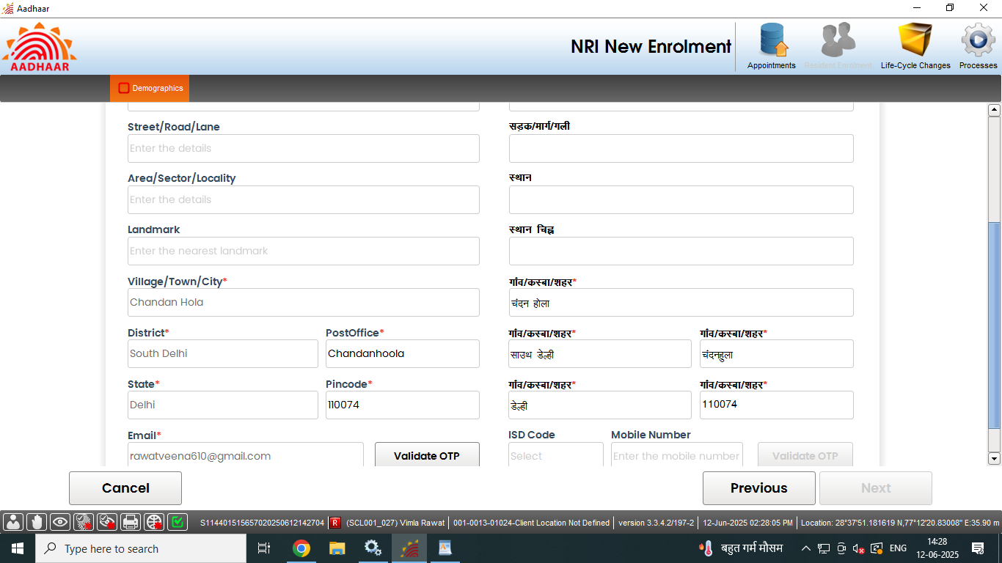
Step-9
Record address of the resident NRI. Fields with (*) mark (pin code, state, district and post office) are mandatory. Email address and mobile will be auto populated as per the details entered in step- 7, click next.

Slide 13
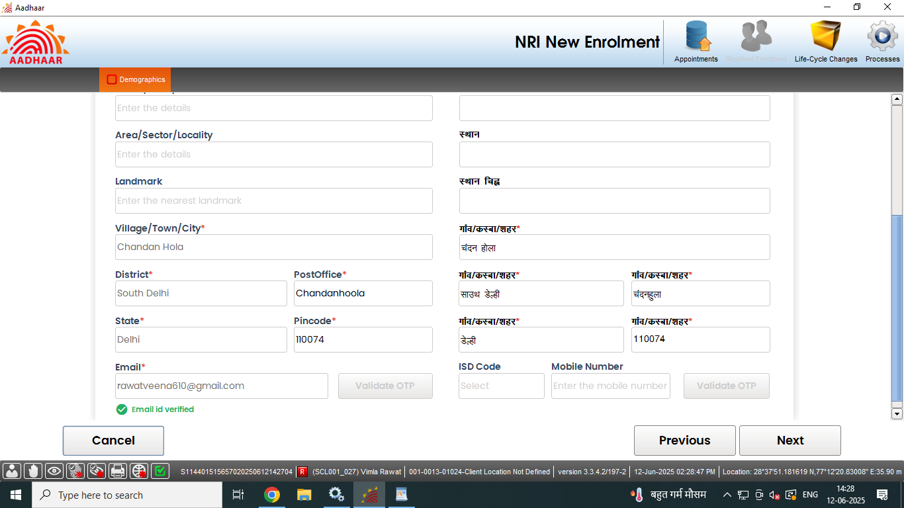
Step-10
‘Validate the email address’ and mobile number through OTP received on provided email and mobile number and click next.

Slide 14
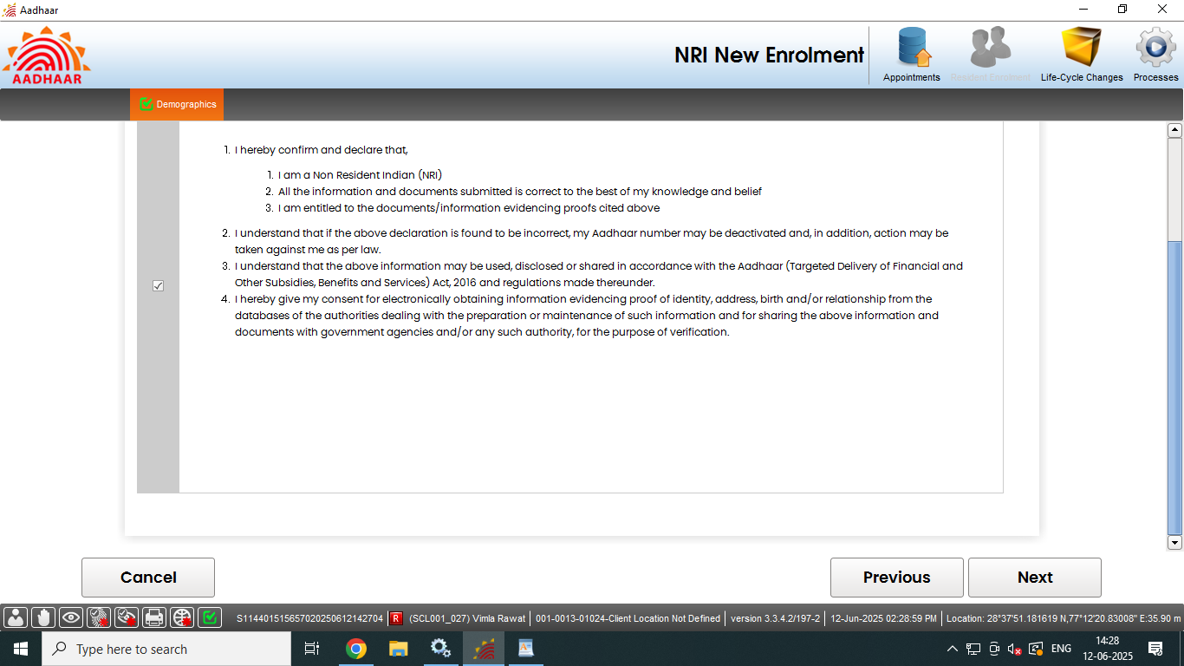
Step-11
Record ‘consent’ of the applicant by selecting check box and click next

Slide 15
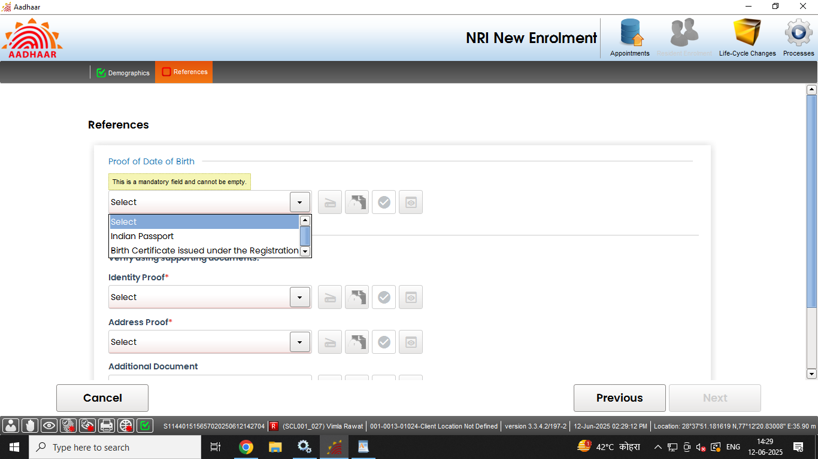
Step-12
Operator to click on the scan button to scan and upload the valid document displayed as per ‘List of acceptable document for Enrolment and Update’.
Click Here to Scan Documents

Slide 16
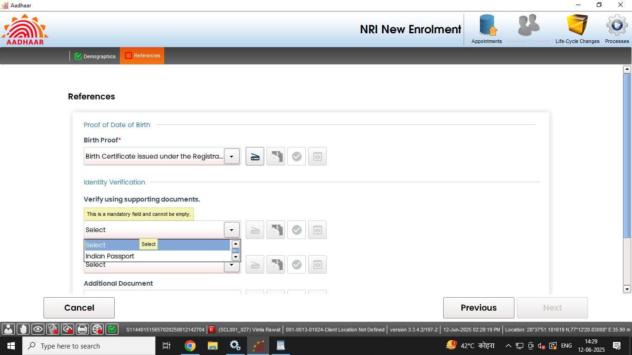
Step-13
Operator to click on the scan button to scan and upload the valid document displayed as per ‘List of acceptable document for Enrolment and Update’.

Slide 17
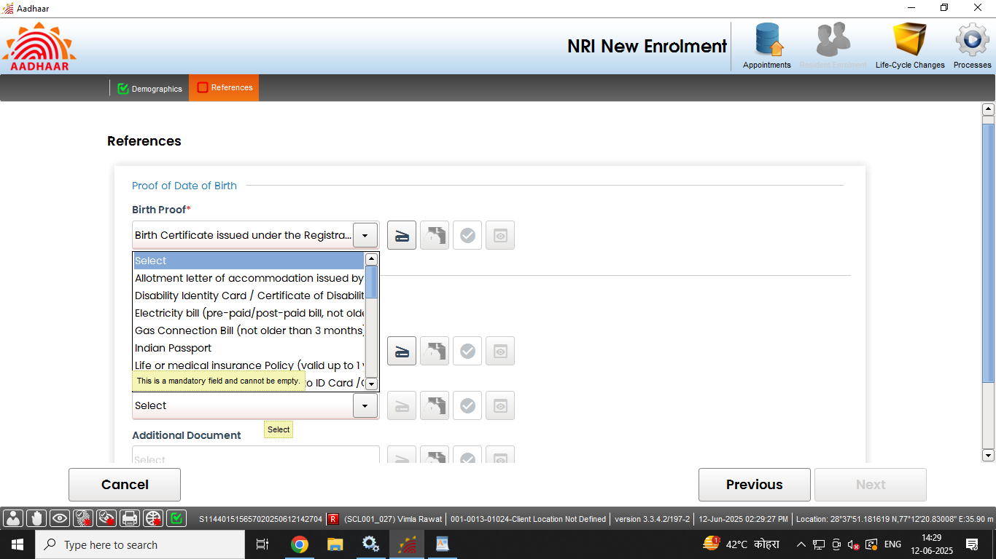
Step-14
Operator to click on the scan button to scan and upload the valid document displayed as per ‘List of acceptable document for Enrolment and Update’.

Slide 18
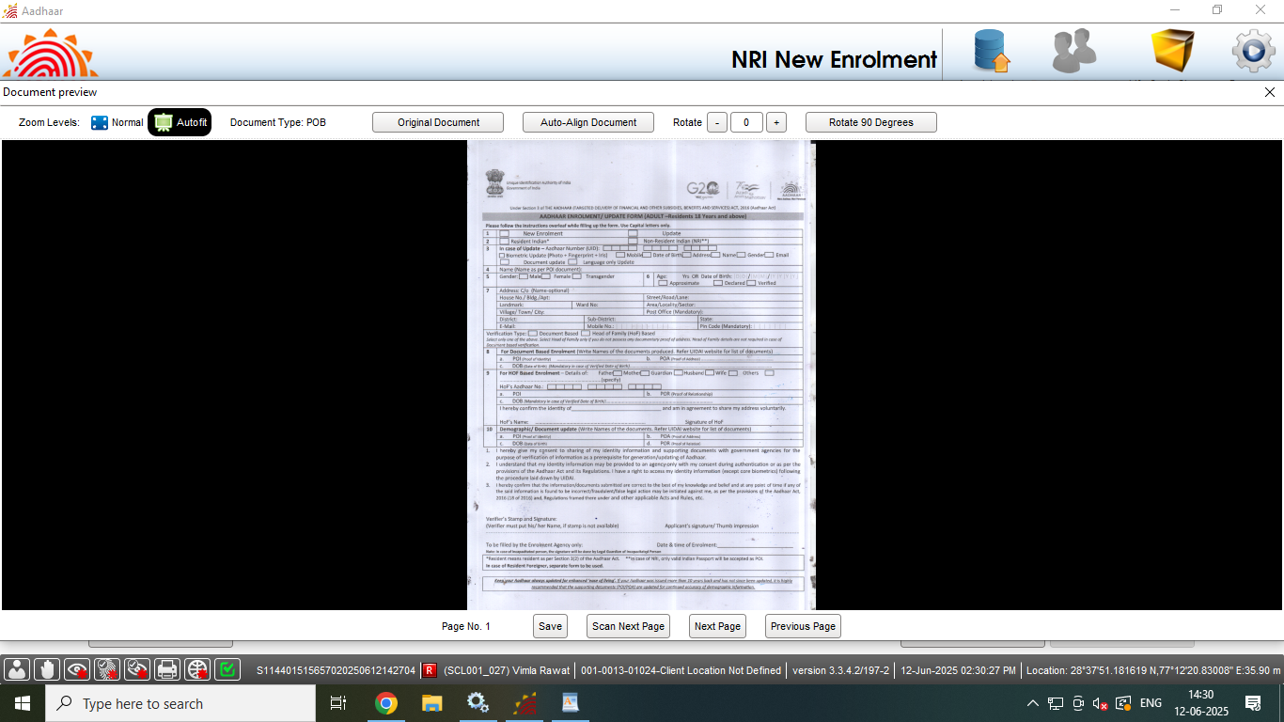
Step-15
Preview of the scanned document would appear, operator shall check the document preview

Slide 19
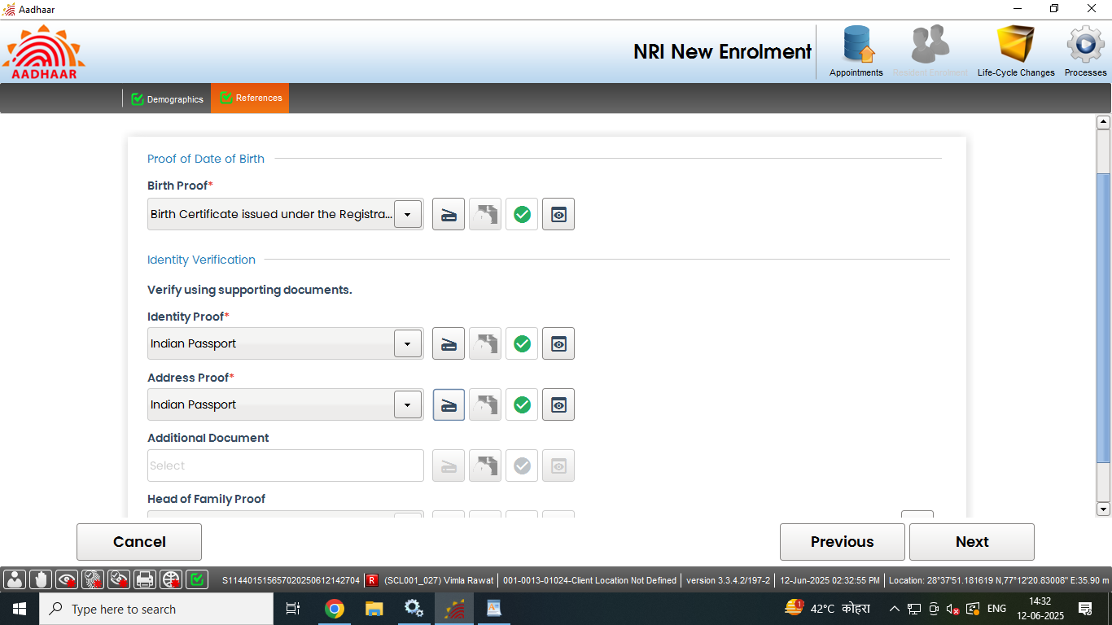
Step-16
Similarly upload all the valid documents. After the scanning is done successfully "Green Tick" symbol indicates that the upload to backend service is successful. Click next.

Slide 20
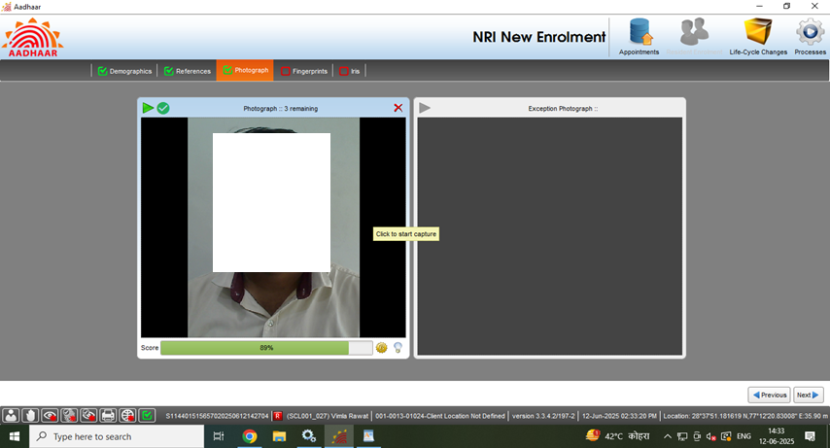
Step-17
Capture face of the applicant as per process and click next

Slide 21
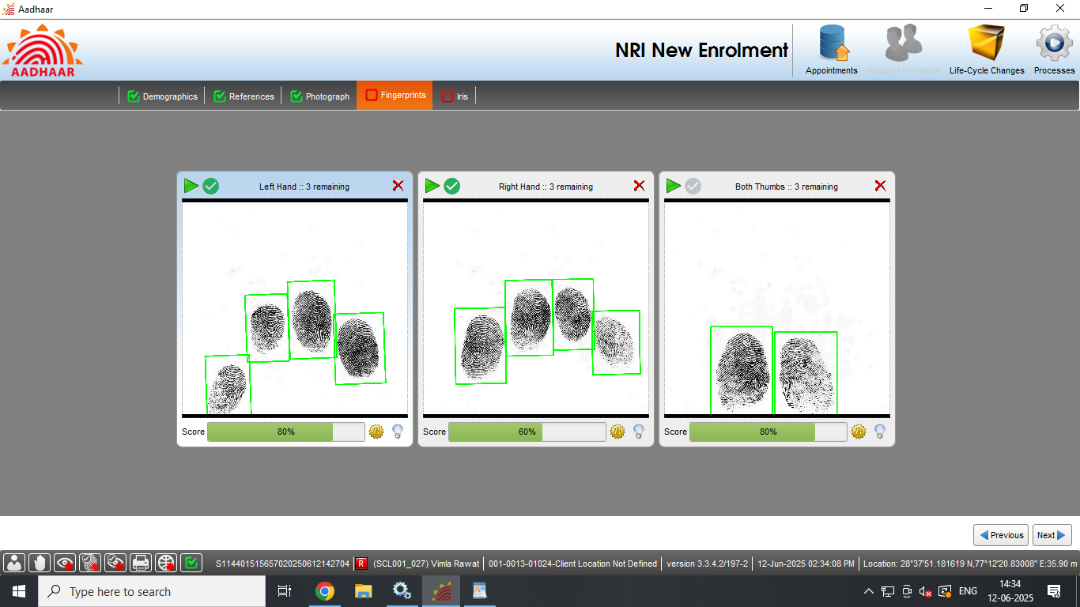
Step-18
Capture the fingerprints of the resident and click next.

Slide 22
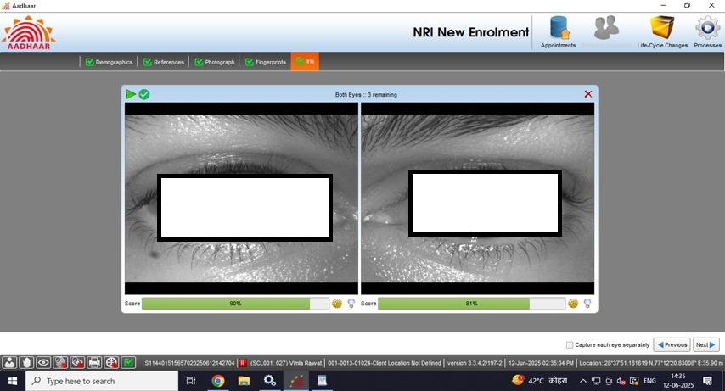
Step-19
Capture both iris of the resident and click next

Slide 23
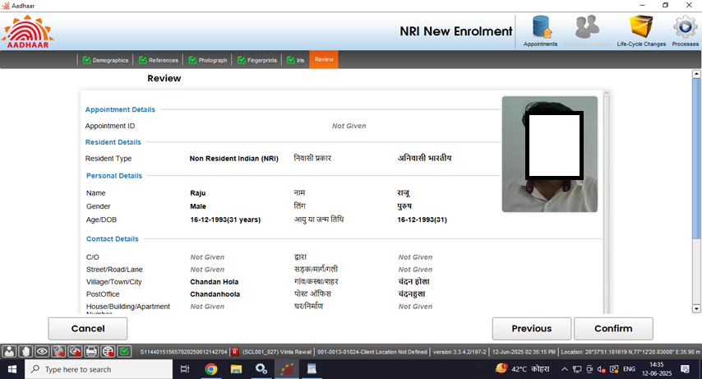
Step-20
Request the applicant to verify all the entered details, in the review page. After the operator’s confirmation, the details cannot be changed.

Slide 24
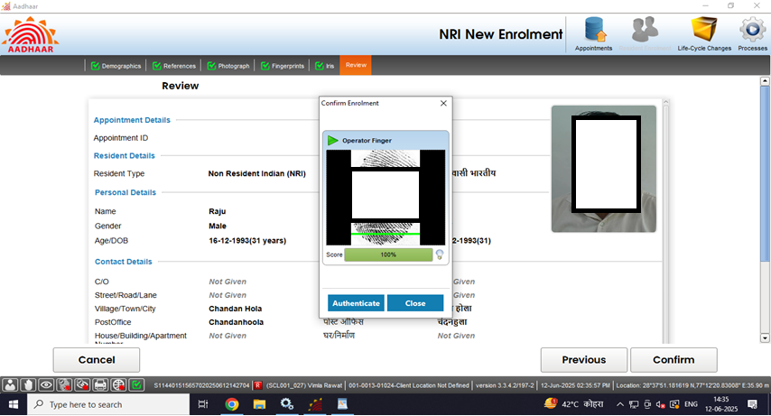
Step-21
The operator should confirm that the entered details are correct by providing his/her biometrics.

Slide 25
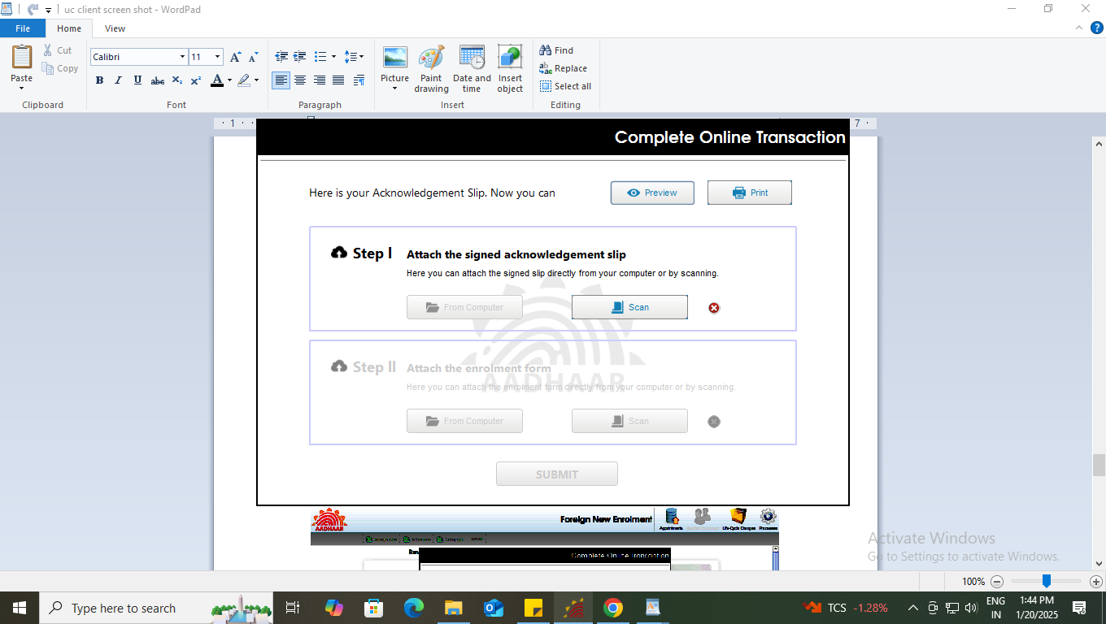
Step-22
After the confirmation, operator can preview the acknowledgement slip.

Slide 26
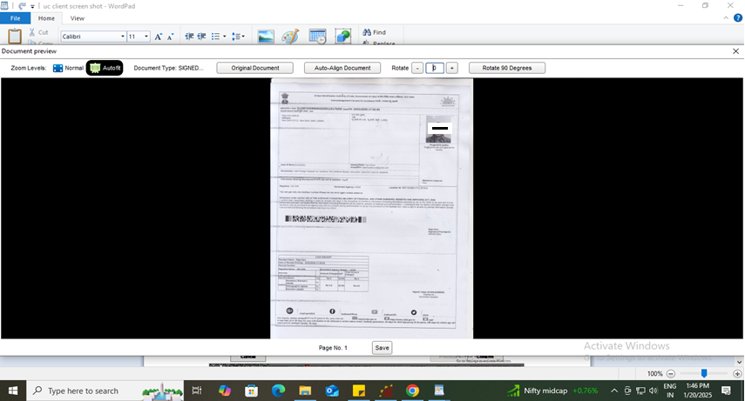
Step-23
See the Preview of acknowledgement slip and take the print-out for uploading the same

Slide 27
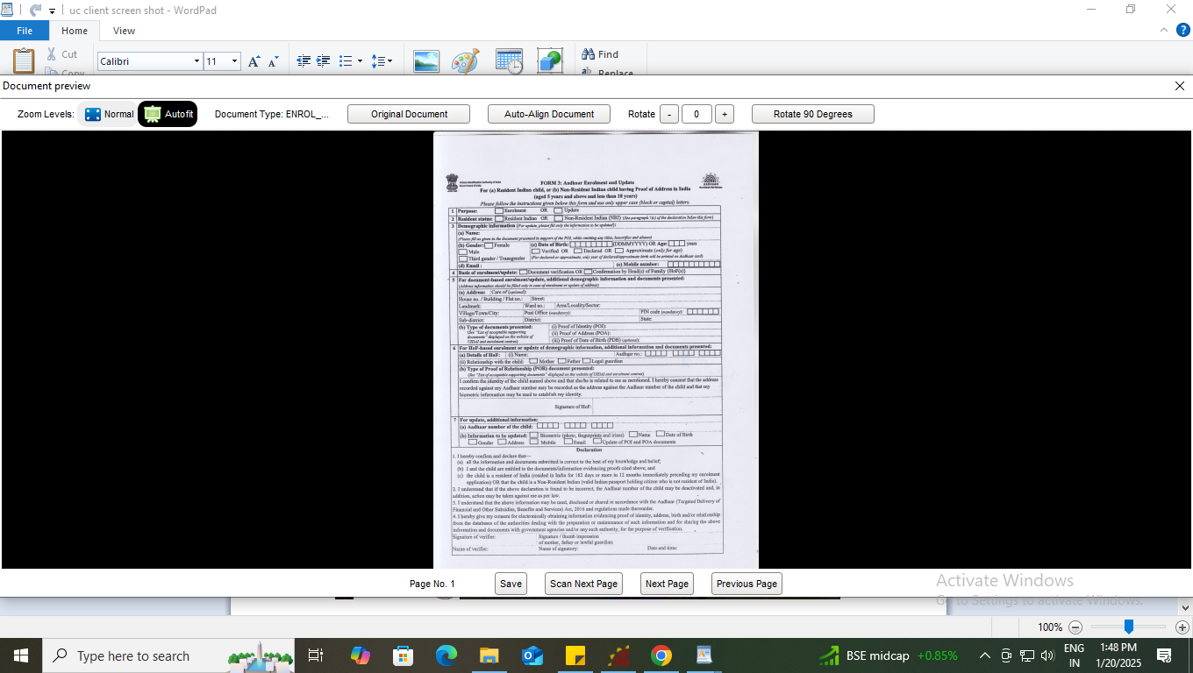
Step-24
Scan and upload the signed enrolment form filled by the resident

Slide 28
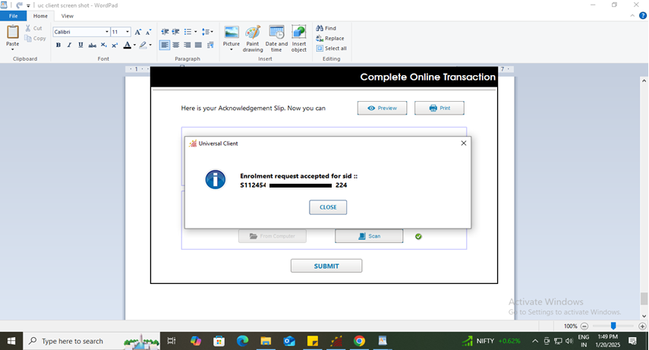
Step-25
After uploading the enrolment form submit button will be enabled, after successful submission of enrolment request following message will be displayed.

Slide 29
Case Two
Resident having Foreign Address

Slide 30
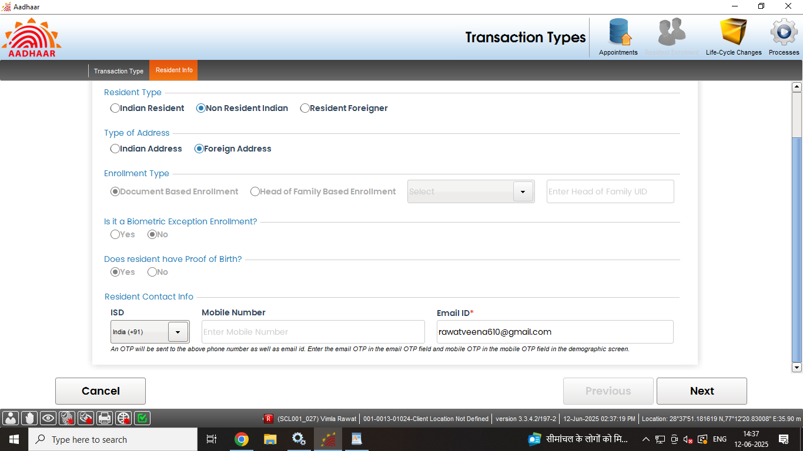
Step-6
Select “Non Resident Indian” radio button in resident type option, then select “Foreign Address”, all other fields shall get selected according to the resident type.

Slide 31
Step-7
Enter valid ‘email address (mandatory)’ and mobile number (optional).

Slide 32
Step-8
Enter basic details of the resident as per filled submitted form:

Slide 33
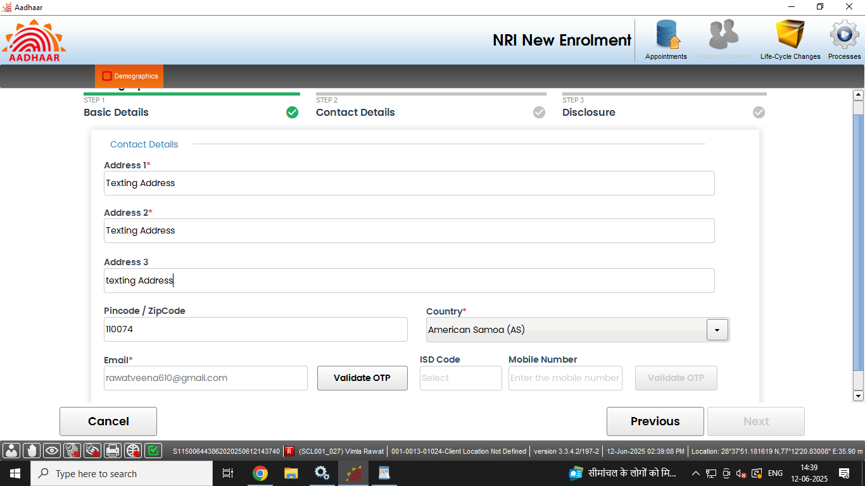
Step-9
Record addresses of the resident NRI. Fields with (*) mark (pin code, country name) are mandatory. Email address and mobile will be auto populated as per the details entered in step- 7, click next.

Slide 34
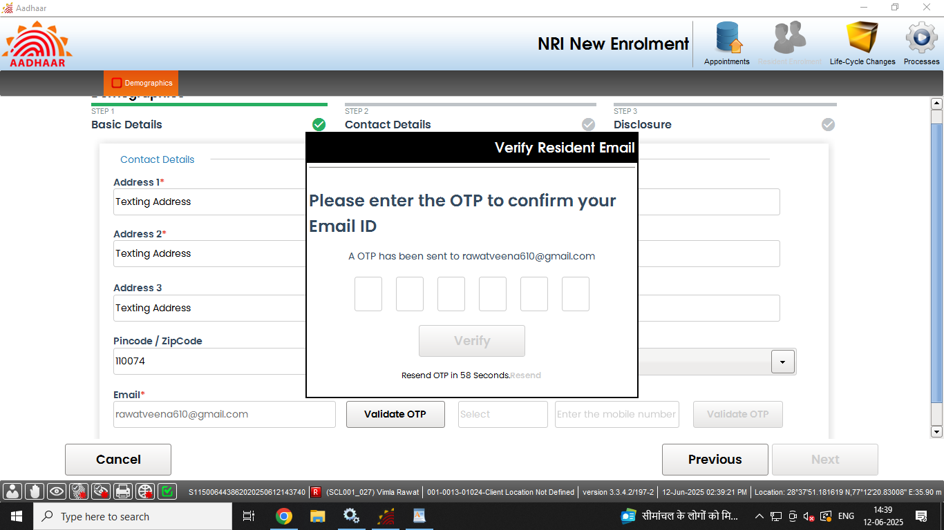
Step-10
‘Validate the email address’ and mobile number through OTP received on provided email and mobile number and click next.

Slide 35
Step-10
‘Validate the email address’ and mobile number through OTP received on provided email and mobile number and click next.

Slide 36
Step-11
Record ‘consent’ of the applicant by selecting check box and click next

Slide 37
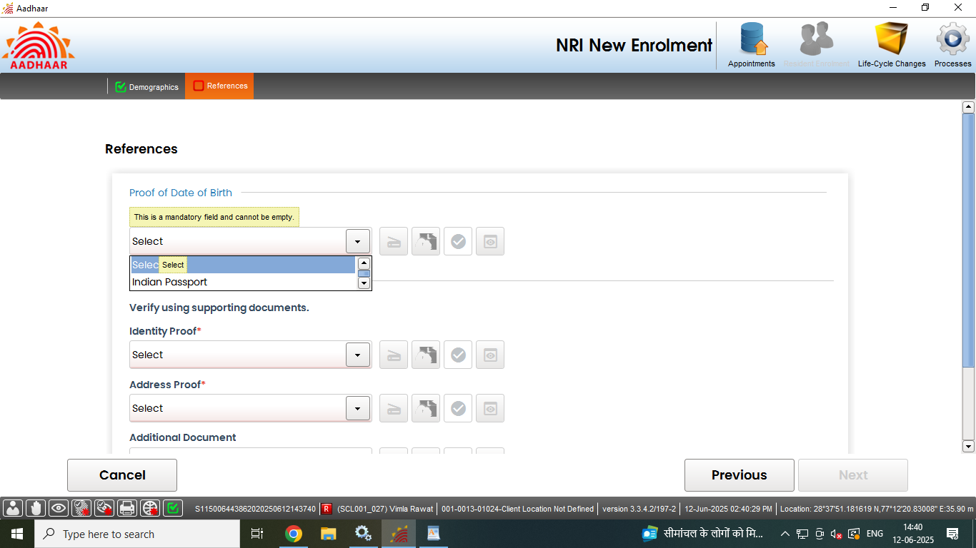
Step-12
Operator to click on the scan button to scan and upload the valid document displayed as per ‘List of acceptable document for Enrolment and Update’.
Click Here to Scan Documents

Slide 38
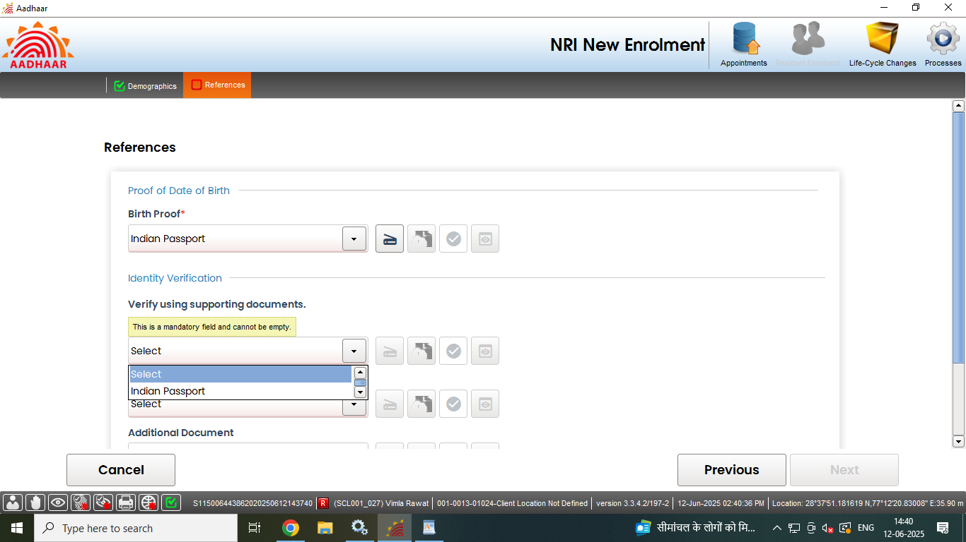
Step-13
Operator to click on the scan button to scan and upload the valid document displayed as per ‘List of acceptable document for Enrolment and Update’.

Slide 39
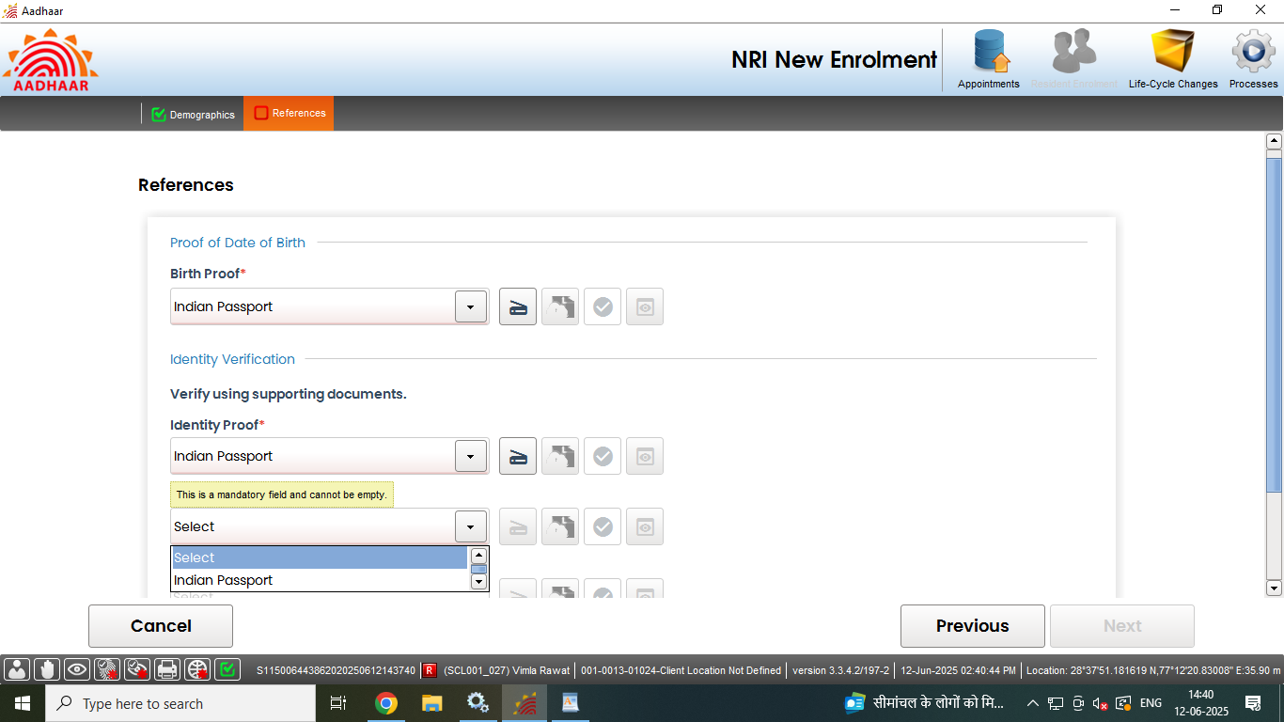
Step-14
Operator to click on the scan button to scan and upload the valid document displayed as per ‘List of acceptable document for Enrolment and Update’.

Slide 40
Step-15
Preview of the scanned document would appear, operator shall check the document preview

Slide 41
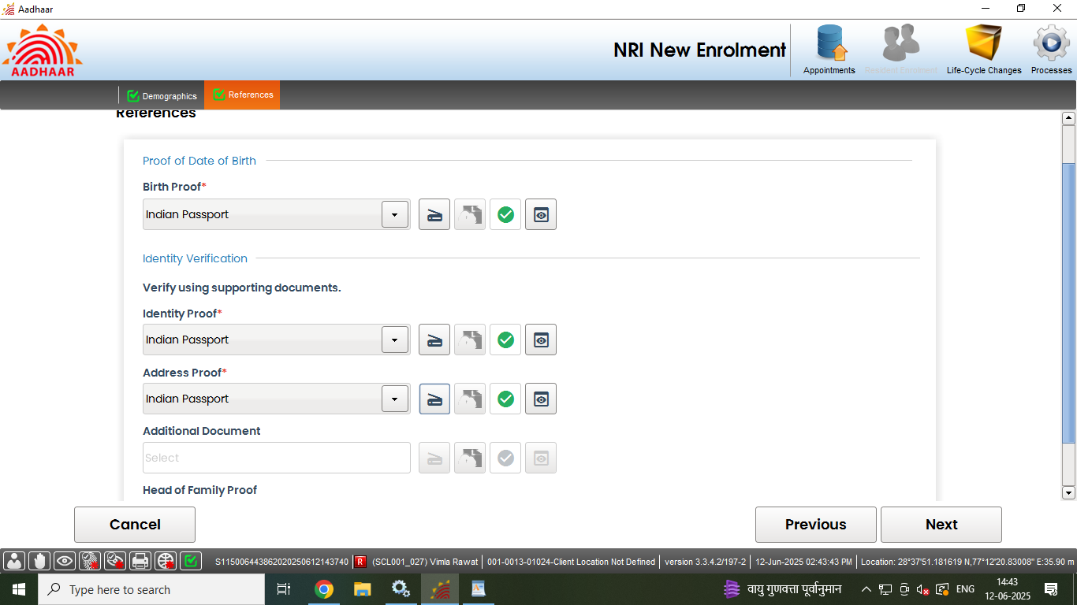
Step-16
Similarly upload all the valid documents. After the scanning is done successfully "Green Tick" symbol indicates that the upload to backend service is successful. Click next.

Slide 42
Step-17
Capture face of the applicant as per process and click next

Slide 43
Step-18
Capture the fingerprints of the resident and click next.

Slide 44
Step-19
Capture both iris of the resident and click next

Slide 45
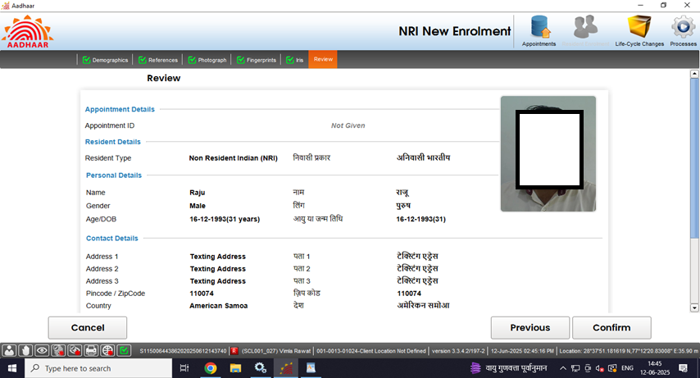
Step-20
Request the applicant to verify all the entered details, in the review page. After the operator’s confirmation, the details cannot be changed.

Slide 46
Step-21
The operator should confirm that the entered details are correct by providing his/her biometrics.

Slide 47
Step-22
After the confirmation, operator can preview the acknowledgement slip.

Slide 48
Step-23
See the Preview of acknowledgement slip and take the print-out for uploading the same

Slide 49
Step-24
Scan and upload the signed enrolment form filled by the resident

Slide 50
Step-25
After uploading the enrolment form submit button will be enabled, after successful submission of enrolment request following message will be displayed.

Slide 51
Thank You

