Slide 1
Demographic Update

Slide 2
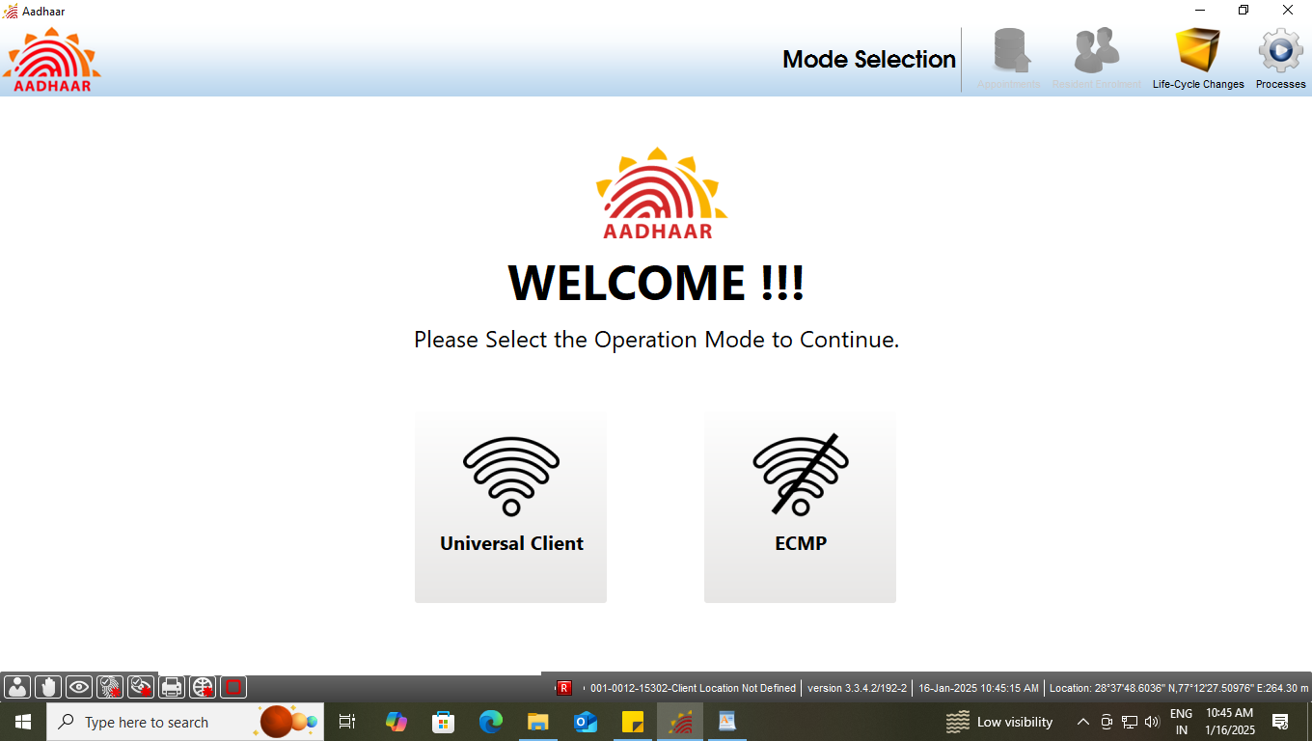
Step-1
Please ensure that the client is connected to internet, then Operator select the option ‘Universal Client’ in Mode Selection.

Slide 3
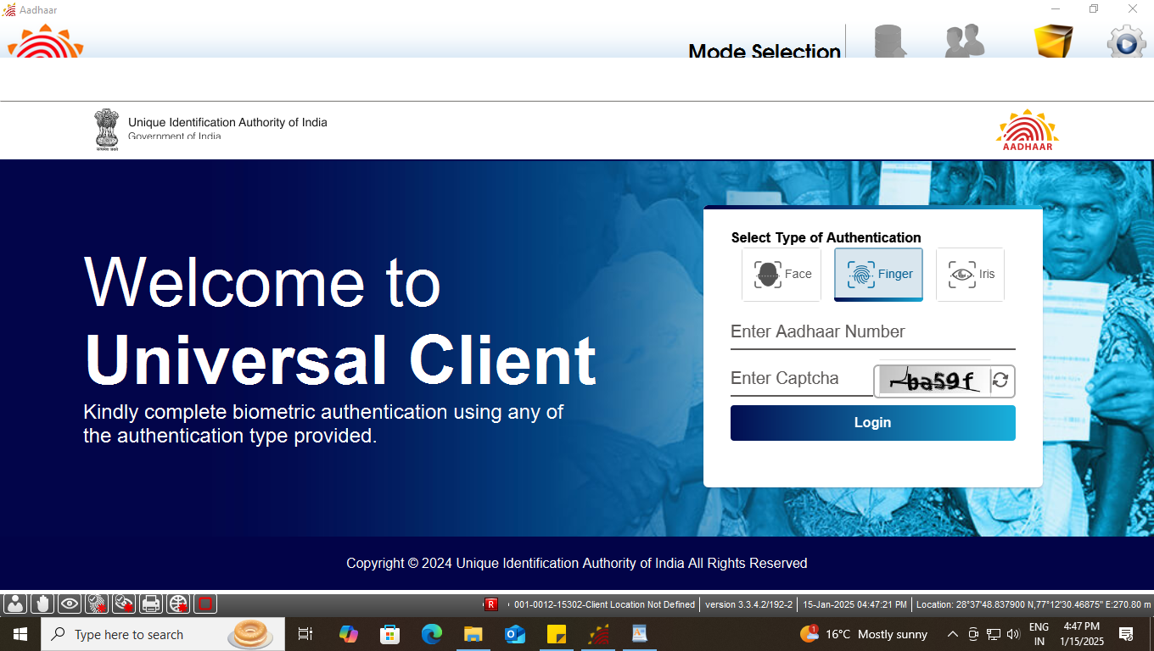
Step-2
Universal Client login page will appear, Enter the ‘Aadhaar Number’ and ‘CAPTCHA’ for login.

Slide 4
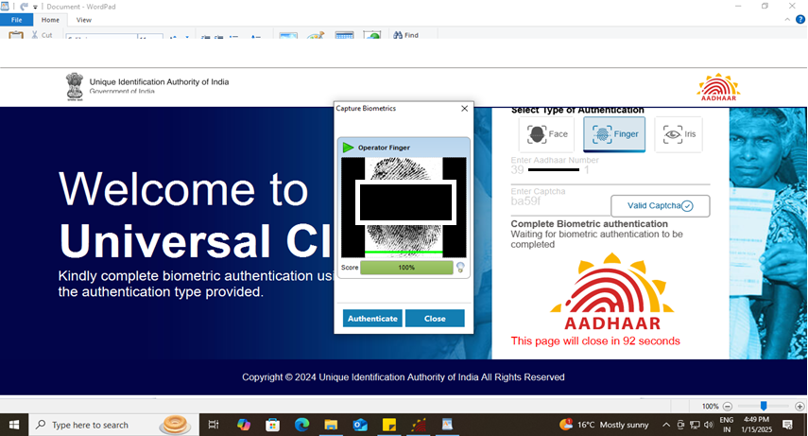
Step-3
Operator needs to give his/her ‘biometric’ for authentication using - fingerprint or Iris.

Slide 5
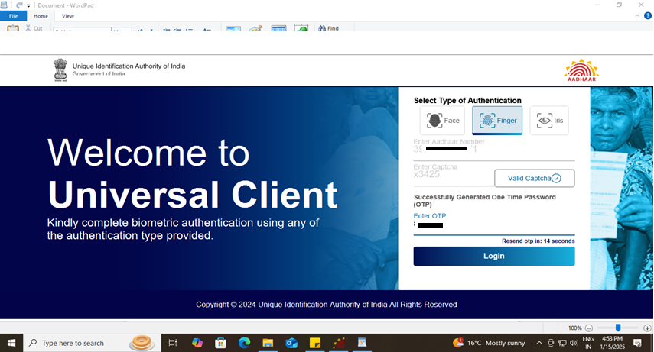
Step-4
After biometric authentication operator received an OTP, Further, Operator will enter the received OTP to proceed.

Slide 6
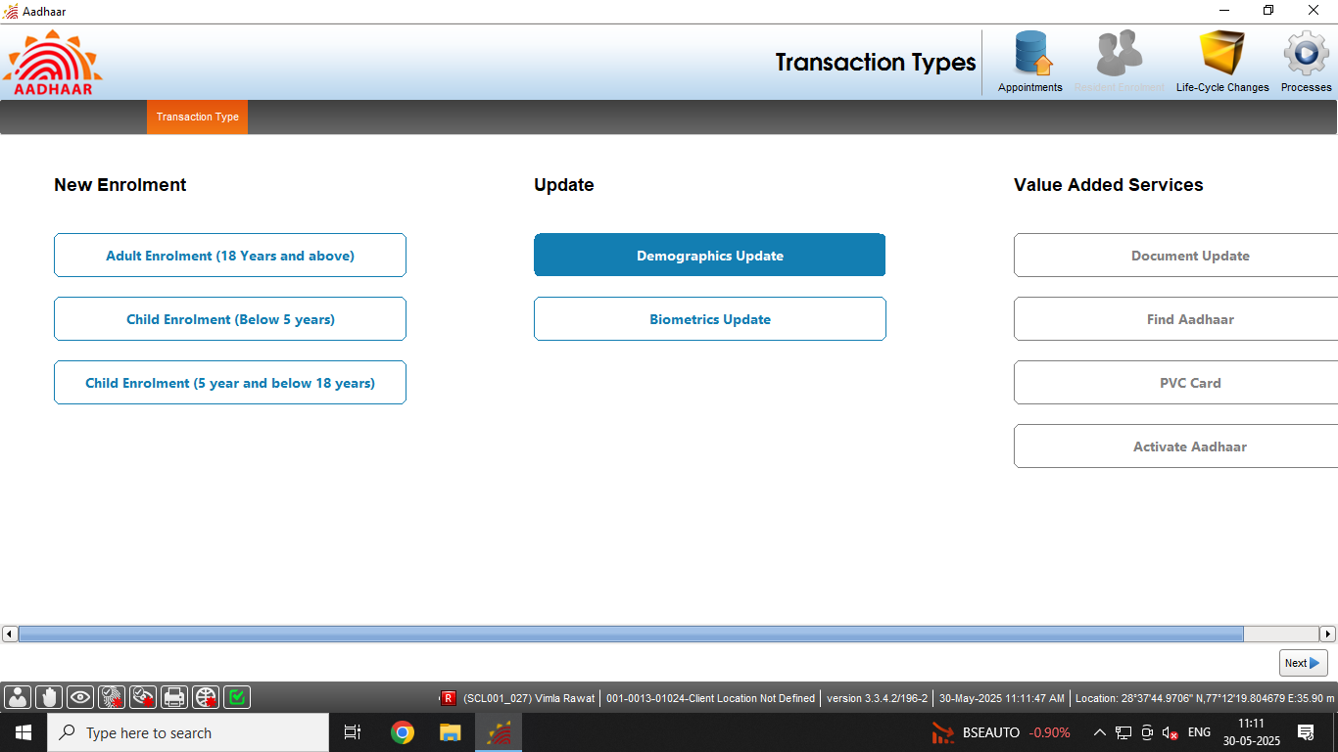
Step-5
Select ‘Demographics Update’ tab under Update option, then click next

Slide 7
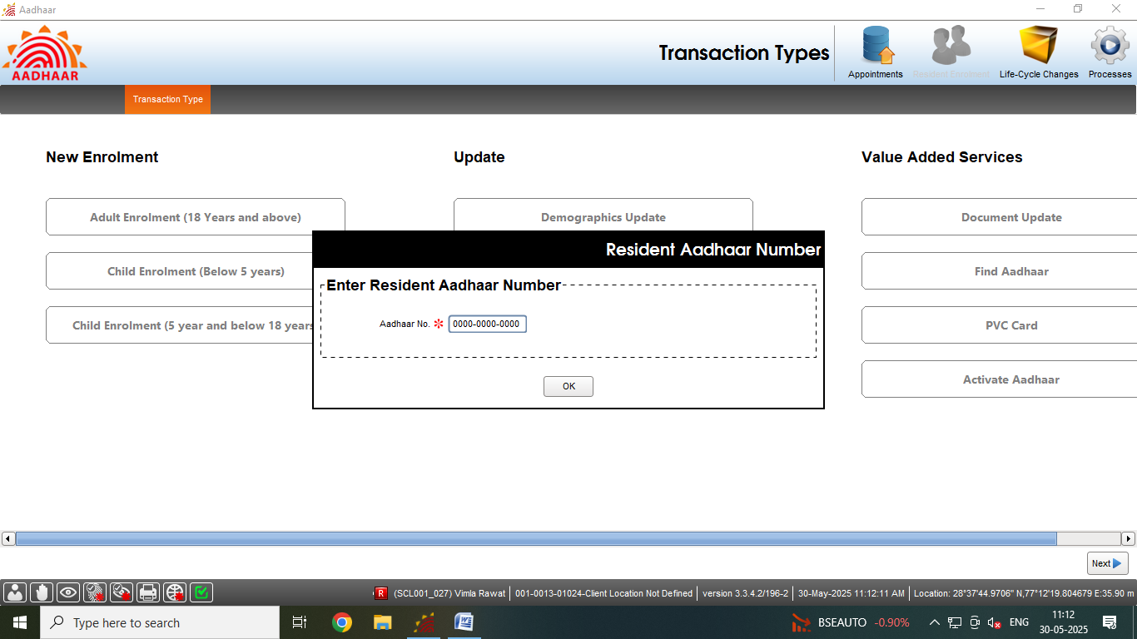
Step-6
Enter the ‘Resident Aadhaar number’ from filled submitted form, then click next

Slide 8
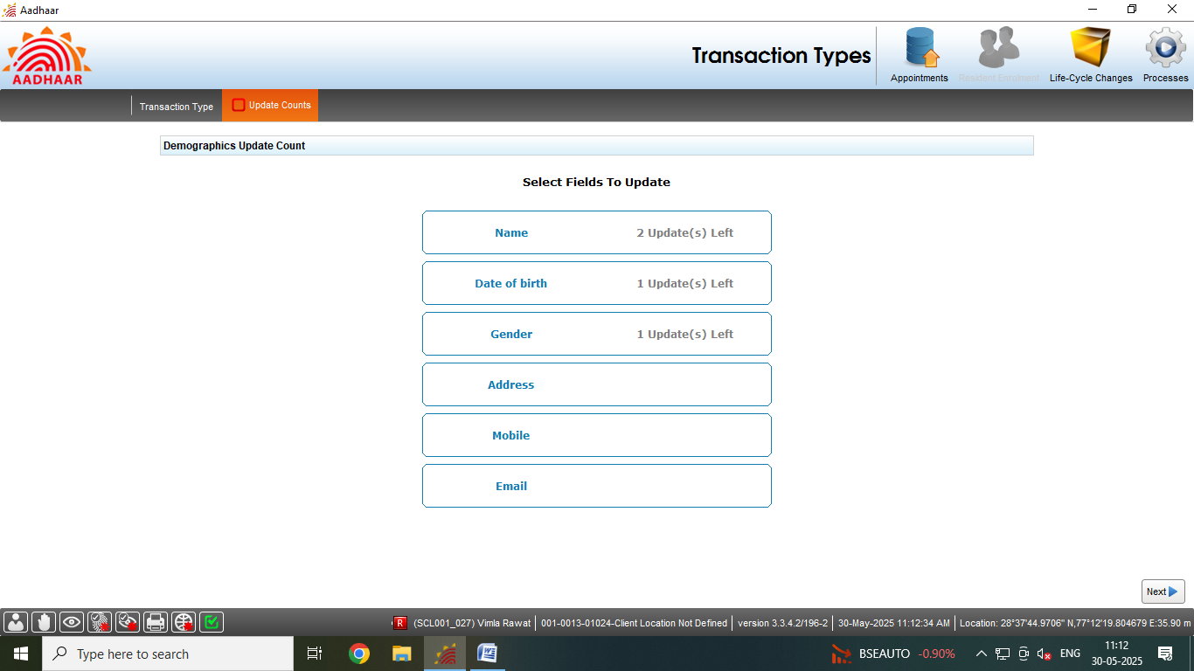
Step-7
Operator may select particular fields or all the relevant fields that resident wants to update.

Slide 9
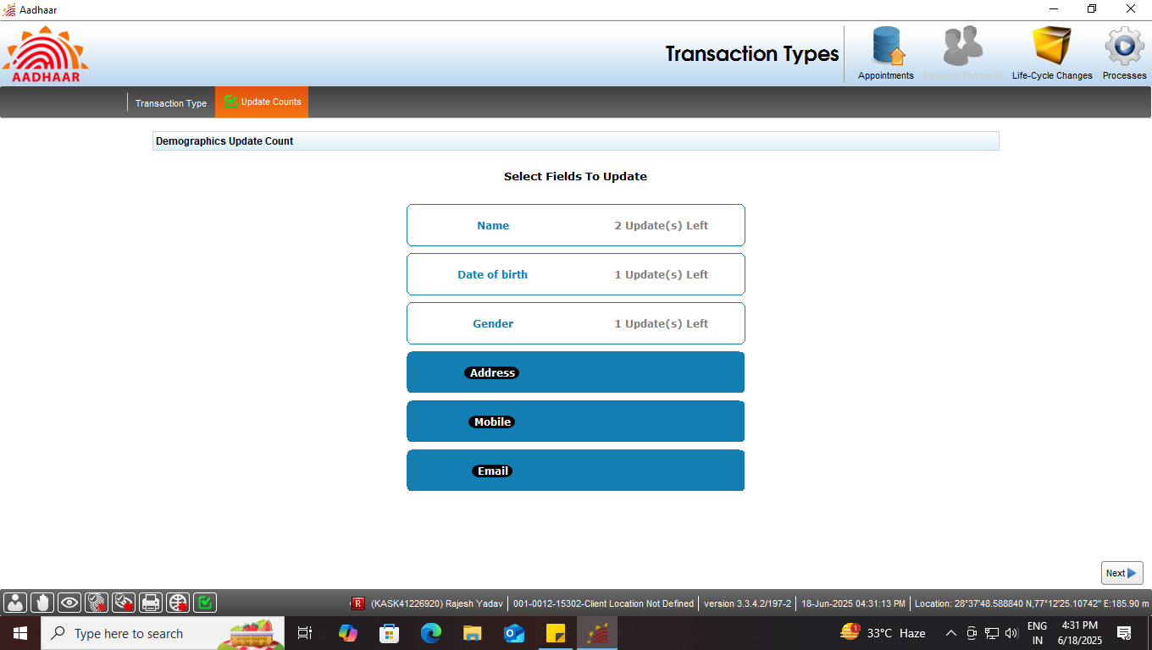
Step-7
In present case ‘Address’, ‘Mobile’ and ‘Email’ are being updated.

Slide 10
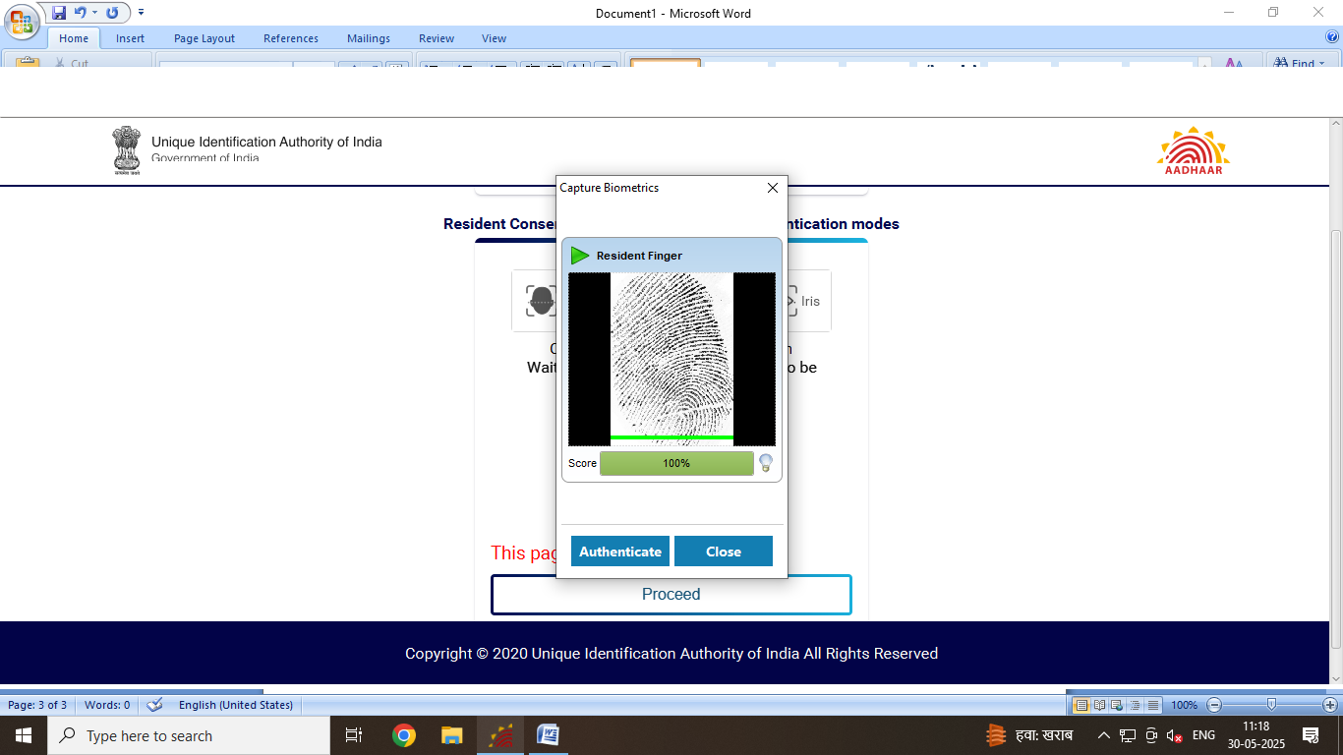
Step-8
Operator now take the resident consent via any Biometric Authentication mode (i.e. Face/Finger/Iris) by clicking on ‘Proceed’, button and authenticate the same.

Slide 11
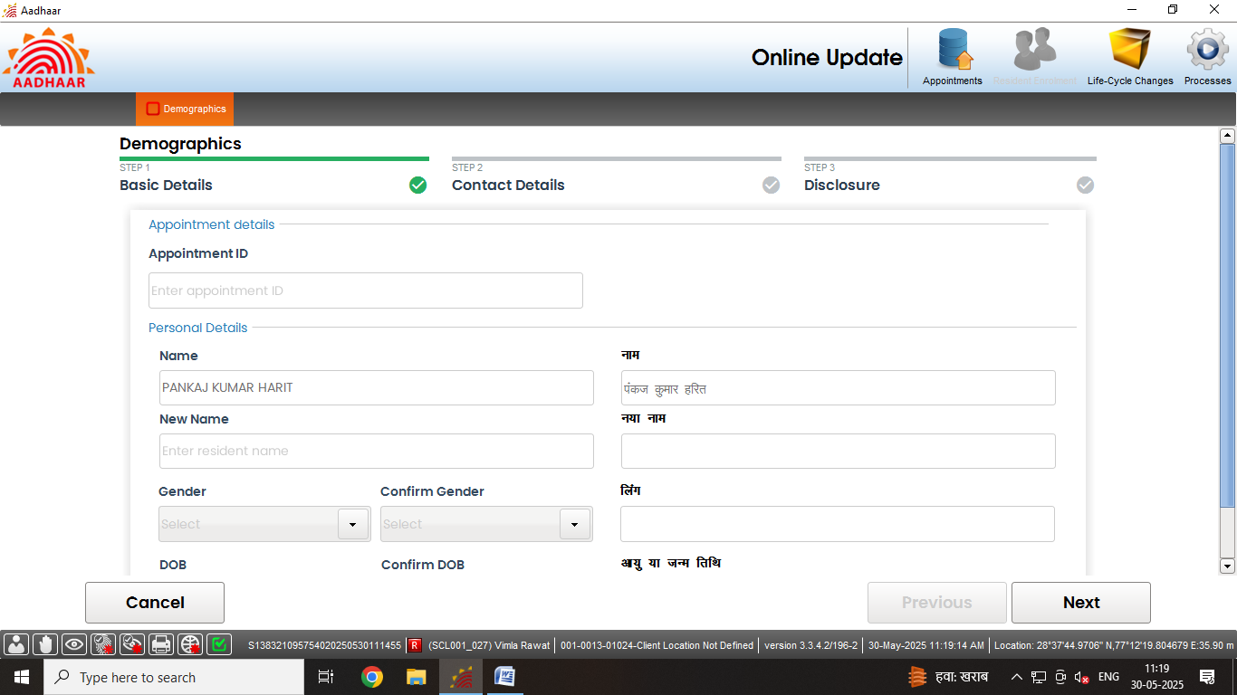
Step-9
Resident Basic and contact details are auto populated, then click next

Slide 12
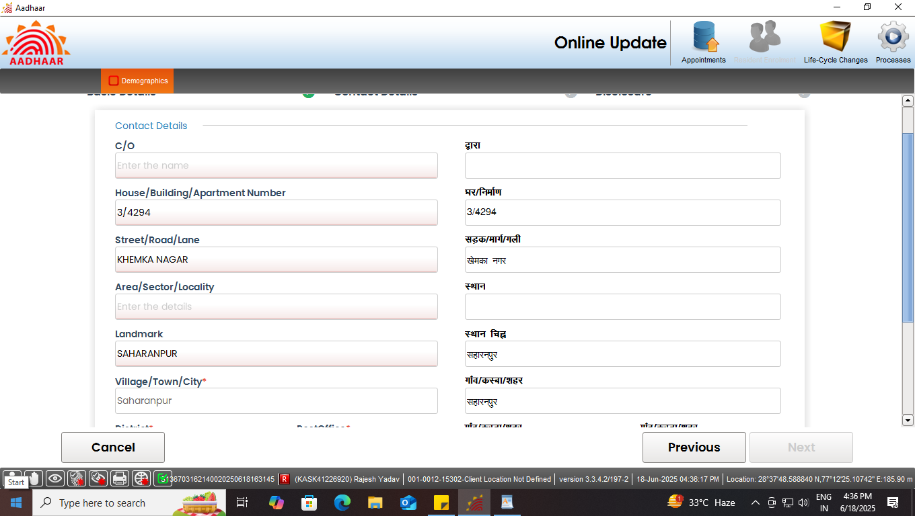
Step-10
Resident Basic and contact details are auto populated, then click next

Slide 13
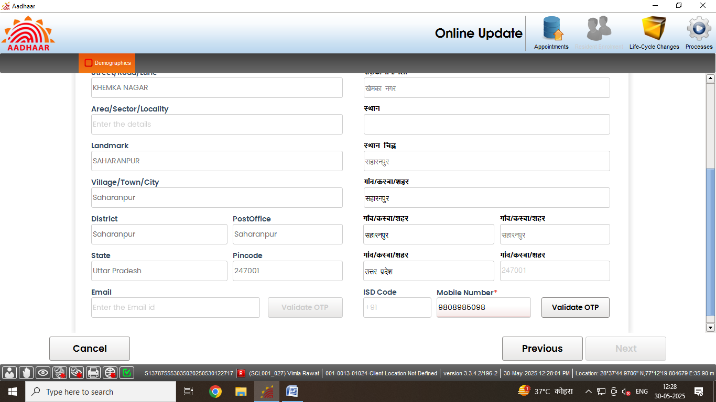
Step-11
In contact details, operator can edit details like Address, Mobile no. and email Id. Further, Operator needs to validate both email Id and Mobile no. of the resident.

Slide 14
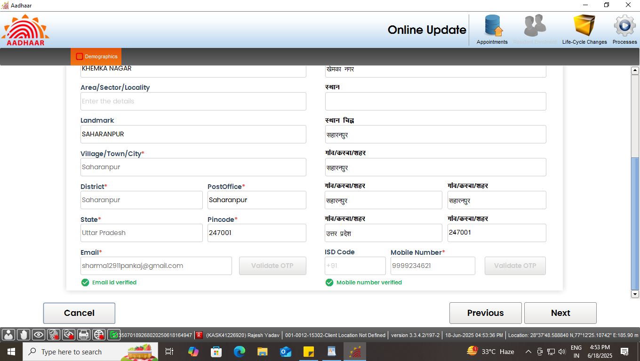
Step-12
Email id and Phone number will be verified.

Slide 15
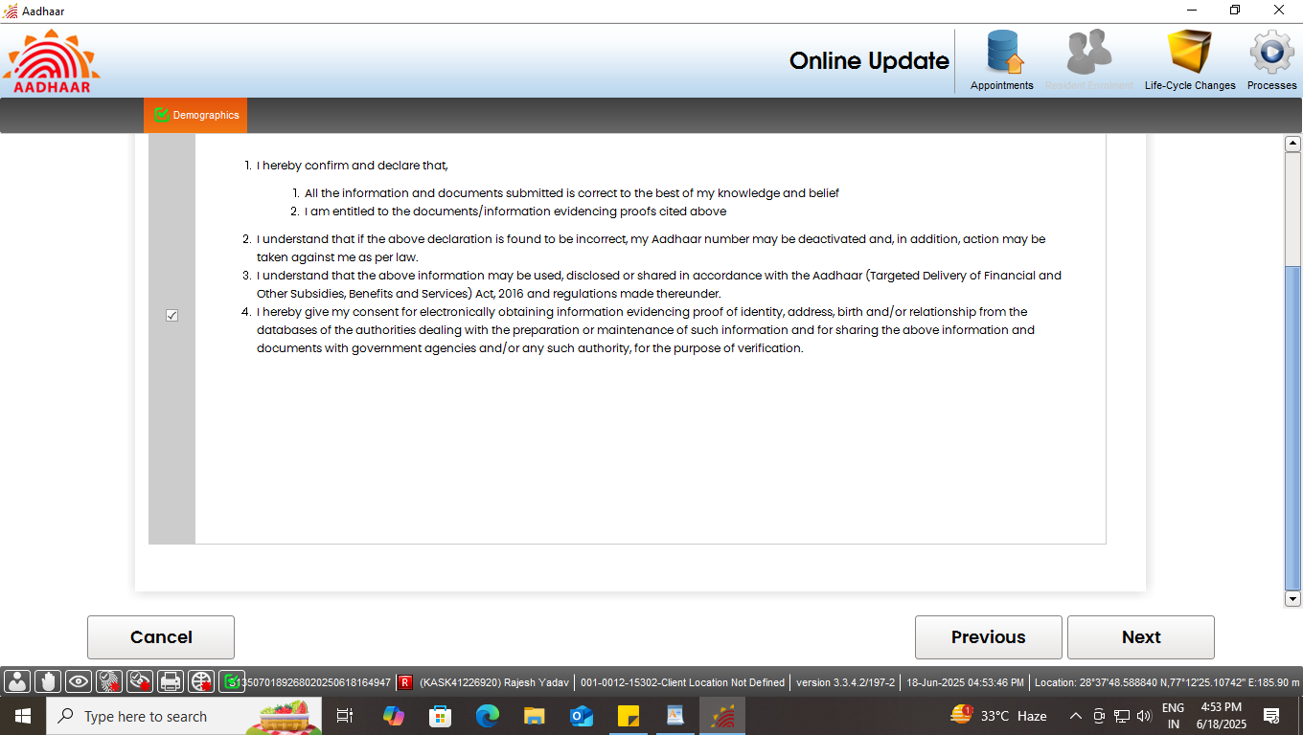
Step-13
Request resident to read the disclosure and give their consent by selecting check box, Click Next

Slide 16
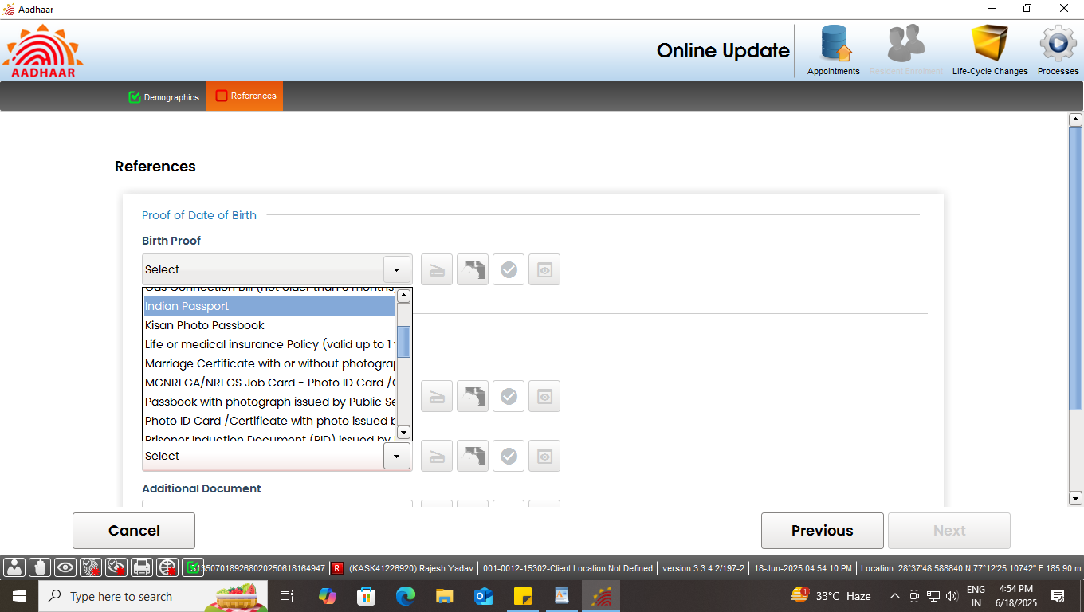
Step-11
Select and scan the valid document for Address proof.

Slide 17
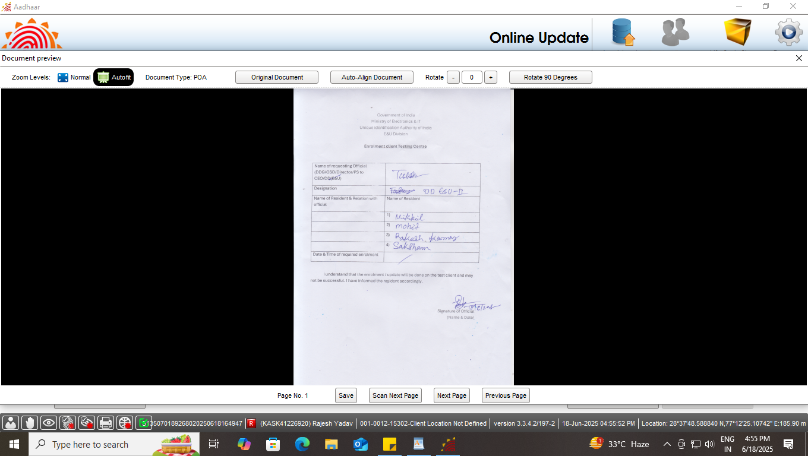
Step-11
Preview the scan document.

Slide 18
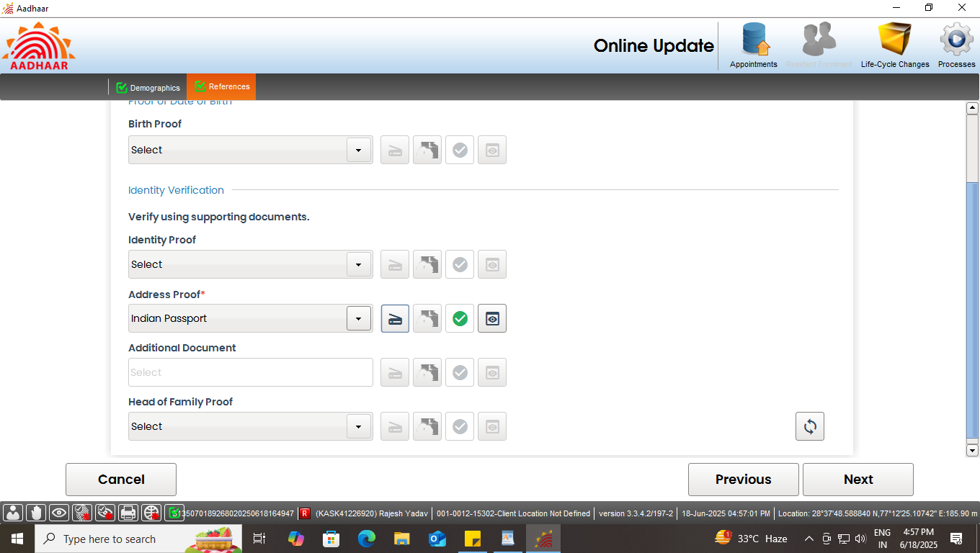
Step-11
After the scanning is done successfully a ‘Green tick’ will appear for validation of the document. Click next

Slide 19
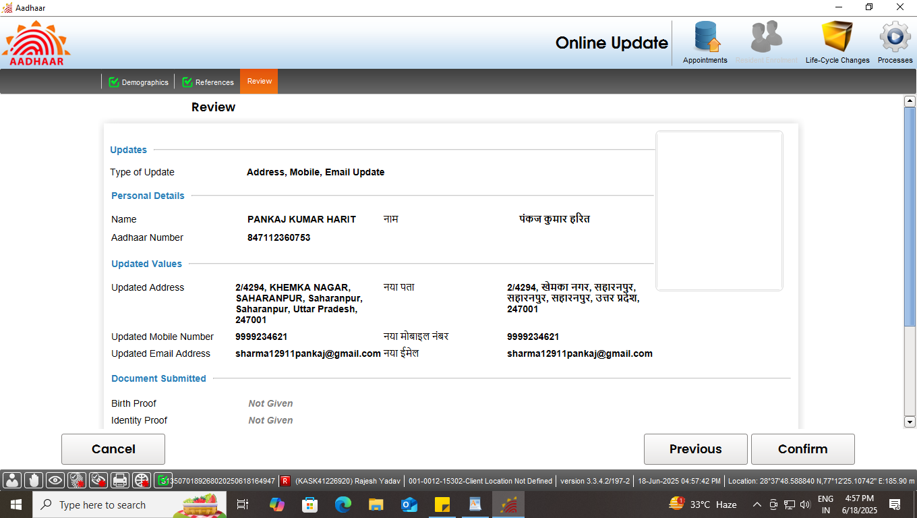
Step-12
The residents will verify all the entered details in the review page. After the operator’s confirmation, the details cannot be changed.

Slide 20
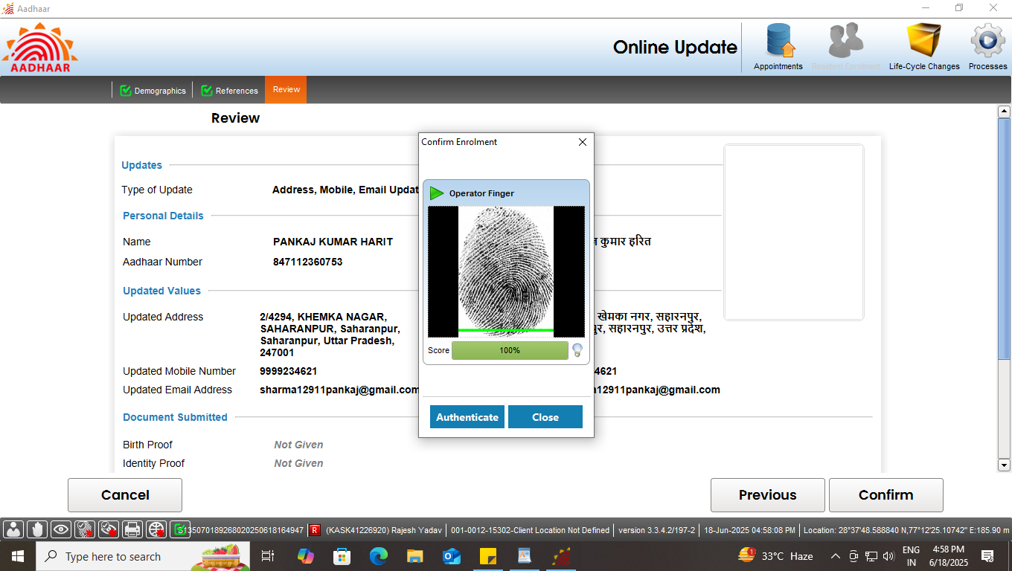
Step-12
The operator will confirm that the entered details are correct by providing his/her biometrics.

Slide 21
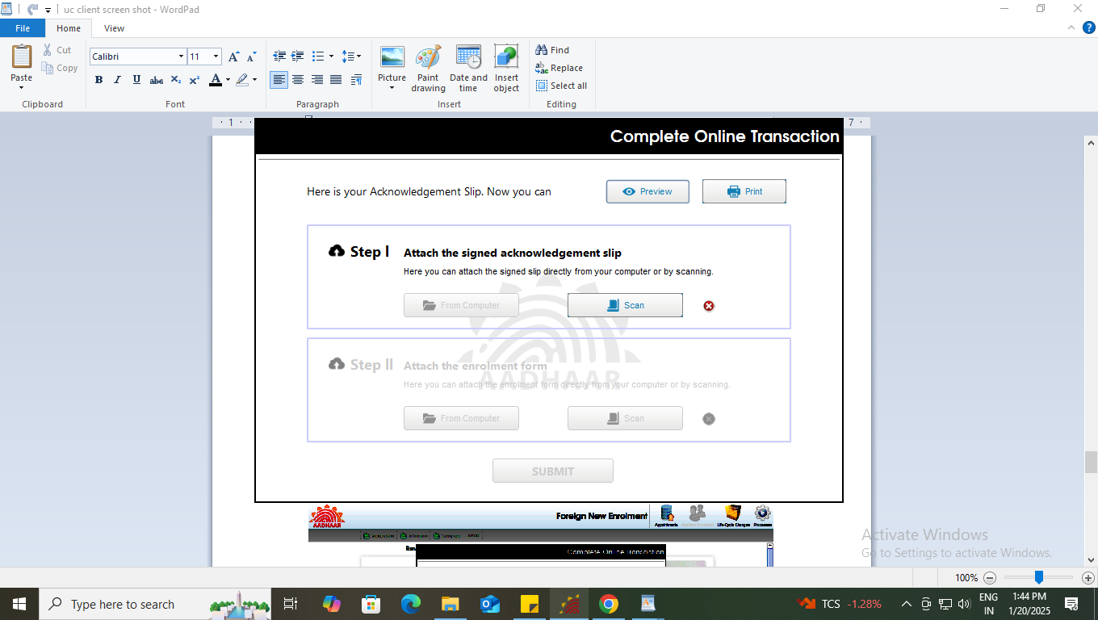
Step-13
After the confirmation, operator can preview the acknowledgement slip.

Slide 22
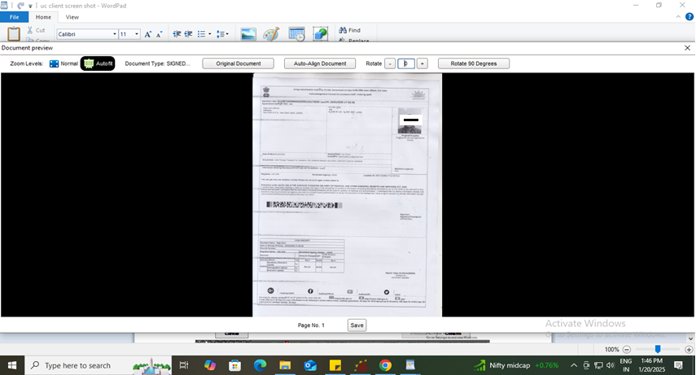
Step-14
See the Preview of acknowledgement slip and take the print-out for uploading the same

Slide 23
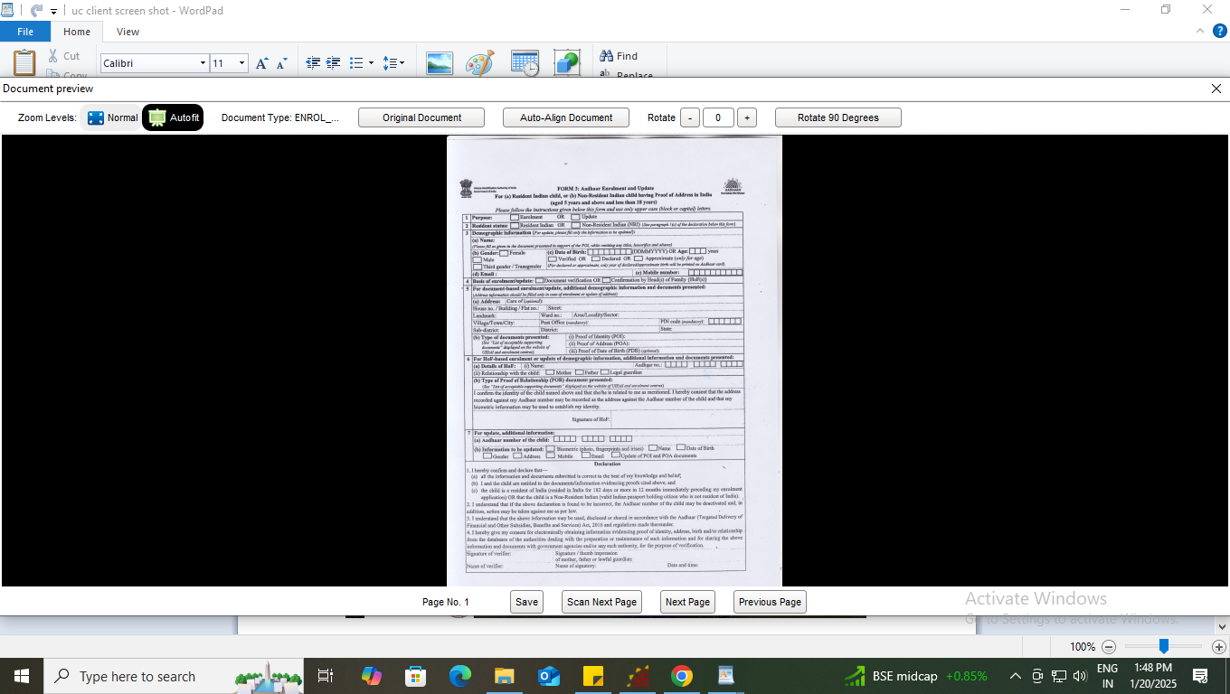
Step-15
Scan and upload the signed enrolment form filled by the resident

Slide 24
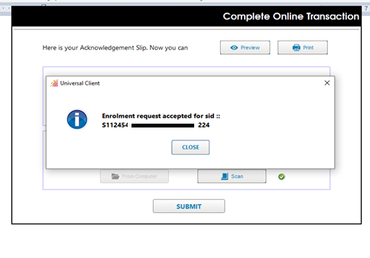
Step-16
After uploading the enrolment form, ‘Submit’ button will be enabled, after successful submission of enrolment request following message will be displayed.

Slide 25
Thank You

