Slide 1
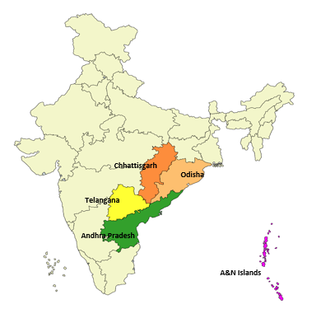
Training Manual on Aadhaar Enrolment/Update
UIDAI Regional Office
HYDERABAD

Slide 2
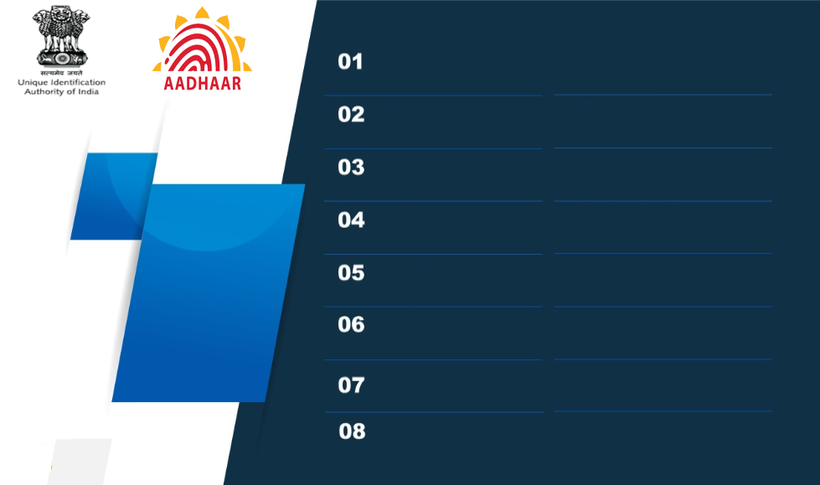
Introduction to UIDAI and Aadhaar
Enrolment & Update Process (ECMP+UC)
Handling of Differently abled Residents
Resident Documents Handling
Data Quality Verification and guidelines
Errors & Penalties Levied by UIDAI
Residents Support & Grievance Handling
Aadhaar Operator – Dos & Don’ts

Slide 3
Vision of Aadhaar
“Empower residents of India with a unique identity and a digital platform to authenticate anytime, anywhere”

Slide 4
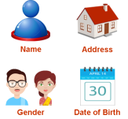


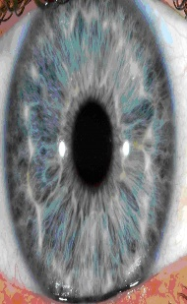
Introduction to UIDAI and Aadhaar
Aadhaar is a 12-digit Unique Identification (UID) number provided to the residents of India and resident Foreigners. Given once in a life time. Never gets reallotted.
The following information are captured during Aadhaar Enrolment.
Demographic Data:
Name Mobile
Age/Date of Birth, Email
Gender, (not Mandatory)
Address
Biometric Data:
Facial Photograph
10 fingers,
2 IRIS

Slide 5
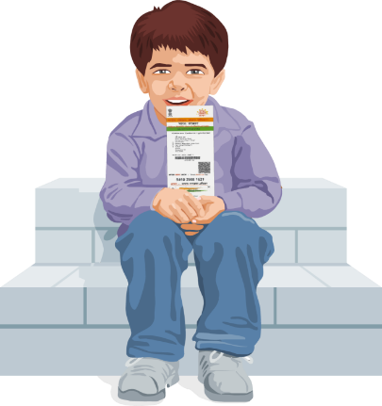
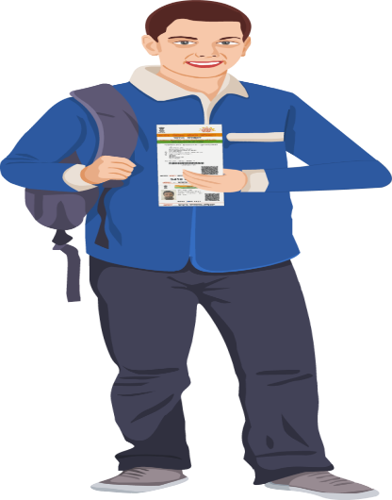

Types of Enrolment & Updates
Types of Enrolment:
0-5 (Child Enrolment i.e., Bal Aadhaar)- without Bio metric Head Of Family (HOF) based.
Adult Enrolment- with Bio metric- Through State Portal.
0-5 Yrs.
6-18 Yrs
Types of Updates:
Demographic: Name/ Gender/ DOB/ Address/ Mobile/ Email
Bio metric: Finger/ Iris/ Photo
Mandatory Bio metric Update (MBU): 5-7 & 15-17 years.
18+

Slide 6

Timeline for Aadhaar Generation & Limits
Timeline for Aadhaar Generation:
0 to 18 Enrolment : 30 days.
Adult 18+ : 180 days.
Demo Update (Gender/Address/Mobile/ Email): 30 days.
Demo Update(Name/ DOB): 60 days.
Exceptional Update: 90 days.
No Limits for Address Update in
Aadhaar
No Limits on Update of Resident
Mobile , Email
Name Update -2 Times
Gender Update - 1 Time
DOB Update - 1 Time

Slide 7

“ Aadhaar For All “
0-5
5-17
18+
Bal Aadhaar
Mandatory Biometric Update (MBU)
Adult Enrolment
Enrolment through BC (Digitally Verifiable) & either of the Parent’s Biometric (HOF).
No additional Documents required.
Two times MBU (5-7 Years & 15-17 Years)
Biometrics are Captured
All packets are routed through State Portal only.
Note: Resident of any age group can enroll for Aadhaar by submitting valid POI, POA, DOB/POR.

Slide 8
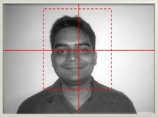
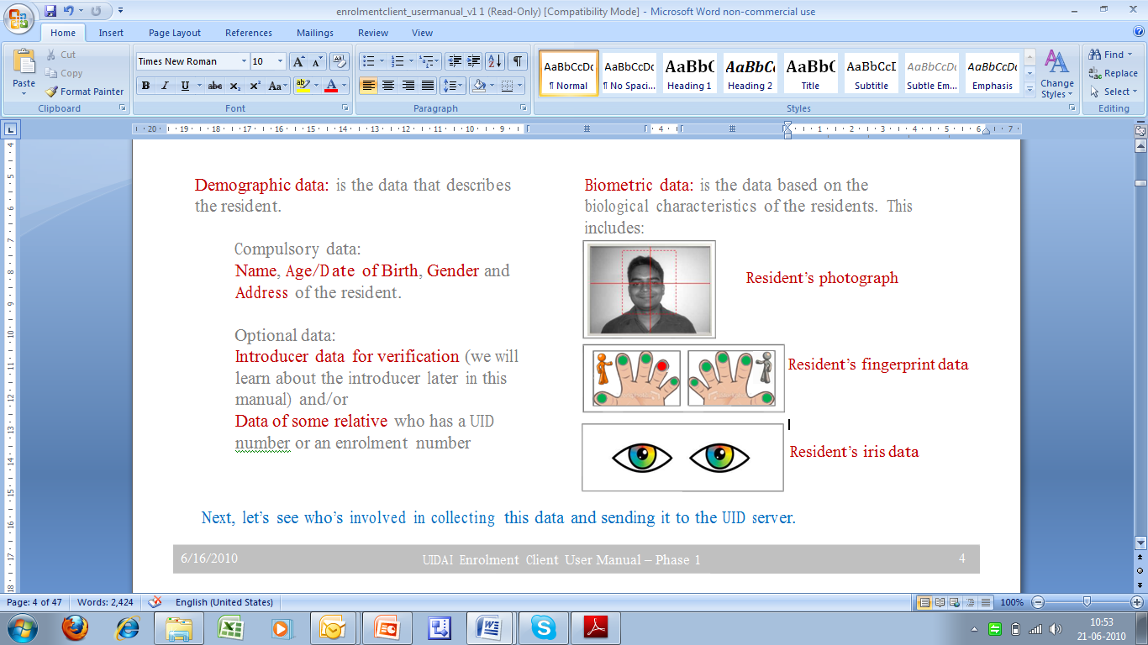

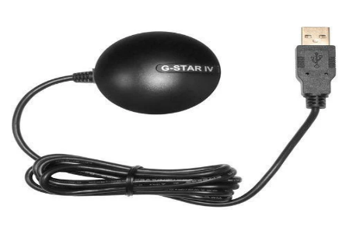
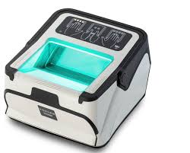
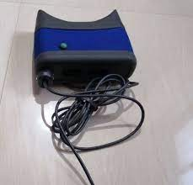
Aadhaar Enrolment/Update through ECMP
All demographic & biometric data of residents are recorded in ECMP:-
Compulsory data:
Name, Age/Date of Birth,
Gender and
Address of the resident.
Optional data:
Mobile number
Email address
Photograph
Biometric Data
Demographic Data
10 Fingerprints
Both Iris
Multiplatform OS Compatibility with upgraded Windows and Linux as per UIDAI’s policy. The devices used are: -
Note: ECMP shall be replaced by Universal Client shortly i.e. by 31.12.2025.

Slide 9
ECMP vs Universal Client
Category | ECMP | UC
Email and Mobile number | No validation | Through OTP
Civil Registration System (CRS)/Non CRS State (through API) | No integration | Auto-fetching of data through BRN (Birth Registration Number)
Documents (POI/POA/POB) Verification. | No Realtime Verification | Realtime Verification
Resident foreigner enrolment | No separate flagging | Can be enrolled with limited validity as per VISA.
NRIs | Enrolled with Indian address only | May enroll with Indian/foreign address as well
Operational Mode | Works in offline mode, packets are created on client | Fully online application with packet creation at Backend.
Limits available (DGN) | No Information available. | Realtime display of Name/DoB/Gender change limits
Aadhaar Status | No Information available | Realtime status - Deactivated/ Suspended/Cancelled
For Details Click Here

Slide 10
Documents Required: Enrolment and Update
First Time Enrolment:
0 to 5 Enrolment : BC & HOF authentication.
6 to 18 Enrolment : POI/POA/*POR (HOF)
Adult 18+ : POI & POA. POB (Verified)
Update:
Name change : POI/Passport/PAN/Voter ID/ Ration card/DL/Service Photo.ID/Pensioner photo ID/Board Marksheet/Gazette (for complete name change)/ Resident certificate for minor Name change.
DOB : POB/ SSC marks sheet/BC/PP/PPO(Self), Govt. ID (State/Central).
Address: POA (PP, Gas/Electricity/Telephone Bill/ Sale deed document/Bank Pass book.
Exceptional Cases:
Exceptional major Name Change : Gazette notification. Minor-RC/PAN/EPIC
Exceptional DOB : only BC
Exceptional Update : Gender- Certificate issued by the District magistrate./BC
Double Click Image for more details w.r.t. List of Acceptable Documents
Note : All the exception cases need to be processed in Universal Client Only.
*For 0-18 Years Enrolment, BC is mandatory.

Slide 11
Home Enrolment(s) & Update(s)
Home Enrolment Service for senior citizens/ bedridden/infirm/ persons with disabilities (Divyangjan) etc on chargeable basis in addition to normal fee applicable as per UIDAI’s Official Rate Chart as a Service Charge.
₹700 (including GST) for the First Applicant.
₹350/- (including GST) for each additional resident
The additional resident should be of the same address.
Double Click on the Image above

Slide 12
Enrolment and Update Charges w.e.f. 01.10.2025
New Enrolment
(Child + Adult)
Special Dispension
Mission Mode MBU:
Charges of 07-15 Years age group is waived off for one year w.e.f. 01.10.2025.
FREE
Mandatory Biometric Update of Children
5 to <7 Years 7 to <15 Years
15 to 17 Years >17 Years
FREE
₹125
Other Biometric Update
₹125
Double Click Image for more details on MBU Charges Waiver
Demographic Update
(Name, Address, DOB, Mobile, Gender, Email)
₹75
POI/POA Document Update
₹75
Find Your Aadhaar
& Colour Printout
₹40

Slide 13


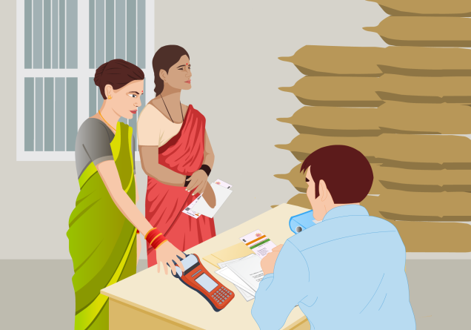
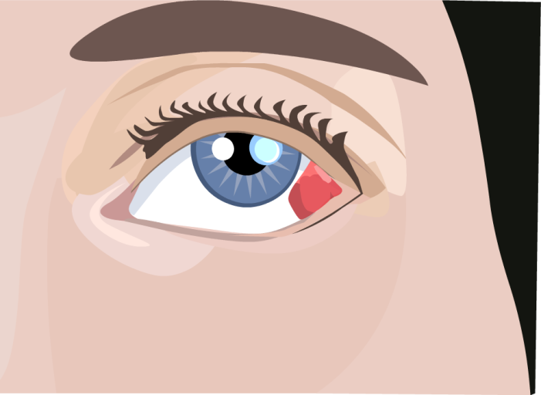
Cases where Biometric Update is required under Exception Handling
Person losing hands due to accident
Plastic Surgery
False Biometric Rejects
Eye injury

Slide 14
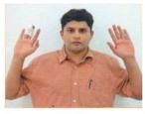
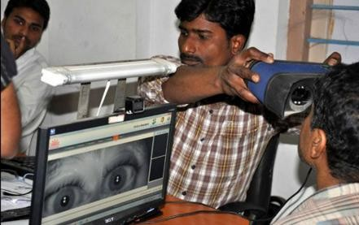


Handling Differently Abled Residents
 | Problem |  | Exceptions in Handling Fingerprint Image Capture
 | Missing / amputated / bandaged fingers
 | Problem |  | Exceptions in Handling Iris Image Capture
Capturing Iris image is not possible
Squint / disoriented eye
Biometric Exception Handling

Slide 15
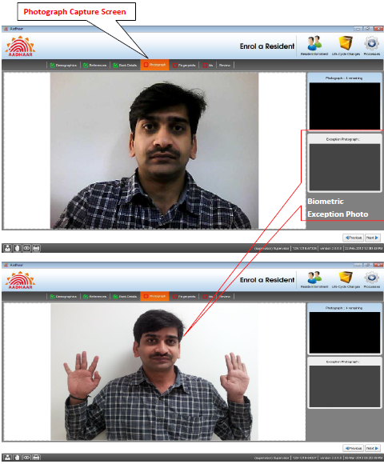
Capturing Biometric Exceptions in ECPM/UC
Correct Biometric Exception Capture
* Two Photographs will be taken in Biometric Exception Cases as shown above.

Slide 16
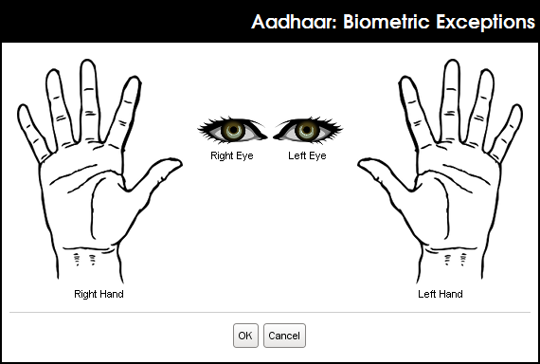
Capturing Residents Biometric Exceptions
Specifying Exceptions
All exceptions are to be indicated here.
Specify the resident’s biometric exceptions by clicking on the specific part of the image.
Bandaged and finger(s) with wounds, can also be marked exception.

Slide 17
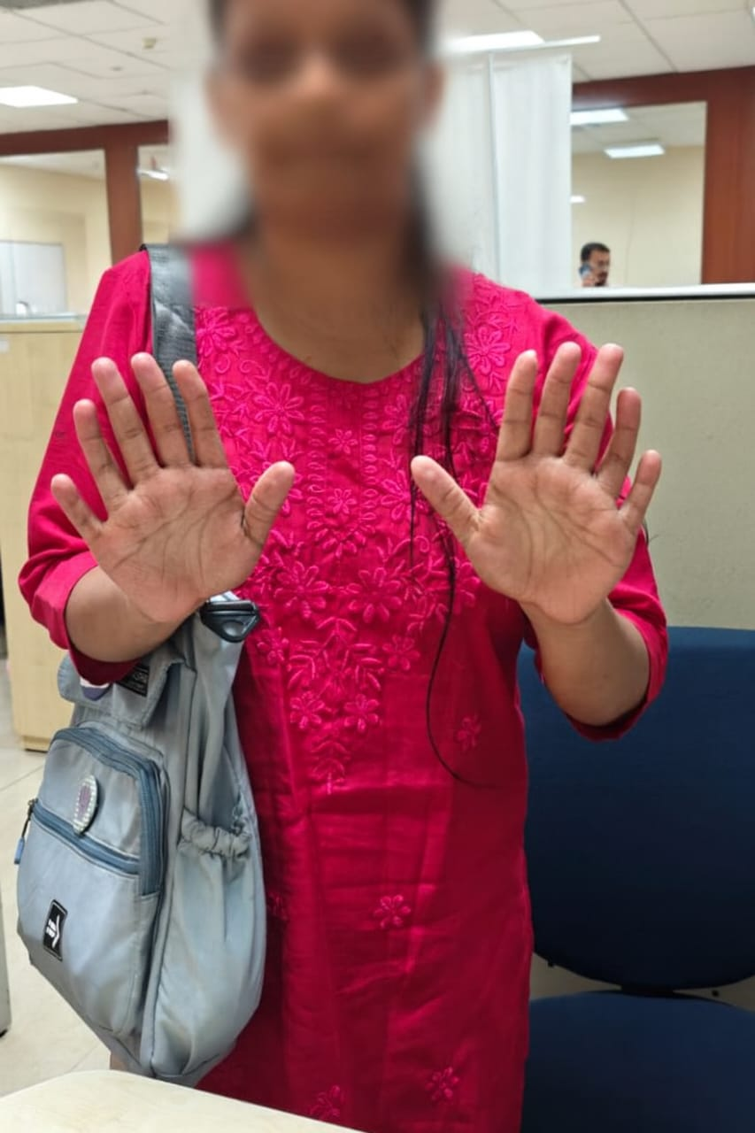
Case Study
Resident having 06 fingers in each hand
If the resident has extra finger/s, ignore the extra finger.
This will not be captured as a Biometric exception.

Slide 18
Guidelines for Operator(s) (Behavioural Standards)
DOs
Respond politely and professionally
Use clear and simple language
Protect all personal information
Assist vulnerable residents gently
Explain Aadhaar steps honestly
Provide accurate, updated details
Treat everyone equally
Maintain good hygiene and appearance
DON’Ts
Do not raise voice or argue
Do not take extra charges or bribes
Do not share any personal data
Do not deny service without reason
Do not ask unnecessary personal questions
Do not show political or religious views

Slide 19
Guidelines for Operator(s) – (Center Management Guidelines)
DOs: -
Display center time as scheduled
Keep center clean, organized, and well-lit
Display official rate card and notices
Ensure all biometric devices work properly
Clean biometric scanner after every use
Use queue or token system
Update software per UIDAI protocols
Upload data securely; no remote access
Give acknowledgement slip immediately
DON’Ts: -
Do not allow unauthorized access.
Do not keep residents’ original documents
Do not take kit outside premises
Do not expose passwords or IDs
Do not shortcut biometric/document steps
Do not favor anyone for money
Do not exceed authorized center capacity

Slide 20
Categorization of Errors and Penalty Charges as per Policy 5.0:
G
R
A
V
E
E
R
R
O
R
S
DOE 1
₹10,000
Per Packet
>=3 – 1 month suspension.
If the operator is a repeated Operator, suspension for 12 month with impose of financial disincentive.
Refer Annexure II for more details
Double Click Image for more details on Policy 5.0.
Fraudulent activity
₹25,000 Per Incident
Gross Violation; Enrolment as a child with age; Enrolment of an adult; Unauthorized Location; Wrong Capture of Biometrics; Mixed Biometrics; Gummy Finger, Corruption etc.
Refer Annexure III for more details
POP
₹25,000 Per Incident
Suspension of the activities of the operator concerned
Imposing of financial disincentives on the Registrar
DOE -2
₹50 Per Packet
DE
₹50 Per Packet
BE
₹1,000 Per Packet
AL
₹50 Per Packet
*RSV
₹250 Per Packet
>= 30 – 1 Month Suspension
If the operator is a repeated Operator, suspension for 12 month with impose of financial disincentive.
Refer Annexure II for more details
*Rejection during source verification at QC
46

Slide 21
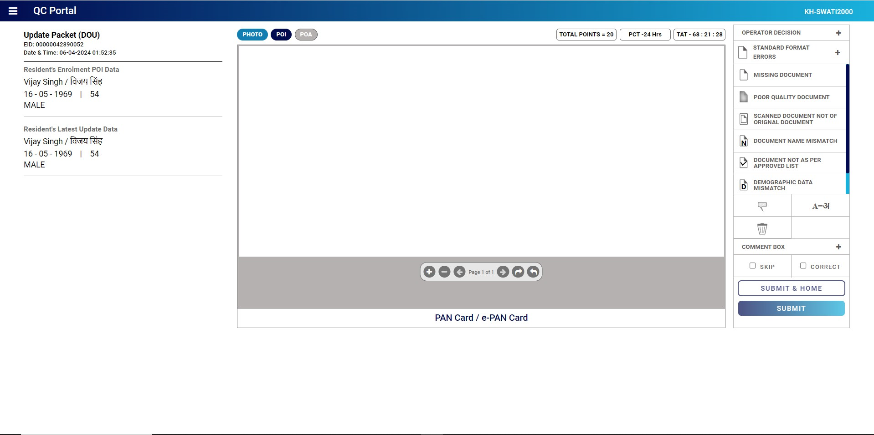
DoE1 - Test Cases – Fraud/Missing Document :
Missing Document falls under DOE1 Category- FRADULENT
Upload of Enrolment Form as Resident Doc falls under DOE1 Error -FRADULENT
Upload of Acknowledgement Slip as Resident Doc falls under DOE1 Error -FRADULENT
Note: Rs 10000/- EID & Suspension for 1 year >= 1 Error

Slide 22
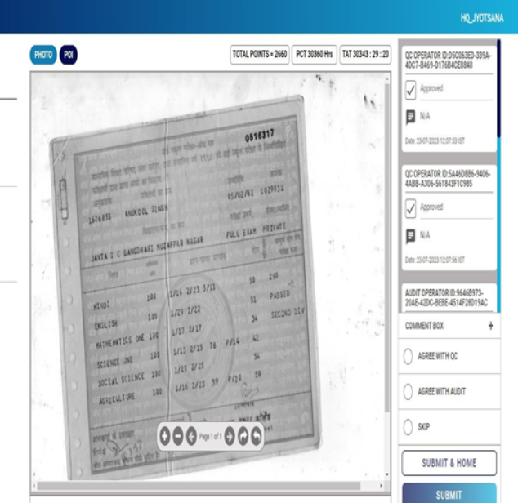
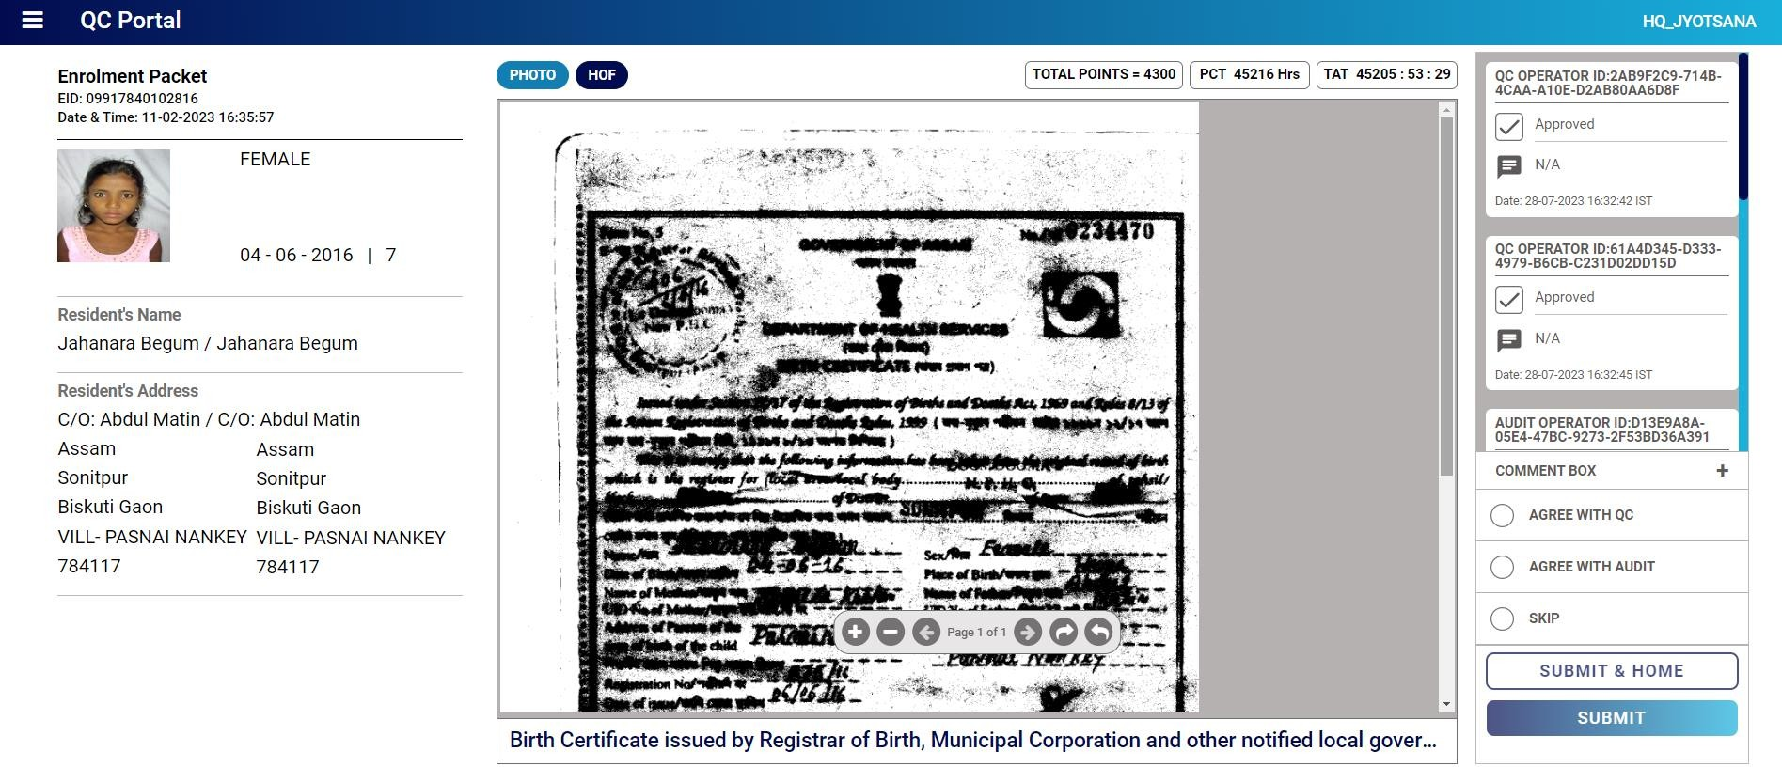

NOT READABLE/VISIBLE Document Details
DoE2 - Test Cases – Poor Quality Document:
PARTIAL DOCUMENT
Scanned Image is of Not ORIGINAL
Note: Rs 1000/- EID & Disassociation for 30-100 Errors & Suspension for 1 year >100

Slide 23
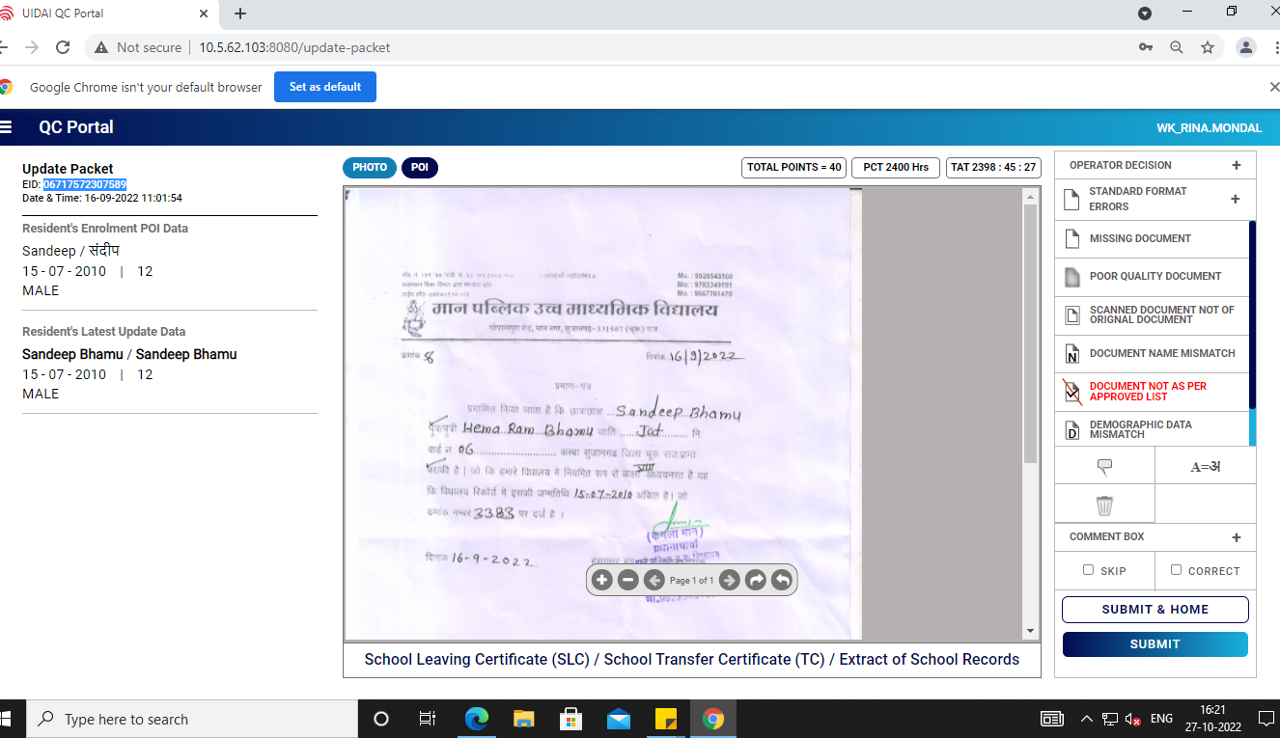
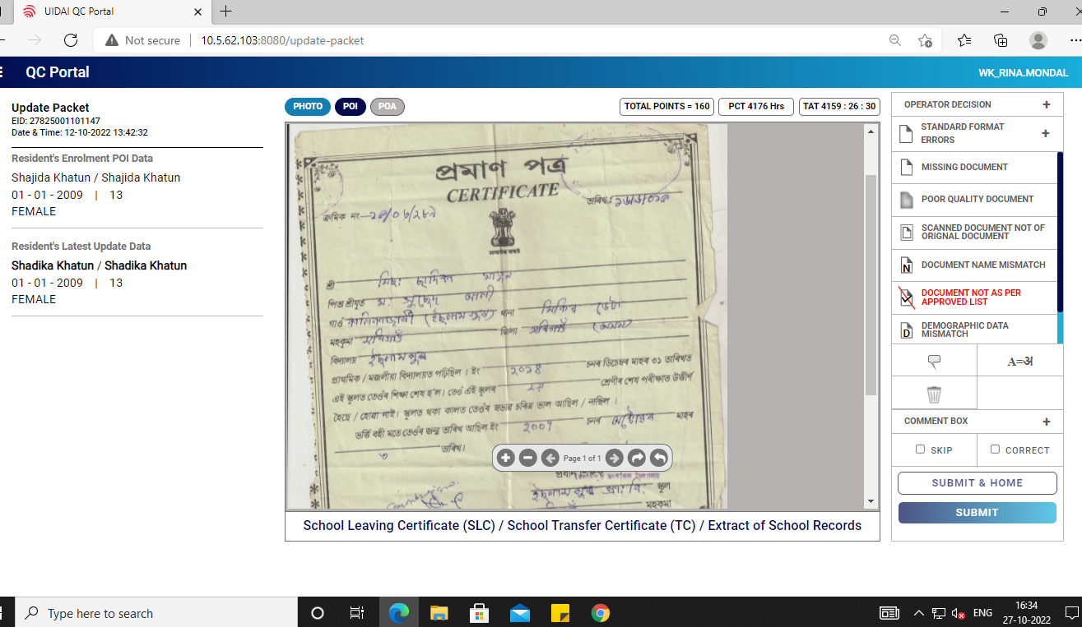
DoE2 - Test Cases – Invalid Document:
Invalid (Letter Head)
Invalid Document (Without Photo doc not valid for POI)
Note: Rs 1000/- EID & Disassociation for 30-100 Errors & Suspension for 1 year >100

Slide 24
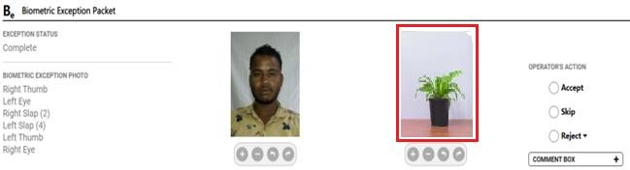
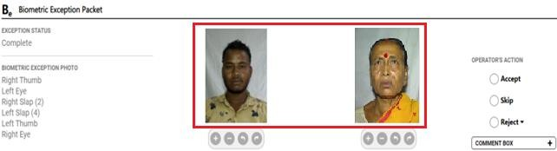
3. BE- Test Cases –Biometric Exception Packets:
(Object in Exception Photo)
(Photo Mismatch in Exception)
Note: Rs 10000/- EID & Suspension for 1 year >= 1 Error

Slide 25

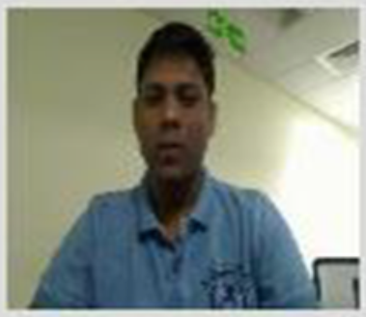
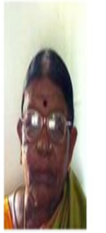





BE- Test Cases – Poor Photo/ Incorrect Photo:
Rejection Categories
Insufficient Light
Resident is too far from camera.
Eyes are not clear due to spectacles
Photo not on center/In Correct Posture
Background is not white
Another Face/Object/Shadows
Forehead not clearly visible/ Incomplete Photo
Not looking towards Camers & Ears not Visible
Poor Quality(No Light)
Eyes not clear
Too Far
Photo incomplete (till shoulders required)
Background is not white
Another/2nd Face
Shadow in Back Ground

Slide 26
Std.Certificate - Test Cases – QC Rejection:
Certifier Cross Stamp missing on
Resident Photograph
Certifier Cross Signature missing on Resident Photograph
Certifier /Issuer Incomplete Details

Slide 27
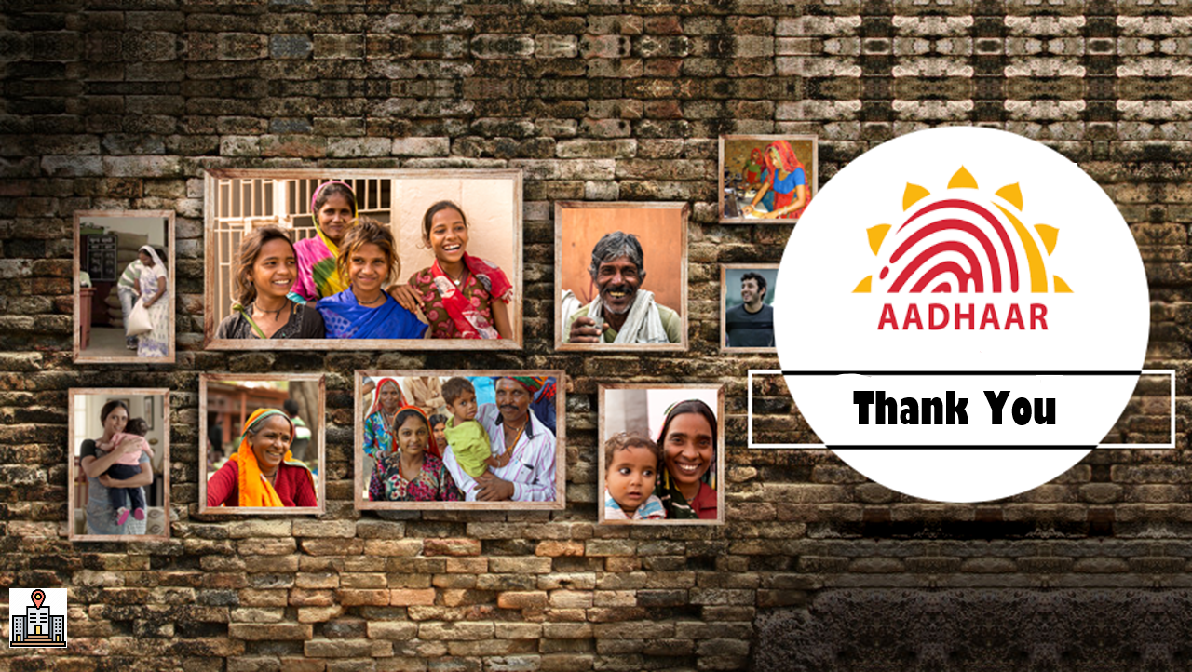
UIDAI Regional Office-Hyderabad, 6th Floor, East Block, Swarna Jayanthi Complex, Beside Maitrivanam, Ameerpet Hyderabad-500 038, Telangana Reception : 040-23739269 Grievance : 040-23739266

Slide 28
Aadhaar Enrolment & Update through Universal Client
Universal Client (UC): Upgraded and robust version for Aadhaar Enrolments & Updates.
Features of UC:
Simplifies the Enrolment/Update processes
Improve transparency
Minimize rejections
Faster processing of enrolment/update requests
Ensuring robust security of resident’s Personally Identifiable Information (PII)
Challenges with ECMP client | Description
No-real time Checks | No validation, Can lead to error and Fraudulent entries
Manual Errors | Typographical Errors causing rejections: Demographics (name/address) or Poor biometric captures
Detailed PPT - UC

Slide 29
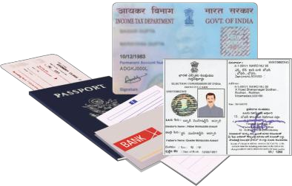

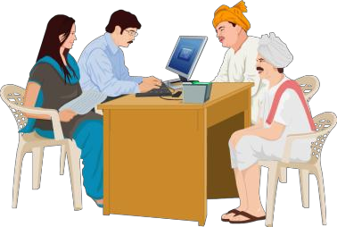

2.1 Types of Enrolments & Updates
E
N
R
O
L
M
E
N
T
T
Y
P
E
Document Based
HoF (Head of Family) Based Enrolments
Updating Demographic data like Name, Age, Gender, DOB, Mobile Number, E-mail, Address.
U
P
D
A
T
E
S
T
Y
P
E
S
DEMOGRAPHIC UPDATE
BIOMETRIC UPDATE
Updating Photo, Fingerprints and IRIS

Slide 30
AADHAAR OPERATOR - Dos and Don’t
An Aadhaar Operator represents UIDAI’s commitment to secure, transparent, and citizen-friendly services.
Every Operator must follow:
Behavior Standards &
Center Management Rules.

Slide 31
Advantages of UC – Ease of E&U
Feature | Description
Latest details of Aadhaar | Latest details of resident Aadhaar are displayed
Limits available | Realtime display of Name/DoB/Gender change limits
Status of Aadhaar | Can check the status of Aadhaar (Deactivated/suspended)
Documents preview | Enhanced Feature
Mobile/email validation | Through OTP
Validations at client side | Operator’s resident’s biometric are validated at the frontend
Value added services | Document Update; Find Aadhaar; PVC card etc.
Notifications | Realtime Eligibility for MBU; Document Update related

Slide 32
Benefits to Operator - UC
Benefit | Description
Less rejections | Due to real time validation of demographics/documents.
Time saving | Pre-filled details of the resident Aadhaar are displayed, which can be edited, resulting in saving of time
Faster processing | The real time data fetching results in faster processing of enrolment and update process
Role based access & GPS geofencing | Prevents misuse and only authorized operator is permitted.

